Slide 1
Claude Monet
Suharskaya Olya 10-B

Slide 2
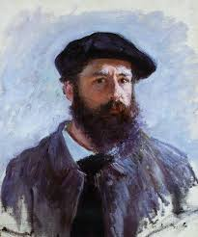
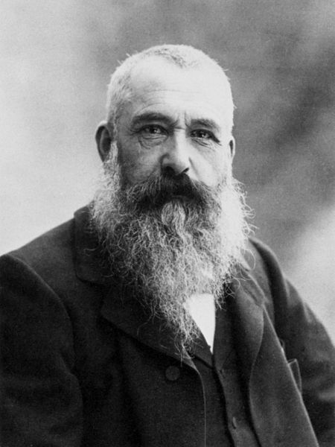
Oscar-Claude Monet ( 14 November 1840 – 5 December 1926) was a founder of French Impressionist painting, and the most consistent and prolific practitioner of the movement's philosophy of expressing one's perceptions before nature, especially as applied to plein-air landscape painting. The term "Impressionism" is derived from the title of his painting Impression, soleil levant(Impression, Sunrise), which was exhibited in 1874 in the first of the independent exhibitions mounted by Monet and his associates as an alternative to the Salon de Paris.

Slide 3
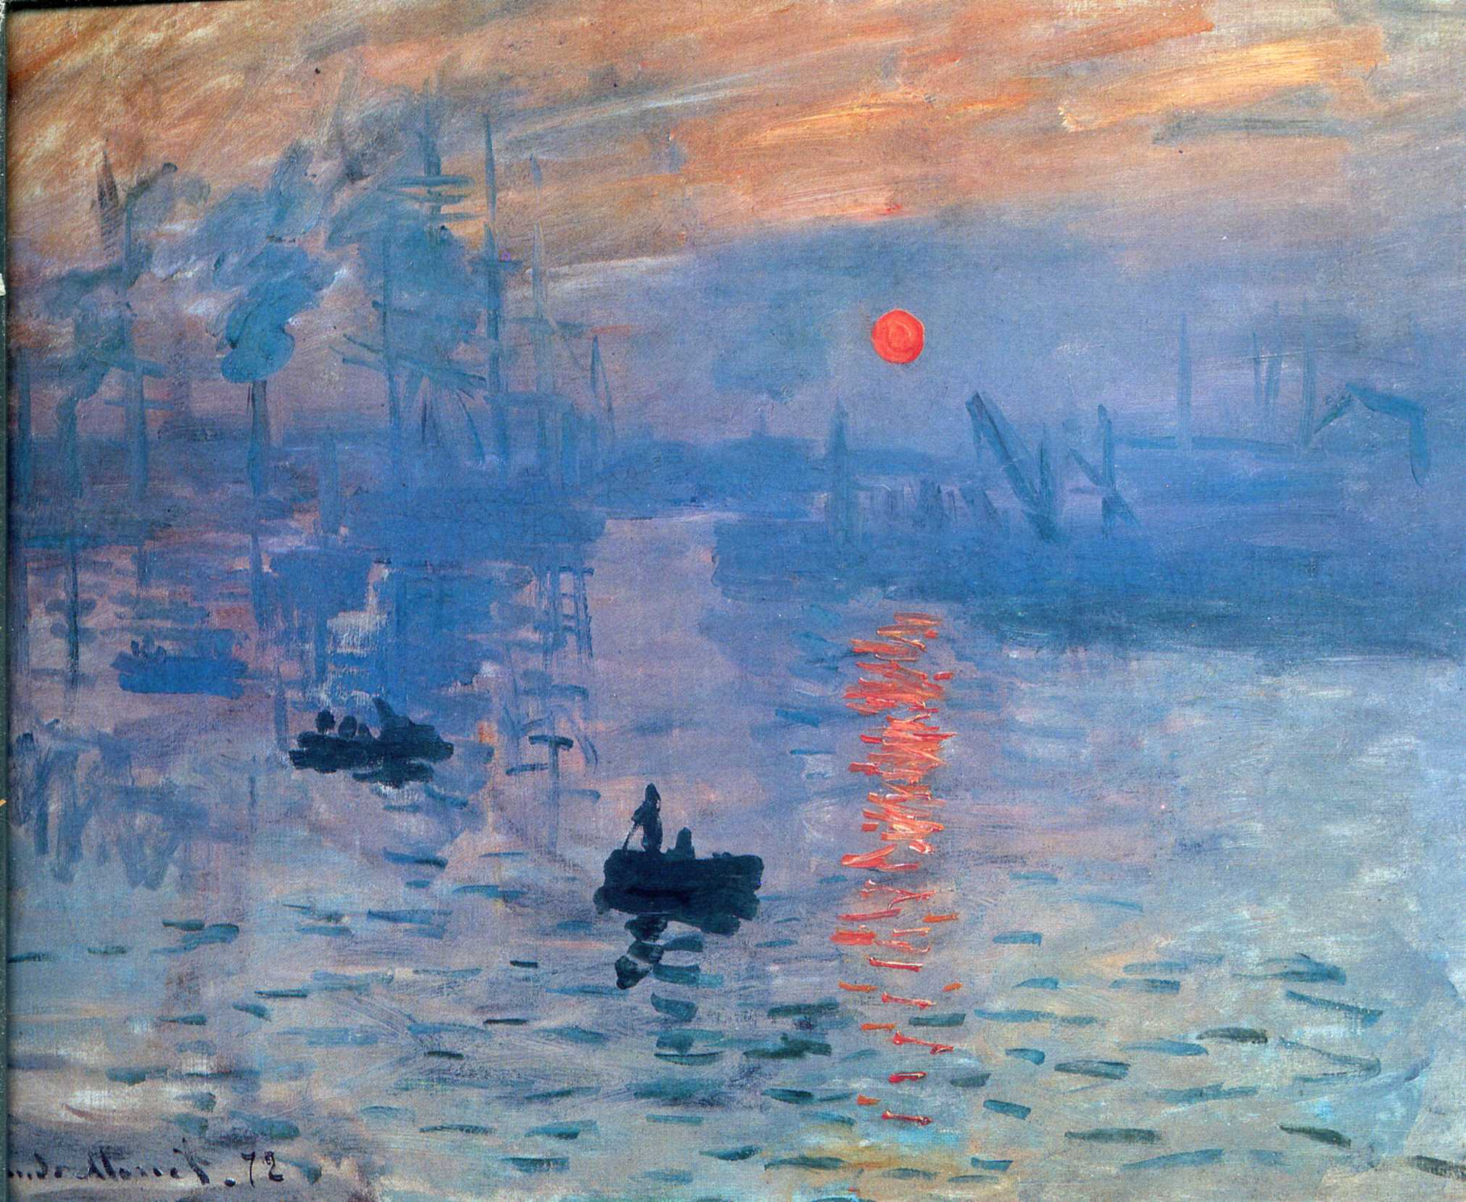

Slide 4
The first Impressionist exhibition was held in 1874 at 35 boulevard des Capucines, Paris, from 15 April to 15 May. The primary purpose of the participants was not so much to promote a new style, but to free themselves from the constraints of the Salon de Paris. The exhibition, open to anyone prepared to pay 60 francs, gave artists the opportunity to show their work without the interference of a jury.In addition to Impression: Sunrise (pictured above) Monet presented four oil paintings and seven pastels. Among the paintings he displayed was The Luncheon (1868), which features Camille Doncieux and Jean Monet, and which had been rejected by the Paris Salon of 1870. Also in this exhibition was a painting titled Boulevard des Capucines, a painting of the boulevard done from the photographer Nadar's apartment at no. 35. Monet painted the subject twice and it is uncertain which of the two pictures, that now in the Pushkin Museum in Moscow, or that in the Nelson-Atkins Museum of Art in Kansas City was the painting that appeared in the groundbreaking 1874 exhibition, though more recently the Moscow picture has been favoured.

Slide 5
Paintings 1858-1870

Slide 6
View at Rouelles, Le Havre 1858,

Slide 7
Mouth of the Seine at Honfleur, 1865,

Slide 8
Women in a Garden, 1866–1867,

Slide 9
Woman in a Garden, 1867,

Slide 10
Jardin à Sainte-Adresse, 1867,

Slide 11
The Luncheon, 1868

Slide 12
La Grenouillére 1869

Slide 13
The Magpie

Slide 14
Le port de Trouville (Breakwater at Trouville, Low Tide)

Slide 15
La plage de Trouville, 1870

Slide 16
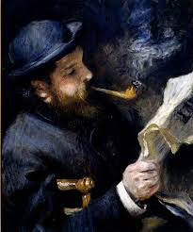
Death of Camille
In 1876, Camille Monet became ill with tuberculosis. Camille Monet was diagnosed with uterine cancer, and she died on 5 September 1879 at the age of thirty-two. Monet made a study in oils of his dead wife. Many years later, Monet confessed to his friend Georges Clemenceau that his need to analyse colours was both the joy and torment of his life. He explained,
"I one day found myself looking at my beloved wife's dead face and just systematically noting the colours according to an automatic reflex!"

Slide 17
John Berger describes the work as "a blizzard of white, grey, purplish paint ... a terrible blizzard of loss which will forever efface her features. In fact there can be very few death-bed paintings which have been so intensely felt or subjectively expressive."

Slide 18
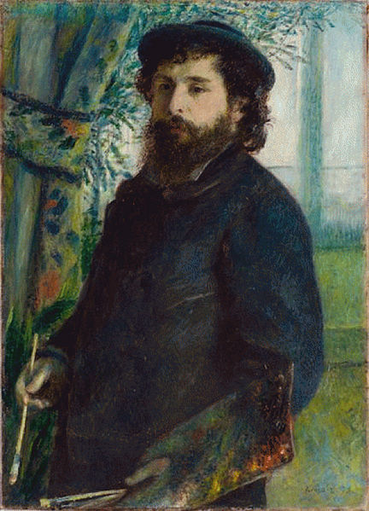
Vétheuile
After several difficult months following the death of Camille, Monet began to create some of his best paintings of the 19th century. During the early 1880s, Monet painted several groups of landscapes and seascapes in what he considered to be campaigns to document the French countryside. These began to evolve into series of pictures in which he documented the same scene many times in order to capture the changing of light and the passing of the seasons.

Slide 19
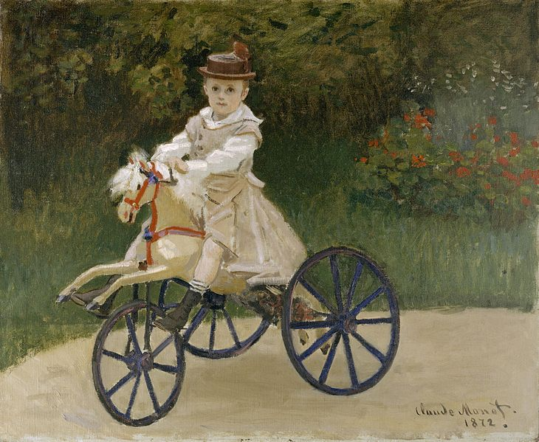
Paintings 1872-1879
Jean Monet on his hobby horse,1872

Slide 20
Camille Monet on a Garden Bench,1873

Slide 21
The Artist's house at Argenteuil, 1873

Slide 22
Coquelicots, La promenade (Poppies), 1873

Slide 23
Argenteuil, 1874

Slide 24
The Studio Boat, 1874

Slide 25
Flowers on the riverbank at Argenteuil, 1877

Slide 26
Vétheuil in the Fog, 1879

Slide 27
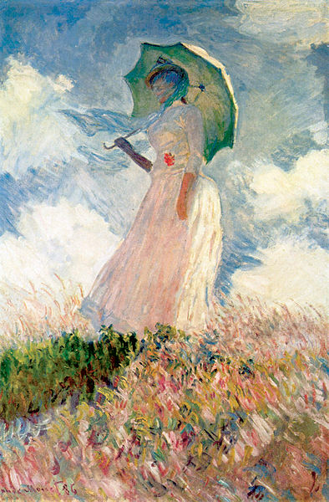
Giverny
At the beginning of May 1883, Monet and his large family rented a house and 2 acres (8,100 m²) from a local landowner. Monet wrote daily instructions to his gardener, precise designs and layouts for plantings, and invoices for his floral purchases and his collection of botany books. As Monet's wealth grew, his garden evolved. He remained its architect, even after he hired seven gardeners.

Slide 28
Monet purchased additional land with a water meadow. In 1893 he began a vast landscaping project which included lily ponds that would become the subjects of his best-known works. White water lilies local to France were planted along with imported cultivars from South America and Egypt, resulting in a range of colours including yellow, blue and white lilies that turned pink with age. In 1899 he began painting the water lilies, first in vertical views with a Japanese bridge as a central feature, and later on the series of large-scale paintings that was to occupy him continuously for the next 20 years of his life. This scenery, with its alternating light and mirror-like reflections, became an integral part of his work. By the mid-1910s Monet had achieved:
"a completely new, fluid, and somewhat audacious style of painting in which the water-lily pond became the point of departure for an almost abstract art." (Gary Tinterow)

Slide 29
Monet's garden

Slide 30
In the Garden, 1895

Slide 31
Agapanthus, between 1914-1926

Slide 32
The rose arches, Giverny, 1913

Slide 33
Water Lilies and the Japanese bridge

Slide 34
Water Lilies, 1906

Slide 35
Water Lilies

Slide 36
Water Lilies

Slide 37
Water Lilies

Slide 38
Death
Monet died of lung cancer on 5 December 1926 at the age of 86 and is buried in the Giverny church cemetery. Monet had insisted that the occasion be simple; thus only about fifty people attended the ceremony.
His home, garden, and waterlily pond were bequeathed by his son Michel, his only heir, to the French Academy of Fine Arts (part of the Institut de France) in 1966. Through the Fondation Claude Monet, the house and gardens were opened for visits in 1980, following restoration. In addition to souvenirs of Monet and other objects of his life, the house contains his collection of Japanese woodcut prints. The house and garden, along with the Museum of Impressionism Giverny, are major attractions in Giverny, which hosts tourists from all over the world.

Slide 39
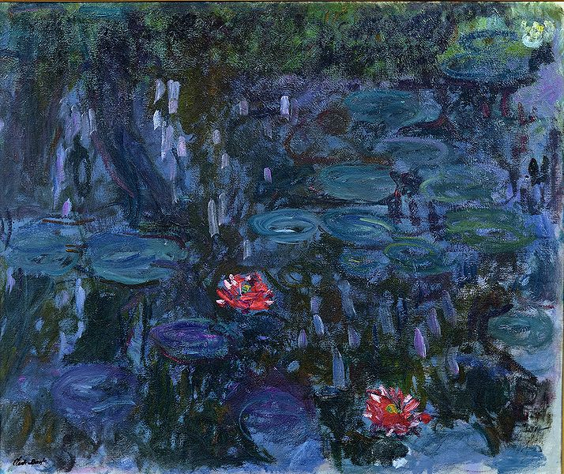
Monet's late paintings
Water Lilies and Reflections of a Willow

Slide 40
Water-Lily Pond and Weeping Willow

Slide 41
Weeping Willow, 1918–1919

Slide 42
Weeping Willow, 1918–1919

Slide 43
House Among the Roses

Slide 44
The Rose Walk, Giverny

Slide 45
The Japanese Footbridge

Slide 46
The Garden at Giverny

Slide 47
Monet's methods
In 1877 a series of paintings at St-Lazare Station had Monet looking at smoke and steam and the way that they affected colour and visibility, being sometimes opaque and sometimes translucent. He was to further use this study in the painting of the effects of mist and rain on the landscape.The study of the effects of atmosphere were to evolve into a number of series of paintings in which Monet repeatedly painted the same subject in different lights, at different hours of the day, and through the changes of weather and season. This process began in the 1880s and continued until the end of his life in 1926.
Helen Gardner writes:
"Monet, with a scientific precision, has given us an unparalleled and unexcelled record of the passing of time as seen in the movement of light over identical forms."

Slide 48
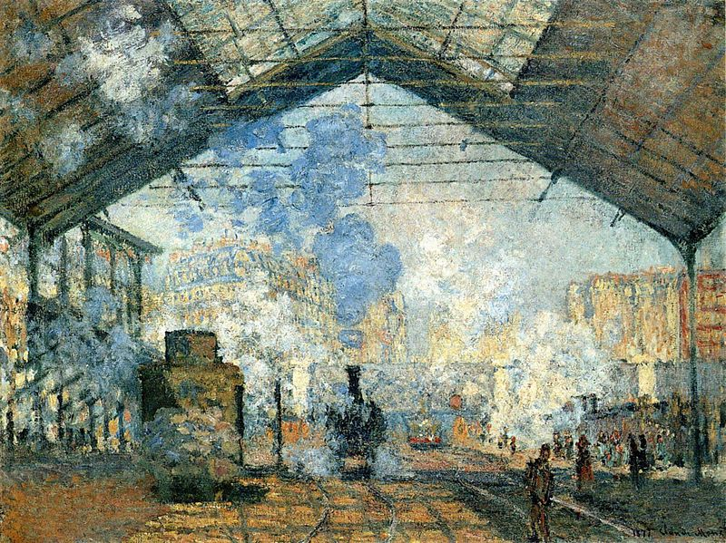
Series of paintings
La Gare Saint-Lazare, 1877

Slide 49
Arrival of the Normandy Train, Gare Saint-Lazare, 1877

Slide 50
The Cliffs at Etretat, 1885

Slide 51
Sailboats behind the needle at Eretat, 1885

Slide 52
Two paintings from a series of grainstacks

Slide 53
Grainstacks, end of day, Autumn

Slide 54
Poplars (Autumn)

Slide 55
Poplars at the River Epte

Slide 56
The Seine Near Giverny

Slide 57
Morning on the Seine, 1898

Slide 58
Charing Cross Bridge

Slide 59
Charing Cross Bridge

Slide 60
London, Houses of Parliament. The Sun Shining through the Fog

Slide 61
Two paintings from a series of The Houses of Parliament, London

Slide 62
Grand Canal, Venice

Slide 63
Grand Canal, Venice

