Slide 1
Hairstyles

Slide 2
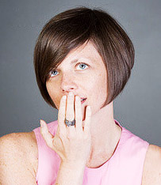

“Bob square”
The most famous hairstyle, beloved all over the world, in spite of old age, it is always in great shape and do not go out of style!
Bob, this is an invention of the hairdresser - Antoine de Paris, who made ​​his career in France.

Slide 3
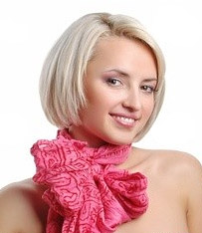
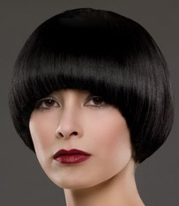
Bob came exactly one hundred years ago, in 1909 in France, thanks to this hairdresser passion of bold and beautiful Jeanne d'Arc and her boyish haircut.
In the twenties, bob reached a peak of popularity and has become merely a symbol of those years with the Charleston dance and dresses with bare shoulders, barely knee.

Slide 4
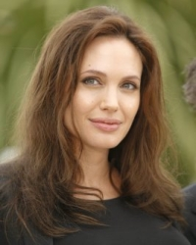
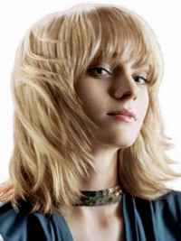
“Ladder”
Haircut ladder was born at the dawn of Hairdressing, long before the first of scissors, and not come down from Olympus to date.

Slide 5
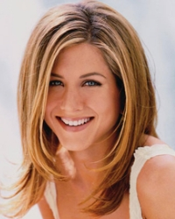
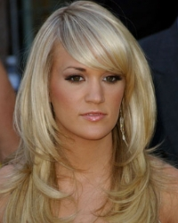
“Cascade”
That Vidal Sassoon in the sixties of the XX century removed the unnecessary ballast from female hairstyles and invented the short and carefully executed haircut.
In the seventies-eighties, the boom has these convenient and practical hairstyles: they were loved by young students and women in advanced age. And the reason for this was the popularity of this haircut between movie stars.

