Slide 1
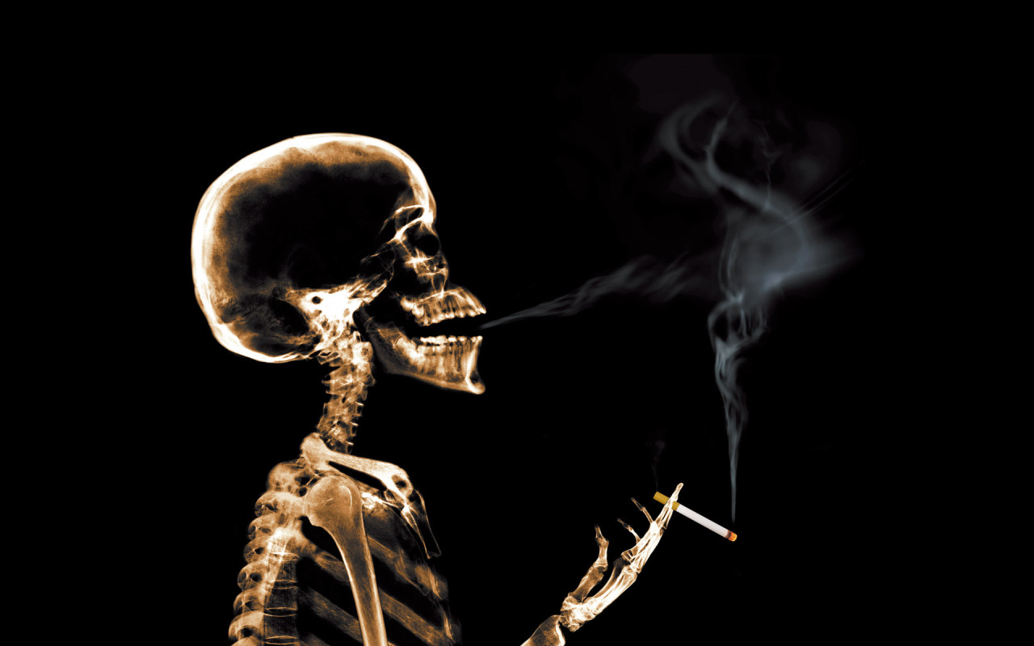
Smoking

Slide 2
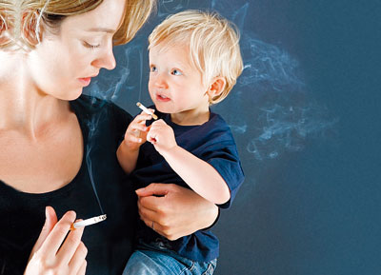
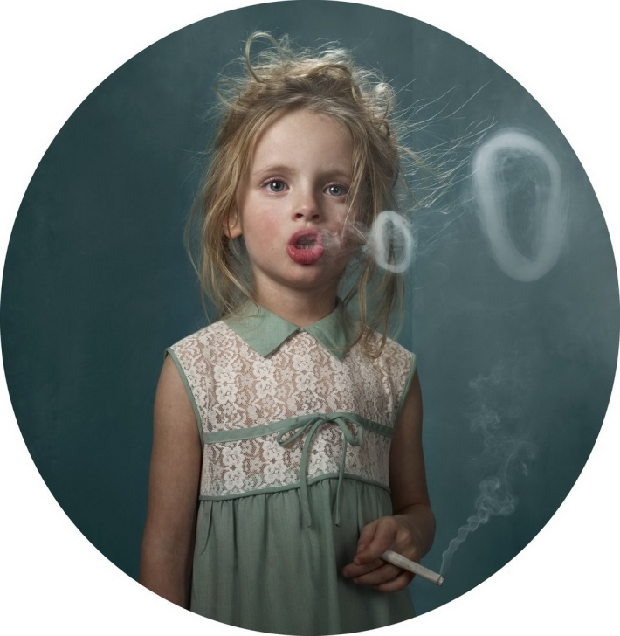
So is smoking good or bad?
I hope most of us think that it is a bad habit, which hurts your health. But how many people so many points of view. And today we also have representatives of different theories and advertisements relate smoking. And especially teenagers consider that’s fashionable and they start smoking before they are sixteen. They copy their parents, brothers, sisters, friends. They think it makes them look grown up. Some of them become nicotine addicts.

Slide 3
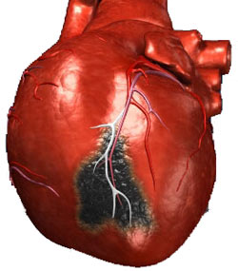
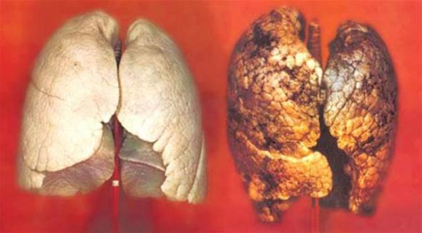
Look at the facts. As the nation- Ukrainians spend more money on tobacco than we do on educating their children or on medicine. Cigarette smoke is complex mixture of harmful chemicals, that can cause diseases like cancer or chronic bronchitis and heart disease. There is no doubt that smoking can affect unborn babies, when women who smoke are pregnant.

Slide 4
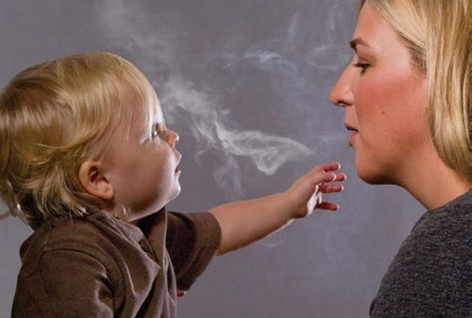
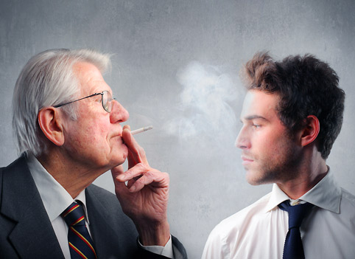
However, it isn’t only smokers, who are at risk.
You can get these harmful effects from breathing in other people smoke.

Slide 5
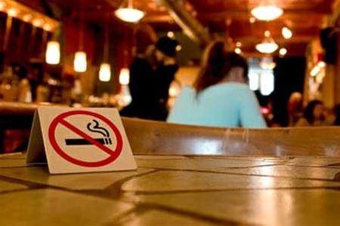
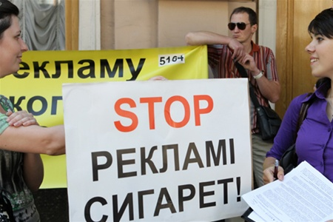
Solution
First, double the tax on all forms of tobacco, to raise the price on cigarettes.
Second, ban all forms of tobacco advertising on TV, radio, in press.
Third, ban smoking itself in all restaurants, trains, public meeting- places and places like school and hospitals.
Fourth, Protecting teenagers don’t sell tobacco to people under the age of 18 and show them the dreadful effect of this dreadful habit.

Slide 6
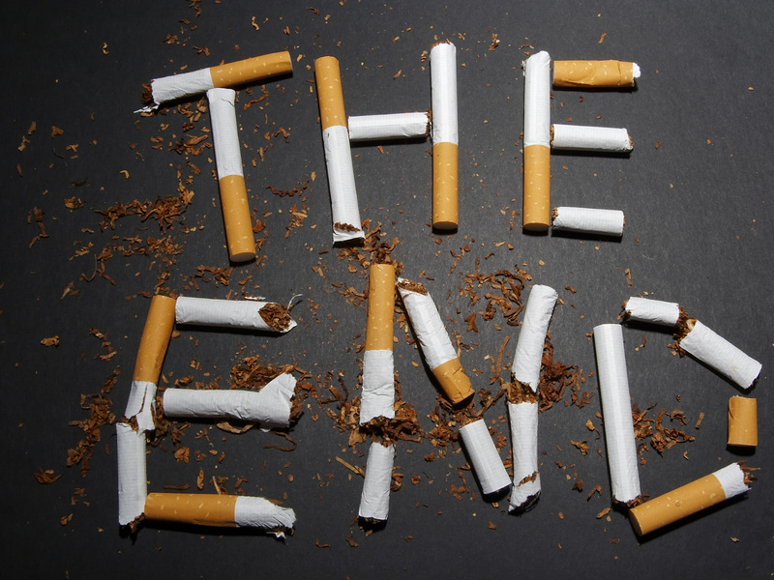

Slide 7
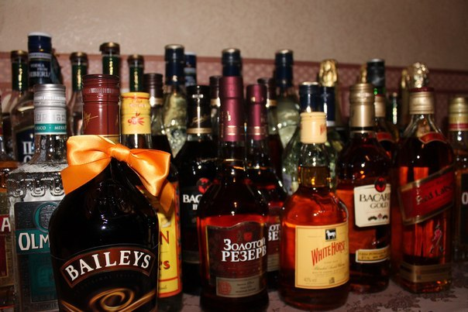
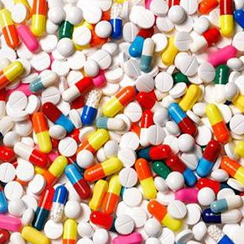
Facts as for drugs
There are three main kinds of drugs: hard, soft and legal. They can all cause addiction, serious illness and even death.
1.Legal drugs include alcohol and tranquillizers.

Slide 8
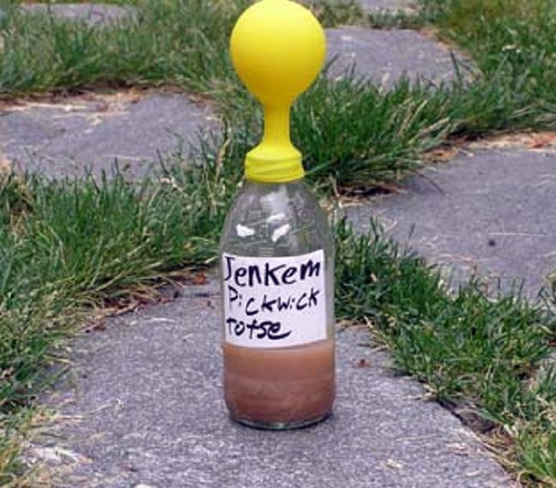
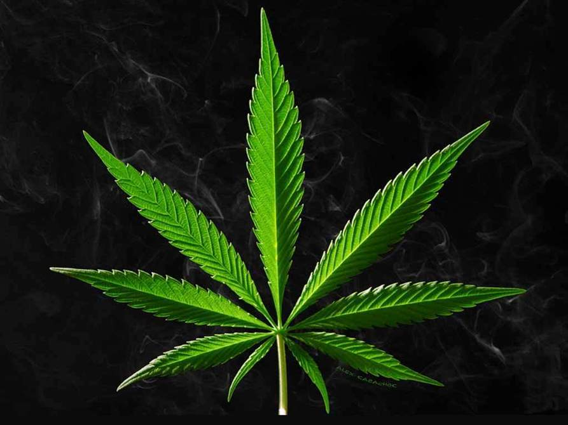
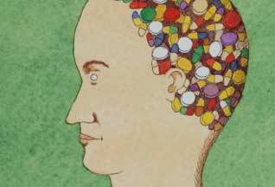
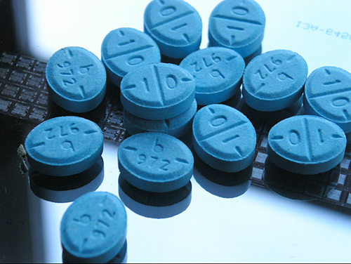
2.Soft drugs include marijuana, amphetamine (speed), solvents(glue), ecstasy.

Slide 9
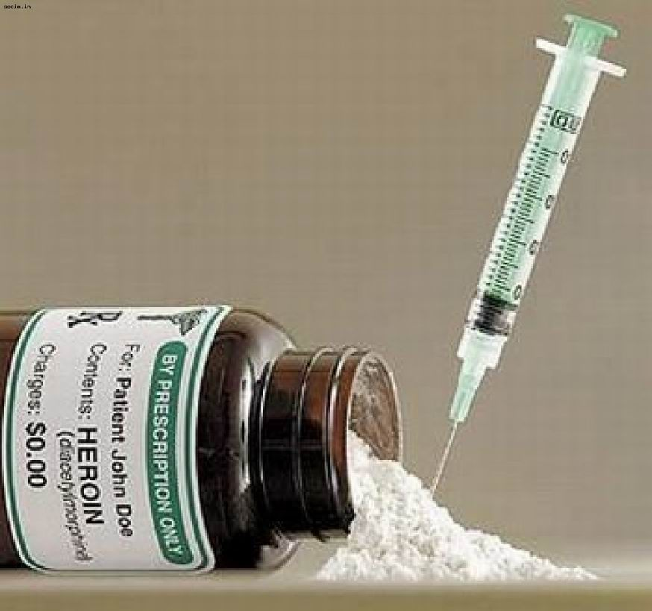
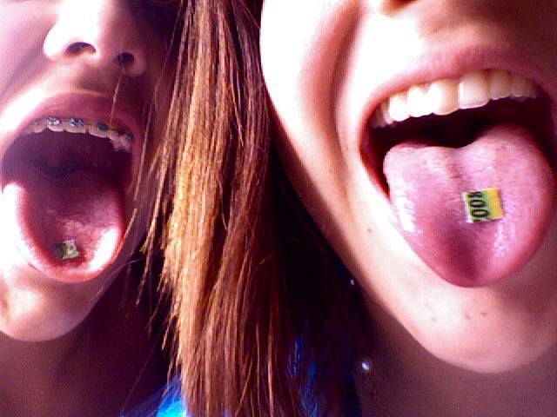
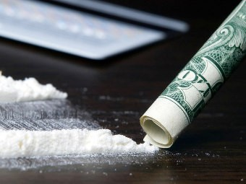
1.Hard drugs include heroin, cocaine, LSD, crack. But any of them can be a cause addiction, serious illness and even death. Thousands of drug-addicts die every year. Some die from AIDS. This is because they use dirty needles or share needles.

Slide 10
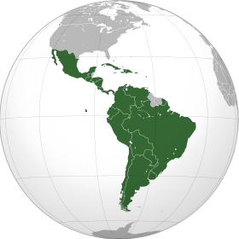
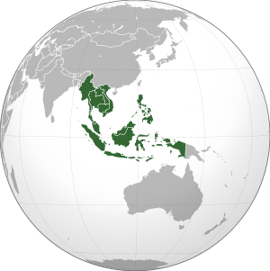
Two most important drugs - growing areas are Latin America and South- East Asia. People there depend on money from their drug crops. Drugs are the second biggest business in the world. Only the arms industry is bigger.

Slide 11
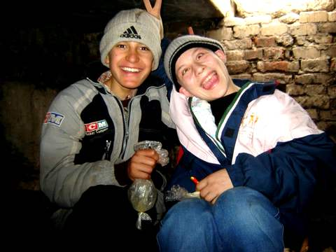
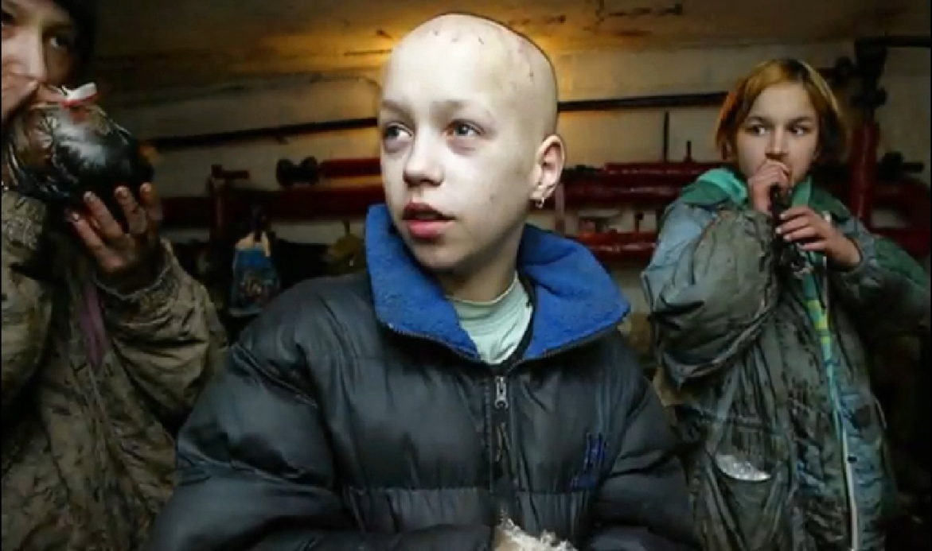
Statistics show that drugs use by British teenagers has doubled since 1989. Last year it was discovered that children of 10 years old were being sold hallucinogenic drugs. The number of young males taking drugs is higher than the number of young females. The greatest increase in drugs use in the past 8 years is by 15-16 years old.

Slide 12
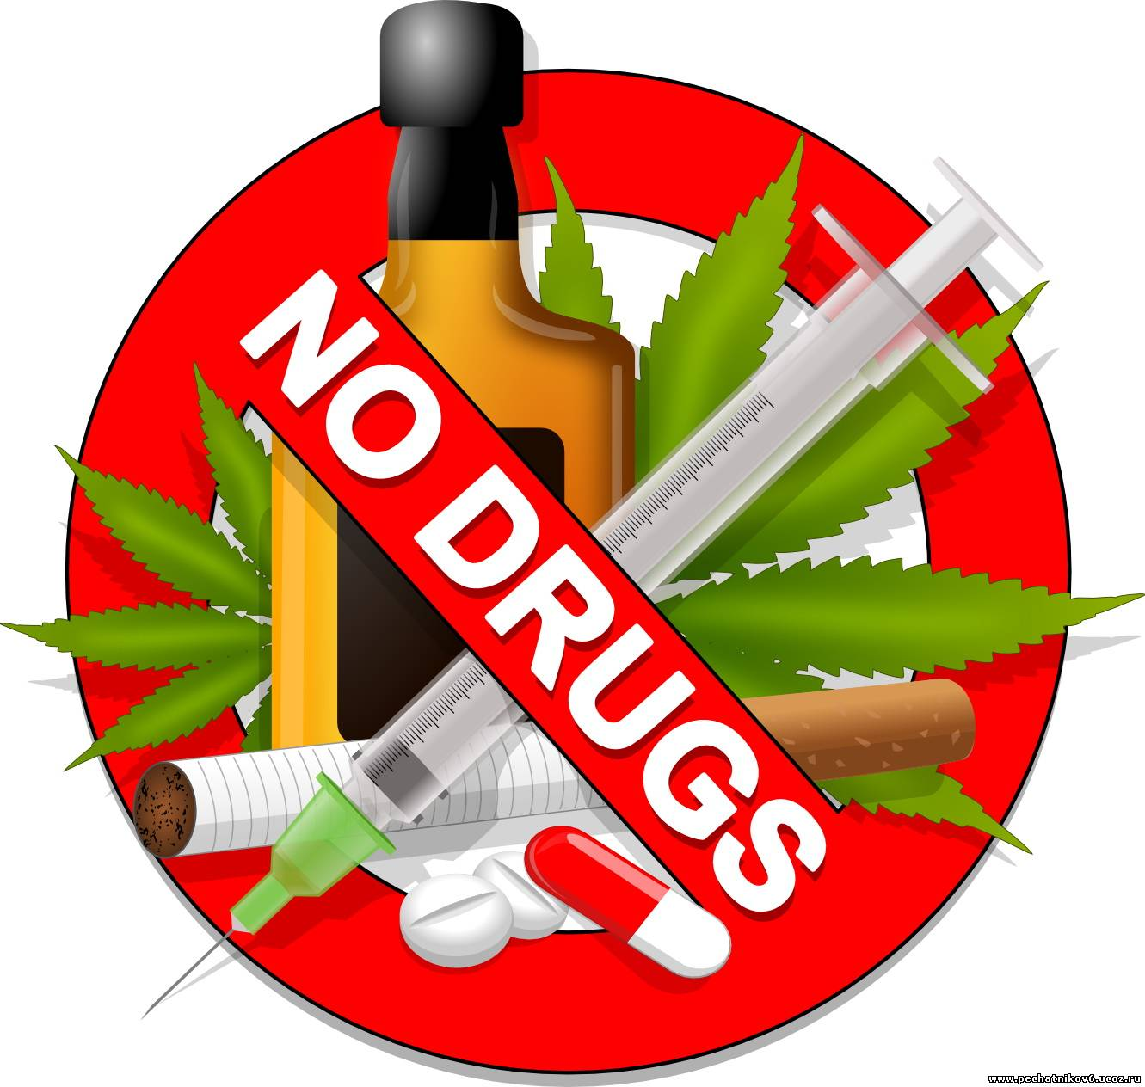
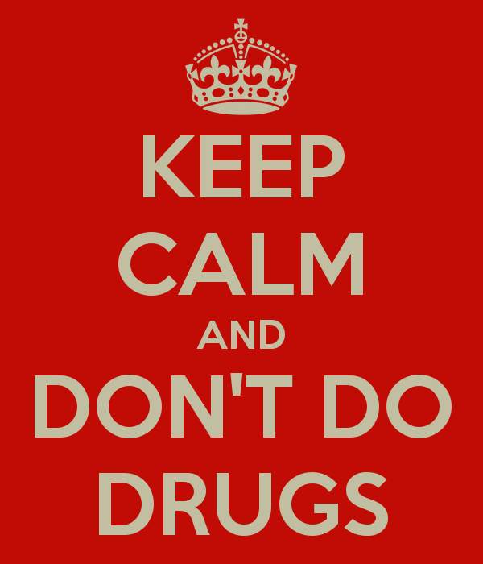
Solution
Advertising companies. They play an important part in the war against drugs. Each campaigns has had a message for example. “Just Say No”, “Don’t Do Drugs”.

Slide 13

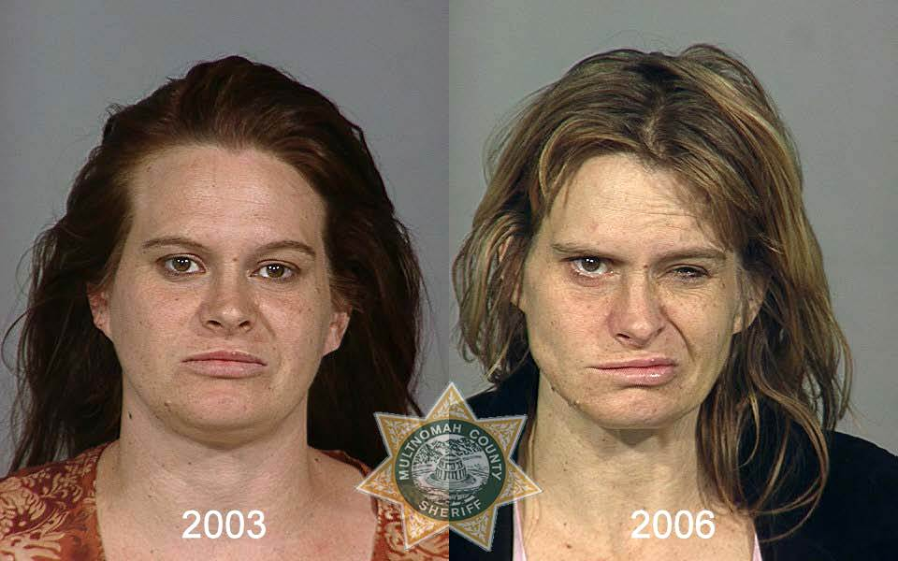
Some anti-drugs campaigns have tried to shock young people. They show how heroin, for example, can completely destroy addicts, lives also how dirty needles spread AIDS. Some companies suggest the slogan “ Choose life, not drugs. Be all you can be”. They show pictures of healthy independent young people – not the problems of addicts.

