Slide 1
Pineapple - Banana Pancakes
Recipe

Slide 2

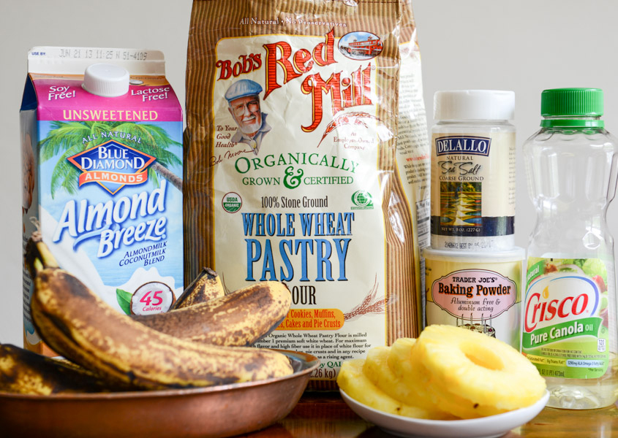
You need
Some soy or almond milk, whole grain flour, baking powder, salt, a little canola oil, bananas for mashing and pineapple rings.

Slide 3
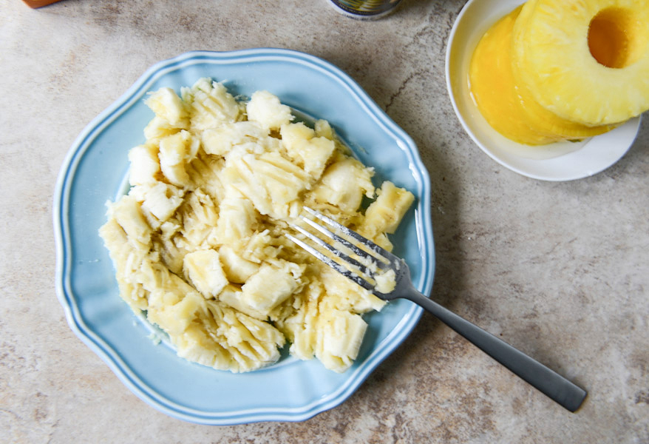
First up, mash the bananas. They don’t need to be completely mashed because we are going to throw them in the food processor.

Slide 4
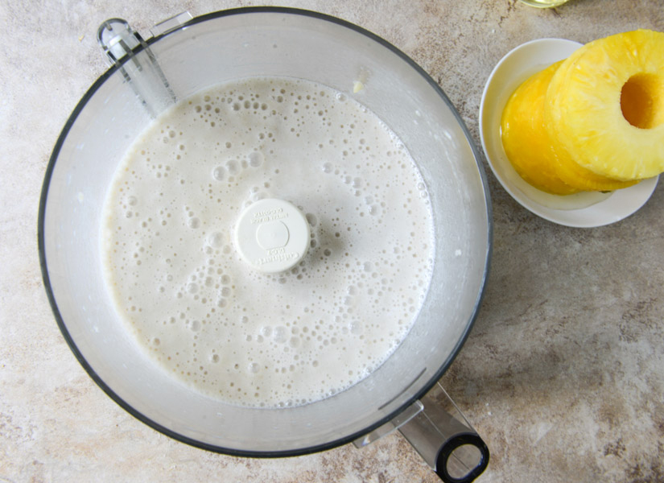
Next, combine them with a little bit of the almond milk and blend, blend, blend. Pureeing them with the milk made the batter silky smooth.

Slide 5
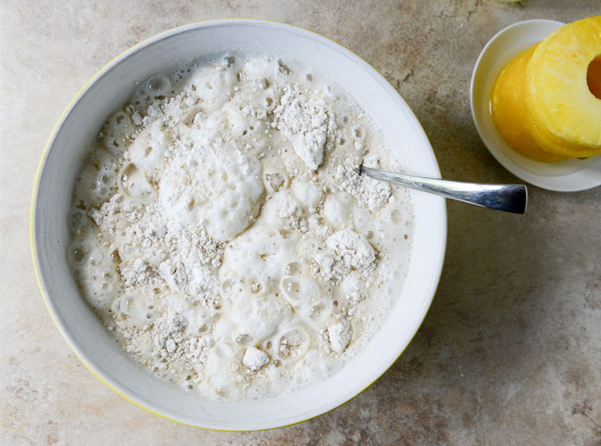
Mix the bananas and milk with the dry ingredients. I use whole wheat. Because of this, I only needed a little less than two cups of milk.

Slide 6
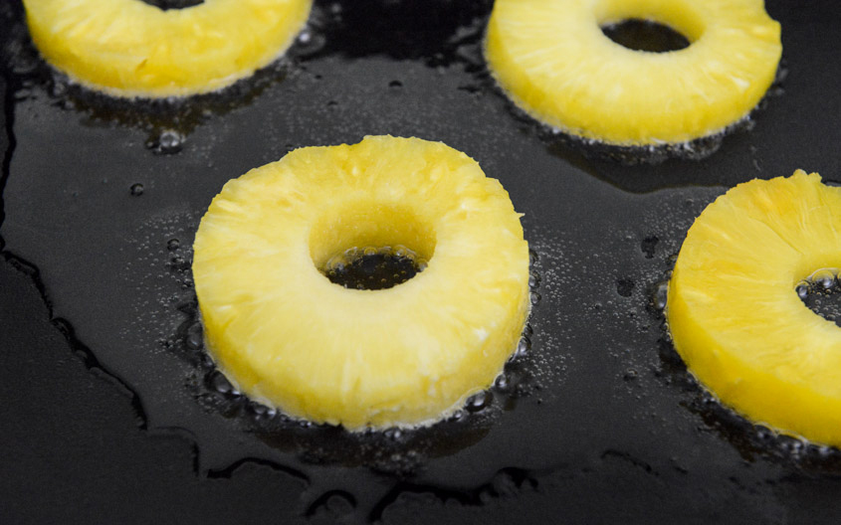
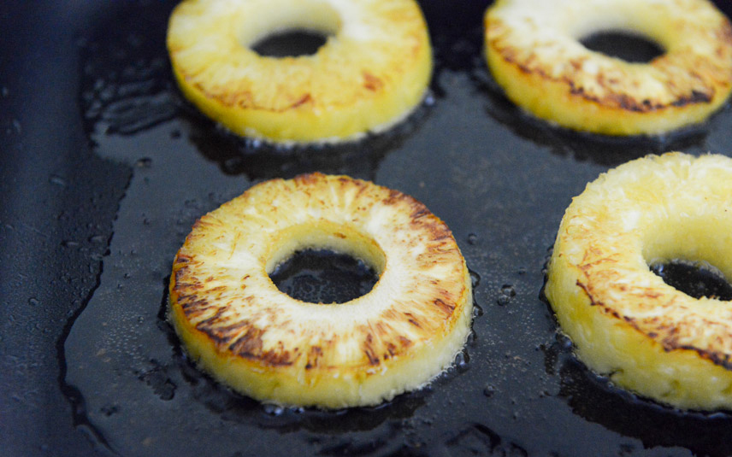
Once the batter is mixed, heat a skillet or griddle over medium-low heat. Add a little canola oil then throw the pineapple rings on to caramelize them.
Once one side is golden - flip it over.

Slide 7
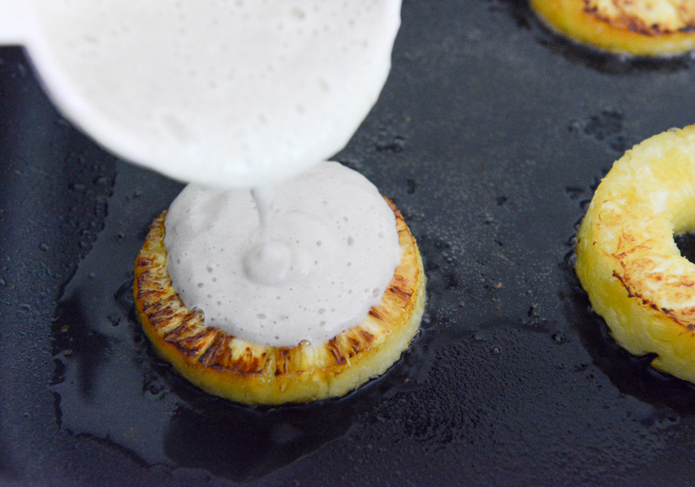
Pour a bit of batter right in the center and just slightly over the outer rings of the pineapple. Let cook until bubbles form and the batter is almost set.

Slide 8
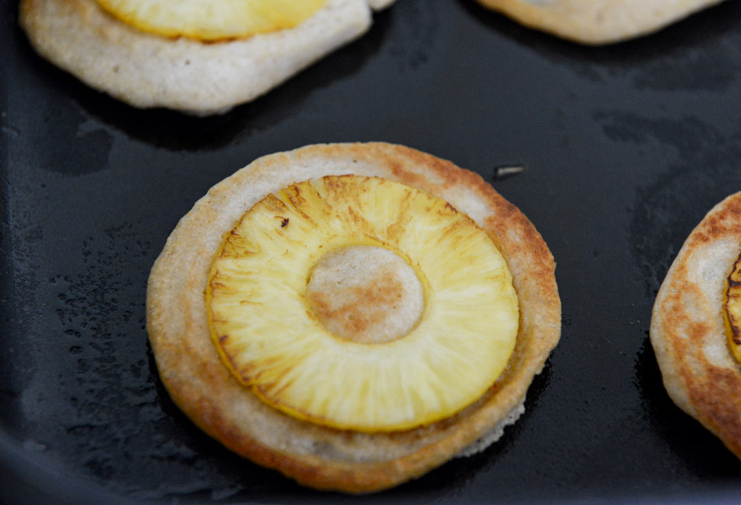
Then flip it!

Slide 9
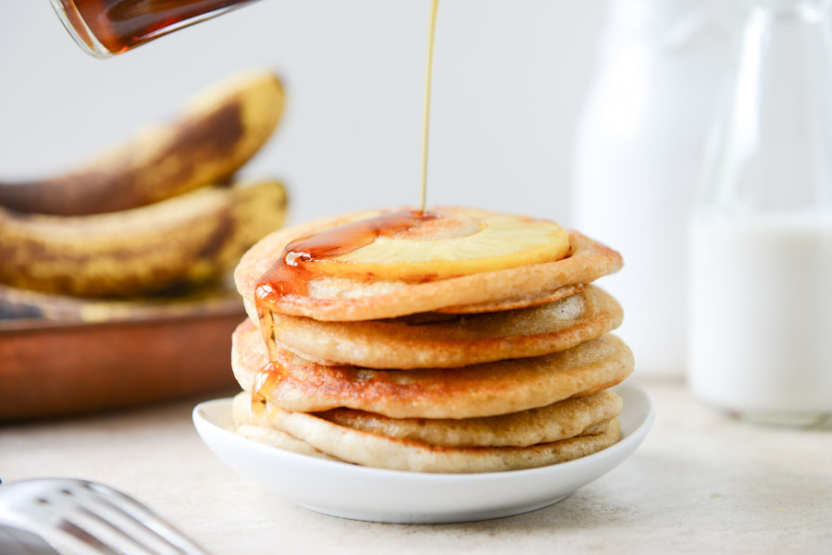
Make the pancakes and pour their honey.

Slide 10
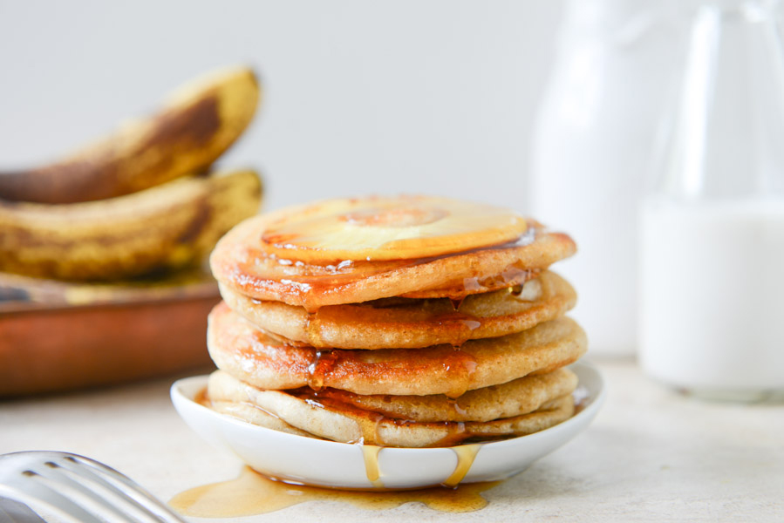
Bon appetit !

Slide 11
Thanks for your attention!
Completed
Victoria Vasylyshyna

