Slide 1
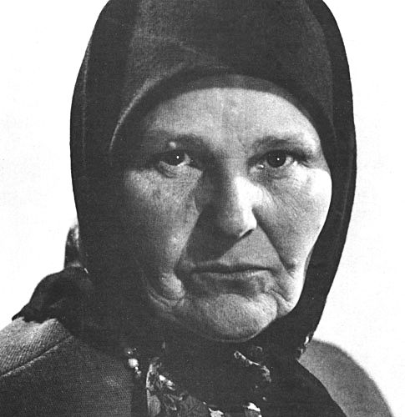
Maria Prymachenko
  (1907-1997)
Виконала:Тимошенко Єлизавета

Slide 2
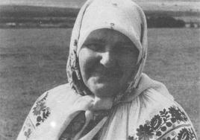
Maria Prymachenko - Ukrainian folk artist, representative of "national primitive " ("naive art"), winner of the National Prize of Ukraine name of Shevchenko, one of the most famous Ukrainian artists.

Slide 3
She was born in the village Bolotnya in Kyiv, in a family where revered folk crafts, customs and traditions of the Ukrainian people. From his father, a carpenter and
mother-sewers, Maria Prymachenko inherited a love of beauty of his native land, to folk art. In artistic arsenal Prymachenko's no "professional tricks" her drawings made ​​on plain Whatman paper brushes factory production
with the use of gouache and watercolor.

Slide 4
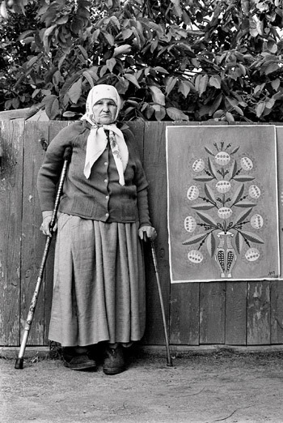
In childhood artist was sick polio.
Maria Oksentiyivna with dignity and courage had carried all life adversity. her son Theodore - folk artist, he was her student and friend.

Slide 5
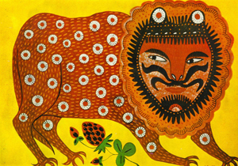
«Animal go for a walk»

Slide 6
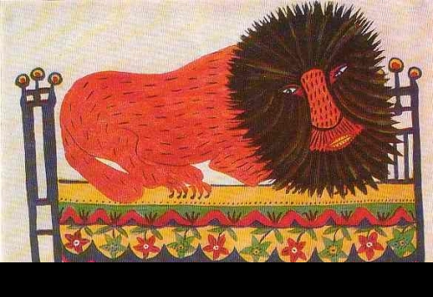
“Lion”

Slide 7
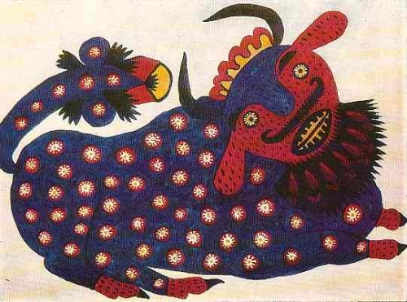
«Blue goby»

Slide 8
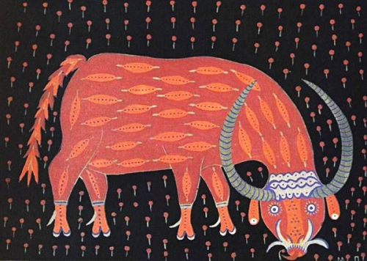
“Goby”

Slide 9
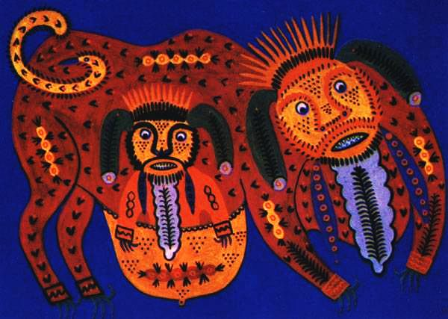
“Monkey”

Slide 10
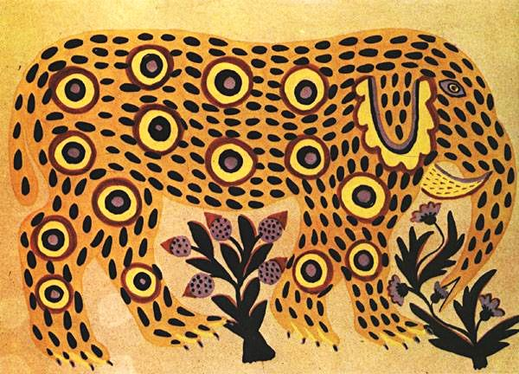
“Elephant”

Slide 11
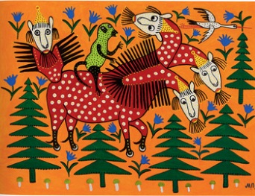

Slide 12
“Animal series`s" Prymachenko - thing unique and does not analogues in Ukrainian nor in the world.
Fantastic beasts - a work of the imagination of the artist. Such animals do not exist in nature.

Slide 13
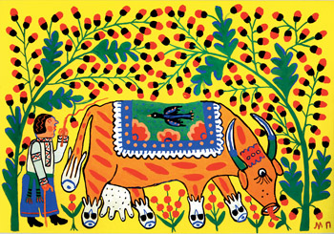
“Як у Чорнобилі було горе із блоком,
а дід корову пас там…”

Slide 14
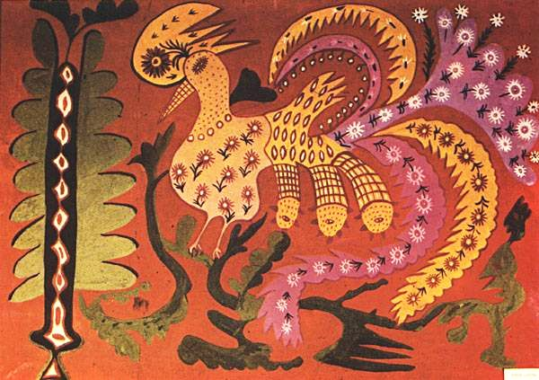
“Forest peacock”

Slide 15
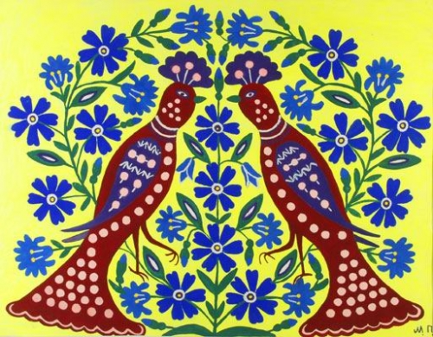
«Two tits»

Slide 16
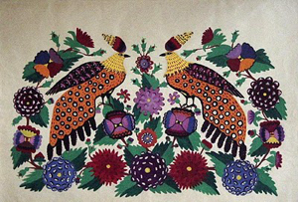

Slide 17
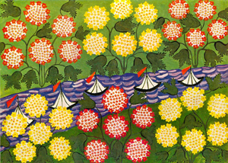
«guelder rose»

Slide 18
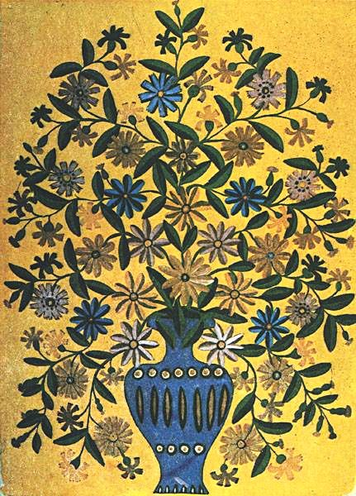
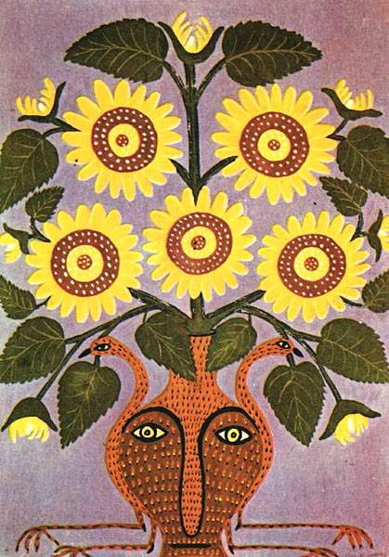
“Flowers in blue vase”
“Sunflower of life”

Slide 19
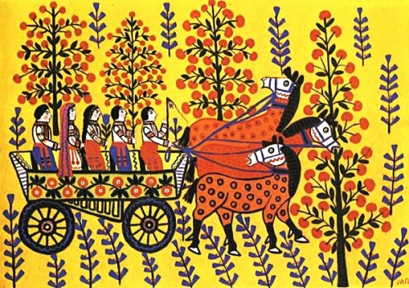
«wedding»

Slide 20
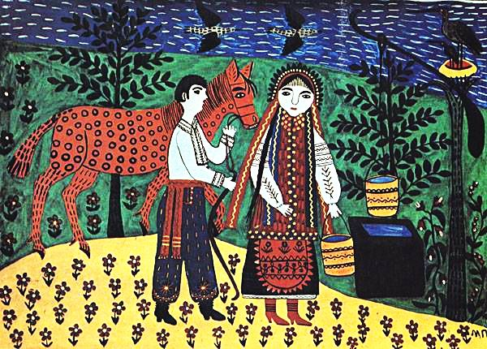
“Сватає Іван Галю”

Slide 21
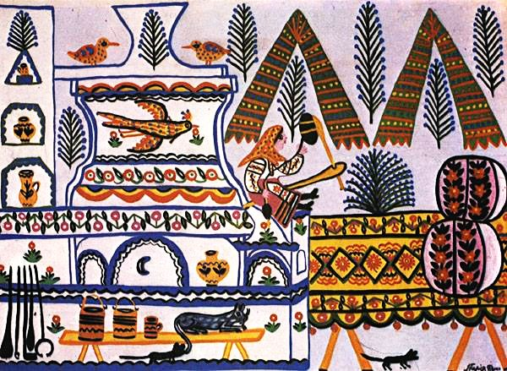
“Сидить баба на печі, пряде куделицю»

Slide 22
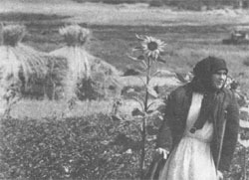
Her paintings are exhibited at shows with great success in France, Canada, Poland, Russia, Germany and many other countries. In 1937 at the World Exhibition in Paris Maria Prymachenko received a gold medal.

Slide 23
2009 - by UNESCO - declared Mary Pryimachenko year.
In honor of artist named minor planet 14624 Primachenko.

Slide 24
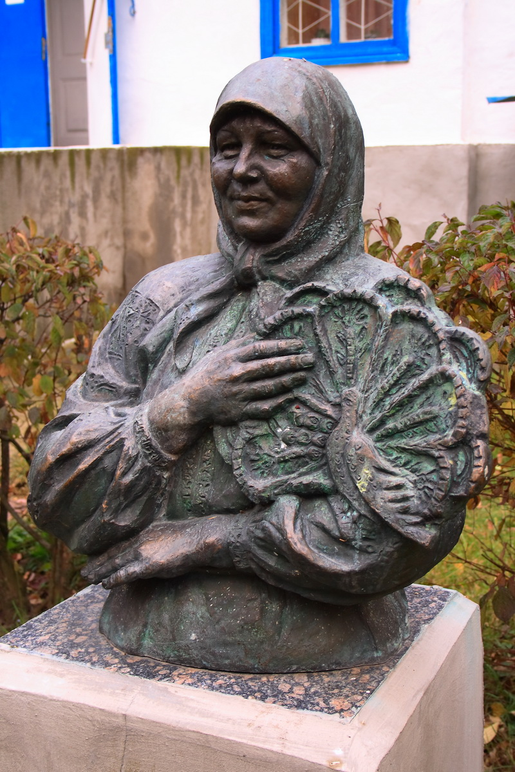
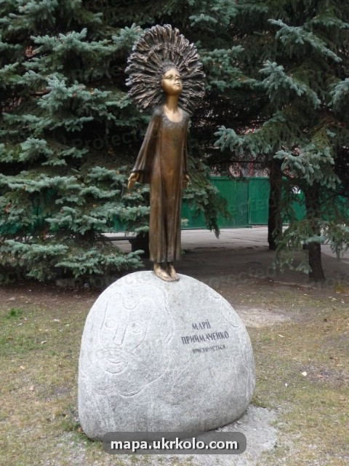
Monuments
Yagotun city
Kiev city

