Slide 1
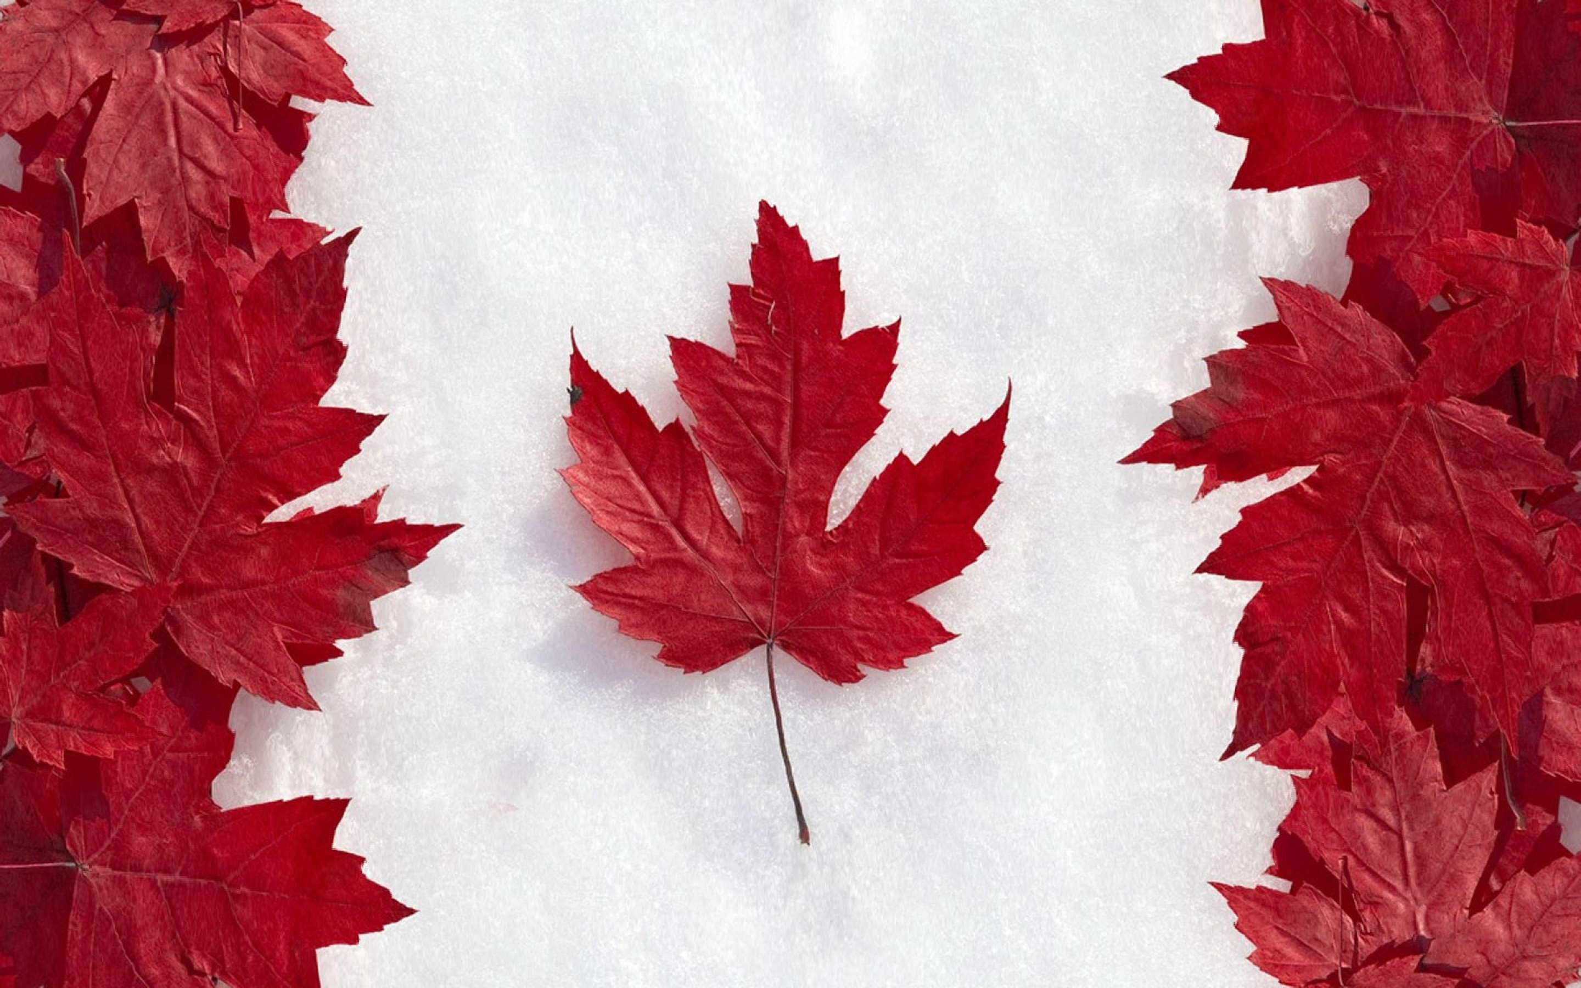
Canada
Seur Olena
10-A

Slide 2
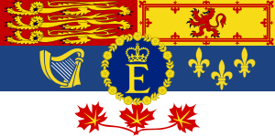
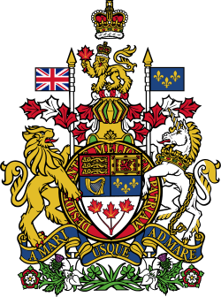
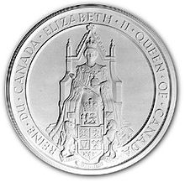
National symbols of Canada
Royal Standard
Royal Arms
National flag
Great Seal of Canada

Slide 3
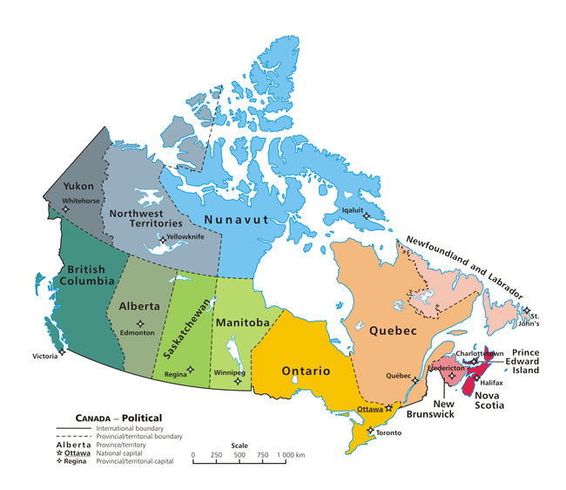
Canada is a country in North America consisting of 10 provinces and 3 territories. Located in the northern part of the continent, it extends from the Atlantic to the Pacific and northward into the Arctic Ocean.
Capital – Ottawa
Largest city - Toronto
Official languages - English, French
Government - Federal Parliamentary Constitutional Monarchy
Area - 9,984,670 km²
Population - 2014 estimate35,344,962

Slide 4
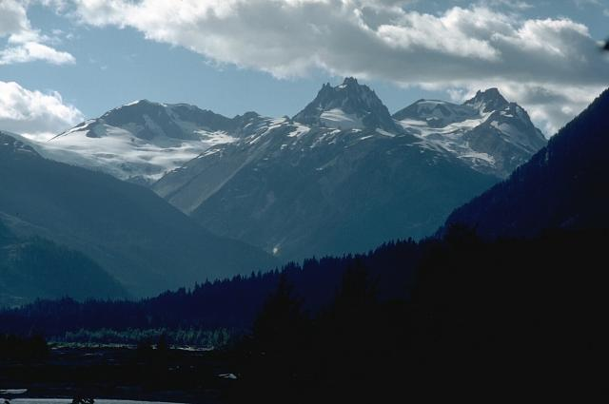
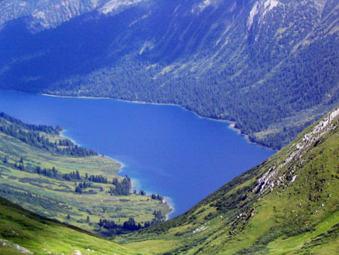
Canada has around 31,700 large lakes. Canada is geologically active, having many earthquakes and potentially active volcanoes, notably Mount Meager, Mount Garibaldi, Mount Cayley, and the Mount Edziza volcanic complex. The most densely populated part of the country is the Quebec City – Windsor Corridor, situated in Southern Quebec and Southern Ontario along the Great Lakes and the St. Lawrence River. On the east and west coasts, average high temperatures are generally in the low 20s °C, while between the coasts, the average summer high temperature ranges from 25 to 30 °C, with temperatures in some interior locations occasionally exceeding 40 °C.
Mount Meager
Great Bear Lake

Slide 5
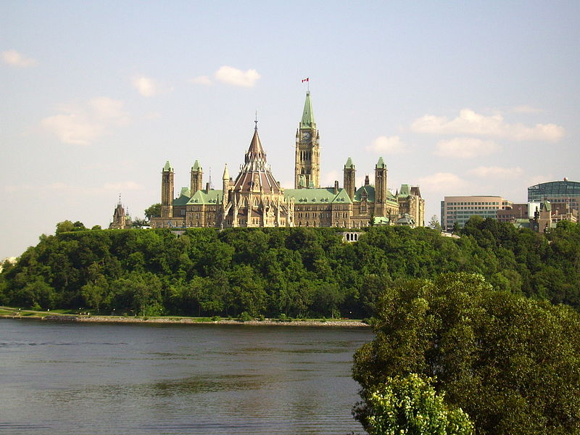
Canada has a parliamentary system within the context of a constitutional monarchy, the monarchy of Canada being the foundation of the executive, legislative, and judicial branches. The Queen's representative, the Governor General of Canada carries out most of the federal royal duties in Canada. The direct participation of the royal and viceroyal figures in areas of governance is limited. In practice, their use of the executive powers is directed by the Cabinet, a committee of ministers of the Crown responsible to the elected House of Commons and chosen and headed by the Prime Minister of Canada, the head of government. Opposition and is part of an adversarial parliamentary system intended to keep the government in check. The Senate chamber within the Centre Block on Parliament Hill. Each of the 308 members of parliament in the House of Commons is elected by simple plurality in an electoral district or riding.
Parliament Hill

Slide 6
Canada is a federation composed of ten provinces and three territories. In turn, these may be grouped into four main regions: Western Canada, Central Canada, Atlantic Canada, and Northern Canada. The Toronto Stock Exchange is the seventh largest exchange in the world. Canada is the world's eleventh-largest economy, with a 2012 nominal GDP of approximately US$1.82 trillion. It is a member of the Organisation for Economic Co-operation and Development (OECD) and the Group of Eight (G8), and is one of the world's top ten trading nations, with a highly globalized economy.
In 2011, Canada spent approximately C$29.9 billion on domestic research and development. As of 2012, the country has produced fourteen Nobel laureates.
The Canadian Space Agency operates a highly active space program, conducting deep-space, planetary, and aviation research, and developing rockets and satellites. Canada is a participant in the International Space Station (ISS), and is a pioneer in space robotics, having constructed the Canadarm, Canadarm2 and Dextre robotic manipulators for the ISS and NASA's Space Shuttle. Since the 1960s, Canada's aerospace industry has designed and built numerous marques of satellite, including Radarsat-1 and 2, ISIS and MOST.

Slide 7
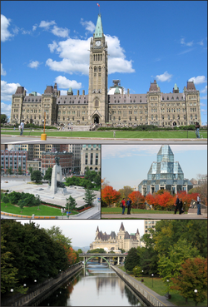
Ottawa is the capital of Canada, and the fourth largest city in the country. The city stands on the south bank of the Ottawa River in the eastern portion of Southern Ontario. Founded in 1826 as Bytown and incorporated as "Ottawa" in 1855, the city has evolved into a political and technological centre of Canada. he name "Ottawa" is derived from the Algonquin word adawe, meaning "to trade". Initially an Irish and French Christian settlement, Ottawa has become a multicultural city with population 883,391 people.

Slide 8
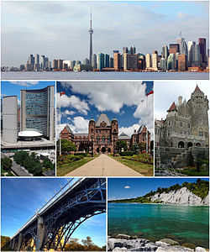
Toronto is the most populous city in Canada and the provincial capital of Ontario. It is located in Southern Ontario on the northwestern shore of Lake Ontario. The history of Toronto began in the late 18th century when the British Crown purchased its land from the Mississaugas of the New Credit. The British established a settlement there, called the Town of York, which its lieutenant governor, John Graves Simcoe, designated as the capital of Upper Canada. The city was ransacked in the Battle of York during the War of 1812. In 1834, York was incorporated as a city and renamed Toronto.

Slide 9
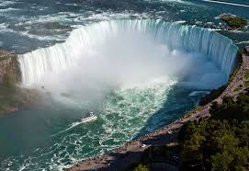
Niagara Falls
Niagara Falls is the collective name for three waterfalls that straddle the international border between Canada and the United States. Located on the Niagara River, which drains Lake Erie into Lake Ontario, the combined falls form the highest flow rate of any waterfall in the world, with a vertical drop of more than 165 feet (50 m).
The number of visitors in 2007 was expected to total 20 million and by 2009, the annual rate was expected to top 28 million tourists.

Slide 10
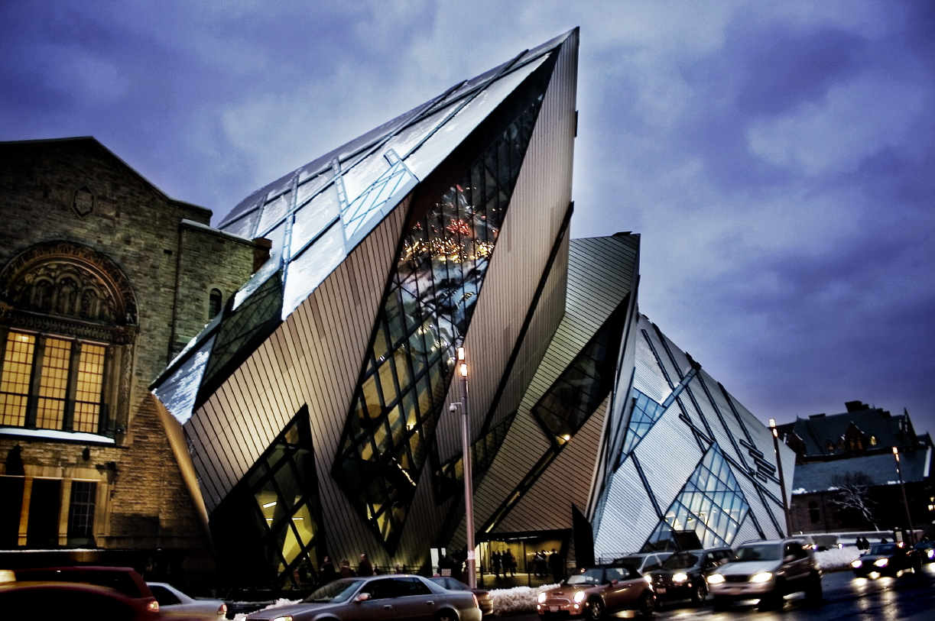
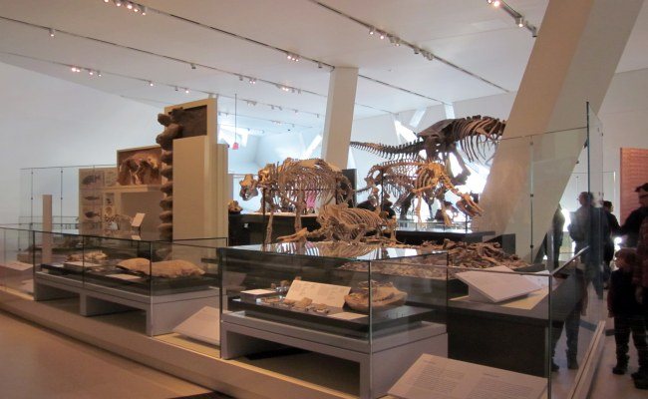
The Royal Ontario Museum (ROM) is a museum of world culture and natural history based in Toronto, Ontario. It is one of the largest museums in North America, attracting over one million visitors every year.[1] The museum is located north of Queen's Park in the University of Toronto district, with its main entrance facing Bloor Street. With more than six million items and forty galleries, the museum's diverse collections of world culture and natural history are part of the reason for its international reputation. The museum contains notable collections of dinosaurs, minerals and meteorites, Near Eastern and African art, Art of East Asia, European history, and Canadian history. It also houses the world's largest collection of fossils from the Burgess Shale with more than 150,000 specimens.

Slide 11
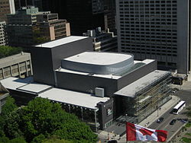
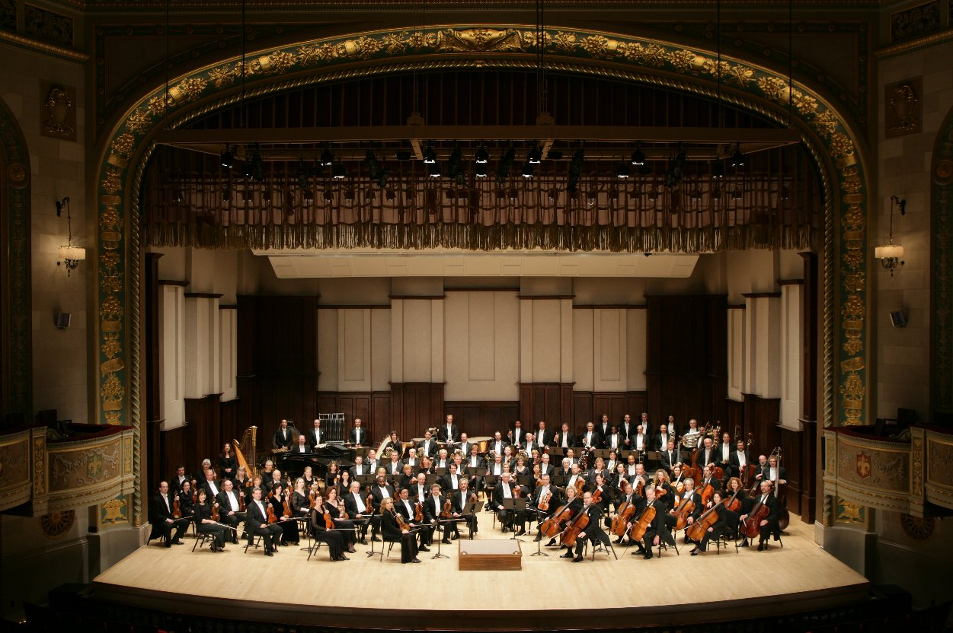
The Canadian Opera Company (COC) is an opera company in Toronto, Ontario, Canada. It is the largest opera company in Canada and the third largest producer of opera in North America. The COC performs in its own opera house, the Four Seasons Centre for the Performing Arts.
The "Toronto Symphony Orchestra" (TSO) is a Canadian orchestra based in Toronto, Ontario. Since 1982, the TSO has performed at Roy Thomson Hall. From the time of its founding in 1922, it had given regular concerts at Massey Hall. The TSO also manages the Toronto Symphony Youth Orchestra (TSYO).

Slide 12
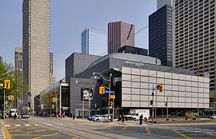
The Four Seasons Centre for the Performing Arts is a 2,071-seat theatre in Toronto, Ontario, Canada located at the southeast corner of University Avenue and Queen Street West, across from Osgoode Hall. It is the home of the Canadian Opera Company (COC) and the National Ballet of Canada.
The Toronto Zoo is a zoo located in Toronto, Ontario, Canada. It opened August 15, 1974, as the Metropolitan Toronto Zoo. Encompassing 287 hectares (710 acres), the Toronto Zoo is the largest zoo in Canada.[citation needed] It is divided into seven zoogeographic regions: Indo-Malaya, Africa, Americas, Tundra Trek, Australasia, Eurasia, and the Canadian Domain. The zoo is currently home to over 5,000 animals representing over 450 species.

Slide 13
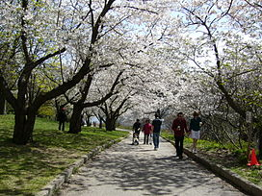
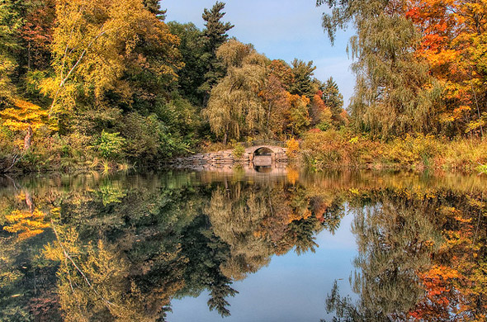
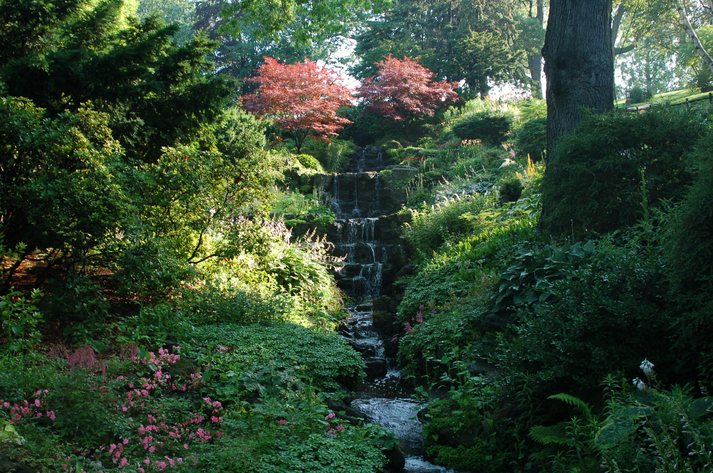
High Park is a municipal park in Toronto, Ontario.It spans 161 hectares (400 acres), and is a mixed recreational and natural park, with sporting facilities, cultural facilities, educational facilities, gardens, playgrounds and a zoo. One third of the park remains in a natural state, with a rare oak savannah ecology. High Park was opened to the public in 1876 and is based on a bequest of land from John George Howard to the City of Toronto. It is the largest park entirely within the city. High Park is located to the west of downtown, north of Humber Bay. It stretches south from Bloor Street West to The Queensway, just north of Lake Ontario.

Slide 14
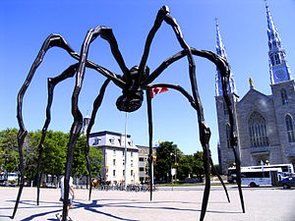
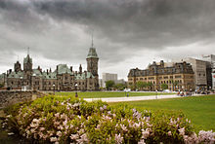
Maman (1999) is a bronze, stainless steel, and marble sculpture by the artist Louise Bourgeois. The sculpture, which depicts a spider, is among the world's largest, measuring over 30 ft high and over 33 ft wide.
The Langevin Block is an office building facing Parliament Hill in Ottawa, Canada. As the home of the Privy Council Office and Office of the Prime Minister, it is the working headquarters of the executive branch of the Canadian government. Accordingly, the term Langevin Block is sometimes used as a metonym for the Prime Minister's Office.
The building is a National Historic Site of Canada.

Slide 15
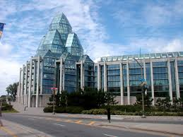
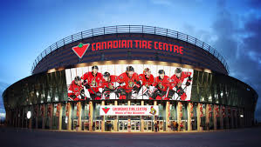
The National Gallery of Canada located in the capital city Ottawa, Ontario, is one of Canada's premier art galleries. The Gallery is now housed in a glass and granite building on Sussex Drive with a notable view of the Canadian Parliament buildings on Parliament Hill. The acclaimed structure was designed by Moshe Safdie and opened in 1988.
Canadian Tire Centre is a multi-purpose arena, located in the western suburb of Kanata, in Ottawa, Ontario. It is home to the Ottawa Senators of the National Hockey League. It has also hosted the Canadian University Men's Basketball Championship (CIS). Opened as The Palladium in January 1996, it was known as the Corel Centre from 1996 to 2006, and Scotiabank Place from 2006 to 2013. The arena hosts ice hockey, basketball, music concerts, skating, and other entertainment events. It is home to the Ottawa Sports Hall of Fame, several restaurants, a fitness complex, and several businesses. The arena has seating for 19,153 and a capacity of 20,500 including standing room.

