Slide 1


Ukraine in the Eurovision
Song Contest

Slide 2
The Eurovision Song Contest - is an annual song competition held among the member countries of the European Broadcasting Union (EBU) since 1956.
Each member country submits a song to be performed on live television and radio and then casts votes for the other countries songs to determine the most popular song in the competition. The contest has been broadcast every year since its inauguration in 1956 and is one of the longest-running television programmes in the world.

Slide 3
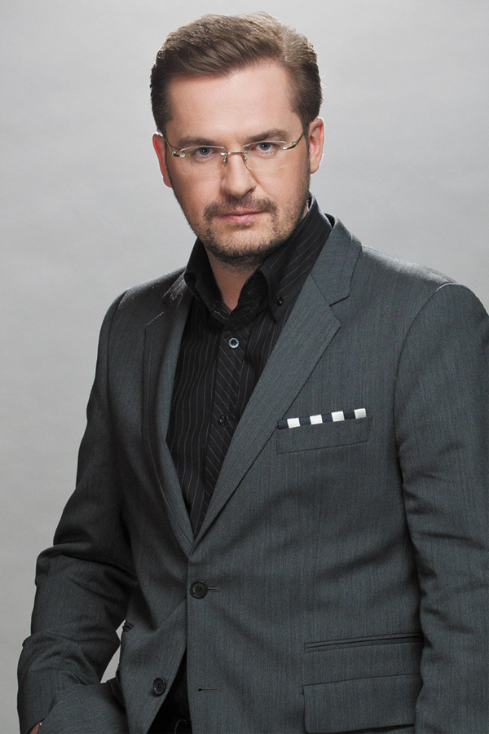
Ukraine has participated in the Eurovision Song Contest twelve times, debuting in 2003 with a 14-th place finish for Oleksandr Ponomaryov(he sang a song «Hasta la Vista»).

Slide 4
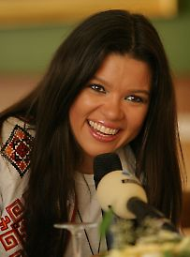
Ruslana Lyzhychko
She won the 2004 Eurovision Song Contest with the song «Wild Dances»receiving 280 points, which at that time was a record of points. Following her victory, she rose to fame in Europe and became one of the biggest pop stars from the Eastern part of the continent.

Slide 6
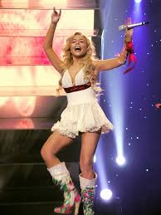
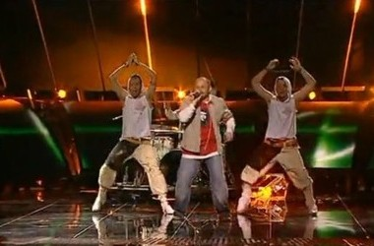
GreenJolly performing «Razom nas bahato» at Kyiv(2005)
Tina Karol performing «Show Me Your Love» at Athens (2006)

Slide 7
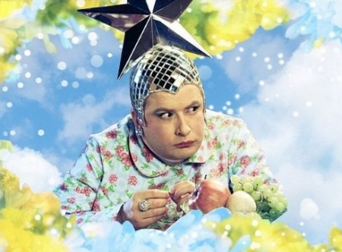
Verka Serduchka
Serduchka's song «Dancing Lasha Tumbai» was sung in four languages: German, English, Ukrainian, and Russian. The invented words "lasha tumbai" caused some controversy after the performance, because many people noted the phrase's similarity to "Russia Goodbye"

Slide 9
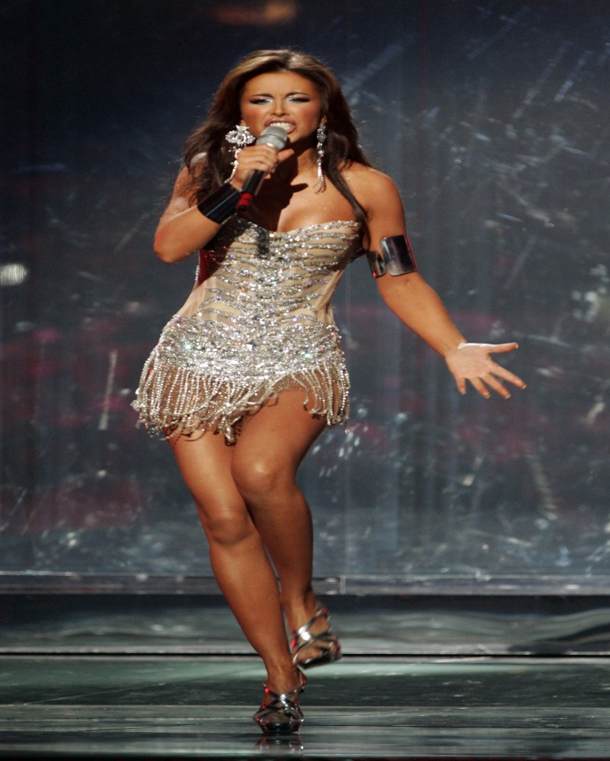
Ani Lorak
At the 2008 Eurovision Song Contest in Belgrade, she sang the song «Shady Lady»
in the second semi final on the 22-nd of May 2008 winning a place in the final. She took the second place in the final after Dima Bilan.

Slide 11
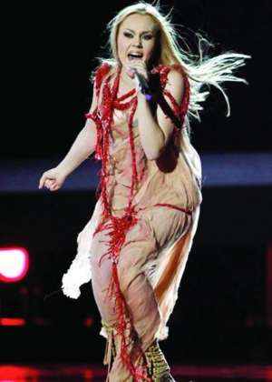
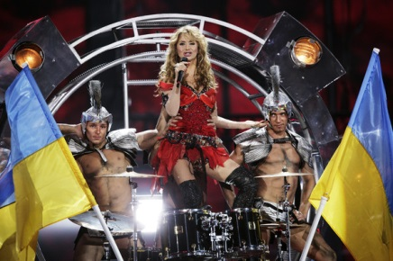
Svetlana Loboda performing «Be My Valentine! (Anti-Crisis Girl)» at Moscow (2009)
Alyosha
performing «Sweet People» at Oslo(2010)

Slide 12
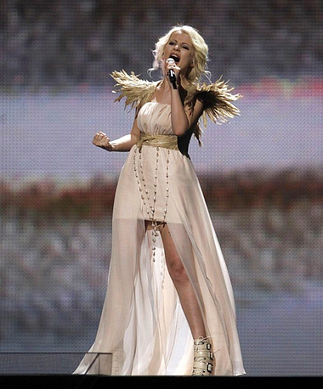
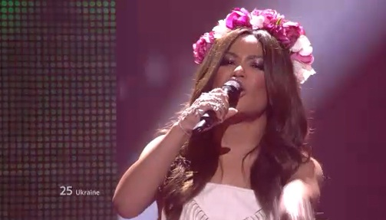
Mika Newton performing
«Angel» at Dusseldorf(2011)
Gaitana performing «Be My Guest» at Baku(2012)

Slide 13
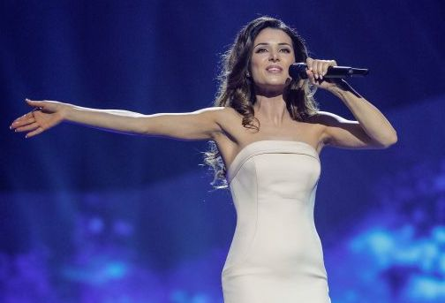
Zlata Ognevich
On 23 December 2012, Zlata made her third attempt to represent Ukraine at the Eurovision Song Contest. Ognevich won the right to represent Ukraine at the Eurovision Song Contest 2013 in Malmo with song «Gravity» Zlata took third place at Eurovision.

Slide 15
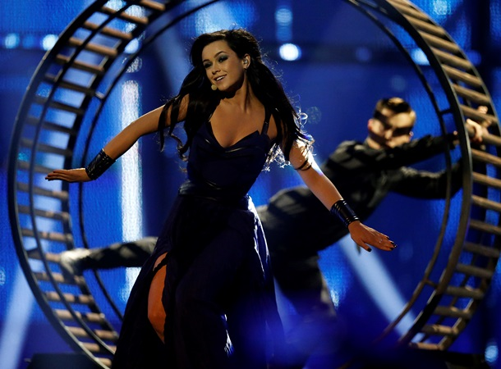
Mariya Yaremchuk performing “"Tick-Tock“
at Copenhagen (2014).
She took 6-th place at Eurovision.

Slide 16
Ukraine won’t take part in Eurovision 2015 because of the difficult political, economical and military problems.

Slide 17
Slogans
2002 – «A Modern Fairytale»
2003 – «Magical Rendezvous»
2004 – «Under The Same Sky»
2005 – «Awakening»
2006 – «Feel The Rhythm!»
2007 – «True Fantasy»
2008 – «Confluence Of Sound»
2010 – «Share The Moment!»
2011 – «Feel Your Heart Beat!»
2012 – «Light Your Fire!»
2013 – «We Are One»
2014 – «Join Us»
2015 – «Building Bridges»

