Slide 1
RUBBISH
Is it really a problem?
By Veronika Aleksejenko

Slide 2
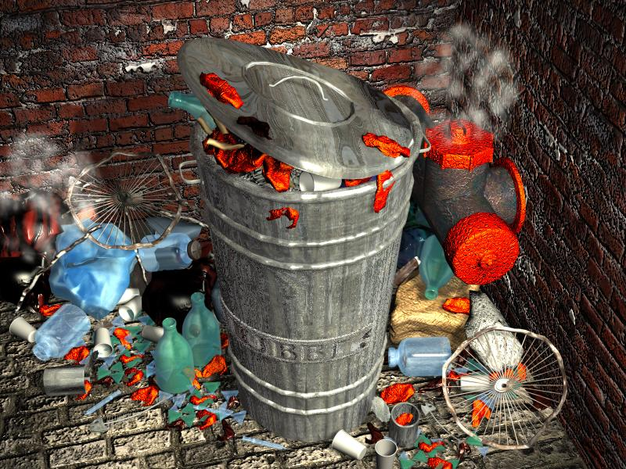
What is rubbish?
Garbage
Any materials unused and rejected as worthless or unwanted

Slide 3
What’s in your bin?
What’s in your bin?

Slide 4
Is rubbish actually worthless?
Rubbish is the result of our:
Food
Shopping
Habits
Packaging
Clothes
Furniture

Slide 5
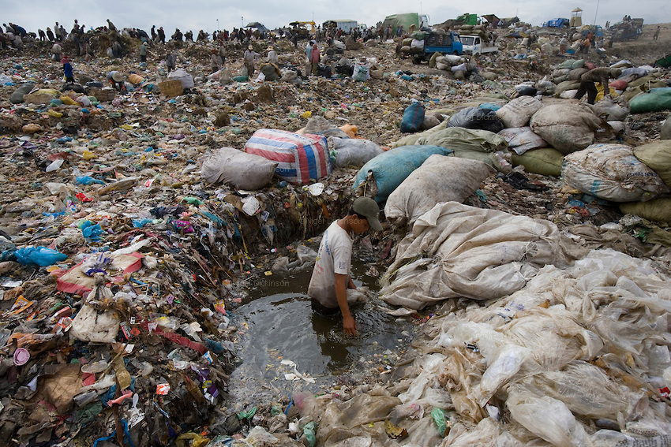

Slide 6
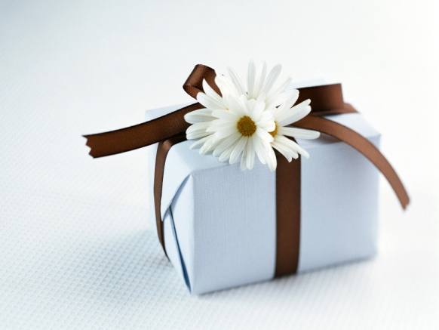
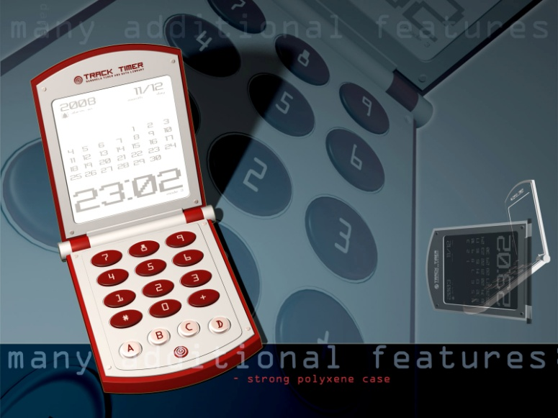
Classification of rubbish
Bio-degradable
(paper, wood, fruits and others)
NON-BIODEGRADABLE
(plastics, bottles, old machines, cans
and others)

Slide 7
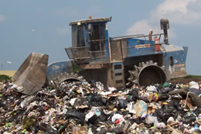
About 80% of all rubbish ends up in landfill sites.

Slide 8
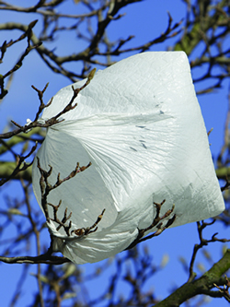
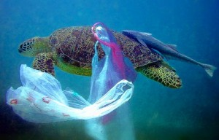
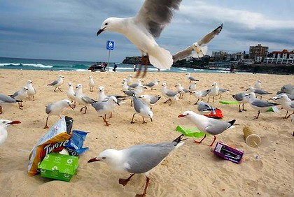
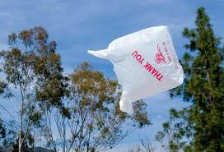
In 2002
around 50 to 80 million bags
ended up as litter in our environment

Slide 9
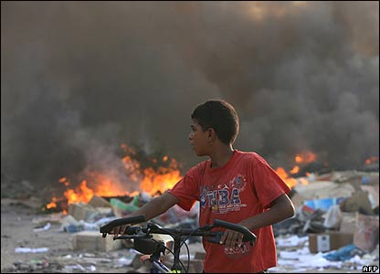
If you burn rubbish, a smoke pollutes the air.

Slide 10
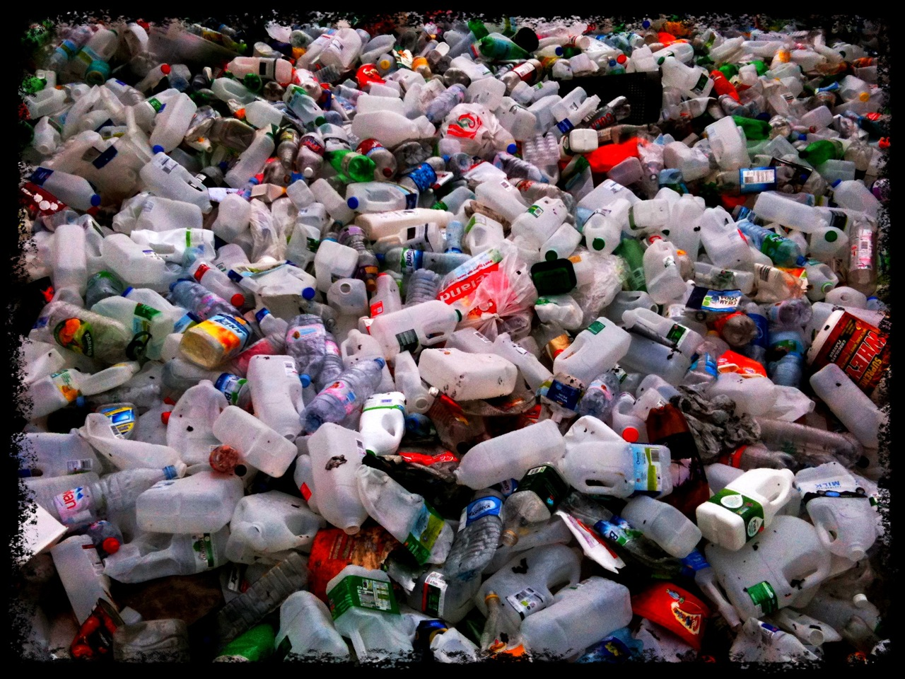

Slide 11
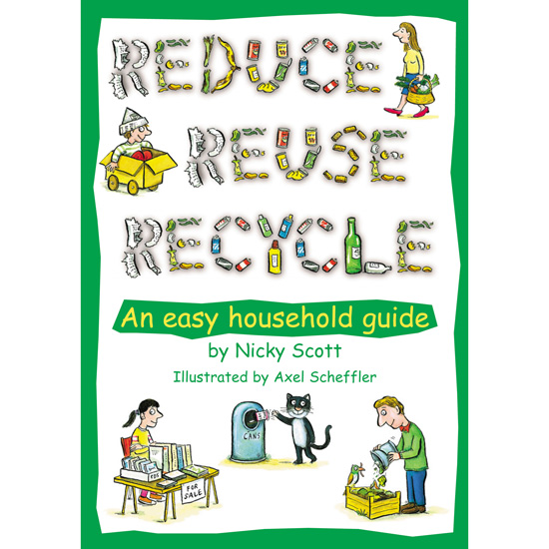
The answer is:
Reduce
Reuse
Recycle

Slide 12
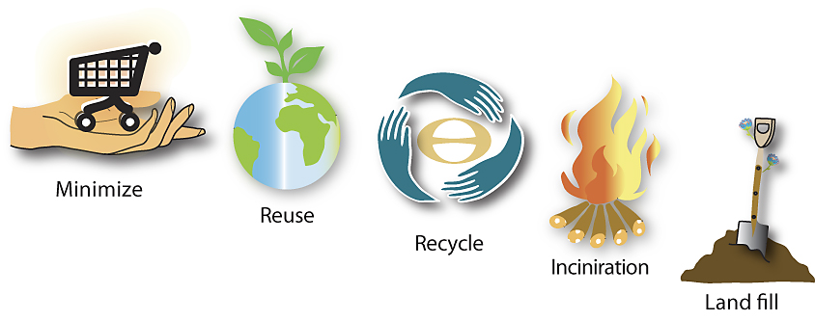
Methods for disposal of rubbish

Slide 13

Reduce
Before you buy something new, ask yourself if you really need it.

Slide 14
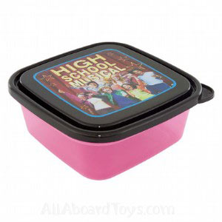
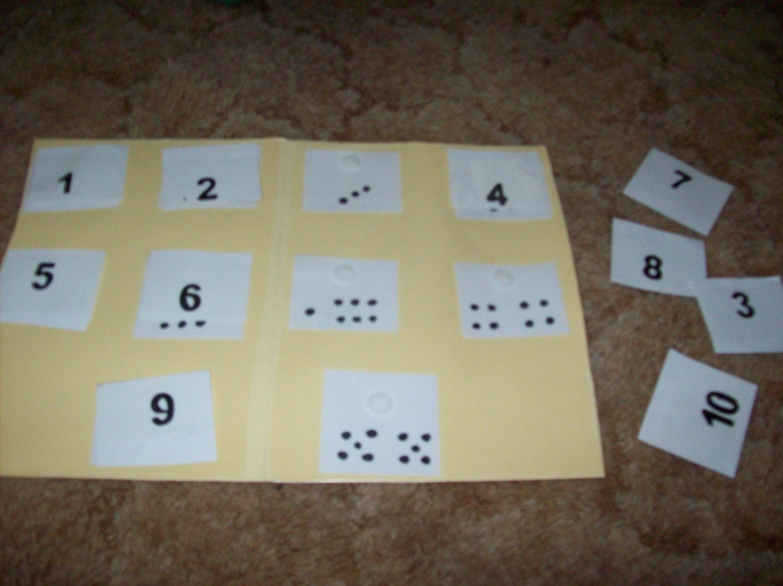
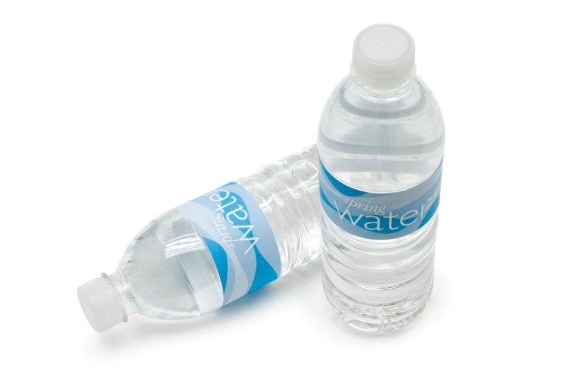
Reuse
Try to use food containers instead of sandwich bags.

Slide 15
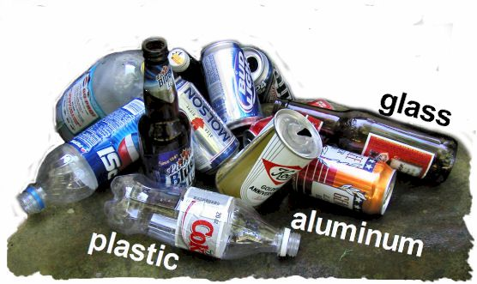
Recycle
Recycle all your glass, old newspapers, plastic and tins.

Slide 16
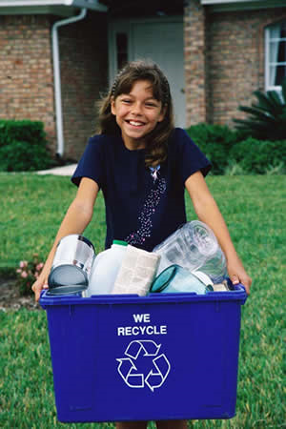
Landfill
Composting
Waste To Energy
Stores
Houses

Slide 17
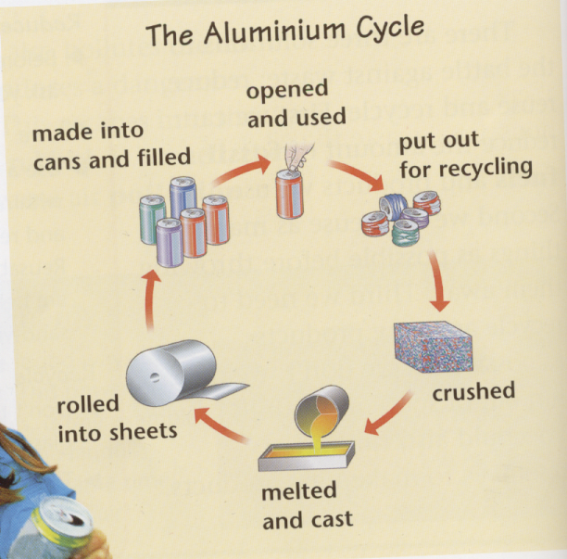

Slide 18
7 Benefits of Recycling
Financial Benefit
Conservation of Resources
Energy savings
Community Building
Jobs creation
Strong economy
Environmental Protection
Notes:
The 7 Benefits of Recycling are: Financial Benefit, Conservation of Resources, Energy savings, Community Building, Jobs creation, Strong economy, and Environmental Protection.

Slide 19
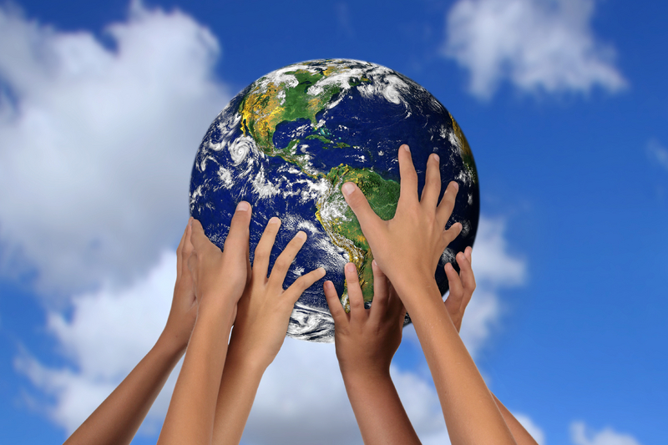
Notes:
Lets all recycle today.

Slide 20
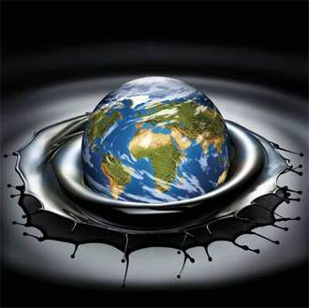
Did you know…
If just 1 in 5 Australians stopped using plastic bags, we would save approximately 88,704,000,000 bags!!!

Slide 21
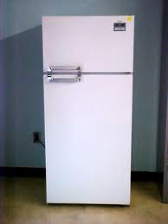
Recycling one tonne of plastic saves enough energy to run a refrigerator for a month!

Slide 22
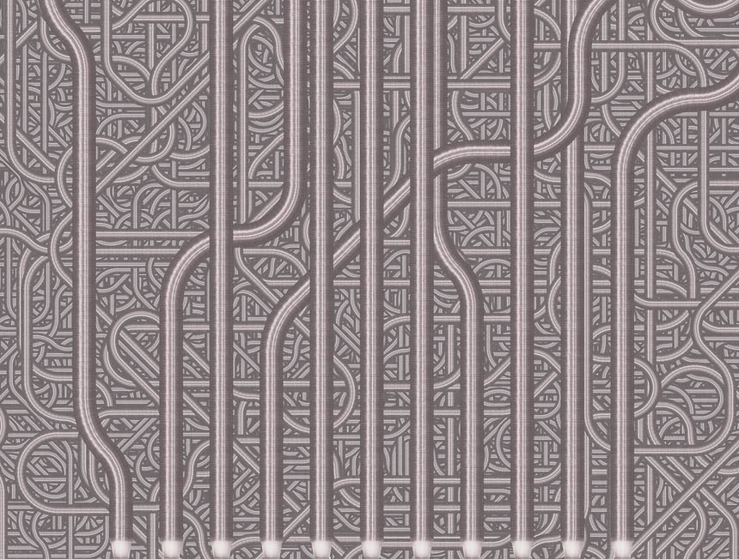
Have you worked out what this is?

Slide 23
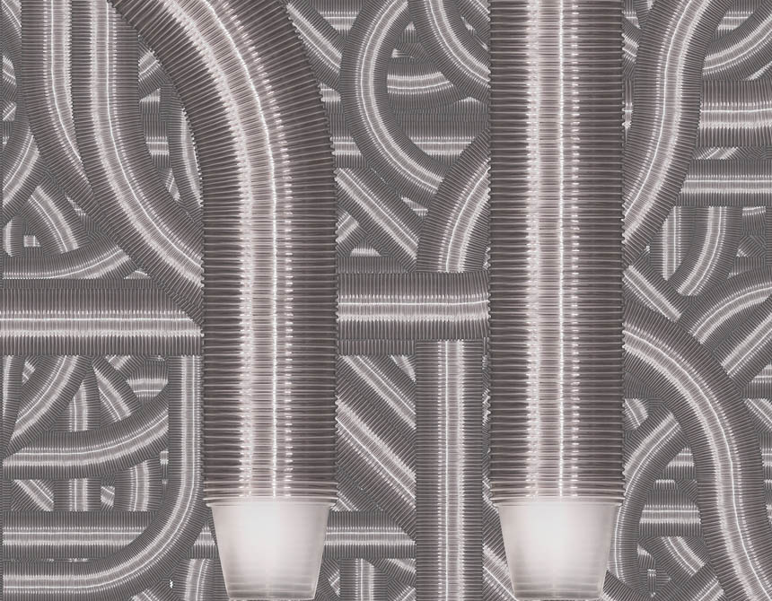
This depicts 1 000 000 cups.
The amount of cups used on airplane flights in America every 6 hours!

Slide 24
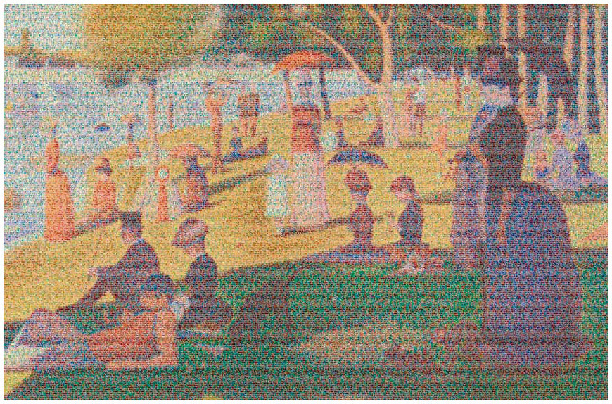

Slide 25
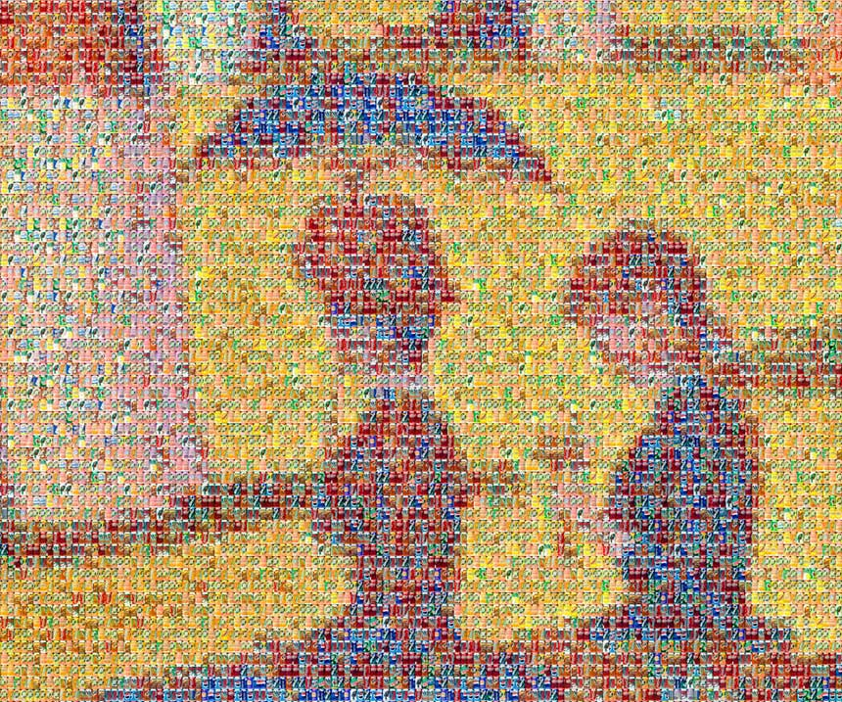
Have you worked this one out yet?

Slide 26
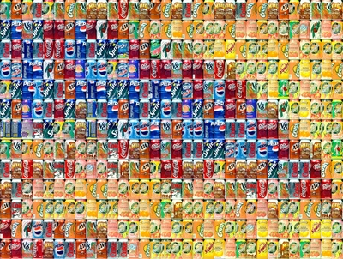
Depicts 100,000 aluminum cans, the number used in the US every thirty seconds!

