Slide 1

Environmental protection
Created by Vazheliuk Liza

Slide 2
Environment
The world environment means simply what is around us. Some people live in a town environment. But the air we breathe, the soil on which we stand and walk, the water we drink are all part of the environment.

Slide 3
Our planet is in danger!
Every day we hear about environmental problems:
Acid rain
Pollution
Climate change
The destruction of rainforests and other wild habitats

Slide 4
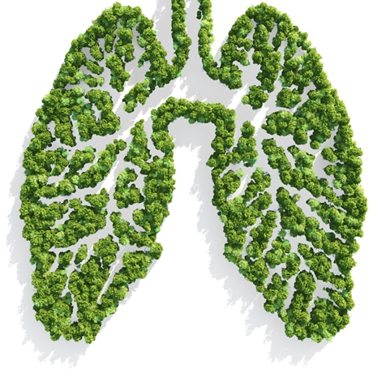
Air pollution
Millions of cars and smoky factories pollute and spoil the air we breathe in. Pollution is hanging over big cities like an ugly brown cloud. It is hurting our lungs as well as the life of animals, birds and plants.

Slide 5
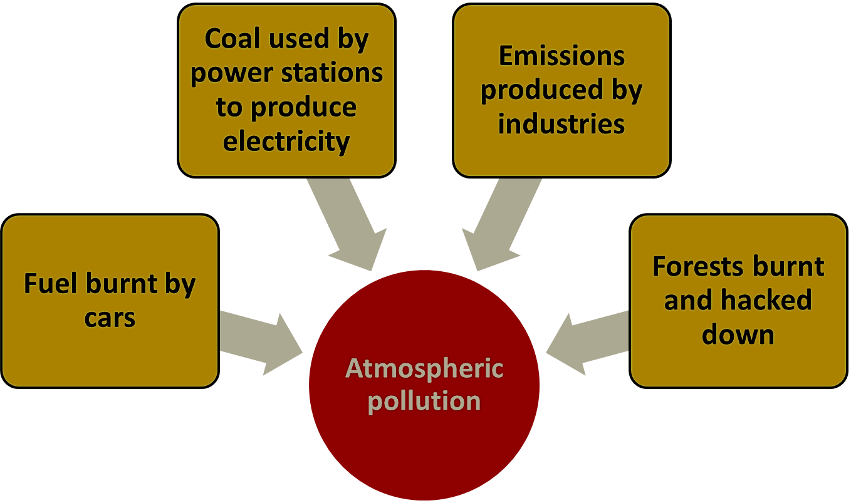

Slide 6
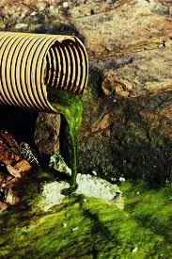
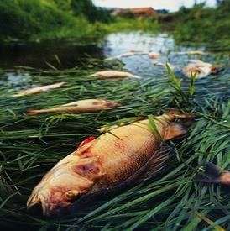
Water pollution
The threat of water pollution is no less dangerous. The amount of waste into the water must be reduced. In the polluted water fish dies first, people may die next.

Slide 7
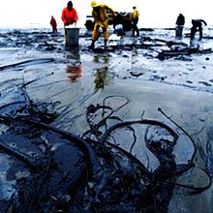
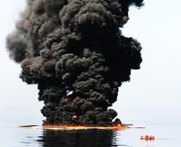
The seas are in danger. They are filled with poison: industrial and nuclear waste, chemical fertilizers and pesticides.

Slide 8
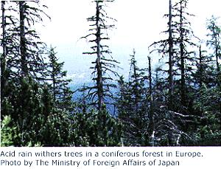
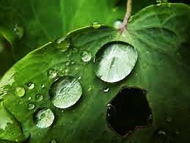
Acid rains
Acid rains are dangerous for animals, plants, water and people.

Slide 9
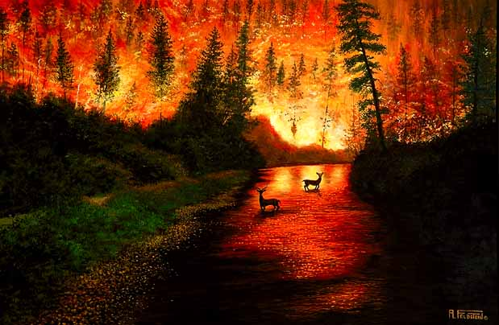
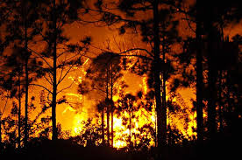
Fires
Forest fires are one of the greatest natural destroyers
of our forests.
Each year fires burn millions of hectares of forest all over the world.

Slide 10
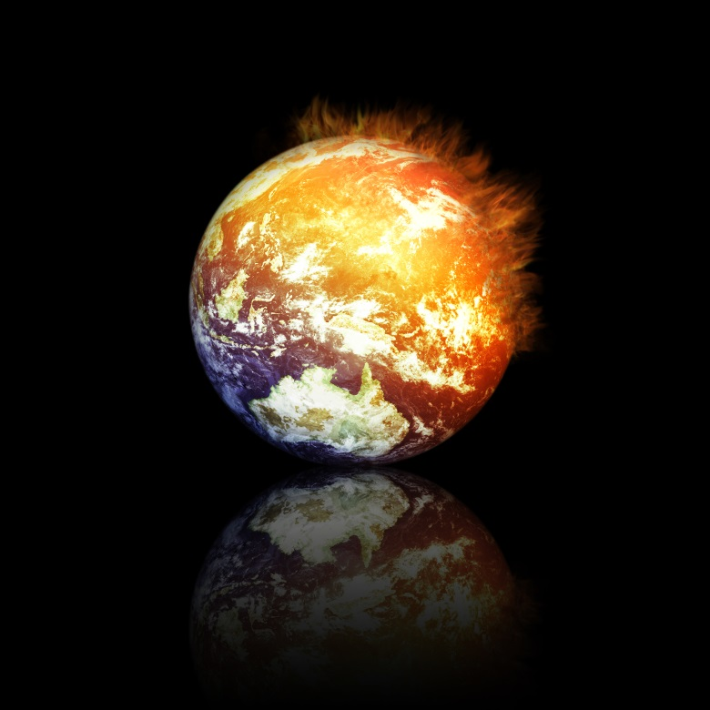
Greenhouse effect
The Earth has been getting hotter because we are producing too many greenhouse gases.
Because the Earth is getting hotter, ice is melting.
Scientists say that in 2050
some parts of Great Britain
will be under the sea.

Slide 11
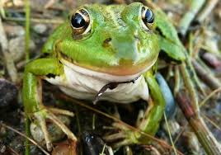
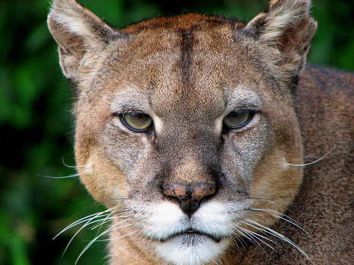
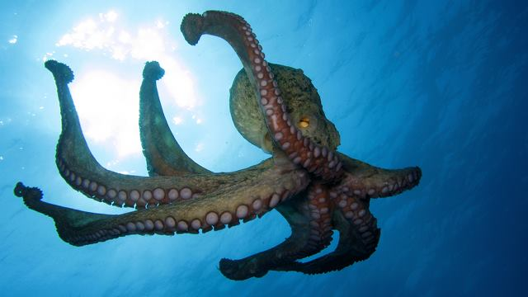
Extinct animals
In the world there are a lot of animals and birds that are in danger.
They are in The International Red Book.

Slide 12
What we can do to protect nature?
We can recycle newspapers, bottles and metal cans.
We mustn’t cut down trees.
Feed birds in winter.
Protect wildlife, plants and trees.
Keep all water clean.
Don’t use aerosol sprays.
Don’t use chemicals in the garden.
Turn off the light when you leave the room.
Don’t cut wild flowers.
Try to avoid buying plastic. It’s hard to recycle.

Slide 13


Slide 14


REMEMBER!!!
Don’t throw the paper
Put litter away
Put it in a rubbish bin
Never break plants and baby trees
Don’t paint on trees
Don’t leave fire
Don’t waste energy
Organize ecological activity
Safe energy
Safe water
Use paper, not plastic

Slide 15
Cписок використаної літератури
1.en.wikipedia.org
2.www.projectbritain.com
3.www.alleng.ru
4.Видео фрагмент з Youtube

Slide 16


