Slide 1
Louis Pasteur
1822-1894

Slide 2
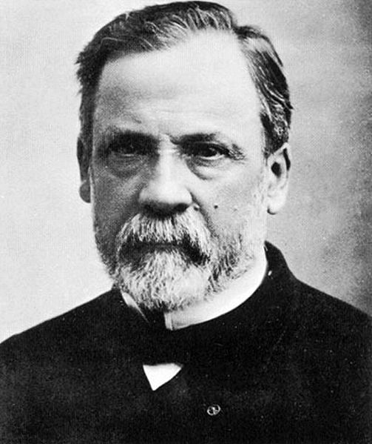

Slide 3
Early Years
Louis Pasteur was born in the French Jura in 1822.
He studied at the college in Arbois , where he was the youngest student.
Here he was interested in reading books and was able to become a teacher's aide .
Then he got a job as a junior lecturer in Besancon. Pasteur proved himself a talented artist, his name was listed in the directories of the XIX century portraitists .
He left the portraits of his sisters and mother, but , due to the enthusiasm chemistry, paint thrown.

Slide 4
His work has been highly appreciated - Louis received a Bachelor of Arts ( 1840 ) and a Bachelor of Science ( 1842 ) at the Ecole Normale shkole.
Paster became a professor of chemistry at the University of Strasbourg , where he met in 1849 and began courting Marie Laurent , daughter of the rector of the university.
May 29, 1849 they were married , married with five children were born , but only two of them survived to adulthood (the other three died of typhoid fever ) .
Transferred personal tragedies inspired Pasteur to find reasons and forced to try to find cures for infectious diseases such as typhoid .

Slide 5
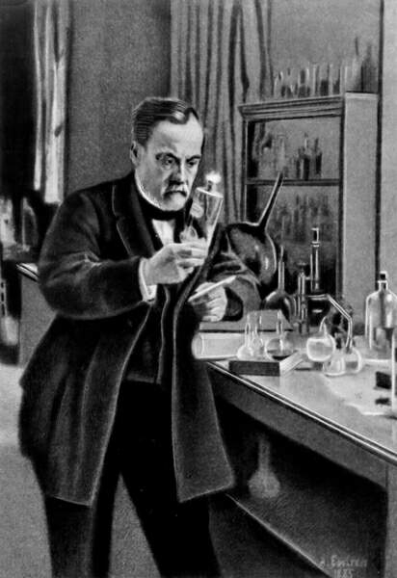

Slide 6
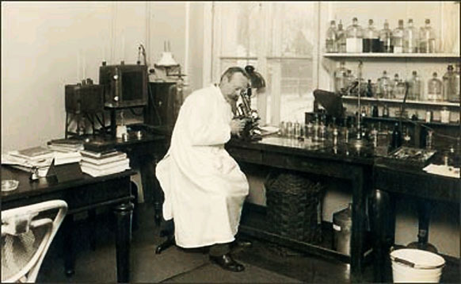
Work in the field of chemistry
First scientific paper published Pasteur in 1848.
He studied the properties of tartaric acid.
After this work Pasteur was appointed associate professor of physics at Dijon Lyceum, but three months later, in May 1849, at the invitation went associate professor of chemistry at the University of Strasbourg.

Slide 7
The study of fermentation
Study of fermentation, Pasteur engaged since 1857.
Louis Pasteur proved that fermentation is a process closely related to the activity of the yeast that feed and reproduce by fermenting liquid.
At the same time, Louis Pasteur made ​​another important discovery.
He found that there are organisms that can live without oxygen.

Slide 8
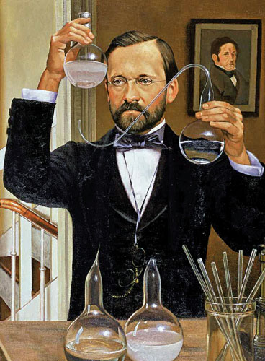

Slide 9
The study of spontaneous microbes
In the years 1860-1862, Pasteur studied the possibility of spontaneous generation of microorganisms.
He spent a fantastic experience, proving the impossibility of spontaneous generation of microbes taking thermally sterilized medium and placing it in an open vessel with a long curved neck.
In 1862 the French Academy of Sciences awarded Pasteur Prize for resolution of the issue of spontaneous generation of life.

Slide 10
interesting facts
Pasteur spent his life biology and treated people without getting any medical or biological education .
In addition, as a child he was fond of drawing .
At the age of 45 years at the Pasteur was a brain hemorrhage . He became disabled : the left hand idle , left foot dragging on the ground. He almost died , but eventually recovered. Moreover , he made then the most significant discoveries : to create a vaccine against anthrax and rabies vaccinations . When the scientist died , it was found that the brain has been a huge part of it is destroyed . Pasteur died from uremia .
Later it was named after the genus of bacteria - Pasteurella (Pasteurella), causing septic diseases , the discovery of which he apparently did not have a relationship.
Pasteur was awarded the Order of almost all countries of the world . Altogether he had about 200 awards .

