Slide 1
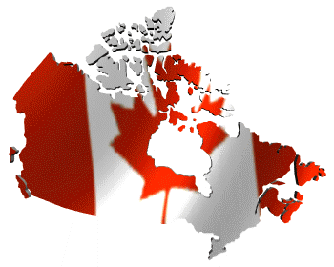
Canada
Geography of Canada

Slide 2

Geographic Landmarks
Canada has a very large and diverse range of geographic features. Canada is divided into 10 provinces and 2 territories. Canada stretches from the Pacific Ocean on the west, to the Atlantic Ocean on the east. Northern Canada reaches into the Arctic Circle, while southern Canada stretches below the northern points of the United States.

Slide 3
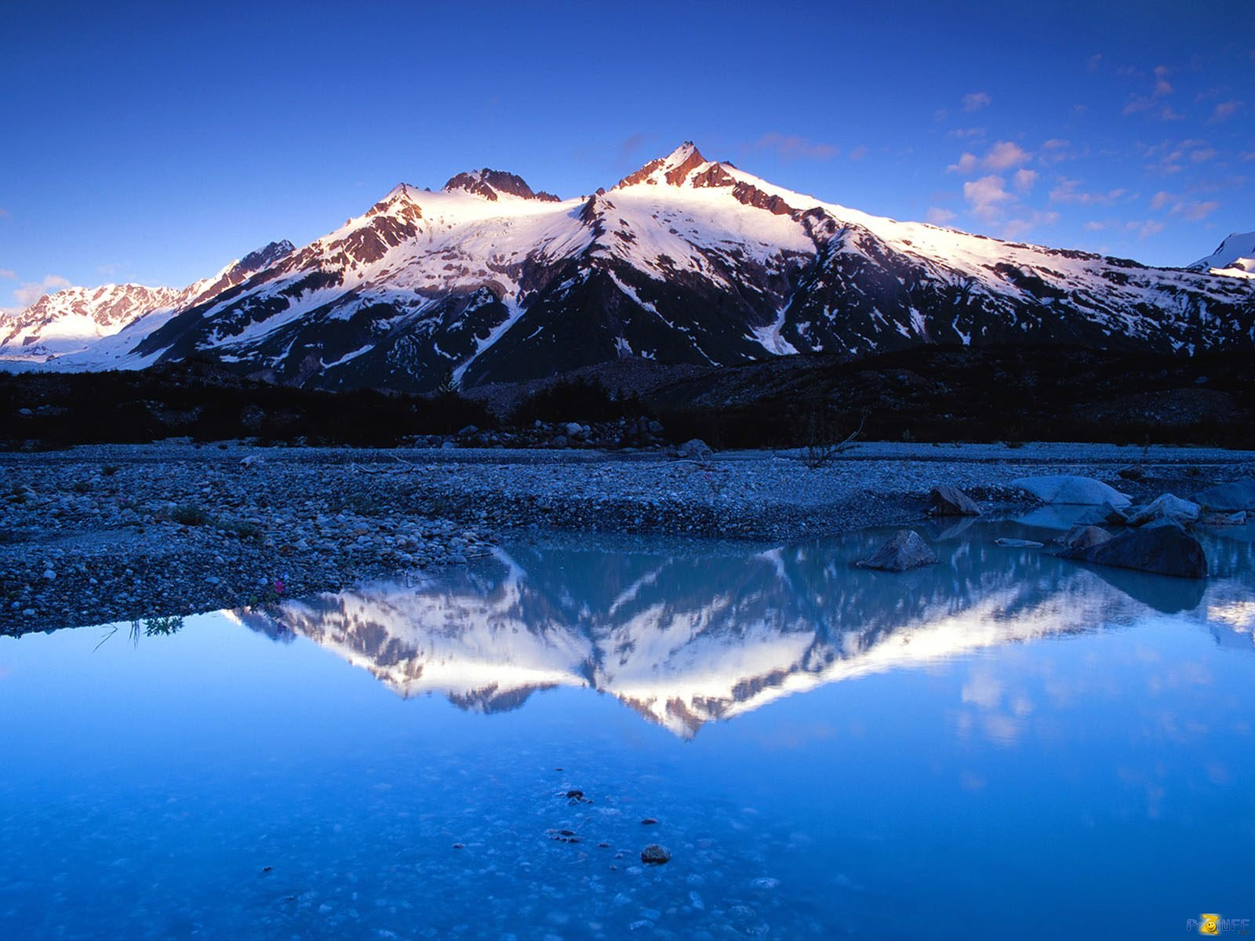

Slide 4
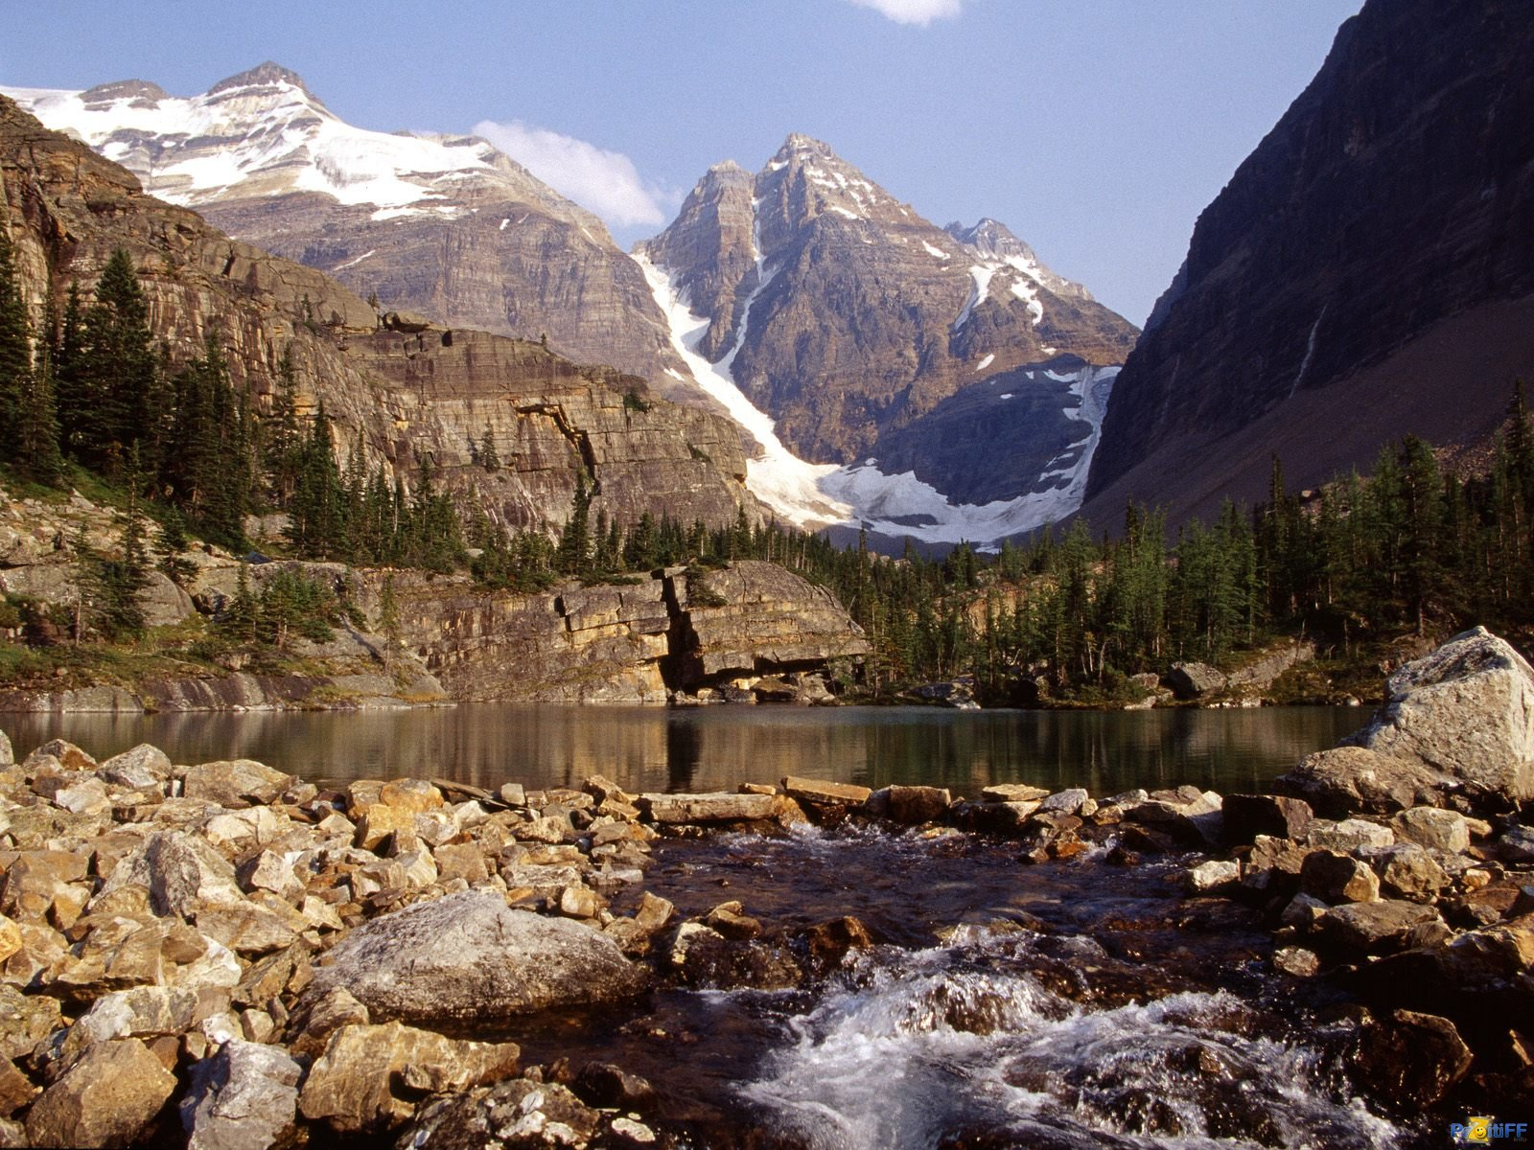
Canada has a very small population, 28 million people, for its geographic size. Much of Canada is still wilderness, cover by forests. The Rocky Mountains cover a major part of western Canada -- British Columbia, the Yukon Territory, and the western part of Alberta.
West-central Canada is mostly prairie, consisting of large grain farms.

Slide 5
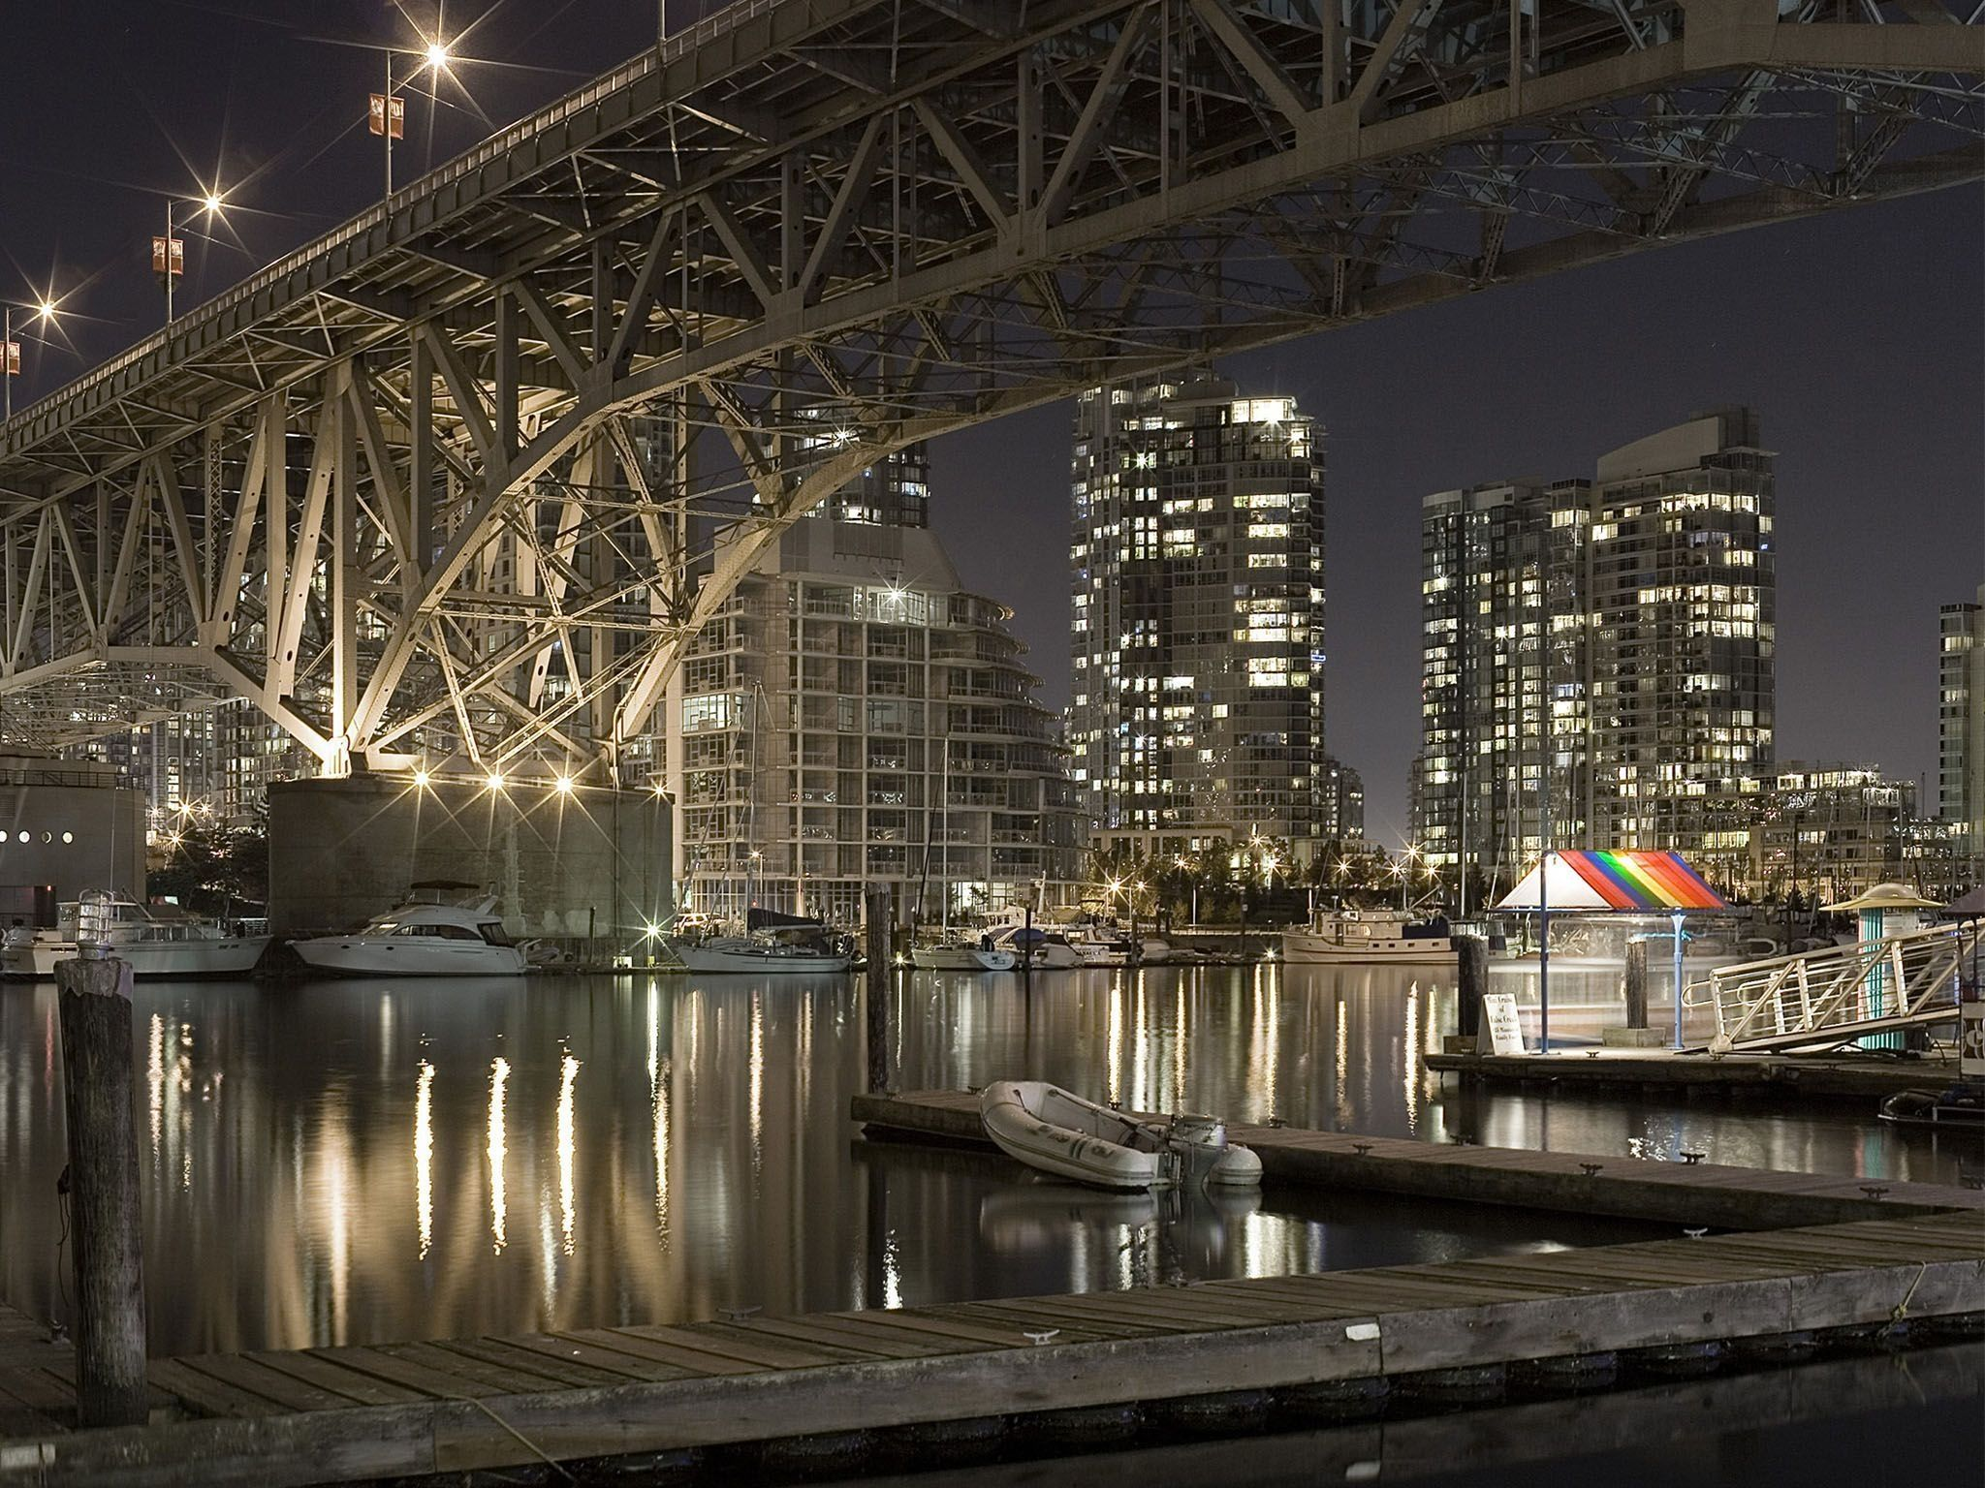
The east-central part of Canada are the provinces of Ontario and Quebec. These are major population and industrial areas. The Maritime provinces on the east coast rely very heavily on the Atlantic Ocean for their way of life.

Slide 6
Points of Interest
The majority of Canada is still wilderness. This makes Canada a popular spot for hunting and fishing.

Slide 7
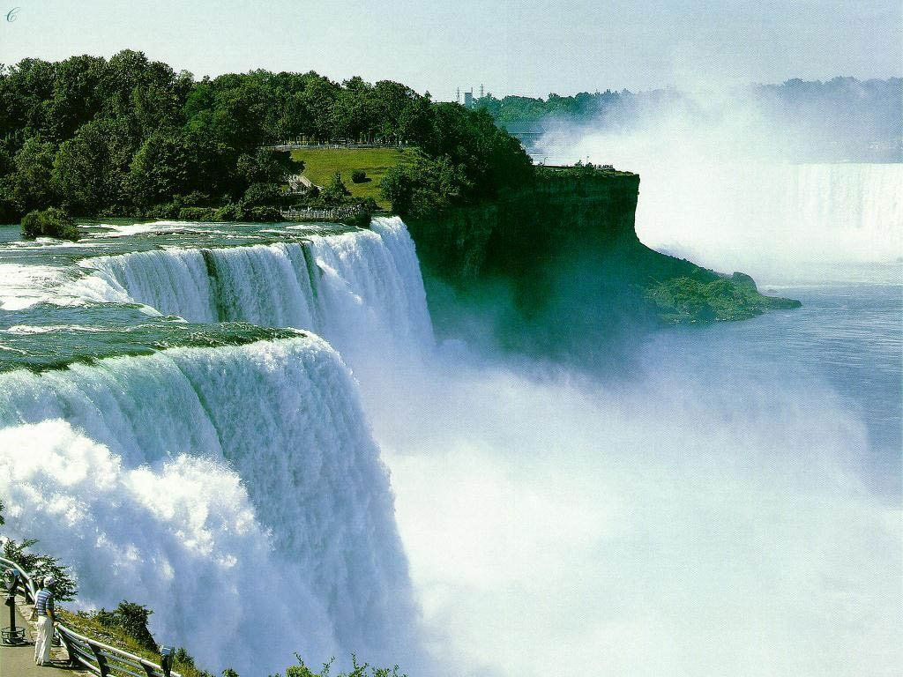
Niagara Falls is one of Canada's best known tourist attractions. It is the largest falls in the world, measured in volume of water.

Slide 8
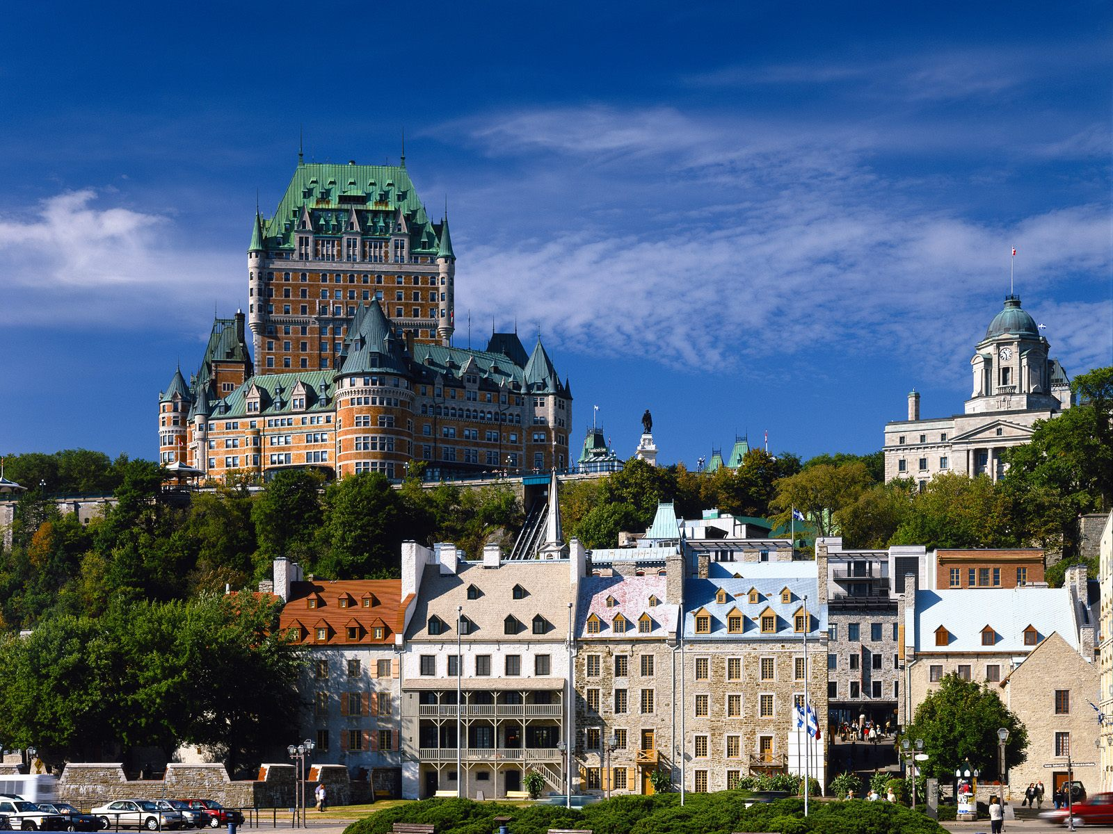

Slide 9
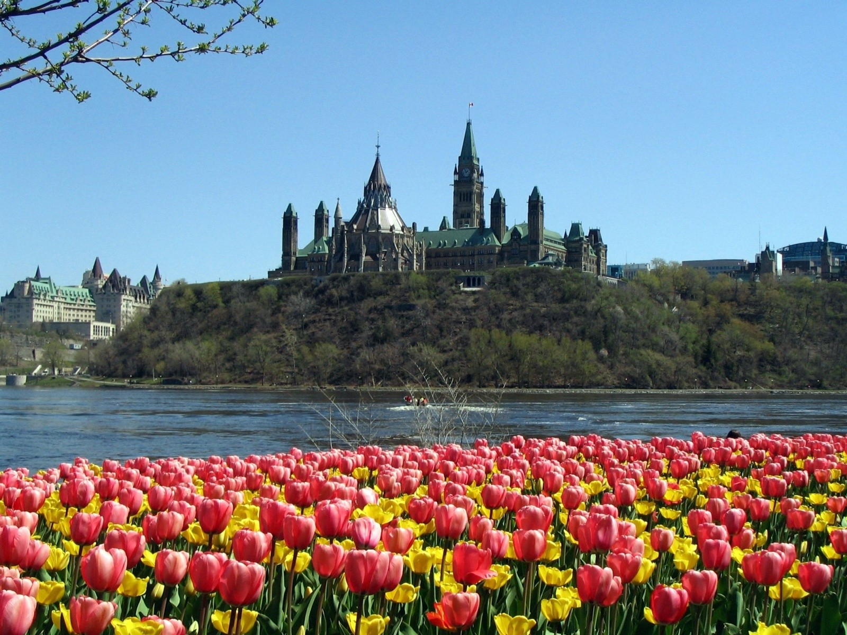

Slide 10
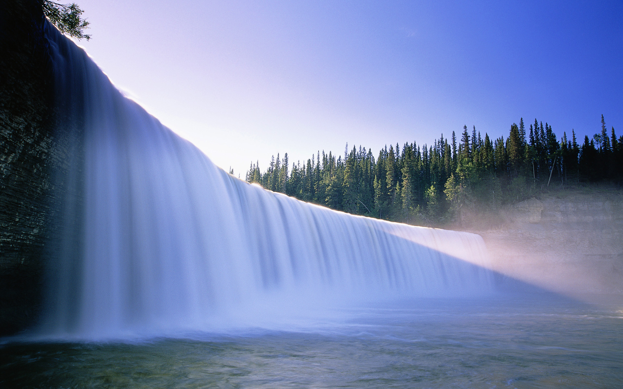

Slide 11
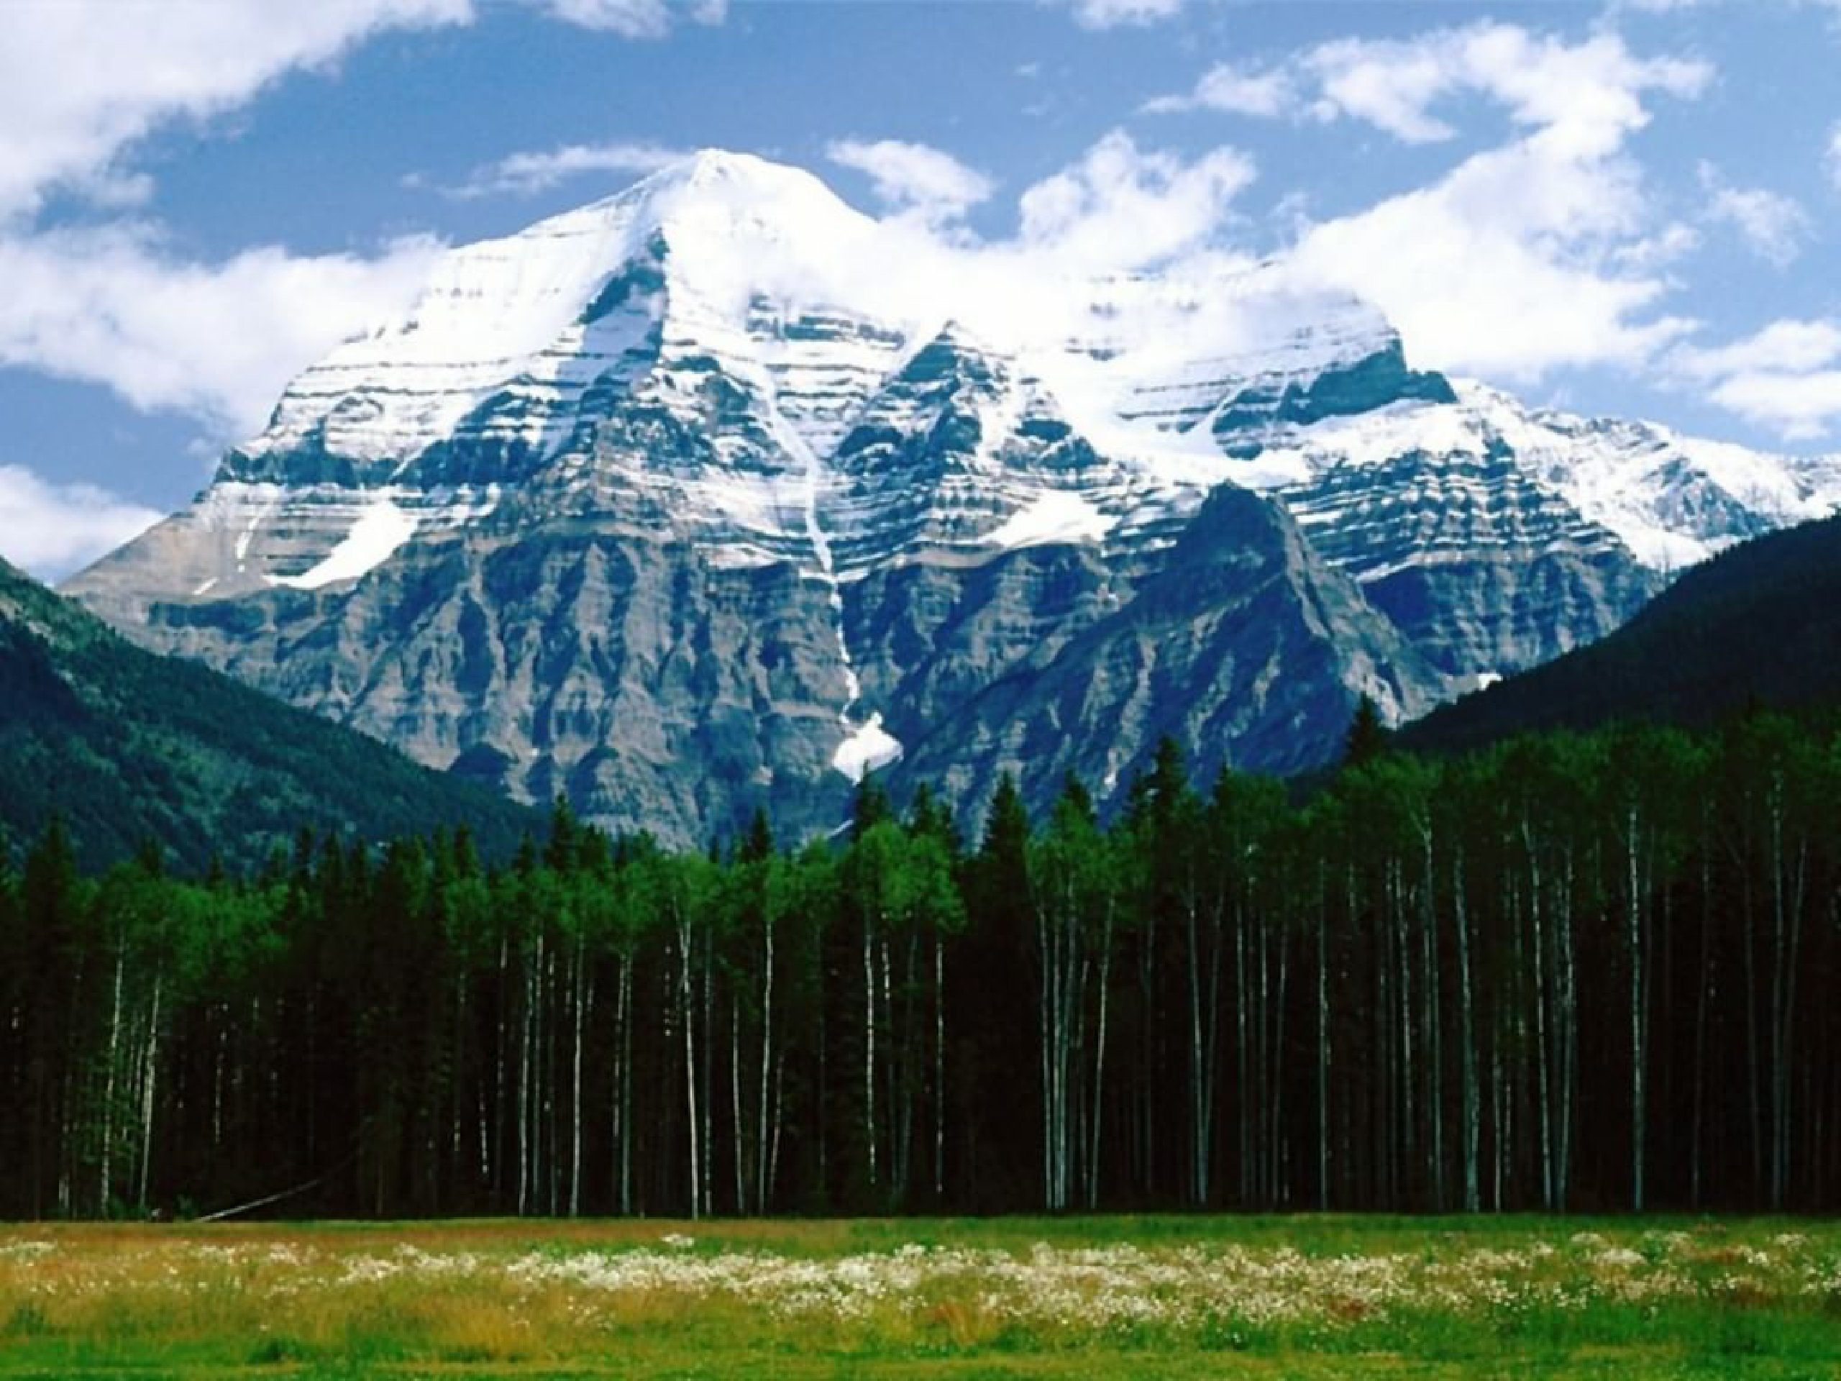

Slide 12
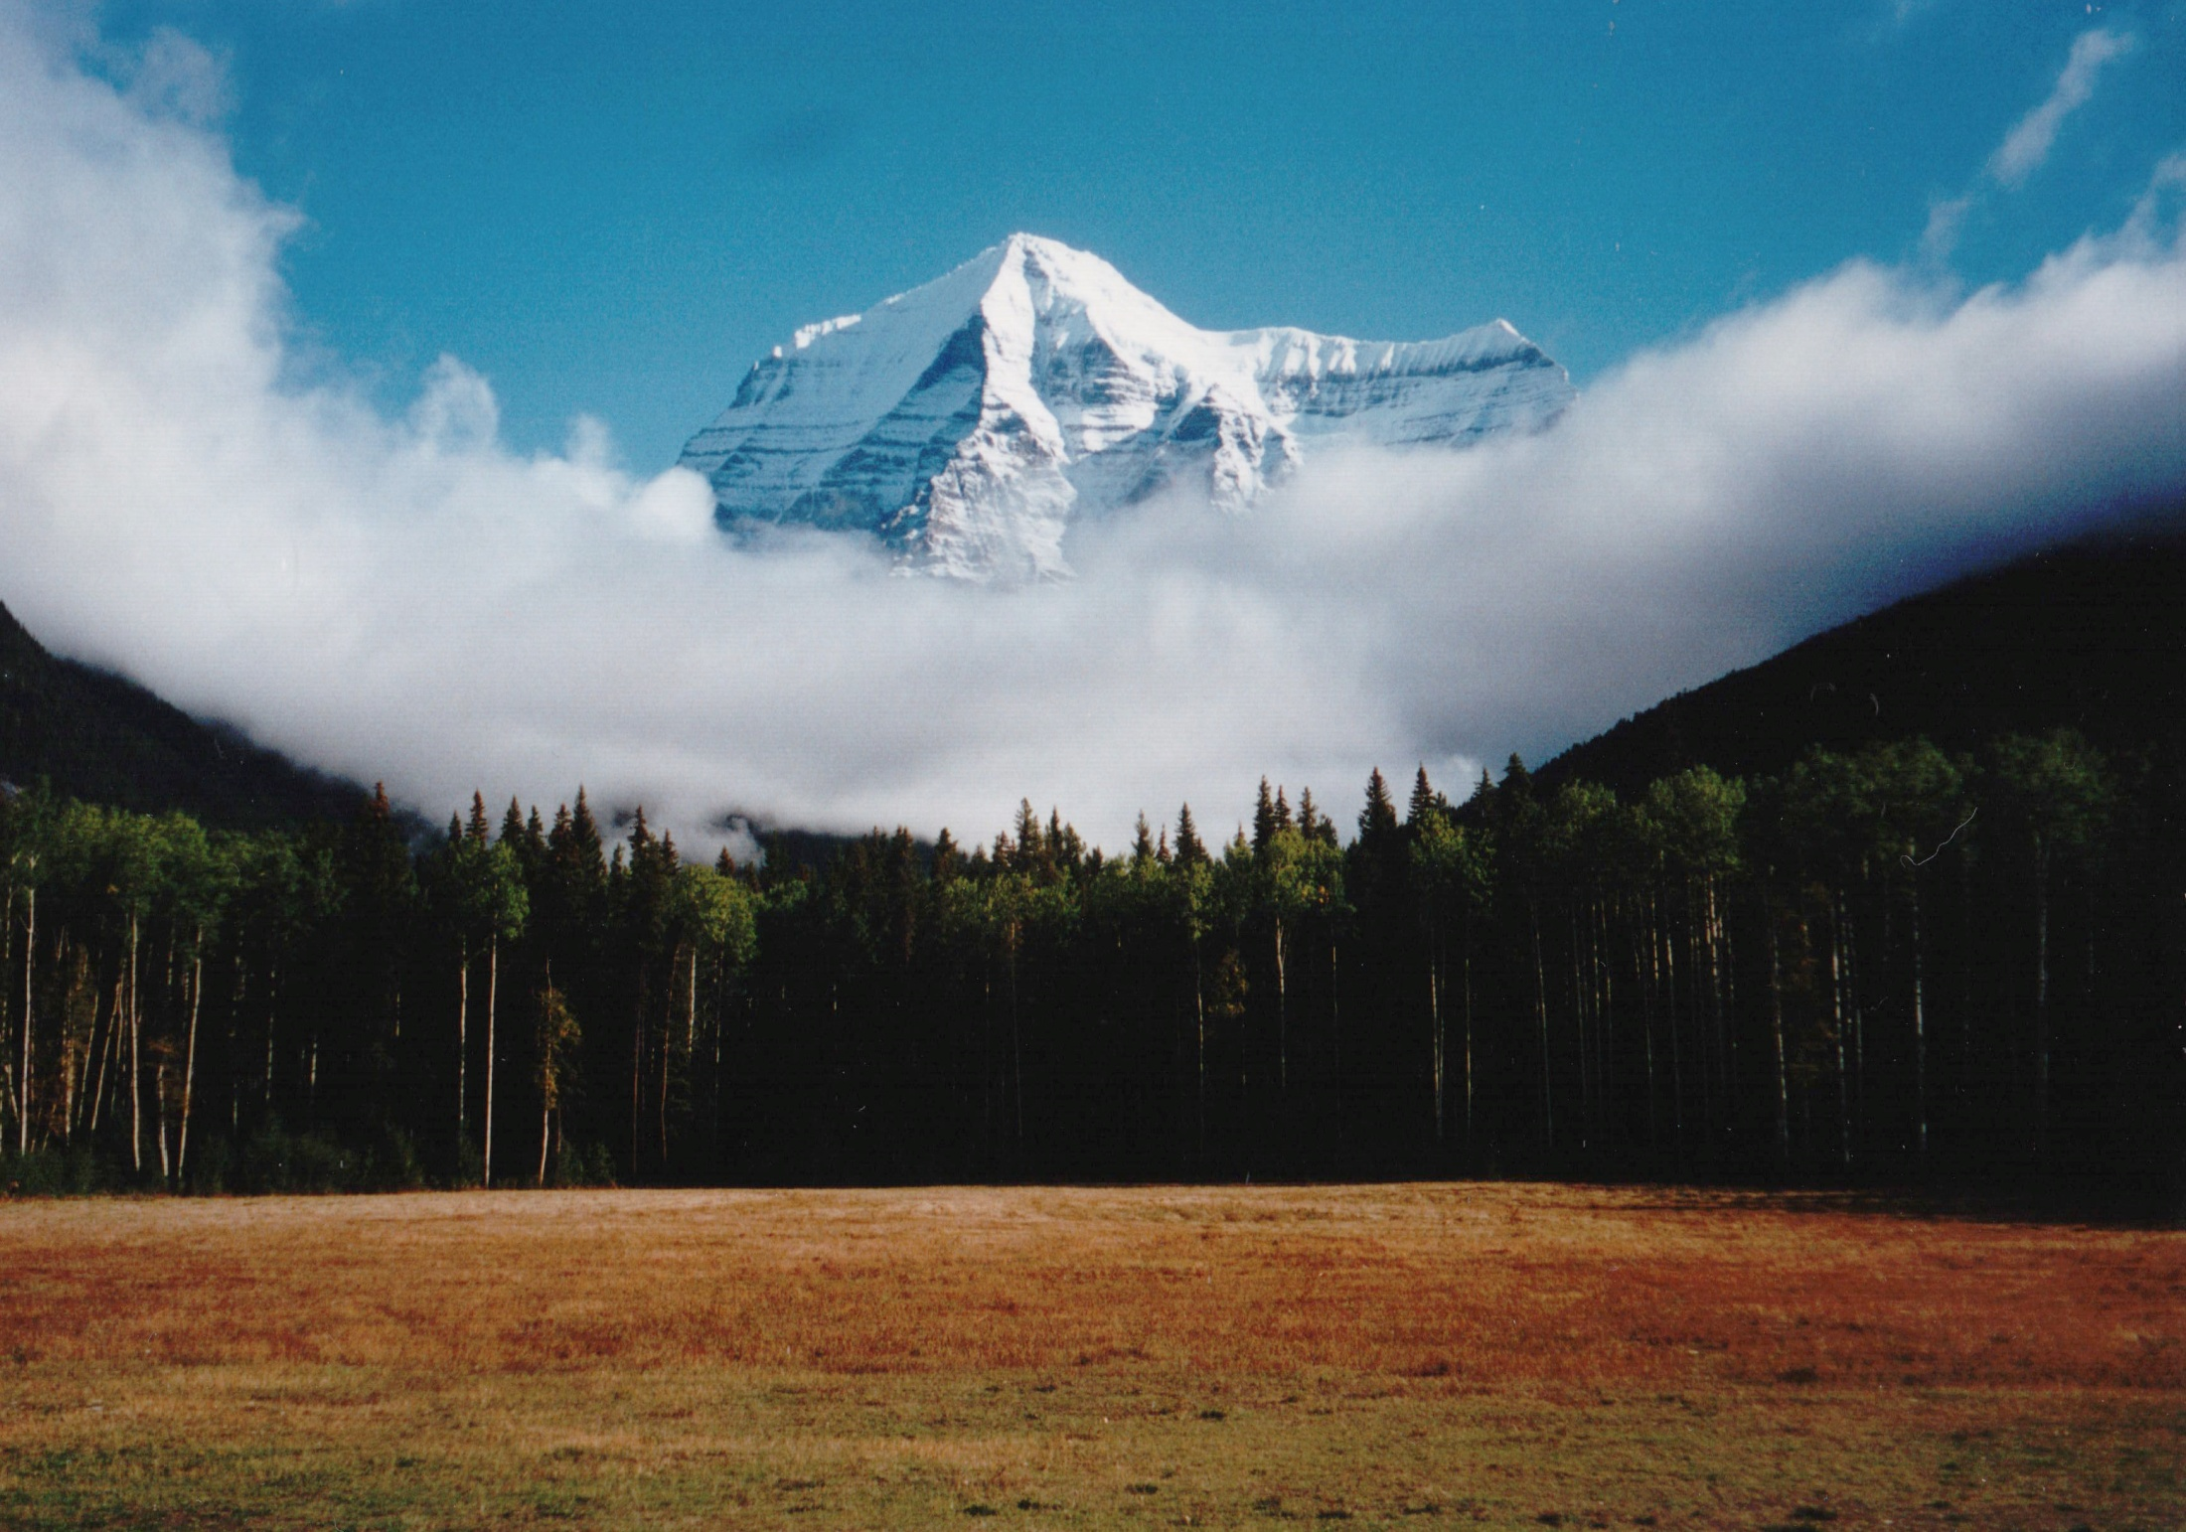

Slide 13
