Slide 1
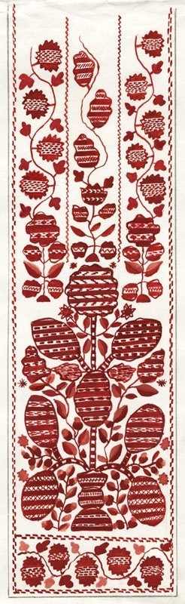
Ukrainian traditional cuisine!

Slide 2
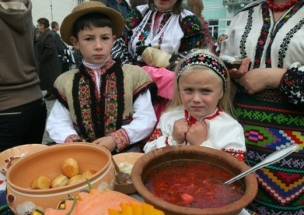
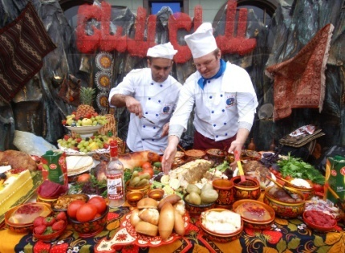

History
National Ukrainian cuisine have it ancient history and it is famous miscellaneous, have hundreds receipts; Borscht and Pampushkas, Piles and Dumplings, Fruit dumplings and Sausages, roast meat and different drinks with fruits and honey, famous far from outside Ukraine. Some of dishes have centuries-old history. Using food for different animal and rational ways of making them do these meals healthy, delicious and juicy. Ukrainian cuisine arise for many centuries, that’s why it shows us customs, taste, social condition, natural and climatic features, historical progress of Ukrainian people.
Many features of traditional Ukrainian cuisine was conditioned way of people’s life, many people in Ukraine worked very hard. Hard working needed sifted food. That’s why for typical dishes of Ukrainian cuisine and rich in proteins, fats and carbohydrates. Lots of typical Ukrainian dishes have difficult complete set of ingredients. Therefore Ukrainian cuisine had unrepeated taste, aroma and juicy.
In XVII century in Ukraine very wide apply potato, use for cooking first, second serving and side dish.
All of Ukraine ethnographical regions had their own features their cuisine.
The most famous product in Ukraine is suet. They eat suet by force, smoked and roasted. Suet use to fry or dress watery dishes: Borscht, Cabbage worm, Soup and other.

Slide 3
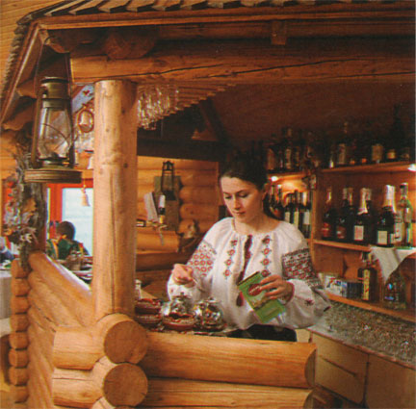
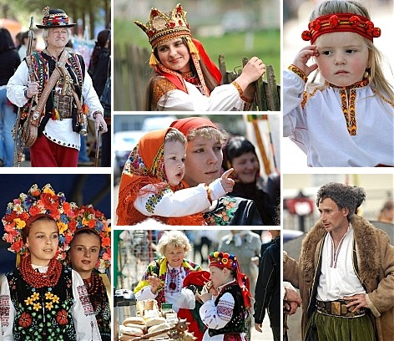
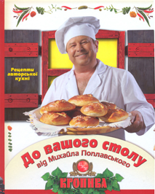
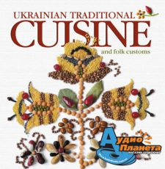
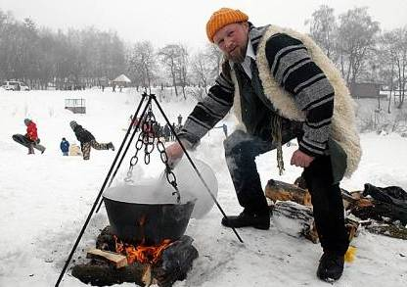

Slide 4
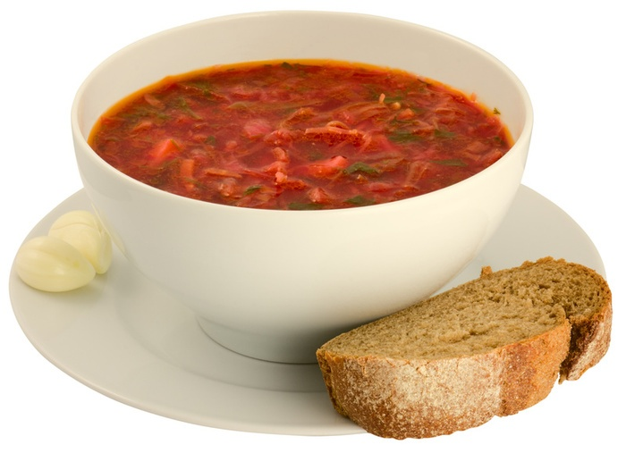
Main course
Among them first position have Borscht. There are lots of receipts of
Borscht; volyn, chernihiv, lviv, rural, dnipro and other. Moreover, each hostess have her own receipt of Borscht. No more popular in Ukraine: Cabbage worm, green Borscht, Solyanka, Rozsolnik.

Slide 5
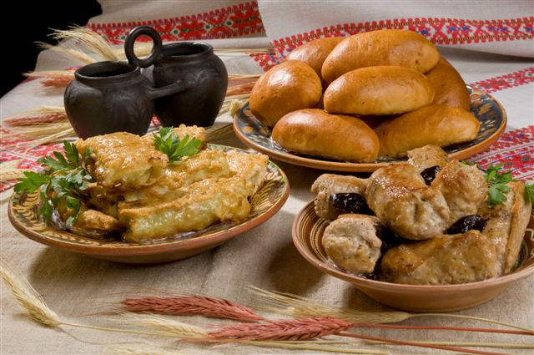
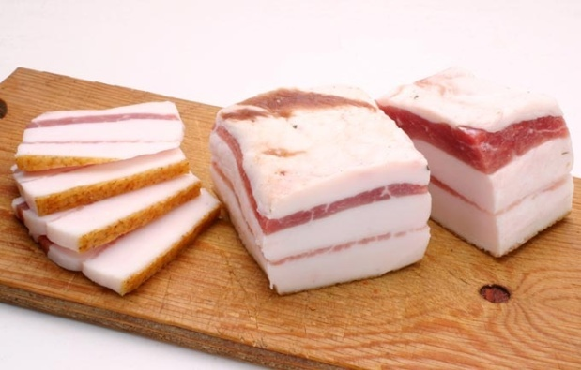
Meat and fish
With meat products used primary pork, then – beef and poultry. Ukrainians eat meat in many ways, the most often fried or simmer. In Ukraine popular stuffed cabbage, ho home-Ukrainian, round rissoles, braised, cabbage and pork lard, Bigos, krychenyky, zavyvantsi, stuffed birds. In Ukraine the tastiest dishes with meat are that cooking in mugs. Ukrainians always use meat to cook main and second courses.
From ancient times as important food in Ukraine is fish. The best noun dishes is: carp baked in cream, pike stewed with horseradish, carp, stewed with onions in sour cream, pikeperch baked with mushrooms and crayfish, carp stuffed with mushrooms buckwheat porridge and another. Active use sea fish and another sea products.

Slide 6

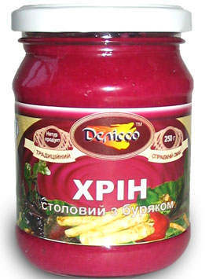
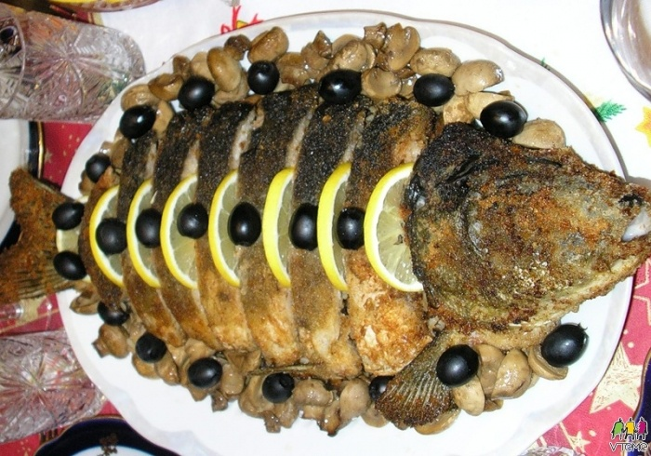
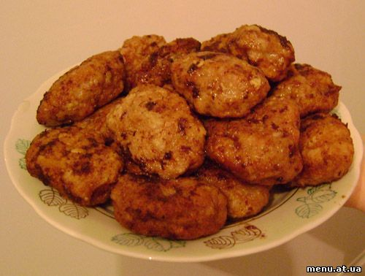
Horseradish- хрін
Pikeperch - короп
rissoles - котлети

Slide 7
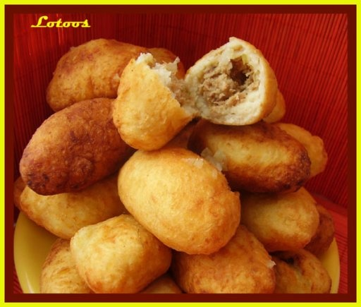
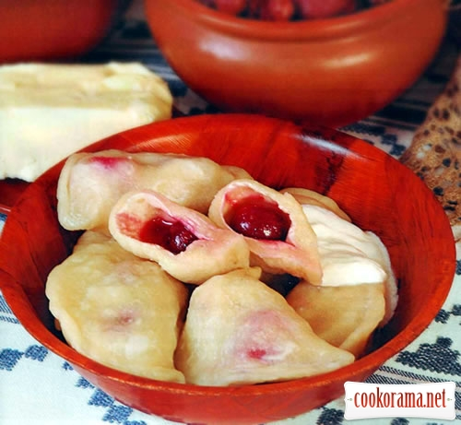
Flour dishes
Always Ukrainians use different flour dishes: dumplings, pancakes, dragonflies, potato pancakes, palyshky.
In the Ukrainian baking many different dishes: breads, pastries, cakes and pies – sweet and salty; short pasty, puff, yeast, fancy… With a wide range of filling: with porridge, and poppy seeds, and meat and cabbage, and cheese, and other. Ukrainian dumplings very famous far from outside Ukraine.
Popular different porridges: millet, buckwheat, pumpkin, porridge made from flour: buckwheat and corn, they eat them with milk, sour cream or sunflower oil fried onion, with Banosh and hominy.
Wide range in Ukraine cuisine have sweet dishes, for cooking what uses fruits, honey, poppy seeds, nuts and other.

Slide 8
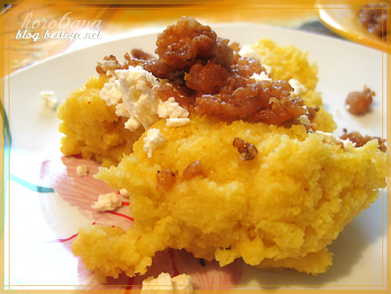
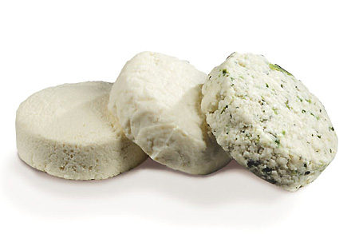
Hominy - мамалига
Banosh - бринза

Slide 9
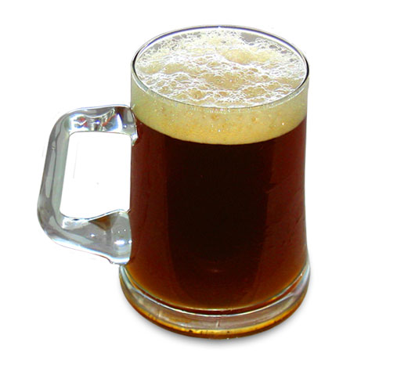
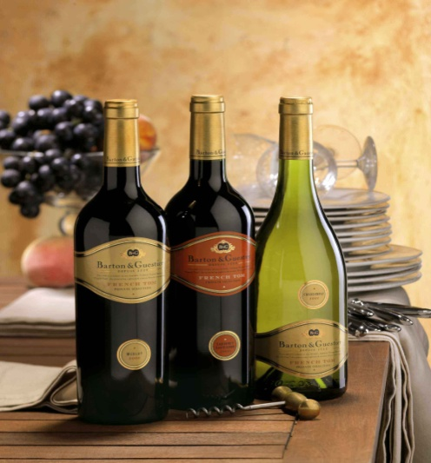
Drinks
The most popular drinks in Ukrainian cuisine is milk products such as fermented baked milk and voltage milk. One of the most famous of drinks in Ukrainian cuisine is uzvar. And from ancient time in Ukraine drink kvass: bread – with crackers, fruit - of wilding – kvass and mealy. And such drinks as tea and coffee have long since become usual throughout Ukraine.
Alcohol drinks
An integral features of festive meal is alcoholic drinks – variety of vodka, brandy, wine, fortified liqueurs. Many recipes for alcoholic drinks famous from ancient times. In our times Odesa’s wine and Carpathean brandy famous all over the world.

Slide 10
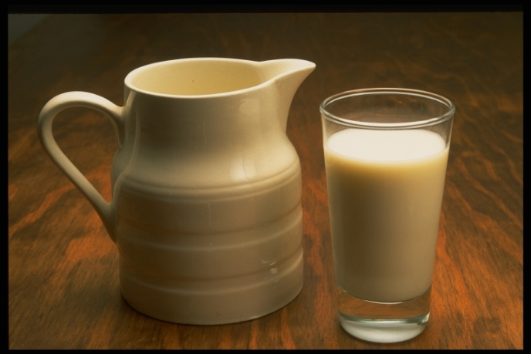
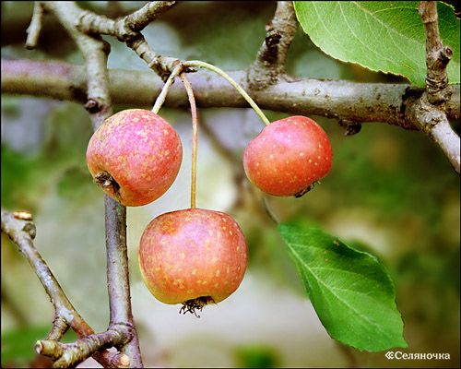
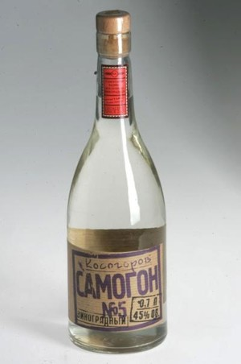
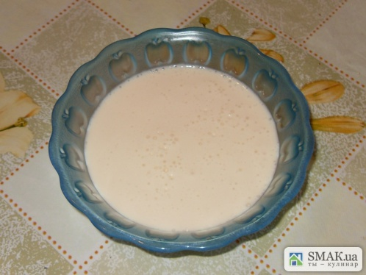
Voltage milk – пряжене молоко
fermented baked milk - ряжанка
Wilding - дички
liqueurs - самогон

Slide 11
Makarenko Galina 8-A

