Slide 1
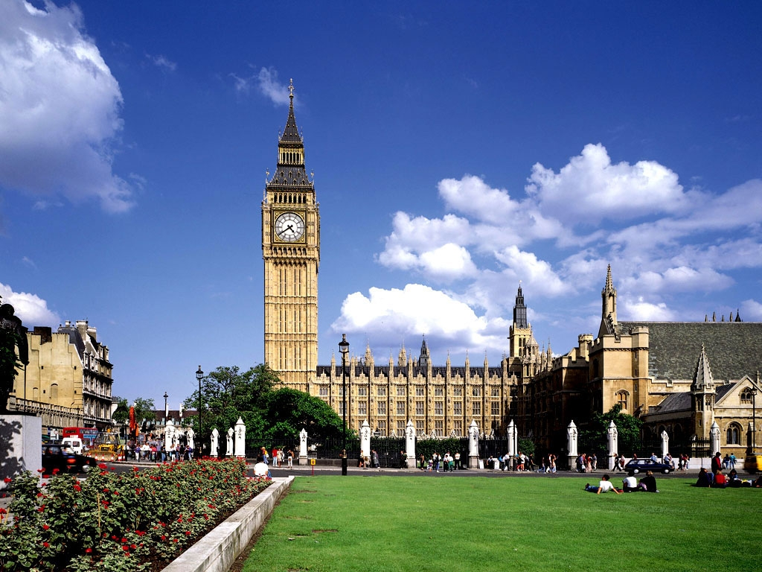
The Great Britain

Slide 2
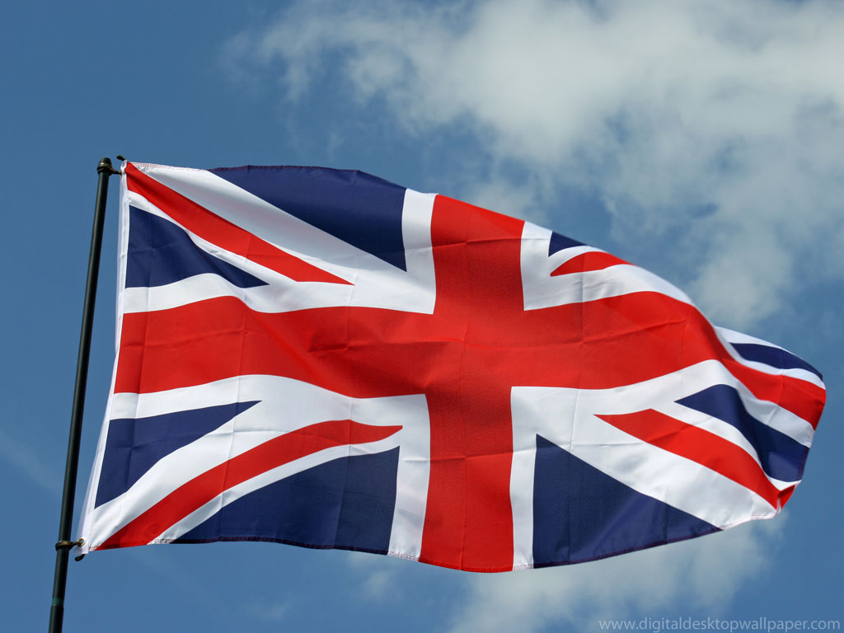
Something about the UK
The United Kingdom consists of four countries: England, Scotland, Wales and Northern Ireland;
London is the capital of Great Britain;
The official language is English;
The UK's form of government is a constitutional monarchy with a parliamentary system;
The current British monarch—since 6 February 1952—is Queen Elizabeth II.

Slide 3
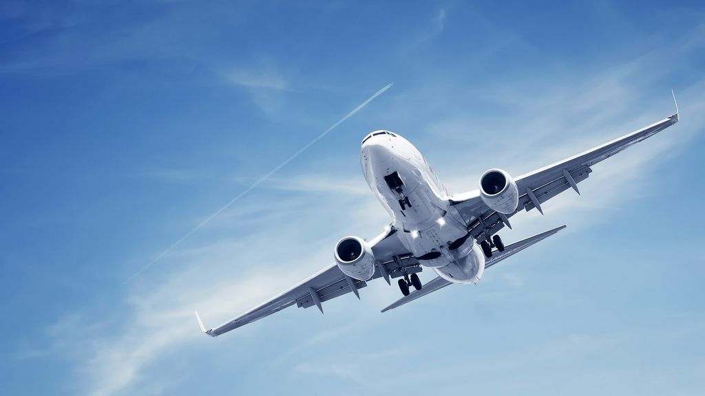
How can you go to the UK?
You can go to the UK by plane, but if you live in Kherson, firstly, you should go to Kiev by train. You can buy ticket in Kiev for direct flights, or opt for the cheaper route with change. In any case, the plane landed in one of the three airports: Heathrow, Gatwick and London City.

Slide 4
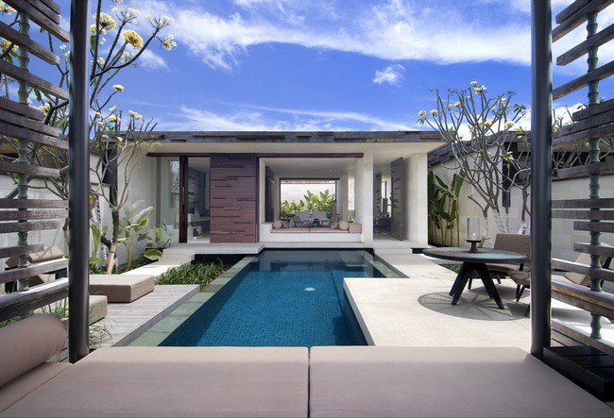
Living in the UK
London is one of the most expensive cities in the world, which means that finding a suitable accommodation with loyal prices and with reasonable terms and conditions very difficult.
There is a general rule: the highest prices in the summer, and the lowest - in the winter.
Most luxury hotels in London are Landmark, Dorchester, Claridges and Mandarin Oriental Hyde Park.
One day stay at the hostel will cost 12-15 pounds, and the hotel will cost from 40 to 130 pounds.

Slide 5
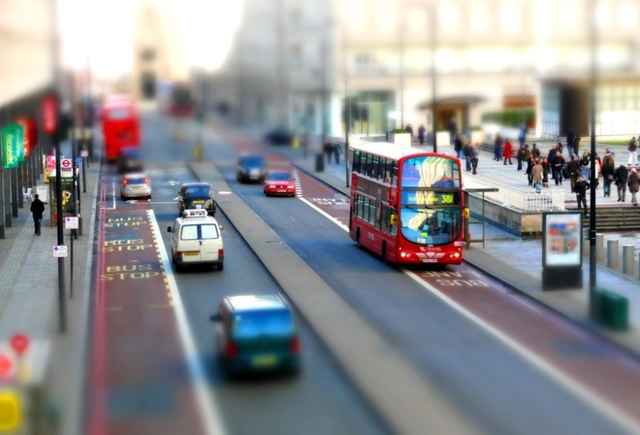
Transportation and meals in the UK
The bus journey to London will cost 1-4 pounds. The price depends on the distance. The fare on the subway is approximately equal to the cost of travel on the buses . One mile taxi ride will cost between 4 to 7 pounds depending on the day of the week. A taxi from Heathrow Airport to central London , for example, will cost from 40 to 70 pounds.
In inexpensive cafes and restaurants, the average cost of a dinner is about 15-20 pounds and rarely exceed 100 pounds , even in relatively expensive establishments.

Slide 6
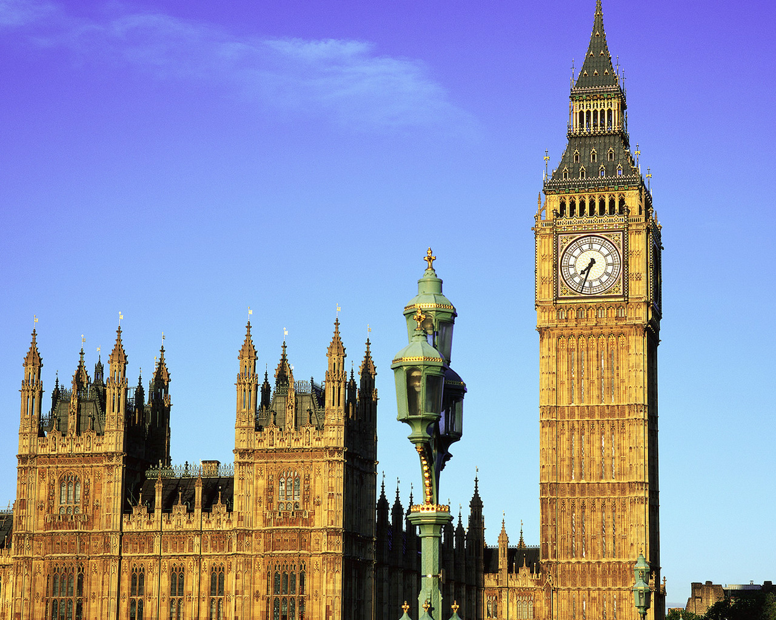
Big Ben
The most recognizable symbol of London and the UK is the famous clock tower of the Palace of Westminster. The clock shows the exact time the citizens and guests of the British capital since May 31, 1859. Chime is heard throughout the city, even during peak hours.

Slide 7
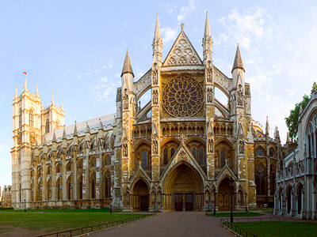
Westminster Abbey
Within the walls of Westminster Abbey coronation of all the kings of Britain since William the Conqueror. It's also where monarchs were buried next to the great poets, senior officials and ministers of the church, where lie William Shakespeare, Charles Dickens, Winston Churchill and many others

Slide 8
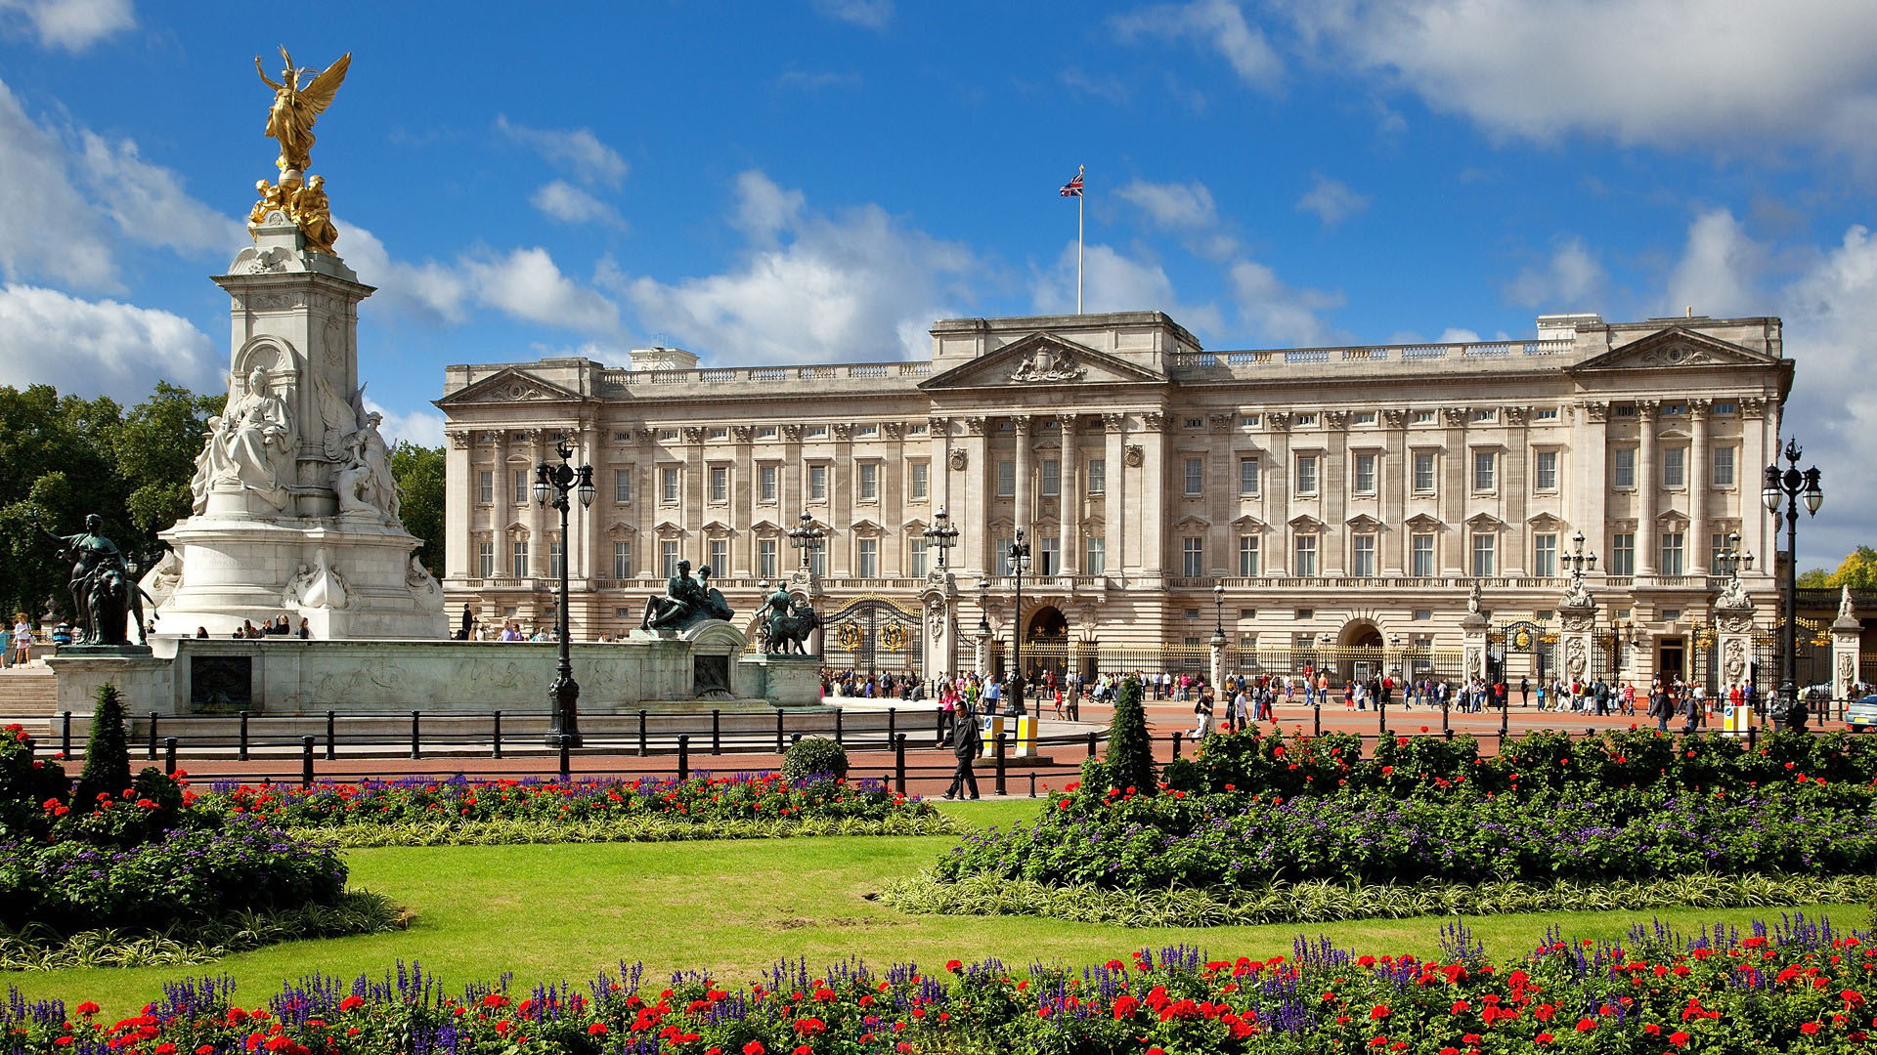
Buckingham Palace
The official residence of the British Queen placed at Buckingham Palace since 1837, when Queen Victoria ascended the throne. Initially, the palace was built for the Duke of Buckingham.

Slide 9
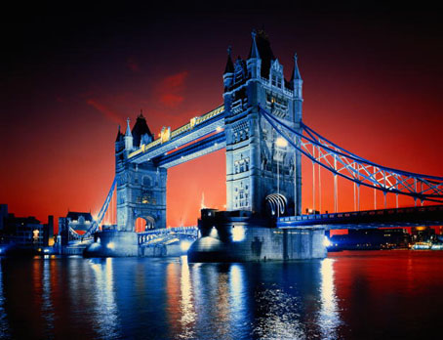
Tower Bridge
The famous Tower Bridge was opened in 1984. Now this structure with two towers is one of the most recognizable symbols of London. The bridge is 244 meters.

Slide 10
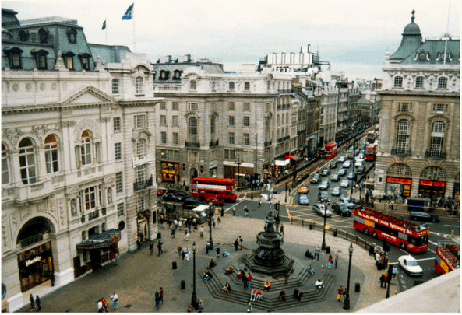
Piccadilly Circus
Center of London is located at Piccadilly Circus. Piccadilly Circus has appeared in London in 1819 and soon gained fame as the most bustling and never sleeping area.

