Slide 1
Traditional meals in Great Britain

Slide 2
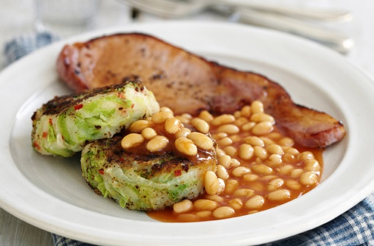
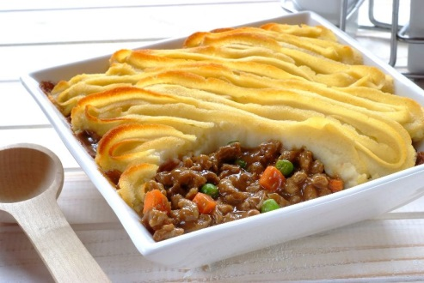
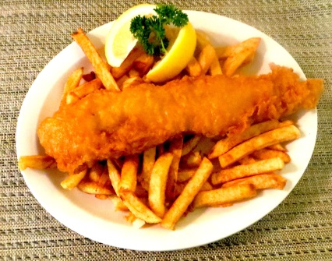
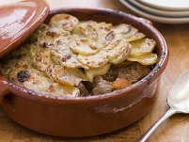
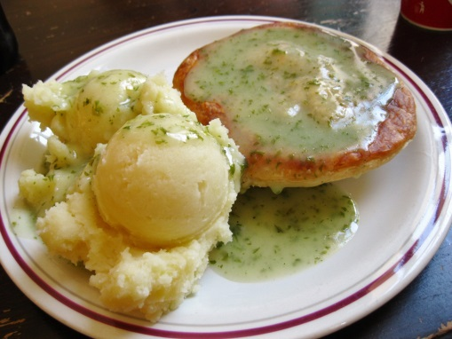
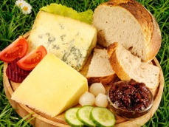
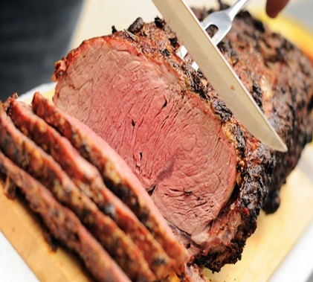
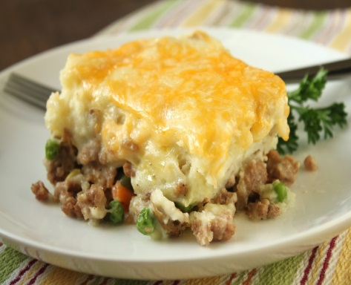
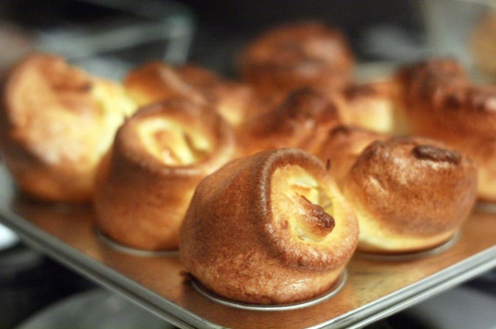
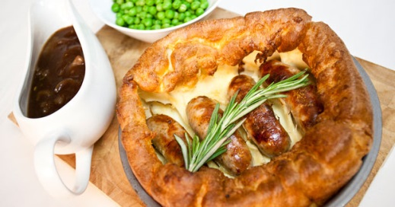
Traditional English dishes have had competition from other dishes over the years. Despite this, if you visit England, you can still be served up the traditional foods that have been eating for years.
Bubble & Squeak
Cottage Pie
Fish and chips
Lancashire Hotpot
Pie and Mash with parsley liquor
Ploughman's Lunch
Roast Meats
Shepherds' Pie
Yorkshire Pudding
Toad-in-the-Hole

Slide 3
Bubble & Squeak
Typically made from cold vegetables that have been left over from a previous meal, often the Sunday roast. The chief ingredients are potato and cabbage, but carrots, peas, brussels sprouts, and other vegetables can be added. The cold chopped vegetables (and cold chopped meat if used) are fried in a pan together with mashed potato until the mixture is well-cooked and brown on the sides.

Slide 4
Cottage Pie
Made with minced beef and vegetables topped with mashed potato.

Slide 5
Fish and chips
Fish (cod, haddock, huss, plaice) deep fried in flour batter with chips (fried potatoes) dressed in malt vinegar.

Slide 6
Lancashire Hotpot
A casserole of meat and vegetables topped with sliced potatoes.

Slide 7
Pie and Mash with parsley liquor
The traditional pie and mash doesn't come without its famous sauce known as liquor which is a curious shade of green and definitely non-alcoholic. The liquor tastes much nicer than it looks (it's bright green!).

Slide 8
Ploughman's Lunch
This dish is served in Pubs. It consists of a piece of cheese, a bit of pickle and pickled onion, and a chunk of bread.

Slide 9
Roast Meats
Beef is eaten with hot white horseradish sauce, pork with sweet apple sauce and lamb with green mint sauce.

Slide 10
Shepherds' Pie
Made with minced lamb and vegetables topped with mashed potato.

Slide 11
Yorkshire Pudding
Yorkshire pudding, made from flour, eggs and milk, is a sort of batter baked in the oven and usually moistened with gravy.
The traditional way to eat a Yorkshire pudding is to have a large, flat one filled with gravy and vegetables as a starter of the meal. Then when the meal is over, any unused puddings should be served with jam or ice-cream as a dessert.

Slide 12
Toad-in-the-Hole
Similar to Yorkshire Pudding but with sausages placed in the batter before cooking.

