Slide 1
STEREOTYPICAL PERCEPTION OF THE BRITISH BY EUROPEANS
by Polina Kyrychenko
11 Grade Bila Tserkva Lyceum of Economics and Law

Slide 2
The topicality of the research
focuses on the trends of mass learning of English
identifying of stereotypes about English society
unwritten rules of behavior in it
how these rules reflect national character of the British

Slide 3
We set the aim
to build an algorithm of behaviour of the Englishmen
distinguish important skills which every person interested in English would find essential

Slide 4
Subject of the research is perception of the British by Europeans.
Theoretical and practical methods were used for this work

Slide 5
The novelty of this work is based on the identifying of the most significant stereotypes of the personalities who are interested in their English knowledge improving, and also researching of the major problems in the perception of the British nation representatives by foreigners.

Slide 6
Relevance of the chosen research topic is determined by the development of globalization and partial loss of national features of nations that are the part of the European Community.

Slide 7
The result of the research is an attempt to classify general principles of English behavior and highlight those sides of British national identity which are usually confused or are considered as typical while they are not more than stereotypes of Europeans.

Slide 8
The research materials could be used to enhance the interest of the Ukrainian society in preserving their national identity and respect for the traditions and mentality of other nations, including native English speakers and deeper understanding of the language processes.

Slide 9
Objectives of our research:
summarize information about the relevance of learning English
analyze the basic stereotypes in the perception of English
identify the causes of false statements about the English nation
point out the reasons of the behavior of the British in situations of their daily life
single out used expressions of Englishmen regarding certain situations and areas of life
classify the major features of the English character
promote awareness of EFL users about necessity and importance of deep understanding of the specific features of the English personality for better sensation of the nuances of lexemes in English and mastery in using it.

Slide 10
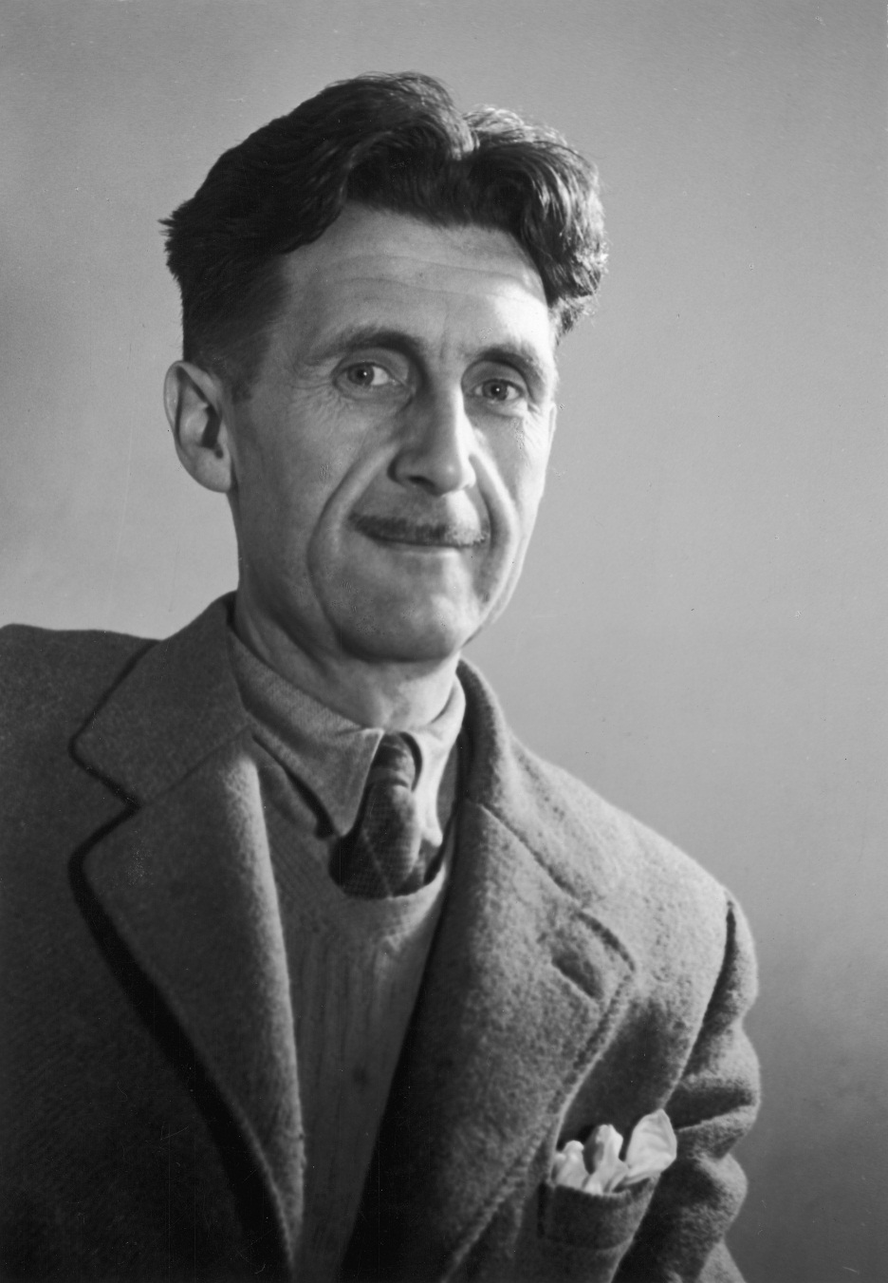
George Orwell
«National identity is something that has ongoing character, extends into the future and into the past, it contains something not to be eradicated like in an alive creature»

Slide 11
Such aspects aim the young people in understanding the importance of language skills and motivate teenagers:
to get more trusted by British brand
read English literature
believe that it is an English musical art is worth the greatest attention

Slide 12
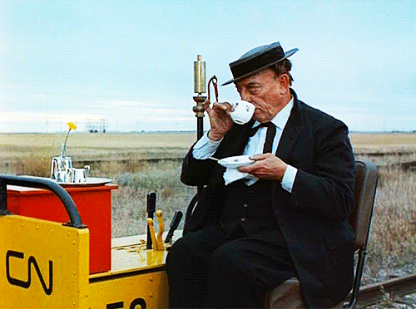
What do I know about English?
What I know about the people to whom this language belongs?

Slide 13
The language of each nation is an integral part of the general mentality of representatives in a state.
Therefore understanding the nation will lead to deeper understanding of the language and will be formed at the subconscious level.

Slide 14
We discovered a set of complex forms of unusual and illogical behavior, strange persuasion and manic eccentric habits.

Slide 15
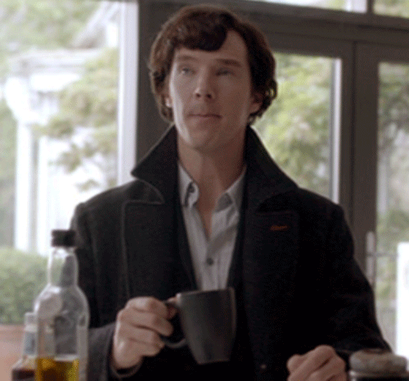
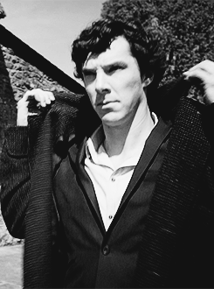
Foreigners often accuse the British in coldness.

Slide 16
It was found that even if a person is fluent in English, they will never feel confident when talking to the British.and her behavioral "grammar" will be full of blunders.

Slide 17
Core: social awkwardness "Core" of English uniqueness. Social awkwardness is short hand notation of all our social systems and chronic defects.
Reflexes
British innate impulses. Cultural analogues of Law of Attraction.
Moral values
The ideals of the British. Their basic guidelines, moral standards under which they try to build their lives, even though they do not always do it.
Worldview
Persuasion of the English. Their way of thinking about the nature of things.
Humor
Humor is the most effective, planted in Englishman genetic antidote to their social inconvenience. English humor is a reflex, spontaneous reaction, especially when the British feel discomfort or inconvenience: if you do not know what to say, tell jokes.
Modesty
They say the opposite of what people are trying to make clear, or use intentional understatement.
Empiricism is peculiar British earthiness, prose, their pragmatism, cynical and arrogant practicality, their die-hard realism
Hypocrisy
One of the stereotypes, secrets we wanted and tried to comprehend. We can say that their forms of politeness /modesty/justice imbued hypocritical, but true is the fact that almost always their hypocrisy is a form of politeness.
Politeness
Politeness as defined involves some artificiality and hypocrisy, but English politeness is almost always a pureformality, compliance with the rules, rather than an expression of genuine participation.
Pessimism
For a typical English whining qualitative difference. Pessimism is their special kind of fatalism.
Moderation
The desire to avoid extremes, excess and intensity of any kind. Fear of change. Fear of fuss. Blame incontinence and the need to restrain their desires.
Fairness, "fair game"
The principle of fair play is the basis of almost all aspects of the unwritten behavioral etiquette.

Slide 18
Conclusion
In this research were discovered the main principles of stereotypical perception of the British. Therefore, were analyzed the relevance of English learning and its application in the field of activity of the person who studies or tries to improve own language skills.

Slide 19
We have shown that in order to master the English language, it is not enough to have a wide vocabulary, but the ability to operate with it in different situations is significant, and it is possible only by understanding the nation whose language we learn.

Slide 20
Consequently, we set and achieved the aim of our work and, after classifying the main characteristic features of the British which are based on primary sources, there was made the algorithm of the investigated behavior of society and also modeled the essential basic skills which can be gained by every person interested in language awareness and skillful use of the knowledge.

Slide 21
Thanks for your attention.

