Slide 1
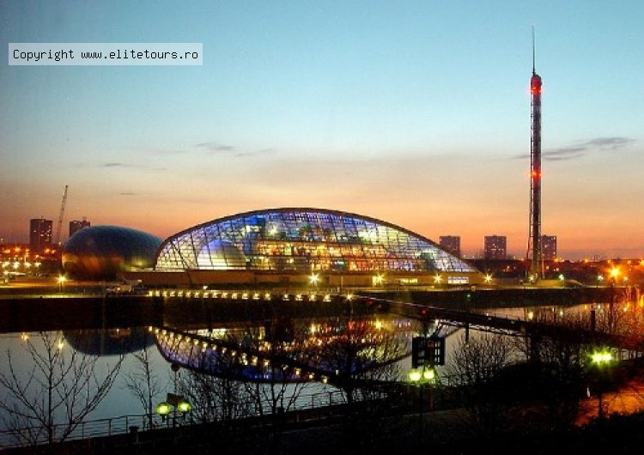
Glasgow
Prepared Pupil of 9-a class
Kolpakchi Yana

Slide 2
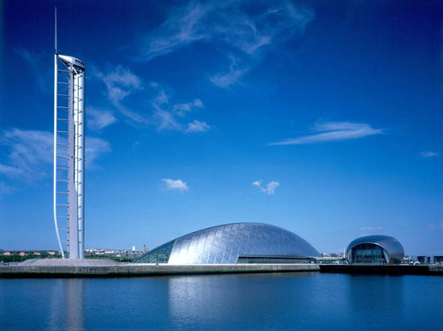
Glasgow
is the largest city in Scotland and third largest in the United Kingdom.
The city is situated on the River Clyde in the country's West Central Lowlands. Glasgow, one of Europe's most vibrant, dynamic and stylish cities.

Slide 3
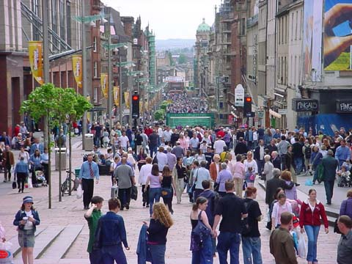
Dialect
The speed of the conversation tends to be quite quick in Glasgow. If necessary, ask people to repeat (even slowly!) what they are saying, Glaswegians are generally very friendly and able to communicate in far more formal English than that which is commonly used if it is required.

Slide 4
Orientation
The visitor, central Glasgow can be divided into two main areas, the City Centre, which contains the majority of tourist sights and much of the city's shopping and entertainment, as well as its commercial heart, and the West End, the bohemian area of cafés, restaurants and bars surrounding the University of Glasgow and Kelvingrove Museum. The best way to get good vistas of the city is to climb the many hills upon which the central area is built.

Slide 5
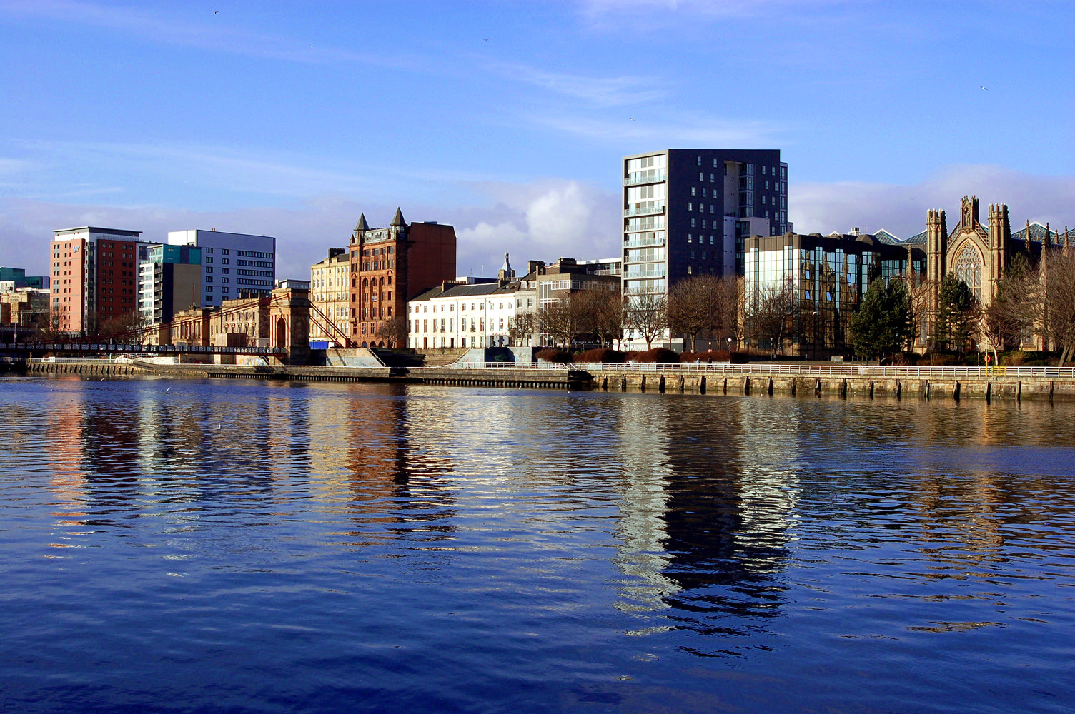

Slide 6
Architecture
Glasgow Cathedra A fine example of Gothic architecture dating from medieval times
City Chambers This imposing structure in George Square was built in 1888 in the Italian Renaissance style
Glasgow Cross
St Enoch Subway Station The original subway station, a quaint building now used as a coffee shop, sits in the middle of St Enoch Square.
Mitchell Library One of Glasgow's best public buildings, it is the largest municipal public reference library in Europe.

Slide 7
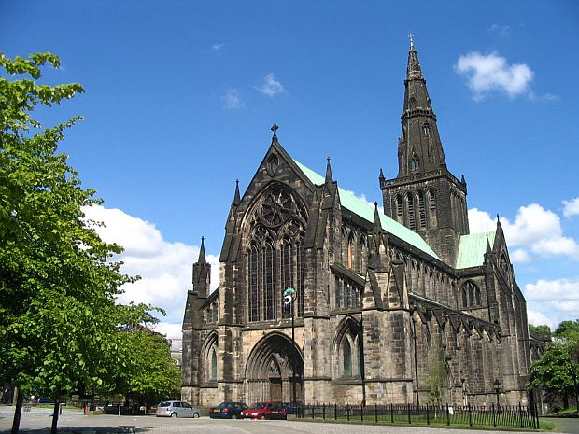

Slide 8
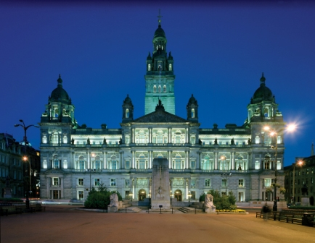

Slide 9
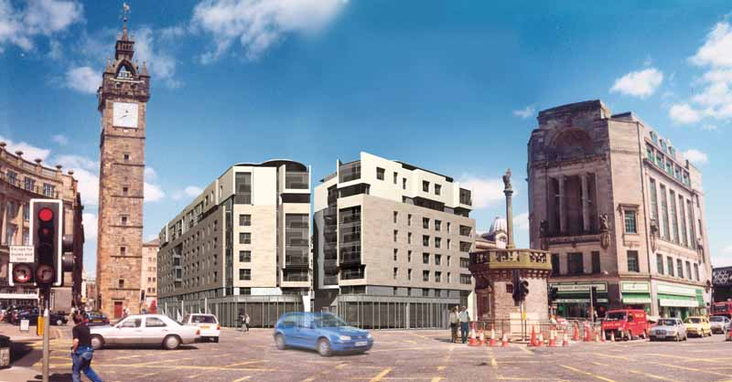

Slide 10
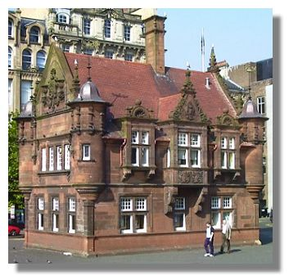
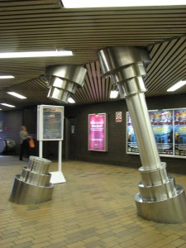

Slide 11
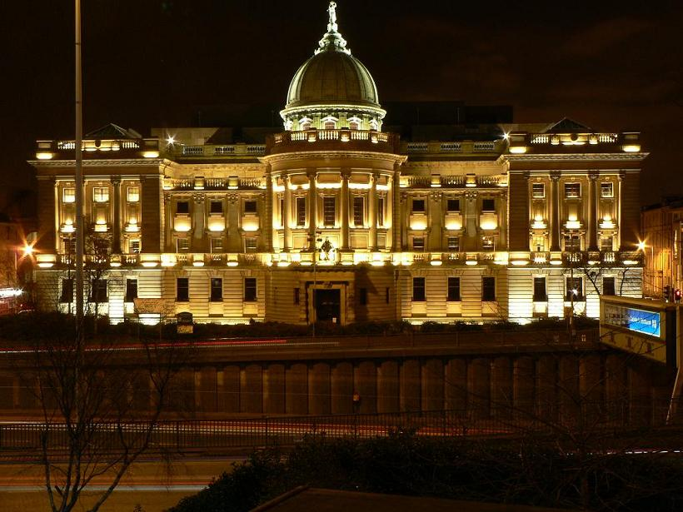
Mitchell Library

Slide 12
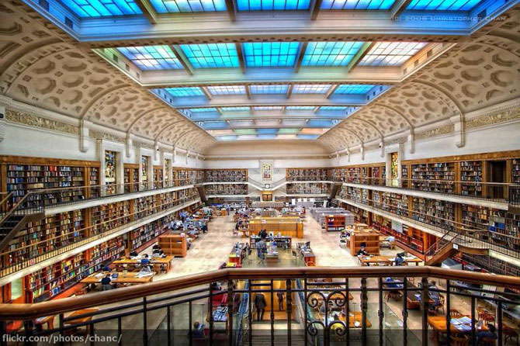
Mitchell Library

Slide 13
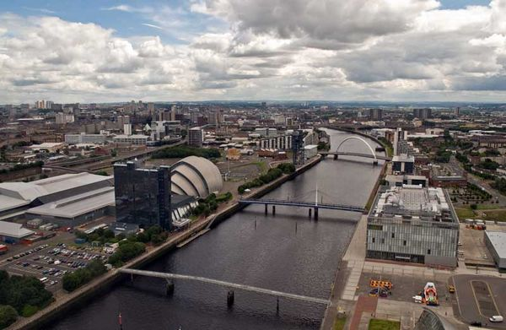
Glasgow
has many museums and art galleries. Also a very large number of beautiful parks and other "heirs of the" art.

Slide 14
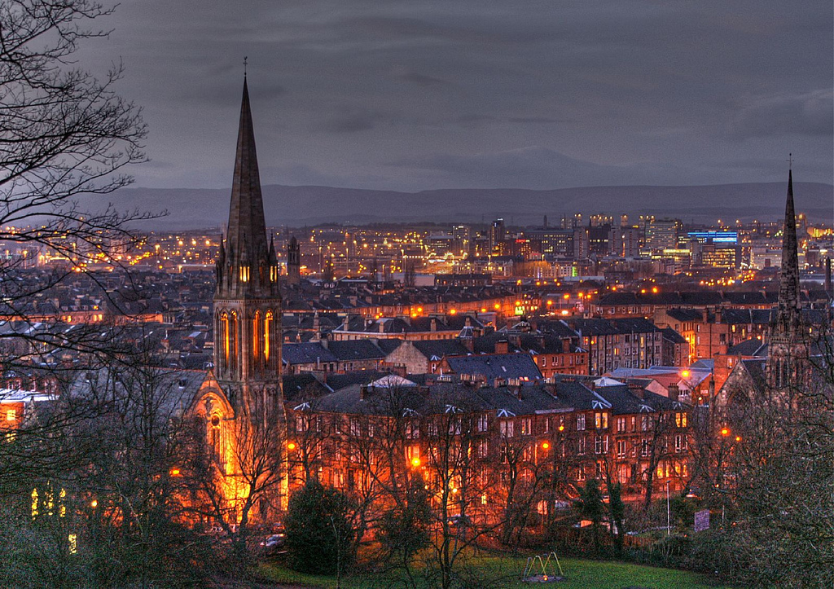

Slide 15
