Slide 1
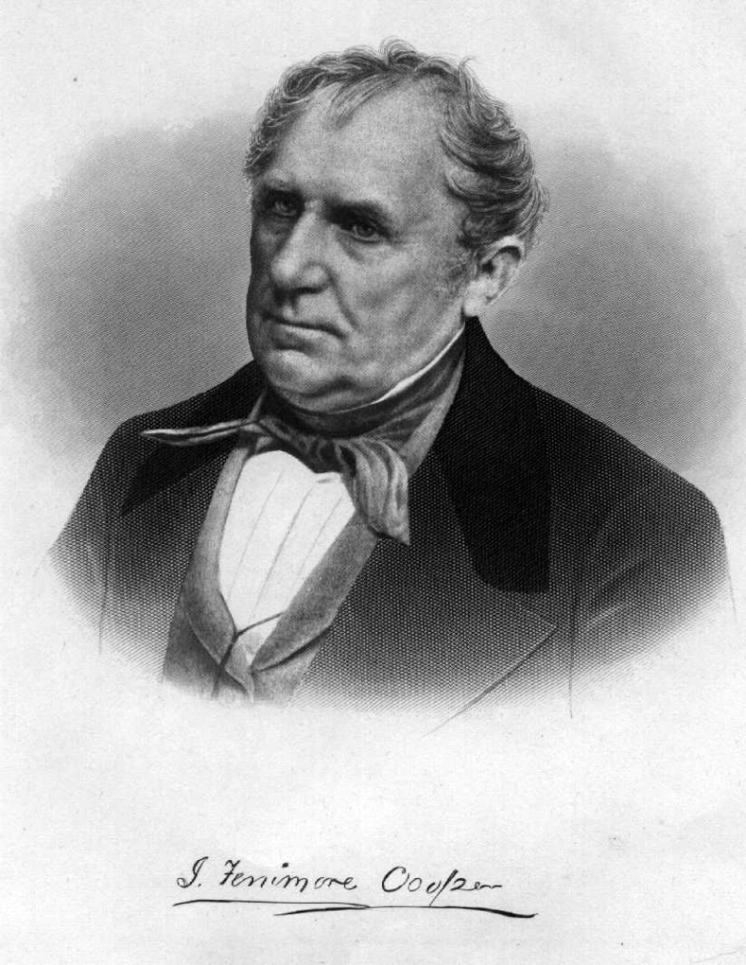
James Fenimore Cooper

Slide 2
Early Life
James Fenimore Cooper was born on September 15, 1789 in Burlington, New Jersey.
He was the eleventh child of twelve, and his parents were William and Elizabeth.
When he was one his family moved and started a town on the frontier of New York.
The town was dubbed Cooperstown after the family.

Slide 3
Schooling
James attended boarding school in Albany for his majority of his education.
After boarding school he went to Yale, but was expelled due to him doing a prank.
After his expulsion he became a midshipman in the navy.

Slide 4
Claim to Fame
James Fenimore Cooper is most famous for his writings.
He wrote such works as Last of the Mohicans, and The Deerslayer.
His wife is the inspiration behind the works.
She bet him he could not write a better book then she was reading. He won the bet.

Slide 5
Cooper as a Reformer
Cooper is the first major American Novelist.
He was the first American writer to write about Native Americans seriously.

Slide 6
Last of the Mohicans
The Last of the Mohicans is the most famous book that Cooper wrote.
It was the most popular book of the time and was very widely read.
It was transferred into almost all languages in Europe, and a few in Asia.

Slide 7
Cooper in Politics
Cooper had many of his ideas in his book criticized by the Whig party.
He went to court several times and won all of his cases.

Slide 8
Legacy
Cooper has a long lasting legacy.
He is still a very famous writer, and The Last of the Mohicans is a very popular movie.
Some of his writings helped to have Americans realize that Native Americans are equal.

Slide 9
Fun Facts
Cooper was expelled from Yale for training a donkey to sit in a professors chair, or blowing up another students door.
Cooper had a large inheritance from his father that just got larger when his brothers died.

