Slide 1
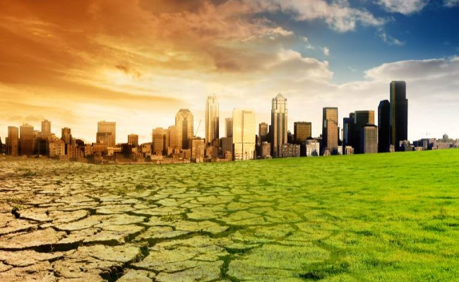
global warming

Slide 2
The reasons
(The theory of the Little Ice Age, or changes in solar activity)
Emissions of greenhouse gases
water vapor
(36-70%)
carbon dioxide (CO2) (9-26%)
methane (CH4) (4-9%)
ozone (3-7%)

Slide 3
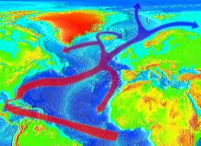
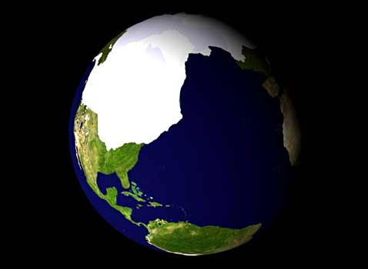
warm or cold?

Slide 4
consequences

Slide 5
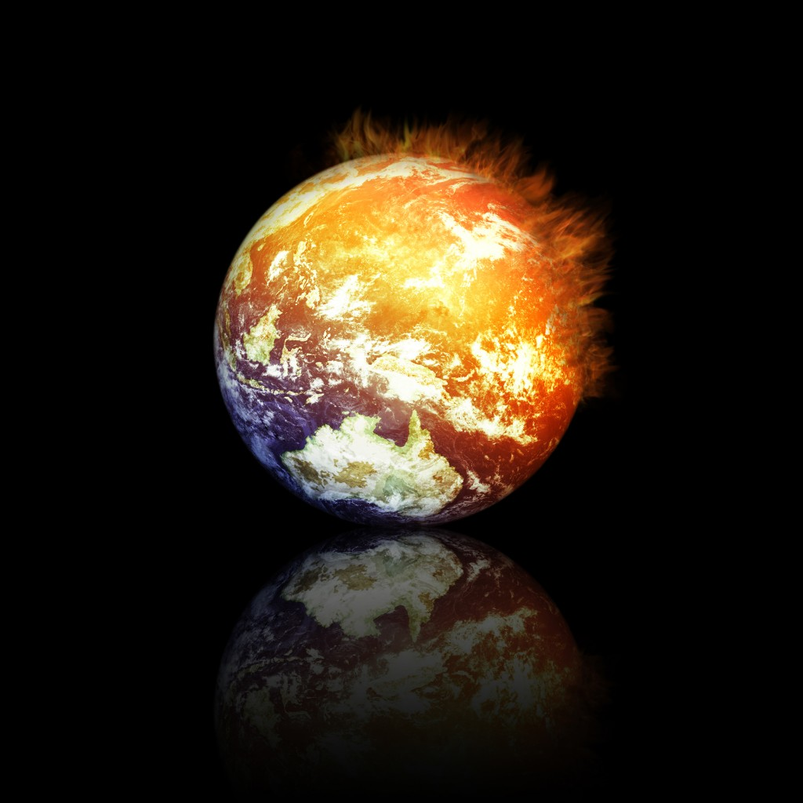
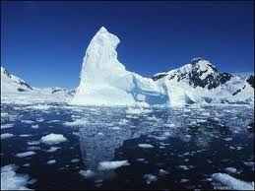
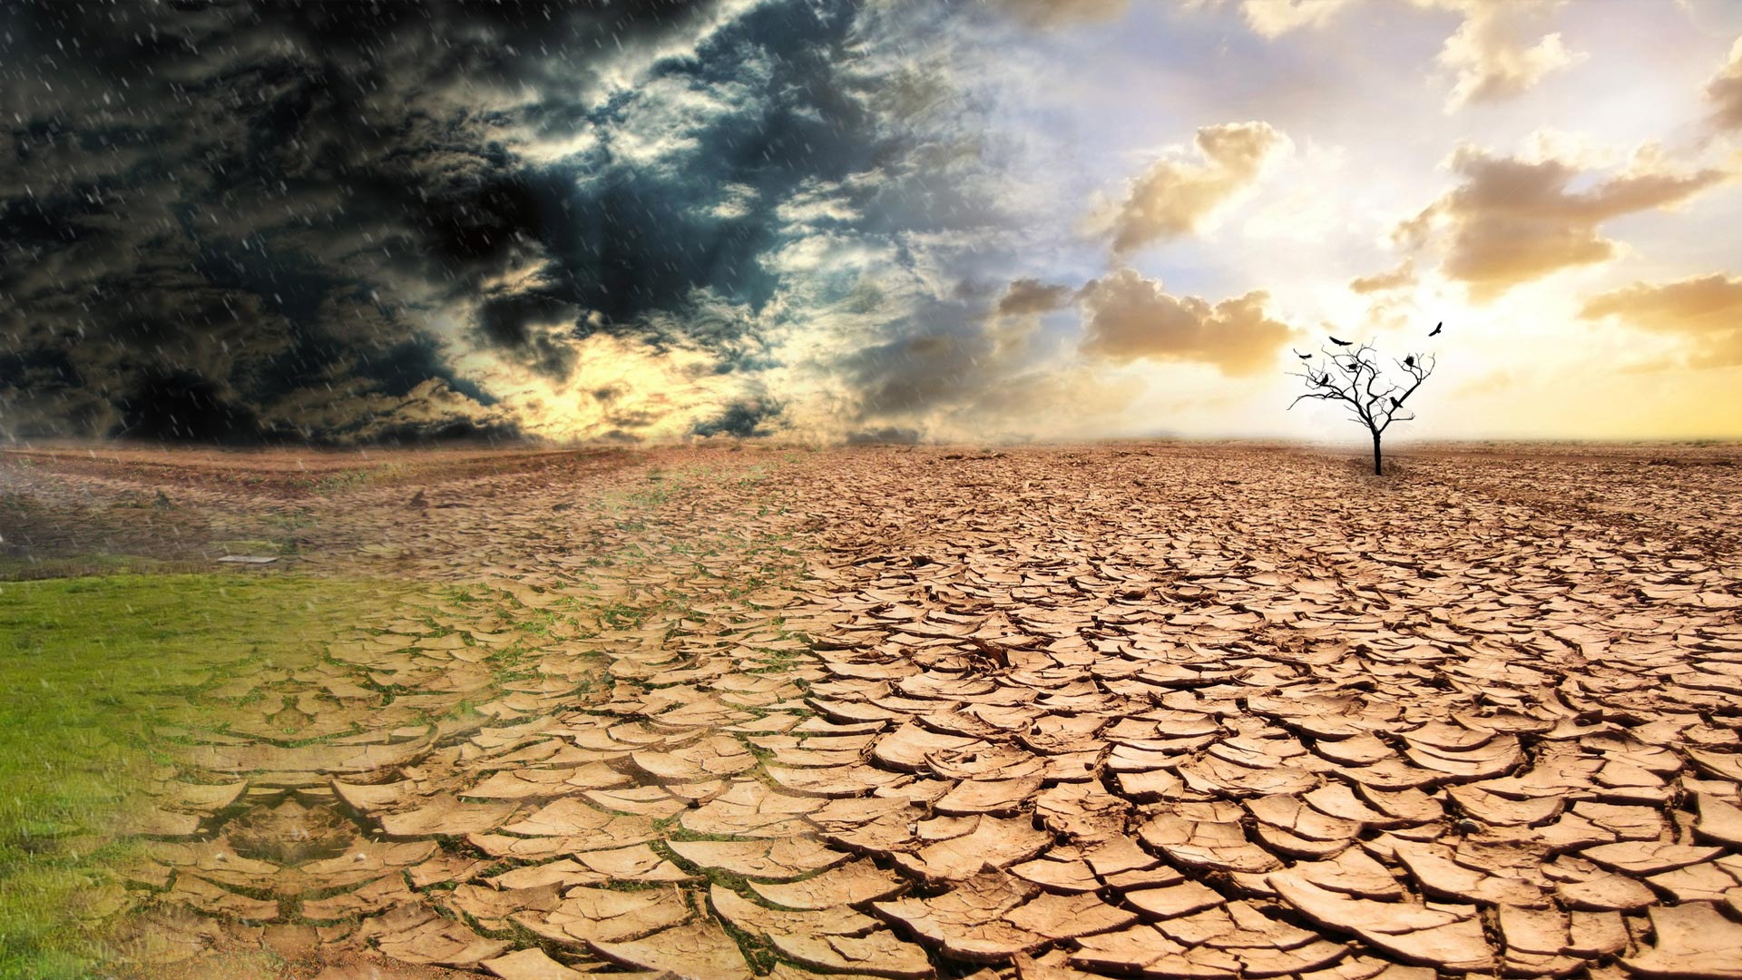
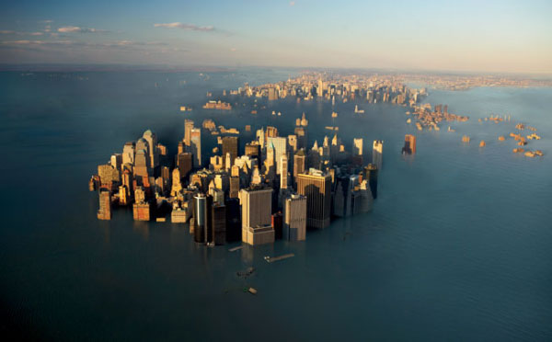
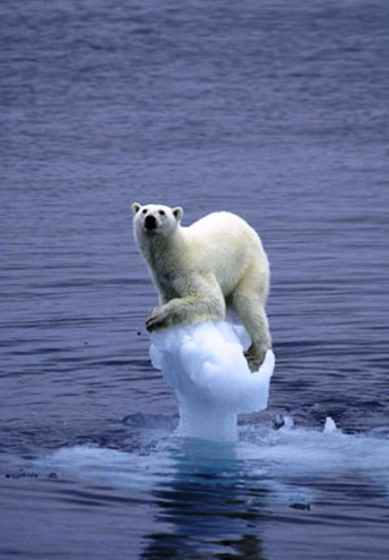
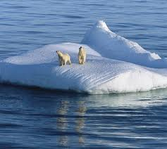
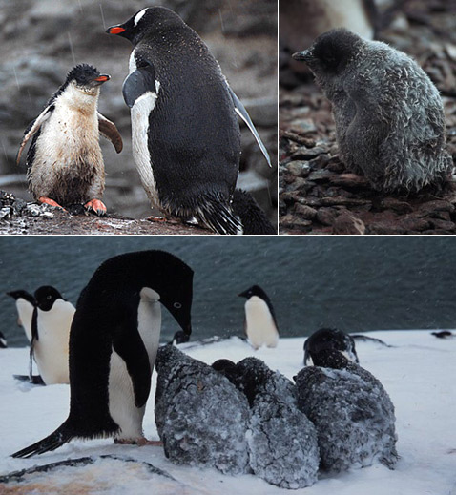
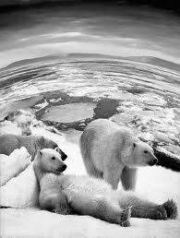
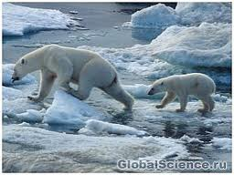

Slide 6
Countries must reduce emissions of CO2 and other greenhouse gas emissions
USA - 7%.
The European Union -8%.
Japan - 6%.

Slide 7
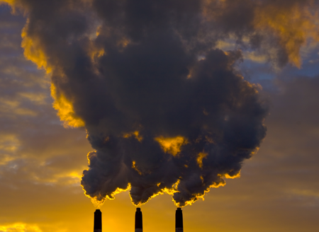

Slide 8

GREENPEACE

Slide 9
