Slide 1
Tornado
Fulfilled:
Gritsak Ilona

Slide 2
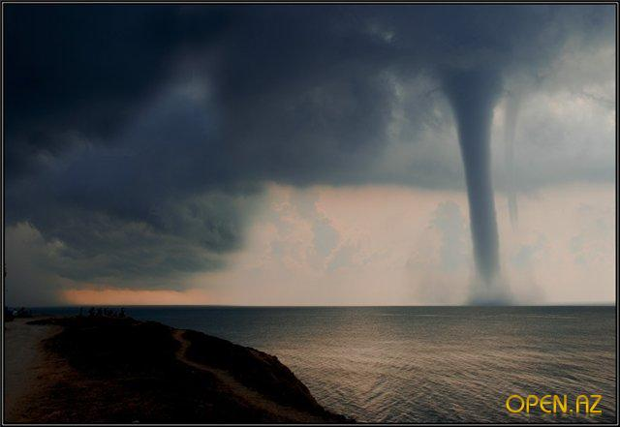
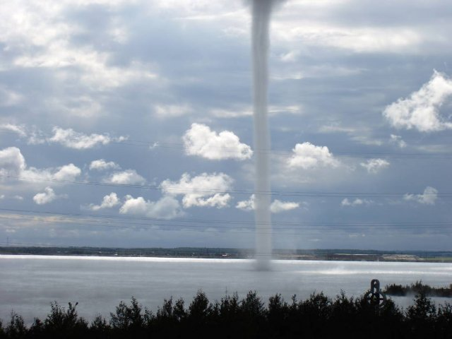
Tornado is the atmospheric vortex that occurs in thunderclouds and extends down to the ground sometimes in the form of a dark cloud sleeve diameter dozens or even hundreds of meters

Slide 3
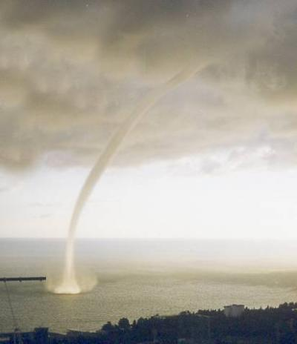
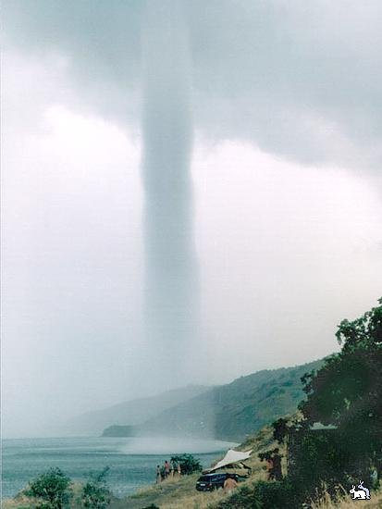
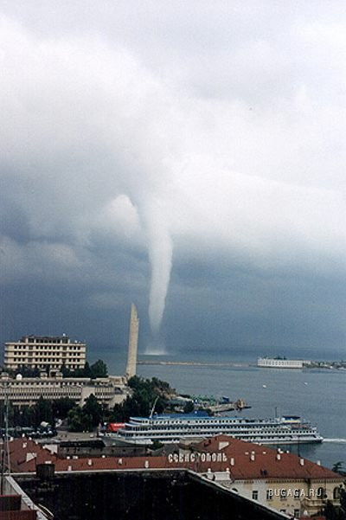
At sea, sometimes you can see one of the terrible and unusual natural phenomena-water spout.

Slide 4
Tornado moving broad band, outside of which often almost complete calm. Light objects tornado picks up high and can be attributed to a considerable distance. When the vortex breaks up, all he seized falls to the ground sometimes tens of kilometers away from where it was lifted into the air.

Slide 5
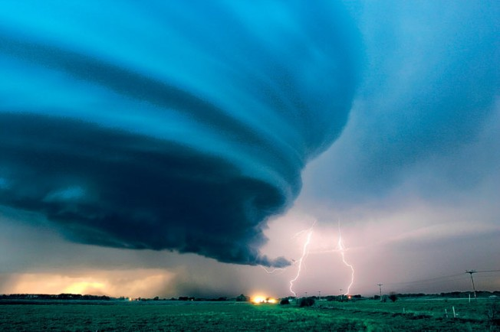
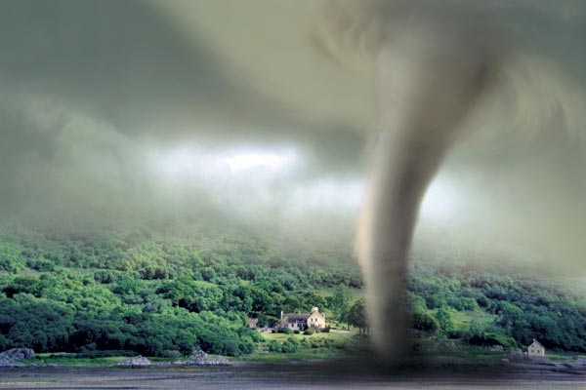
The air inside a tornado so dry and hot that a few minutes wither on the vine flowering trees.

Slide 6
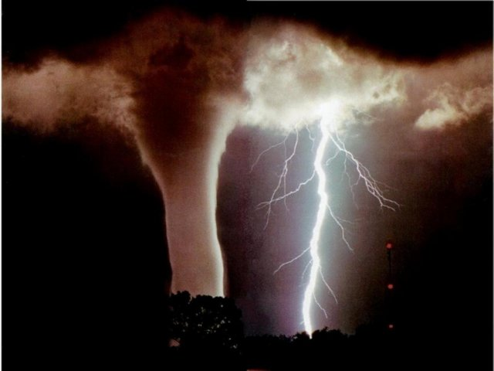
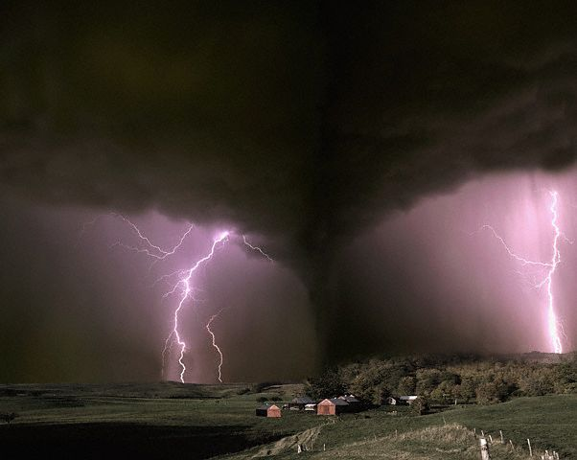
Storm-frequent tornadoes in the United States.

Slide 7
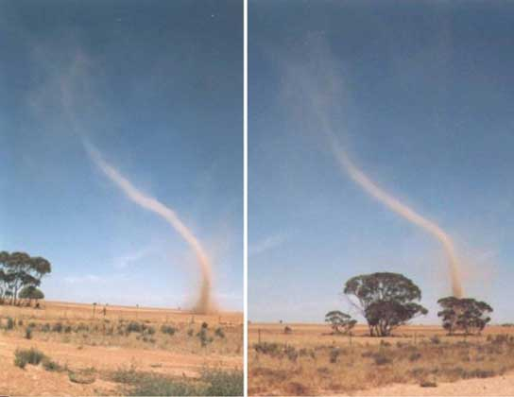
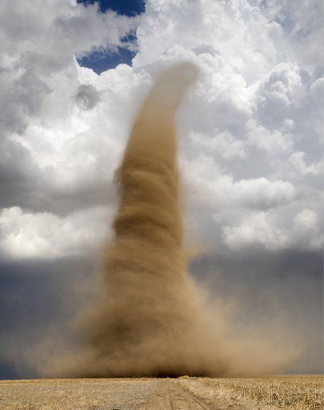
Huge sandy vortices occur sometimes in superheated sand in the scorching desert. This phenomenon is often observed in the Sahara.

Slide 8
The End

