Slide 1


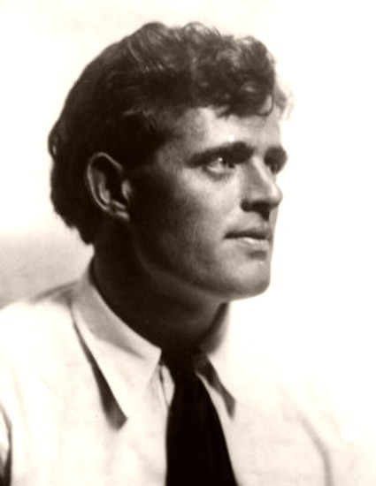
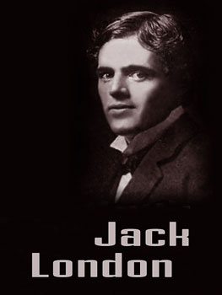

Jack London

Slide 2
Introduction
Born On: January 12, 1876
Born In: San Francisco, California
Married: Bess Maddern and then later Charmian Kittredge
Died On: November 22, 1916 7:45 P.M.
Died In: Glen Ellen, California
Buried In: Jack London State Historic Park in Sonoma County, Northern California
Children: Joan London, Bess London, Joy London

Slide 3



Social Contribution
Jack London made a huge impact on the writing society. The books he wrote opened the minds of many readers, young and old. His books included philosophy, nature, and rules of life. He was also an amazing Socialist. Though some of London’s actions ended him up in jail, he loved to share his thoughts to the public and make it so that his voice was heard. In Jack’s books he found ways to make a half-bread wolf-dog relate to an average day unemployed citizen. The ways they each must fight for life. Jack London was an amazing author!

Slide 4


Childhood
1884: 8-year-old Jack found Signia, a novel, which sparks his future
1876: Flora Chaney gives her newborn, Jack, to a wet nurse.
1884: London family moves to Livermore Valley.
1884: John London, Jack’s adopted father, builds a chicken coop for living.
1886: 10-year-old Jack’s stepsister Eliza marries Captain James Shepard.
1886: Jack takes on job of selling newspapers and a pinsetter.
1887: Jack enrolls in Cole Grammar School in West Oakland.
1888: BY the time Jack is 12 he is sailing a skiff completely around San Francisco Bay.

Slide 5
Adolescence
1889: 13-year-old Jack leaves school for good and works at Hickmott’s Cannery.
1891: Jack buys Razzle Dazzle, a skiff, and begins to steal from oyster beds.
1892: Jack joins the California Fish Patrol in Benicia.
1893: Jack joins the Sophia Sutherland for a 7-month sealing voyage.
1893: Jack wins 1st prize San Francisco Morning Call for “best descriptive article”.
1894: Jack joins Coxey’s “Industrial Armey” to protest unemployment in D.C.
1894: Jack is arrested in Buffalo, New York for vagrancy and spends 30 days in Erie County Penitentiary.
1895: Jack attends Oakland High School, completes High School in 18 months.
1896: 20-year-old Jack, “Boy Socialist”, joins Socialist Labor Party.
1896: Jack attends the University of California at Berkely, and drops out after 1 semester.

Slide 6


Adulthood
1897: Jack set out on a Gold Rush Journey in the Yukon.
1898: The Overland Monthly buys Jack’s story “To the Men on Trail”.
1899: The Black Cat buys Jack’s story “A Thousand Deaths” for $40.
1899: The Atlantic Monthly buys “An Odyssey of the North”.
1900: Jack marries Bess Maddern.
1903: Jack sends “The Call of the Wild” to the Saturday Evening Post.
1904: Jack covers the war in Japan for a News Paper.
1905: Jack marries Charmian Kittredge.
1907: Jack and Charmian set out on a voyage on the Snark.
1911: Jack and Charmian sail the Dirigo around Cape Horn.

Slide 7
Jack’s Books
Call of the Wild: A dog named Buck is stolen and sold for the Gold Rush. On his way to the Klondike he learns to fight, the rules of the wild, and the law of Club and Fang.
White Fang: A half-breed wolf-dog, White Fang, is born and learns the rules of the wild and how to live in captivity and is forced into pit fights.
A Piece of Steak: An aging boxer must win a fight against a much younger man. Not to gain glory but simply to feed himself and his family.
Sea Wolf: A critic and other survivors of an ocean crash follow Wolf Larsen, a sea captain who rescues them.
To Build a Fire: A man travels into the Yukon with a husky-wolf and dies. The dog runs back to camp in search of humans.

Slide 8
Jack London died November 22, 1916. There are a lot of different suppositions about London’s death. Some people consider that he could commit a suicide but his death certificate gives the cause as uremia. His ashes were interred in Jack London State Historic Park, in Glen Ellen, California.

