Slide 1
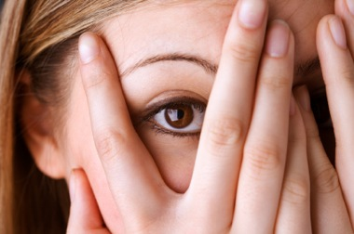
Phobias of famous people

Slide 2
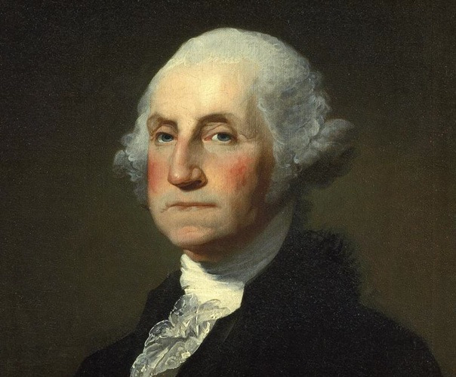

Slide 3
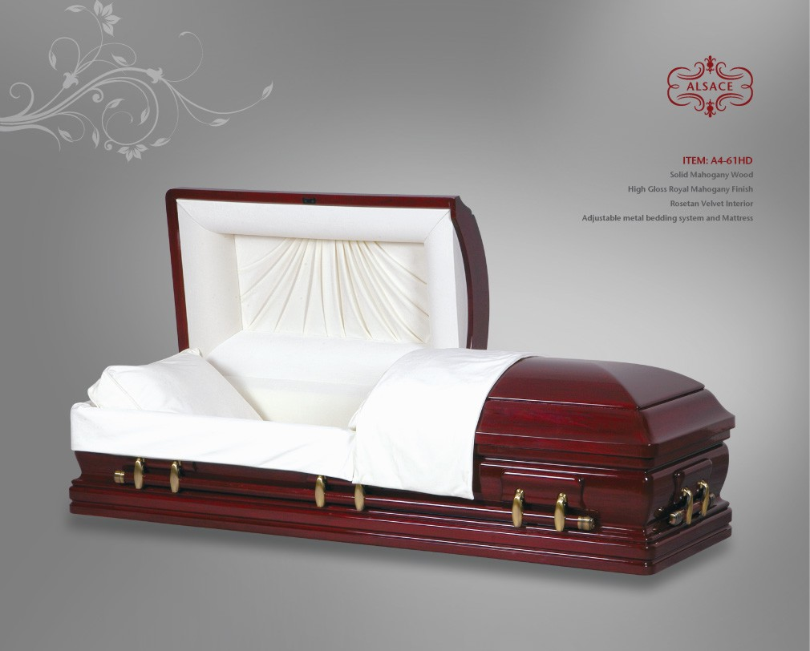
George Washington: first president of the United States of America. He commanded forces in numerous battles, defended our country against the British, and risked his life to save others. He seems fearless, right? Wrong! He had a very serious fear of premature burial. This was clearly expressed on his deathbed, in 1799, where he made his attendants promise that his body would be left out for two days, in case he was still alive. This may seem pretty odd for a man like George Washington, but taphephobia was a common fear for noble people, as well as commoners, living in the sixteenth and seventeenth centuries. Although the fear is not as well known today as it was back then, primitive medicine meant that premature burial has indeed happened throughout the ages.

Slide 4
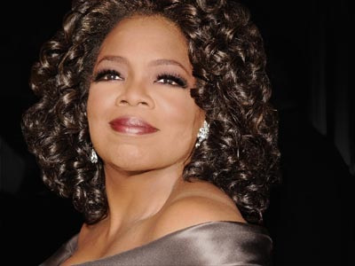

Slide 5
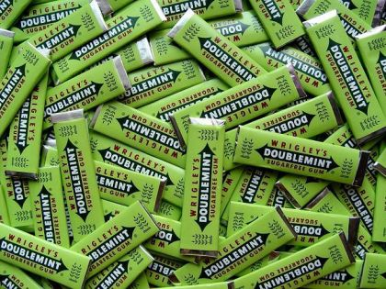
Oprah, the queen of daytime television, has a great phobia of gum chewing. This began for her at an early age, when her grandmother would collect gum and keep it in rows on a cabinet. Oprah was so revolted by this that it caused her to fear gum for the rest of her life. One time, she said, she threw out a plate because it had a piece of gum on it! She is so sickened by gum chewing that she has banned it at her television studio. Surprisingly, her employees and studio audience usually cooperate and give her no reason to fear. Who would have thought that a woman such as Oprah would fear something like gum chewing?

Slide 6
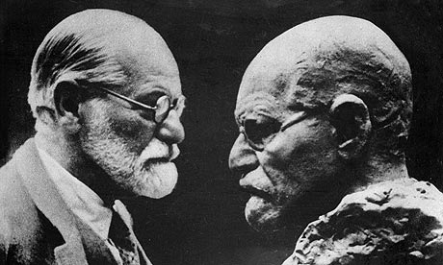

Slide 7
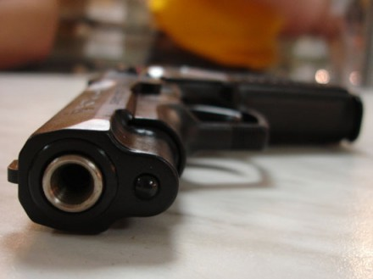
Sigmund Freud, the neurologist who founded the psychoanalyst school of psychiatry and created many world-changing theories, feared weapons and ferns. He is often credited with saying that a fear of weapons is a sign of retarded sexual and emotional maturity. Also, it is common for people to fear weapons. As for having a phobia of ferns, that is not a very common fear. It is difficult to know where this could have come from, as he said little about it and there is scarce detail about it. It is unlikely that he had a traumatic experience with ferns as a child. However, those who knew him agreed that he did fear ferns, and that he would never eat them.

Slide 8
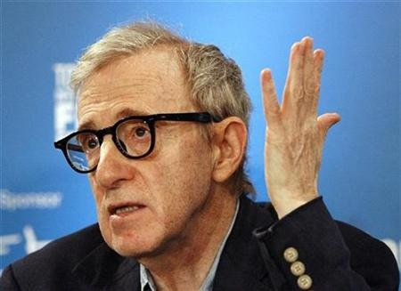

Slide 9
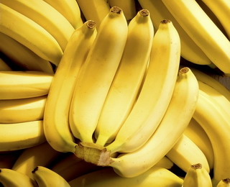
As I stated early, we all have fears. Woody Allen, however, has taken fear to an extreme. The 74-year-old actor and screenwriter is afraid of practically everything. Although he has normal phobias that cause him to fear heights, enclosed spaces and insects, he also has more abnormal fears. Among his weirder terrors are fears of bright colors, animals, elevators and peanut butter sticking to the roof of his mouth! In addition to his countless phobias, he also admits to having very neurotic needs, such as requiring his shower drain to be in a corner rather than the center and cutting his banana into exactly seven pieces before putting them into his cereal every morning. His bounty of fears made him a necessity on this list!

Slide 10
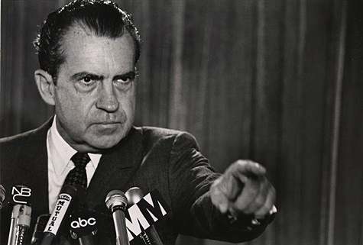

Slide 11

The 34th president of the United States, a man remembered mostly for his role in the Watergate scandal, had an excessive fear of hospitals. He believed that if he were ever to go into a hospital, he would never come out alive. In 1974, he suffered from a blood clot and refused to be taken to a hospital for treatment. However, he was told that if he didn’t go, he would die, and he had to go. This fear is fairly common among people, and they fear hospitals for much the same reason as Richard Nixon.

Slide 12
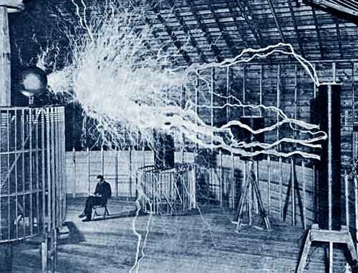

Slide 13

Nikola Tesla was a famous inventor, best known for his work on electromagnetism and electricity. He was a germaphobe who avoided touching people, and anything else that contained germs, at all costs. Tesla was known to wash his hands extremely frequently. In addition to his germaphobia, he was very frightened of jewelry, especially earrings that contain pearls. Pearls revolted him to a very high degree. In addition to his fears, he preferred to do everything in threes or multiples of three. For example, he was adamant about staying in hotel rooms that were divisible by three.

Slide 14
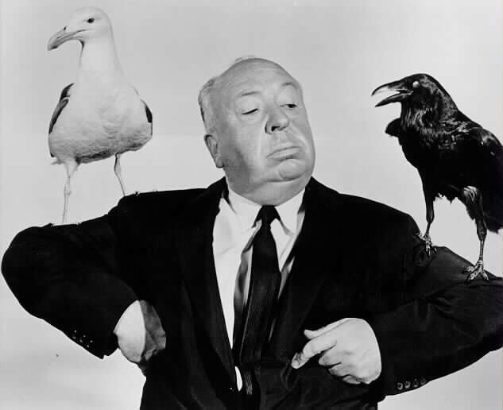

Slide 15

Alfred Hitchcock, a famous Hollywood director and producer known for movies such as Psycho and Vertigo, had an extreme fear of eggs. He said that they are revolting to him! He stated that he never tasted an egg in his whole life, and he refused to even be around them. He claimed that nothing was more revolting to him then seeing a white round thing with no holes spill its yellow liquid. It is unknown why a man like Hitchcock would have such a random fear.

Slide 16
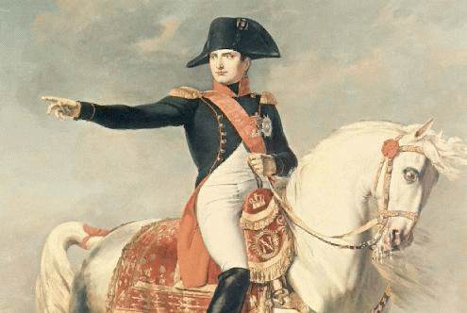

Slide 17

The great Napoleon Bonaparte, Emperor of the French, and great military and political leader, feared felines. Don’t wait for a punch line, because there isn’t one. Cats chilled Napoleon to the bone. However, it is unknown why he feared them. But what is known is that the sight of a kitty would put him in panic mode. And it isn’t just Napoleon! Many other men who tried to rule the world feared cats, including Hitler, Mussolini and Julius Caesar. I guess cats and dictators were never meant to get along!

Slide 18
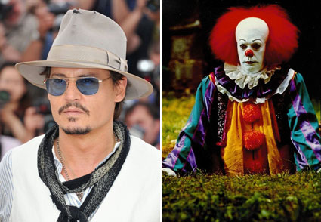
Johnny Depp
Maybe he just read too much Stephen King: Johnny Depp was once scared witless of clowns. "Something about the painted face, the fake smile. There always seemed to be a darkness lurking just under the surface, a potential for real evil," he has said about his phobia.

Slide 19
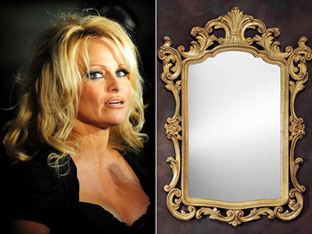
Pamela Anderson
Say what? The former "Baywatch" babe reportedly has eisoptrophobia, or a fear of mirrors.

Slide 20
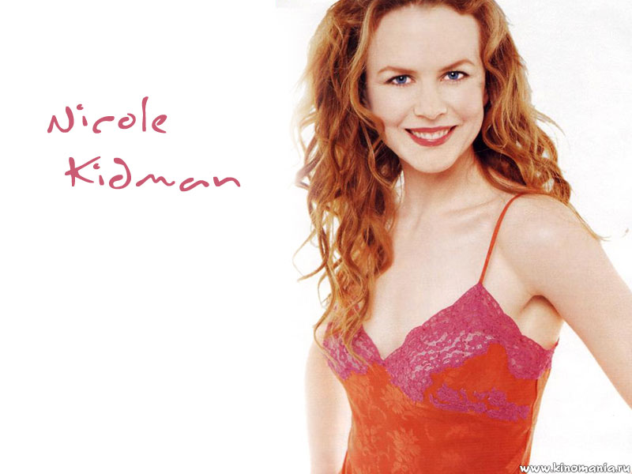

Slide 21
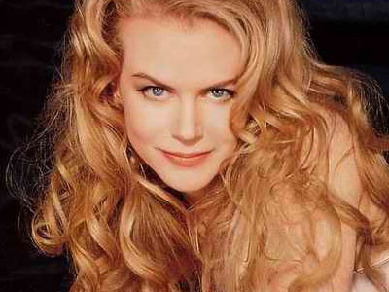
Nicole Kidman
This native Australian beauty apparently didn't like to play in the bush all that much: She's afraid of butterflies. She told In Style magazine: "It's so bizarre. I'm not afraid of snakes or spiders. But I'm scared of butterflies."

Slide 22
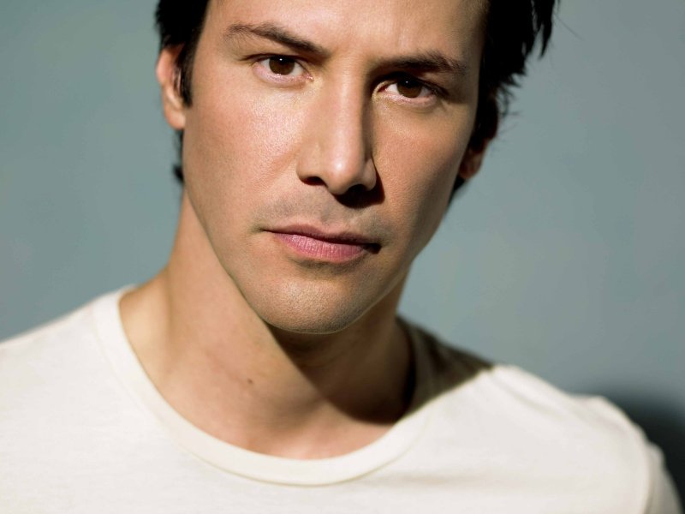

Slide 23
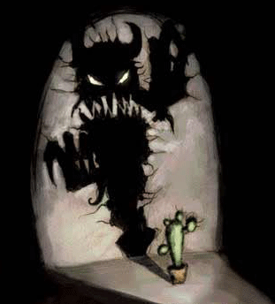
Keanu Reeves
Was it all that time spent in the "Matrix"? "I am afraid of the dark. But I mean that in a real philosophical way," Reeves is reported to have said.

Slide 24
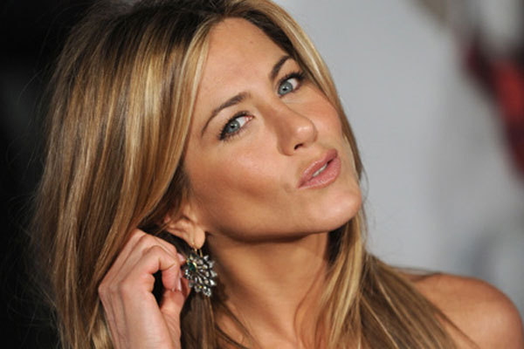

Slide 25

Jennifer Aniston
After a bad experience of flying through an electrical field, Aniston became terrified of traveling up in the air. "What scares me is taking off, because I don't understand how the plane gets up there. I've heard all about the aerodynamics, the speed, the engine. Of course, when your number's up, it's up. Maybe I'm just a control freak. I'm still nervous -- though much better than I was," she has confessed.

Slide 26
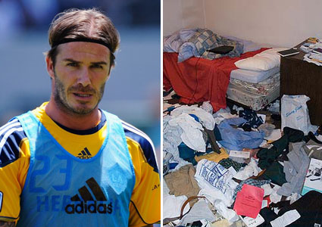
Speaking of dirtiness, David Beckham fears messes of any kind. His surrounding objects must be coordinated by color, form and size and quantity -- only even numbers. This sounds suspiciously like OCD to me.

Slide 27
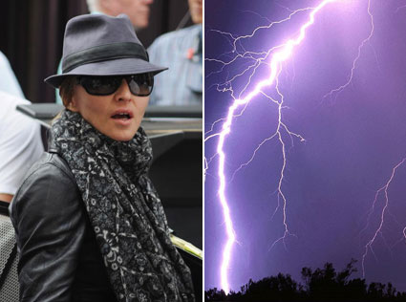
Madonna has a morbid fear of thunder, the only force of nature mightier than her. The condition is known as brontophobia

