Slide 1
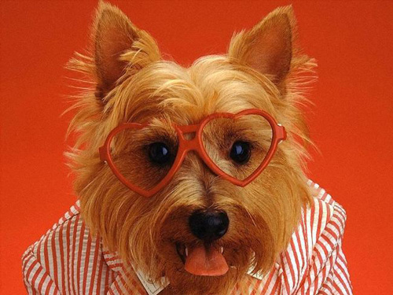
Saint Valentines Day!!!

Slide 3
Valentine's Day (Saint Valentine's Day) is an occasion celebrated on February 14. It is the traditional day on which people express their love for each other by sending Valentine's cards, presenting flowers, or offering confectionery.

Slide 4
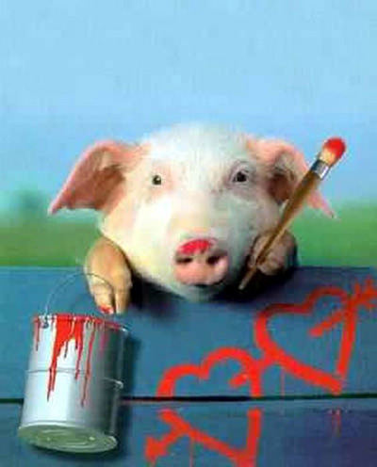

Slide 5
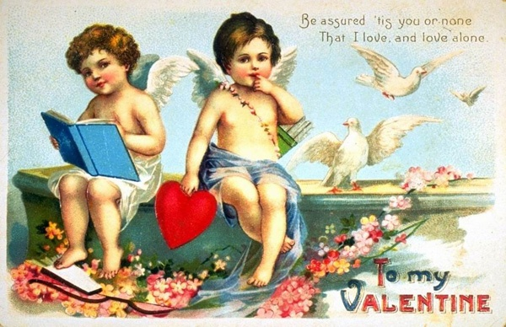
Who is St. Valentine?
There were many Christians names Valentine. According to the Catholic Encyclopaedia, at least three Saint Valentines are mentioned who are associated with 14 February. One is described as a priest at Rome, another as a Bishop of Interamna (now Terni in Italy) and the other lived and died in Africa.

Slide 6
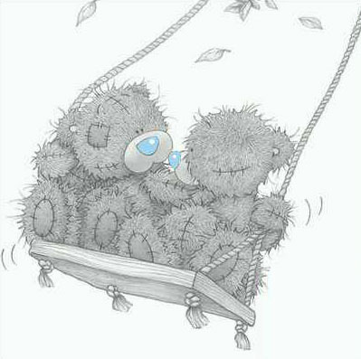

Slide 7
The Valentine that most experts believe is the actual one remembered on St. Valentine's Day was a Roman who was martyred for refusing to give up Christianity.

Slide 9
What happens on Valentines day in Britain?
Each year in Britain, we spend much money on cards, flowers, chocolates and other gifts for Valentine's Day. Traditionally these were sent anonymously, but nowadays we often make it clear who is sending each Valentine.
Valentine'.

Slide 10
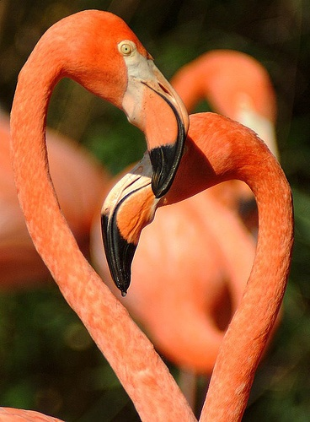

Slide 11
Valentine's Day Superstitions & Traditions
Traditionally, spring begins on St Valentine's Day (February 14th), the day on which birds chose their mates. In parts of Sussex Valentines Day was called 'the Birds Wedding Day'.

Slide 12
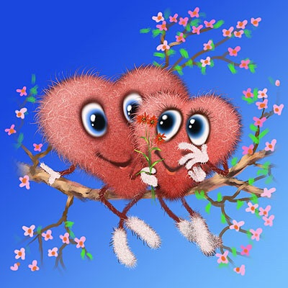

Slide 13
There are many other traditions and superstitions associated with romance activities on Valentine's day including:

Slide 14
the first man an unmarried woman saw on 14th February would be her future husband;

Slide 15
if the names of all a girl's suitors were written on paper and wrapped in clay and the clay put into water, the piece that rose to the surface first would contain the name of her husband-to-be.

Slide 16
if a woman saw a robin flying overhead on Valentine’s Day, it meant she would marry a sailor. If she saw a sparrow, she would marry a poor man and be very happy. If she saw a goldfinch, she would marry a rich person

Slide 17
In the Middle Ages, young men and women drew names from a bowl to see who their valentines would be. They would wear these names on their sleeves for one week.

Slide 18
In Wales wooden love spoons were carved and given as gifts on the 14th of February. Hearts, keys and keyholes were favourite decorations on the spoons. The decoration meant, "You unlock my heart!"

Slide 19
+ BONUS!!!

Slide 20
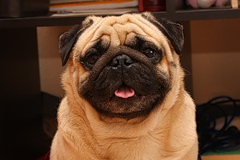

Slide 21
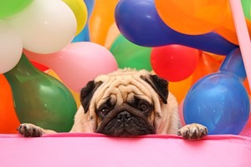

Slide 23
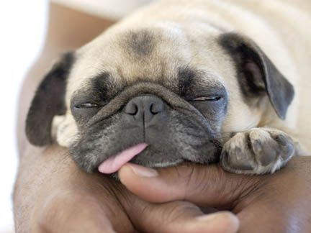

Slide 25
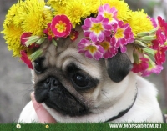

Slide 26
Zhenia Demchenko!!!

