Slide 1
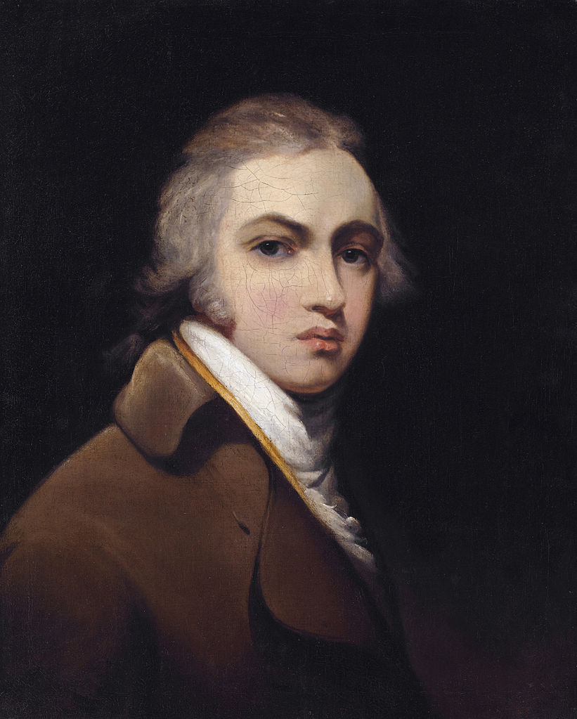
Sir Thomas Lawrence
I was and am still absurdly overpriced, I'm not superman, I'm pretty normal.
April 13, 1769 Bristol - January 7, 1830 London

Slide 2
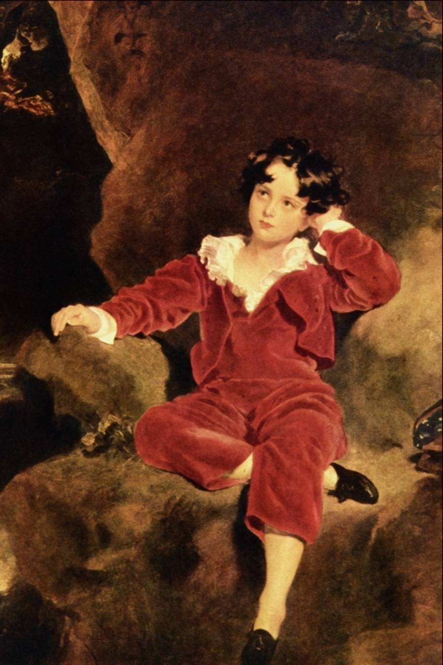
Childhood
Sir Thomas Lawrence, the famous English portrait painter was born in 1769 in Bristol. Thomas was the youngest of 16 children, but most of his brothers and sisters died in infancy.

Slide 3
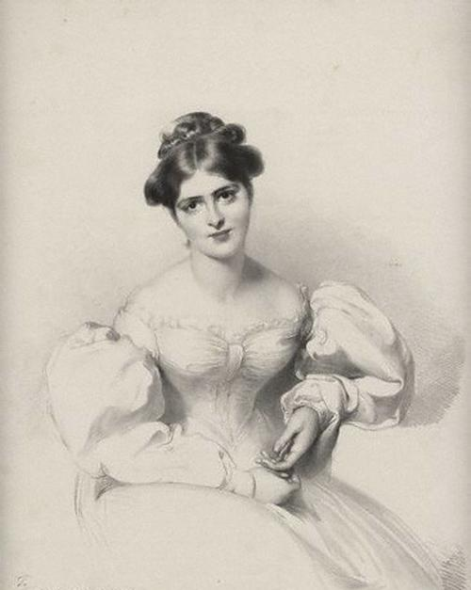
Career
Career Wizard developed rapidly. As a seven year old wonder-kid he made ​​a living by his drawings and pastels, in twelve years had his own workshop in Bath, a fashionable resort, which attracts water to know.

Slide 4
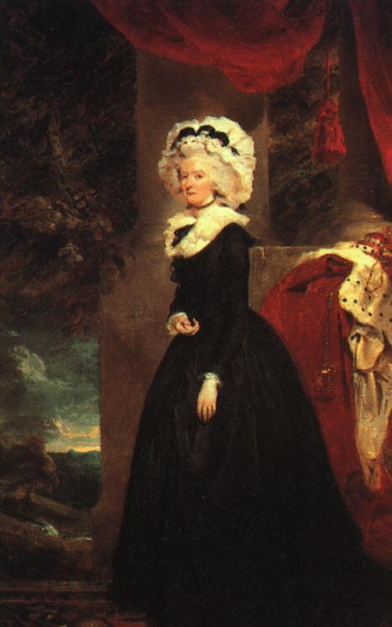
Portrait of a Lady Cremorne
At age 23, became chief painter to the king, replacing the site of the Reynolds, and at twenty-five he was elected an academician. In 1789 he presented to the Royal Academy portrait of Lady Cremorne, earning him an order for a portrait of Queen Charlotte, shown at the Academy in the following year.

Slide 5
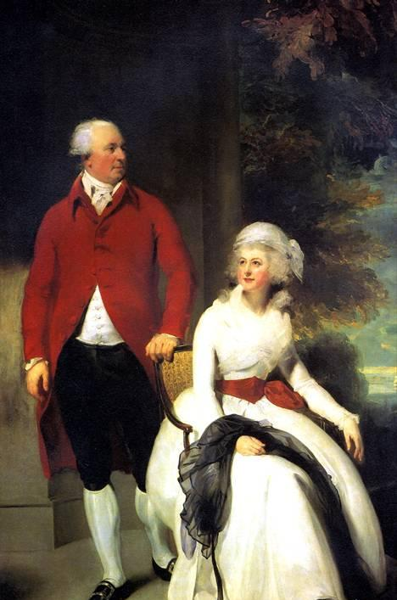
At the same time it creates a theatrical portraits, in which it is clear that the lack of traditional education hampers the depth of expression. These features, as well as financial difficulties caused by the way of life of Lawrence and exceeding its material may be damaging to the quality of his portraits of the artist, and are often forced to fall into technical deliberate superficiality.

Slide 6
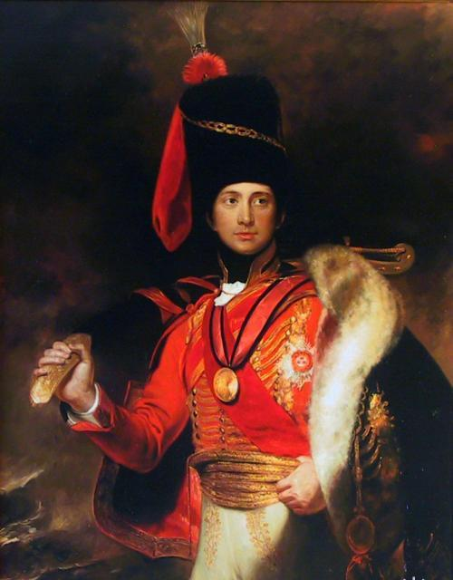
Friends
One of the closest friends of the painter Lawrence Joseph Ferington (Farington), who was a mentor and a good friend. Other was Sir Charles Stuart, half-brother of Castlereagh and the Adjutant General of Wellington. His portrait of a dashing hussar in luxurious scarlet and gold uniforms convey the charm of the military hero and perhaps the most beautiful portrait of Lawrence at the National Portrait Gallery.

Slide 7
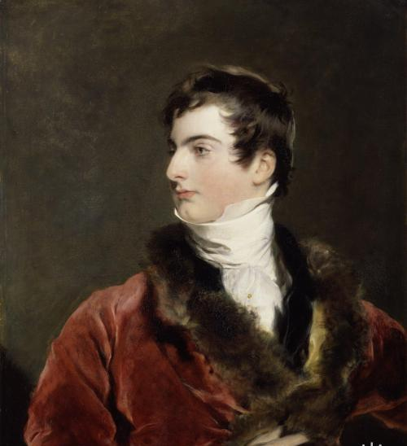
Lawrence became the last major portrait artist who completed his work of the great tradition of English painting of the XVIII century. He created a picture of the high society of the regency in his magnificent painting style and innovative use of color. Having learned the lessons of skill Reynolds, he has not reached, however, in his art, the depth and intellectual richness, which were peculiar to the last.

Slide 8
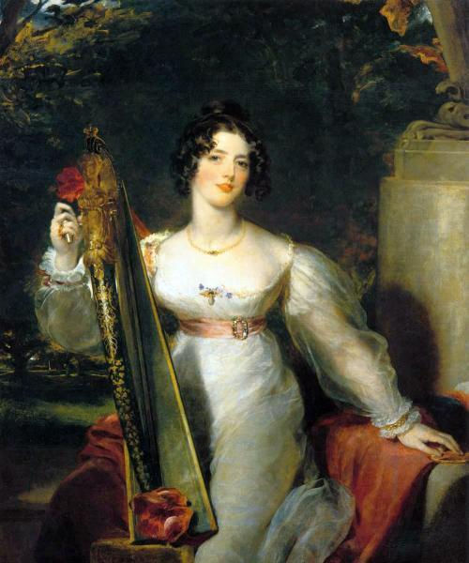
The main feature of the Lawrence art can perhaps be called virtuosity - quality, especially the appreciated in that era. The most successful portrait painter of his time, he wrote in a cursory manner, hundreds of pictures.

Slide 9
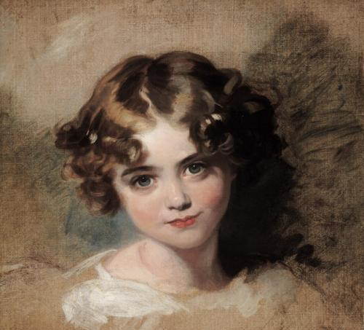
At the time, the name of Thomas Lawrence enjoyed a European reputation. Have a portrait made famous English painter, considered it an honor rulers, higher church hierarchy, military leaders, diplomats and major bombshells.

