Slide 1
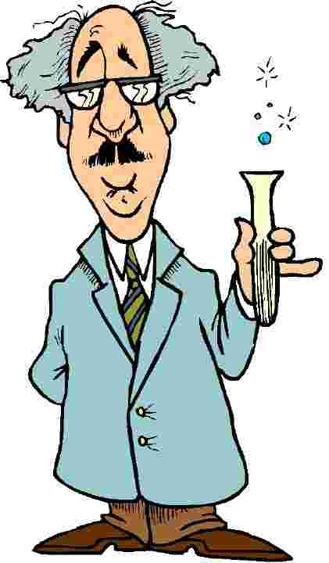


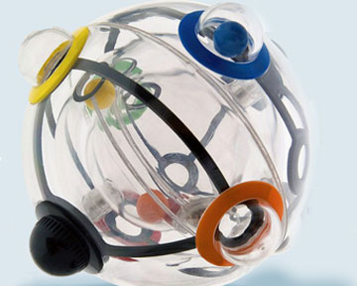
Science and inventions

Slide 2
Content
Isaac Newton
The inventor and his invention
Funny invention
The invention of the future
Modern technology of our homes. How do they help us?

Slide 3
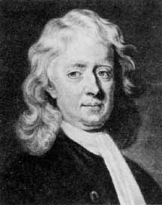
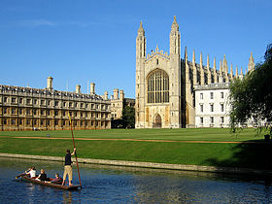
Isaac Newton
(1642-1727)
English physicist and mathematician who was born into a poor farming family. Luckily for humanity, Newton was not a good farmer, and was sent to Cambridge to study to become a preacher. At Cambridge, Newton studied mathematics, being especially strongly influenced by Euclid, although he was also influenced by Baconian and Cartesian philosophies. Newton was forced to leave Cambridge when it was closed because of the plague, and it was during this period that he made some of his most significant discoveries. With the reticence he was to show later in life, Newton did not, however, publish his results.

Slide 4
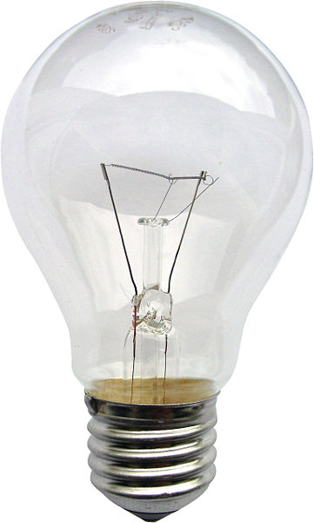

The inventor and his inventions
In 1872-1873 the Russian engineer and inventor Alexander Lodygin made ​​the world's first lamp, which has withstood all tests. It burned only half an hour. When out of the glass bulb began to pump air, light bulbs have become more durable.

Slide 5
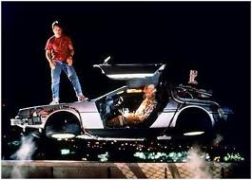
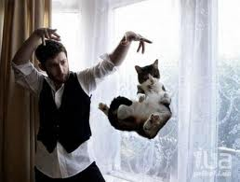
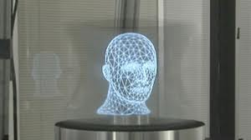
The invention of the future
We live in a world of technology. Yesterday's future is rapidly becoming for us the past. Engineering and technology with incredible pace changes, and appears outdated. Now many of the ideas fiction is all around us, let's look at the invention of the future, which should have been, or may appear soon.
Time machine
Antigravity
Hologram
Food machines
Laser weapons
Flying machines

Slide 6

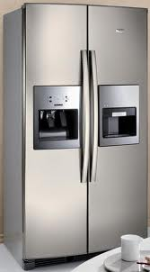
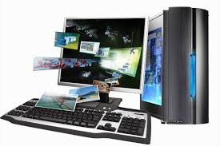
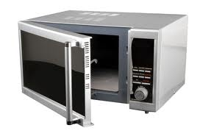
Modern technology of our homes. How do they help us?
A computer is an unusual virtual world in which you can leave your head, spend their leisure time. Using a computer, we can find all the information that we need;
In a microwave oven can heat up quickly prepared dish;
Television useful sports, music, history and science channels;
Refrigerator made ​​in order to ensure that products do not become foul.

