Slide 1
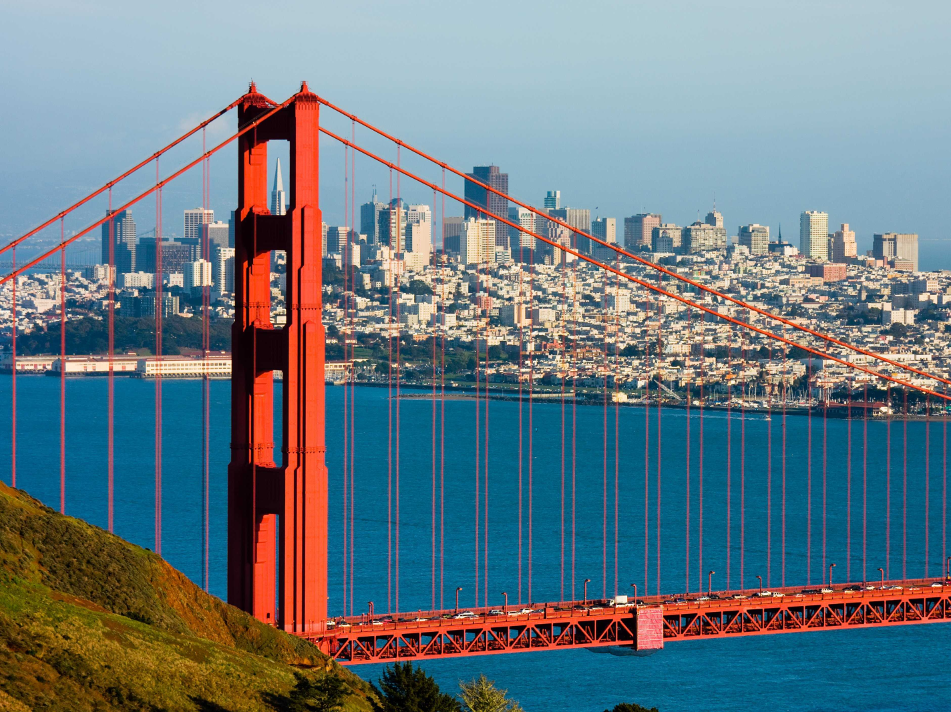
San Francisco

Slide 2
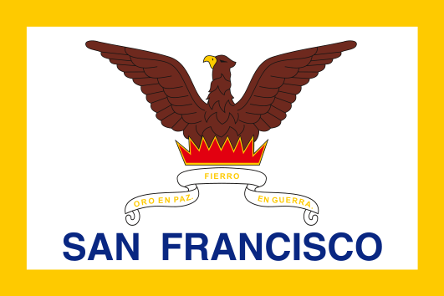
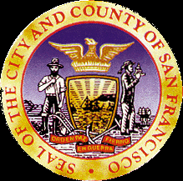
San Francisco, officially the City and County of San Francisco, is the leading financial and cultural center of Northern California and the San Francisco Bay Area.
Flag
Seal

Slide 3
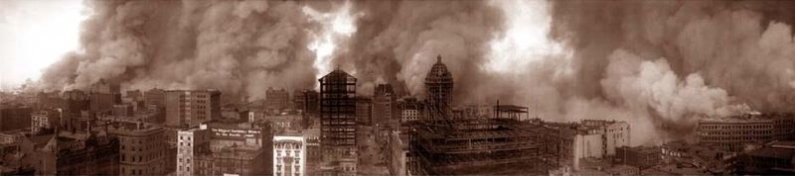
History
San Francisco was founded on June 29, 1776, when colonists from Spain established a fort at the Golden Gate .The California Gold Rush of 1849 made it the largest city on the West Coast in that time. Due to the growth of its population, San Francisco became a consolidated city-county in 1856. But in 1906 the city was destroyed by the earthquake and fire.

Slide 4
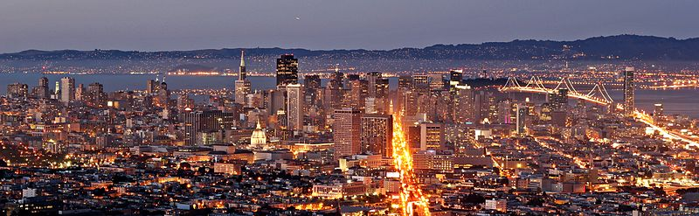
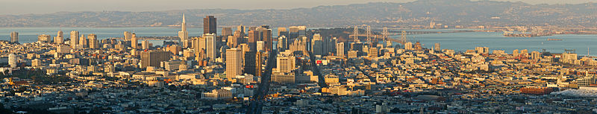
San Francisco is located on the West Coast of the United States at the north end of San Francisco Peninsula.
San Francisco covers an area of more than 600,6 square kilometers. The population is 825,863 people. San Francisco is the fourth most populated city in California, after Los Angeles, San Diego and San Jose.

Slide 5
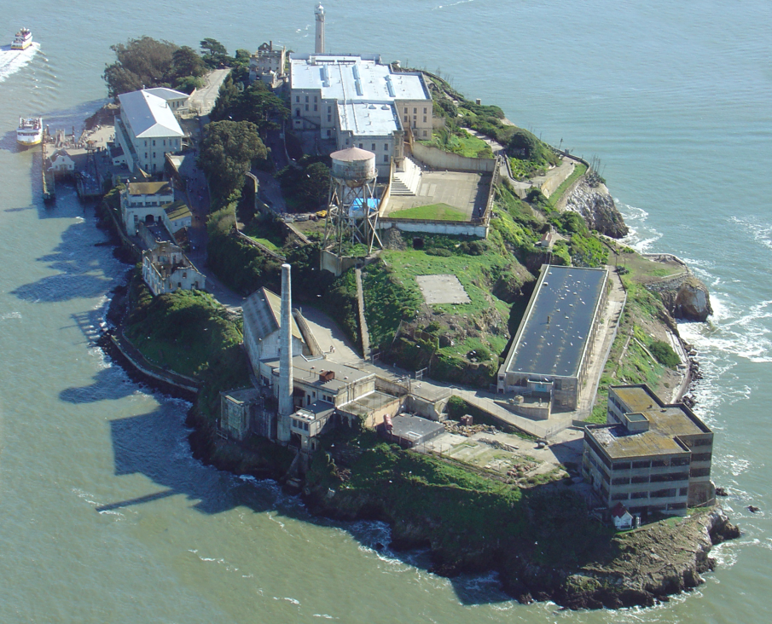
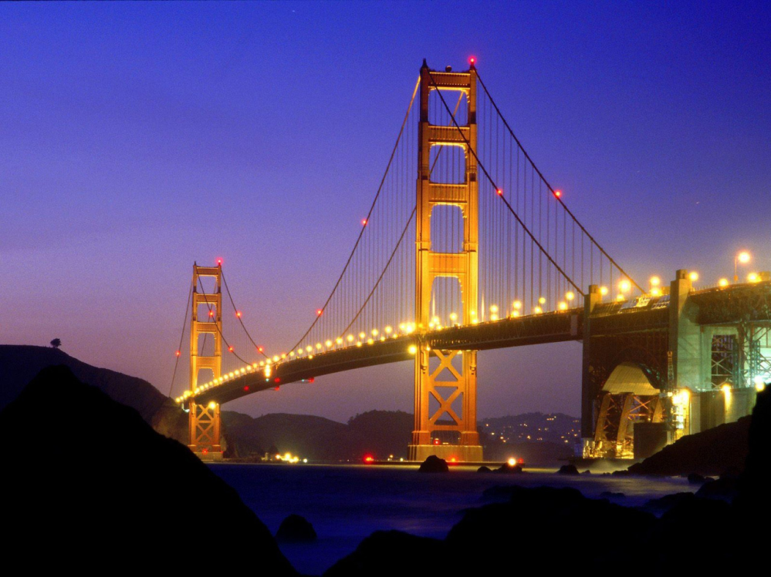
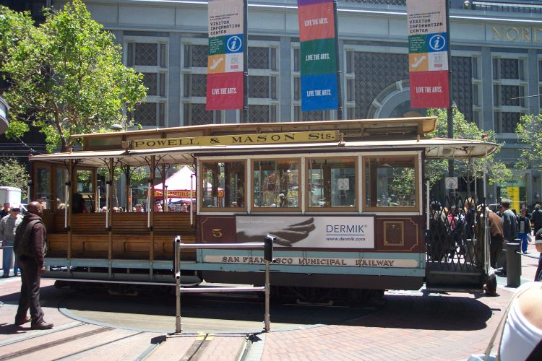
The main landmarks of San Francisco are the Golden Gate Bridge, cable cars, the former prison on Alcatraz Island.

Slide 6
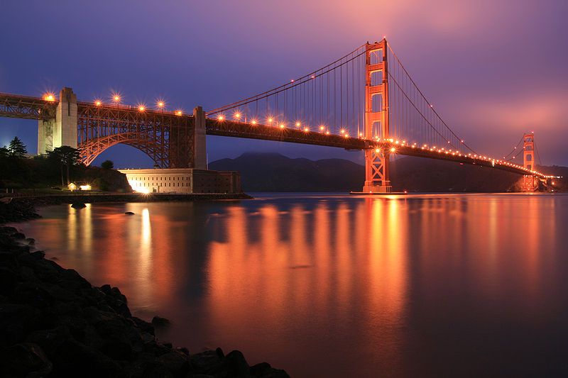
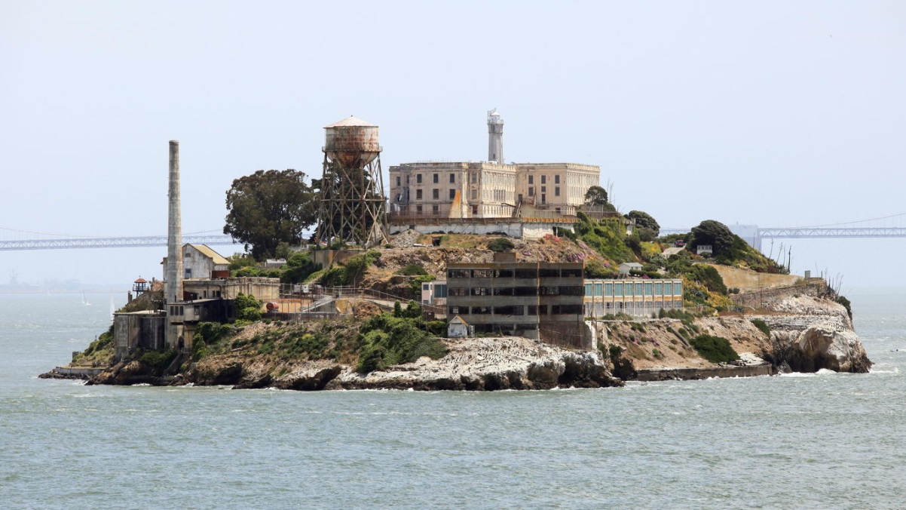
The Golden Gate Bridge is a suspension bridge spanning over the Golden Gate strait. It is one of the most internationally recognized symbols of San Francisco. It was opened in 1937. The length of this bridge is 1970 meters. The Golden Gate Bridge is the second most used suicide site in the world.
Alcatraz Island is located in the San Francisco Bay. The small island was developed with facilities for a lighthouse, a military prison and a federal prison. In 1986 Alcatraz became a National Historic Landmark.

