Slide 1
Why do people travel?

Slide 2
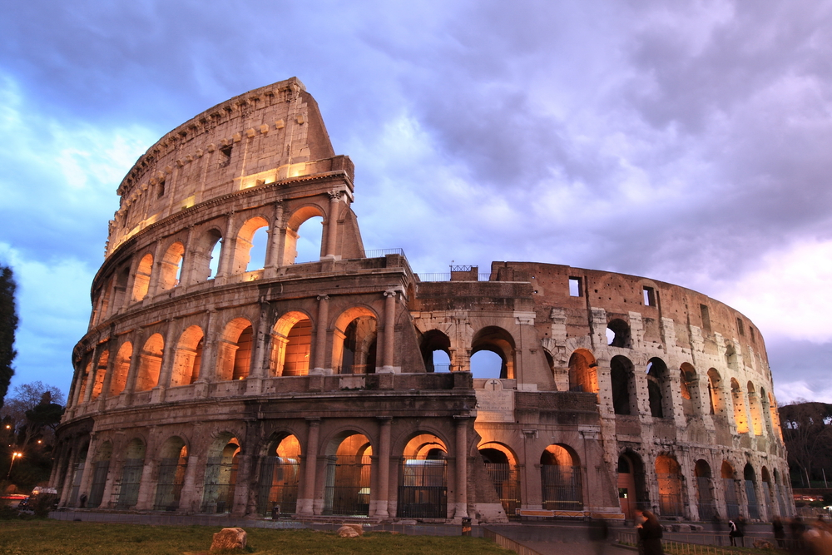
To see the sights

Slide 3
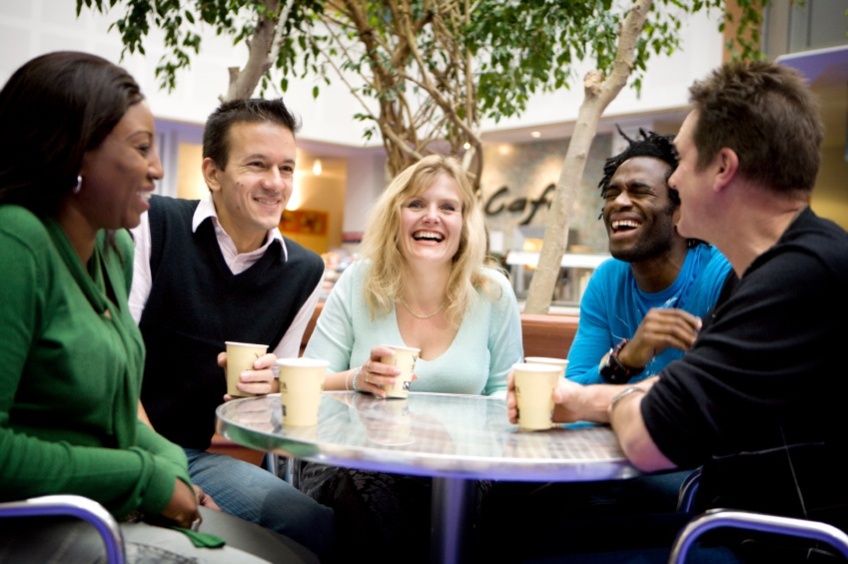
To meet people

Slide 4
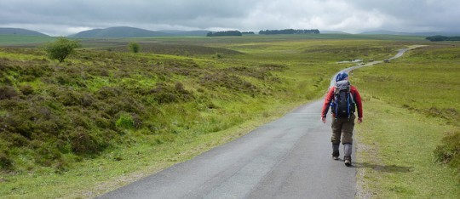
To discover new places

Slide 5
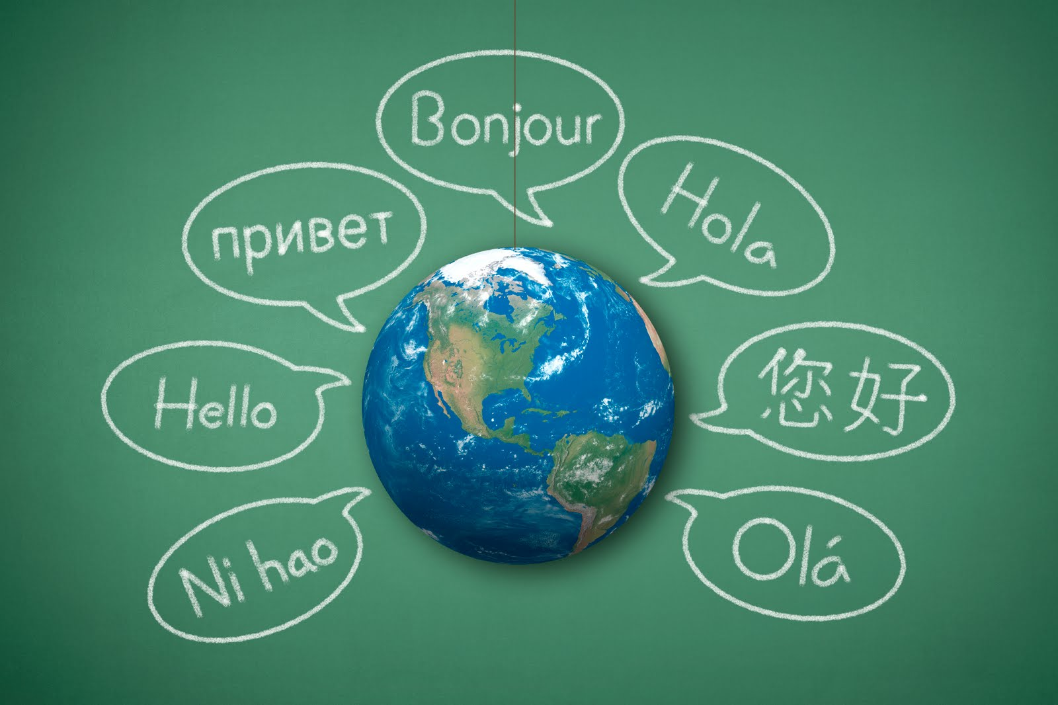
To learn a language

Slide 6
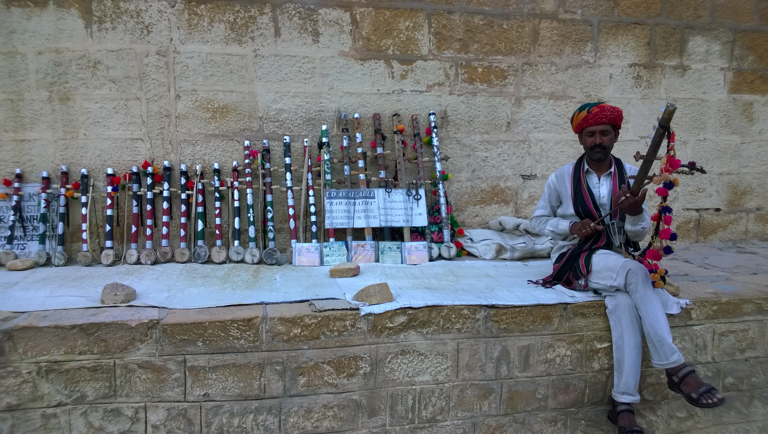
To know the history, culture

Slide 7
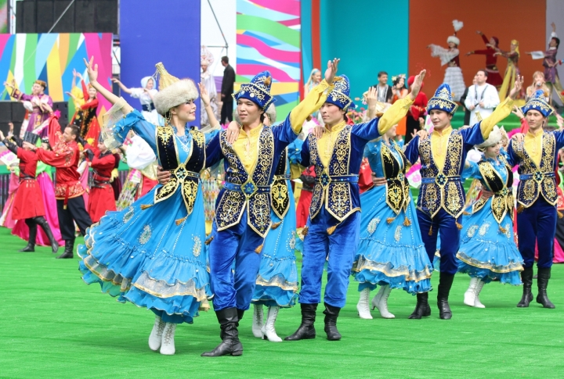
To know customs traditions

Slide 8
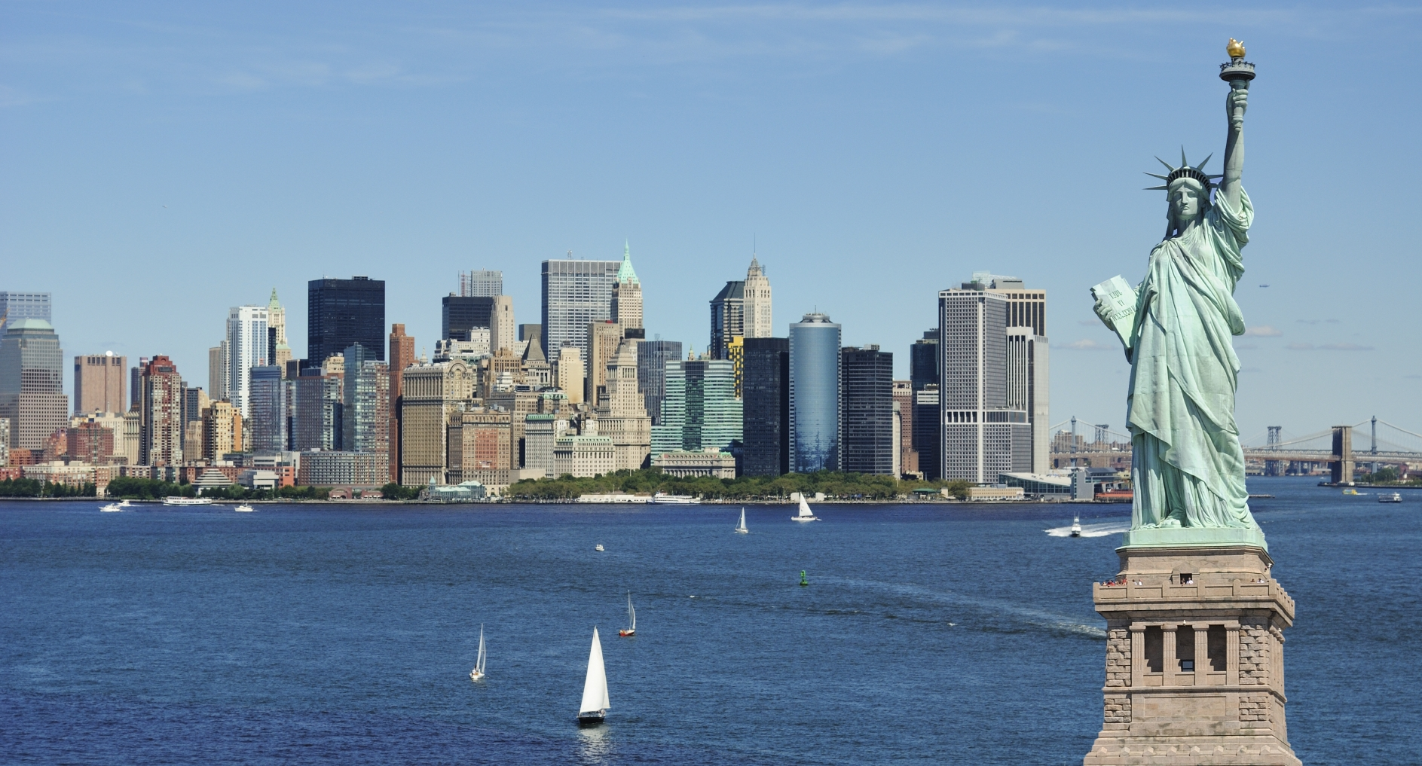
To visit new places

Slide 9
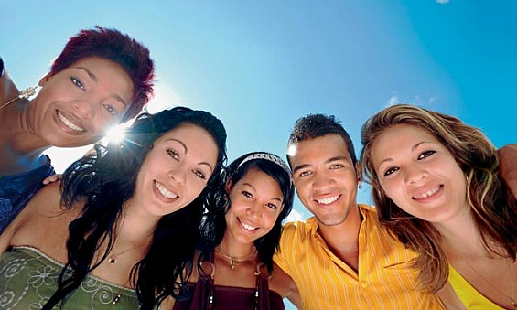
To make friends

Slide 10
Нow can people travel ?

Slide 11
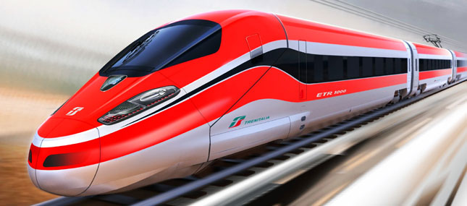
Train

Slide 12
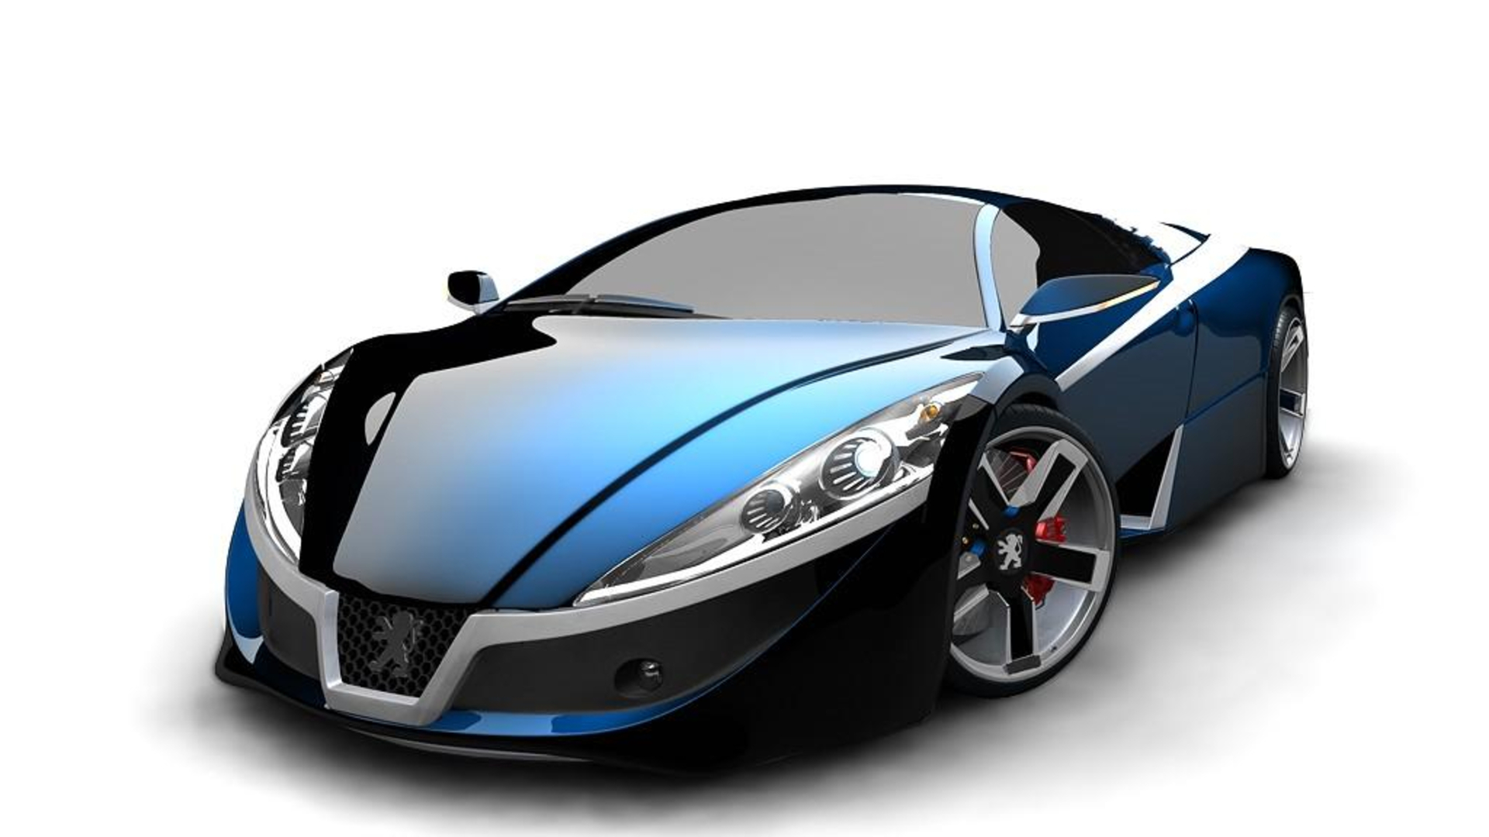
Car

Slide 13
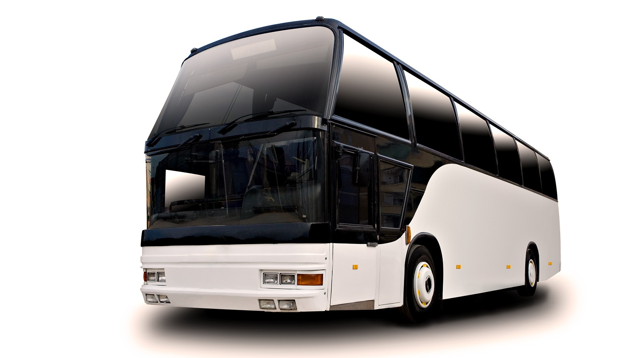
Bus

Slide 14
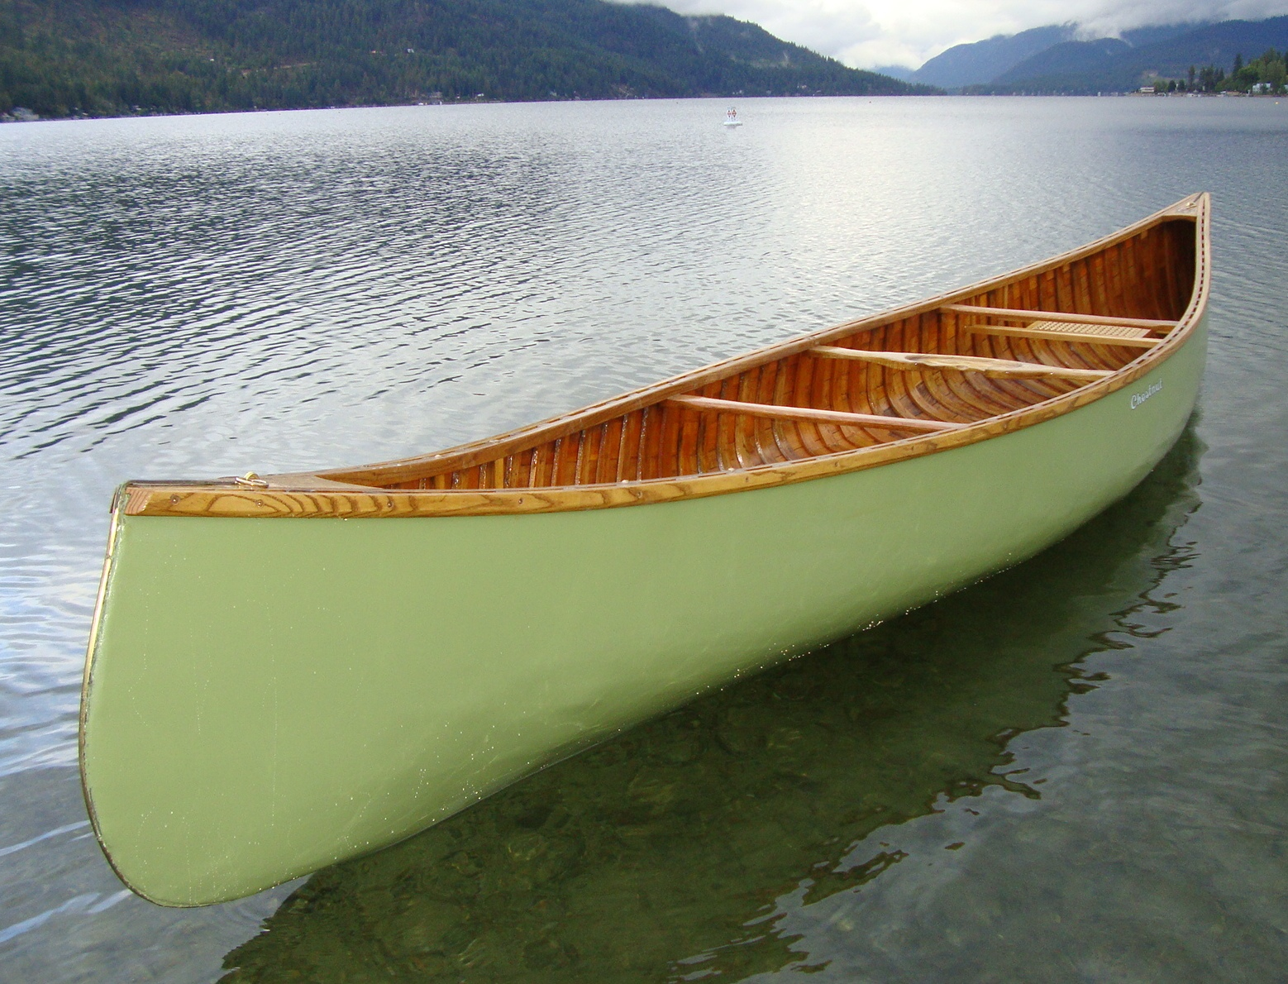
Canoe

Slide 15
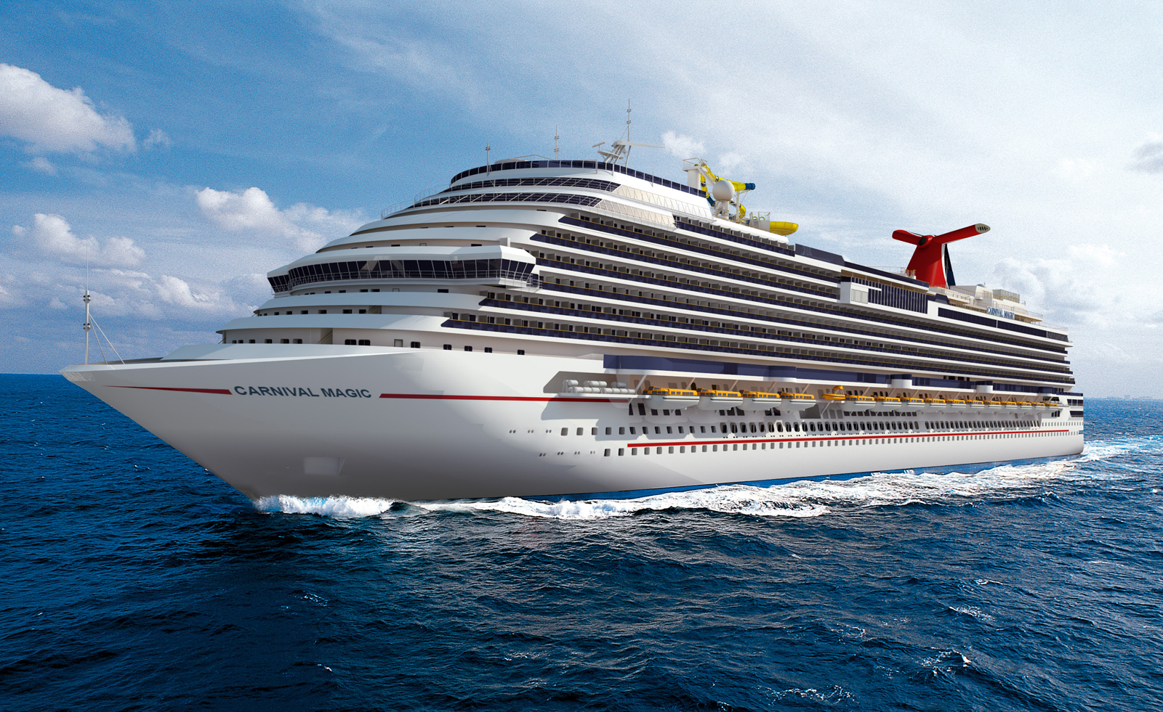
Ship

Slide 16
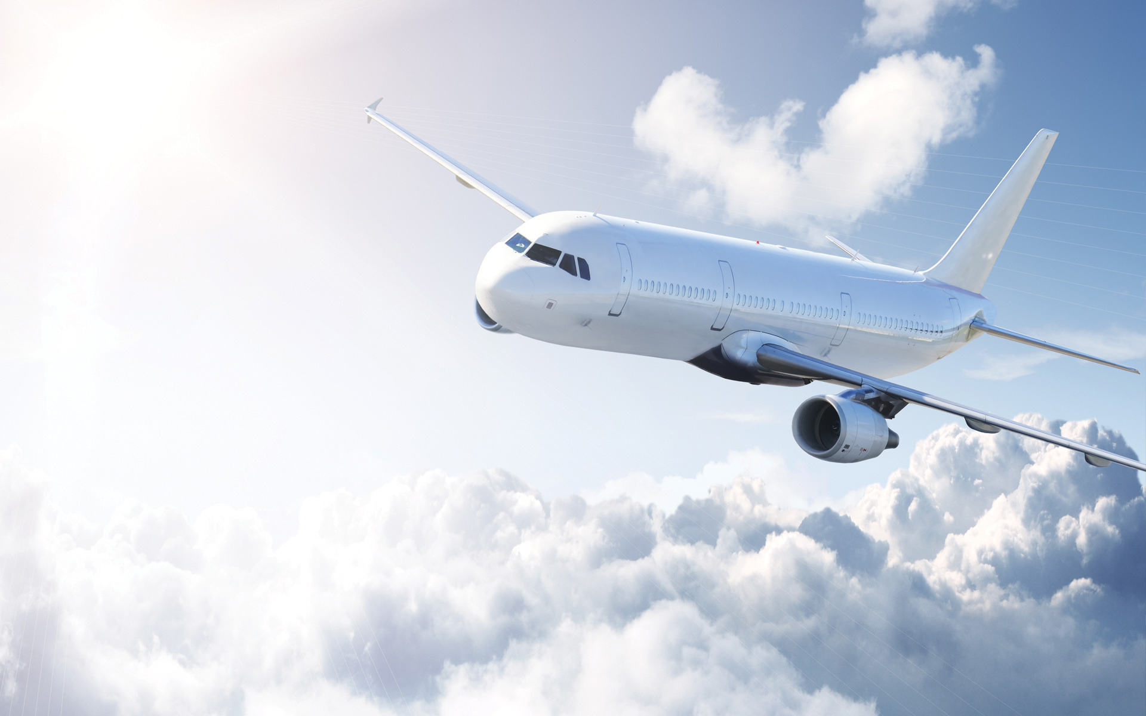
Plane

Slide 17
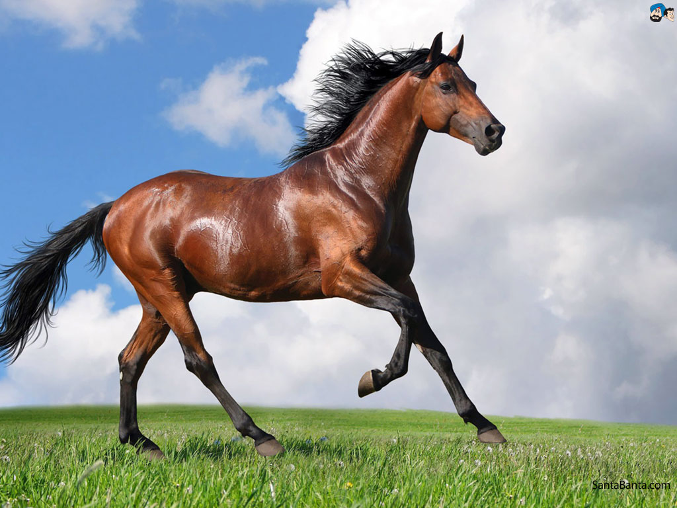
Horse

Slide 18
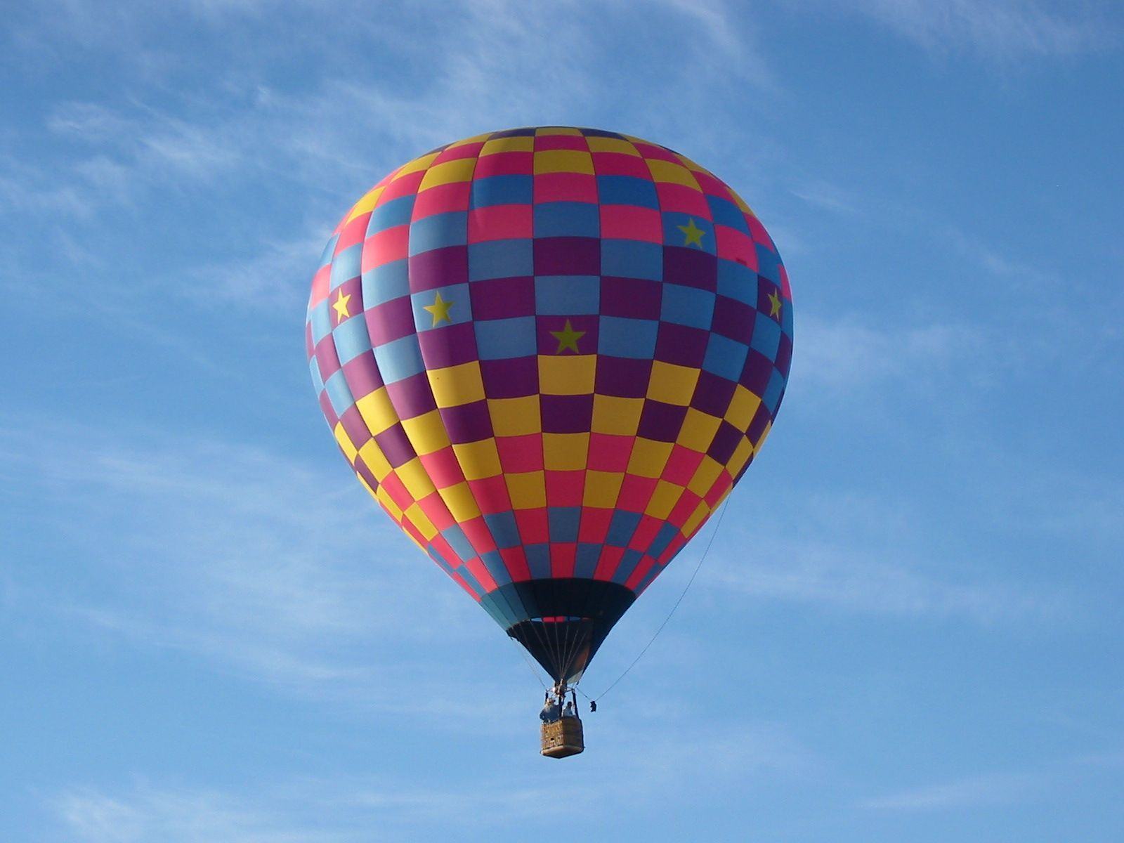
Balloon

Slide 19
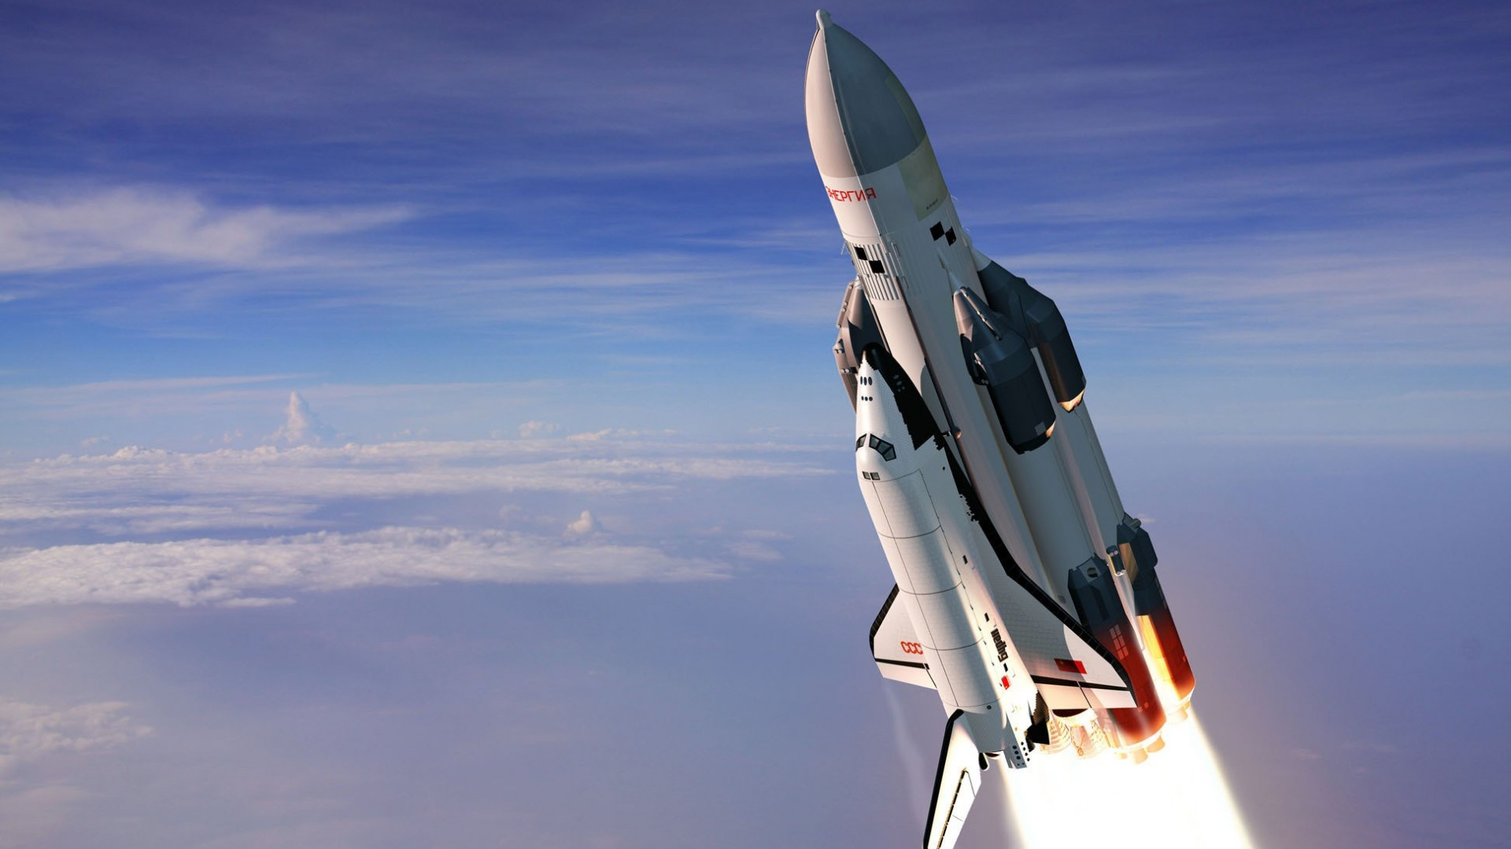
Rocket

Slide 20
Why do some people like travelling ?
by train

Slide 21
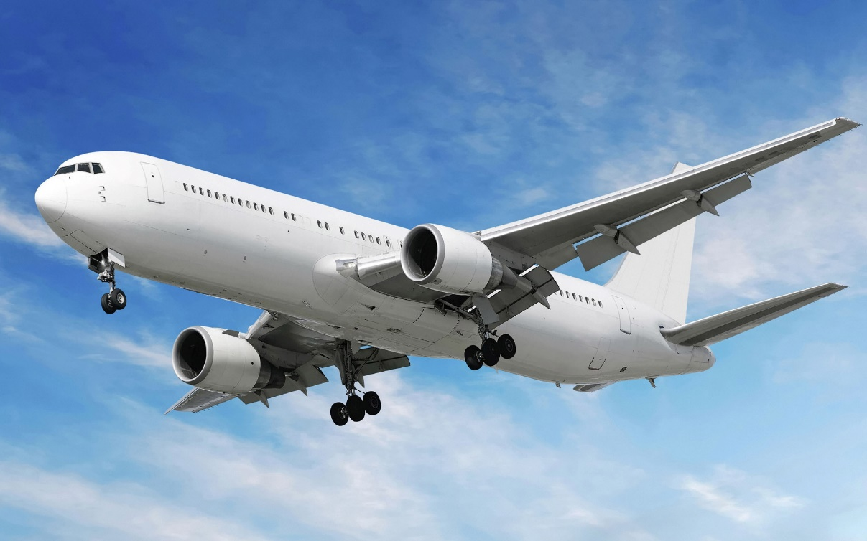
Why do some people like travelling ?
by plane

Slide 22
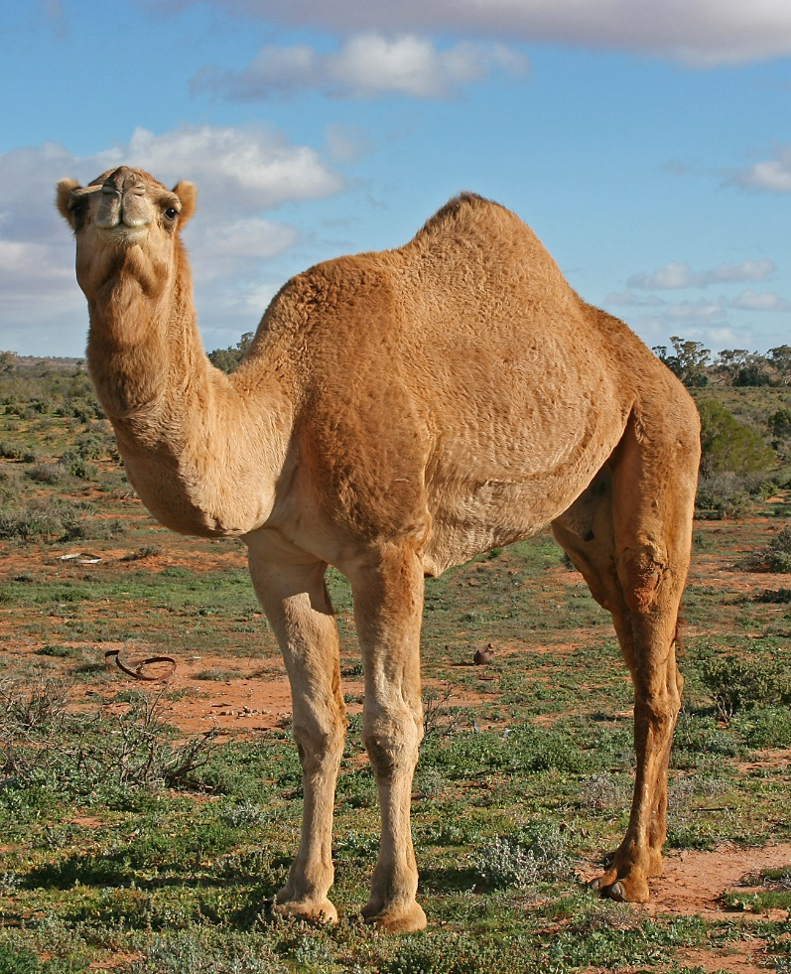
Why do some people like travelling ?
by camel

Slide 23
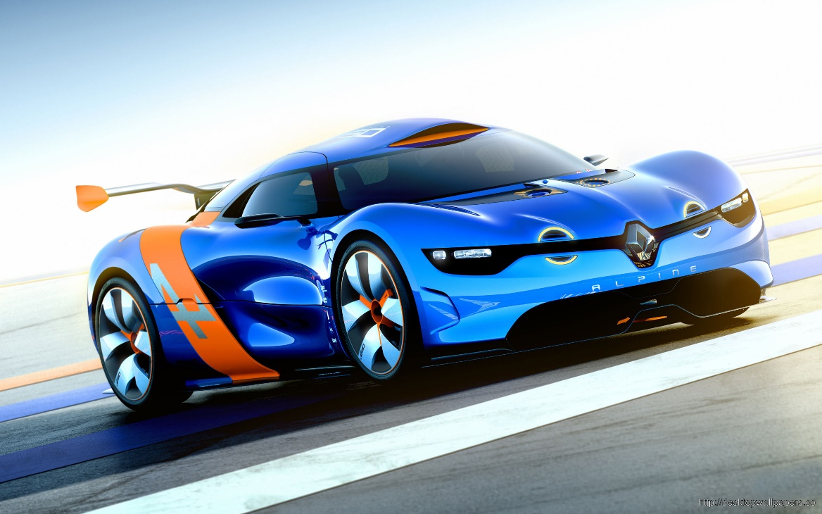
Why do some people like travelling ?
by car

Slide 24
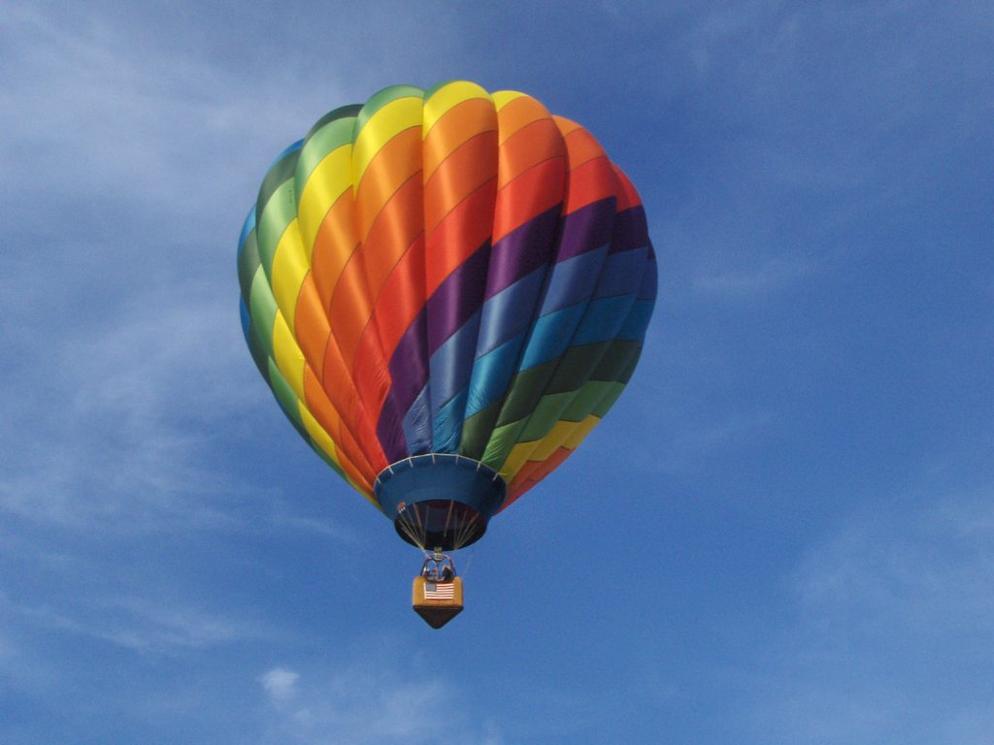
by balloon
Why do some people like travelling ?

Slide 25
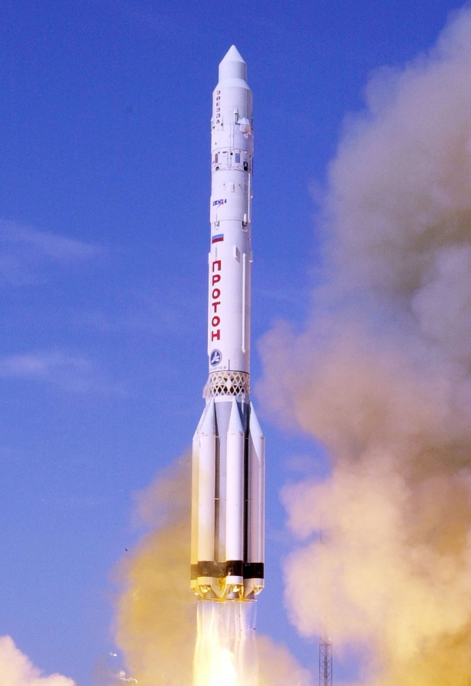
Why do some people like travelling ?
by rocket

Slide 26
What activities do you associate with the holidays?

Slide 27
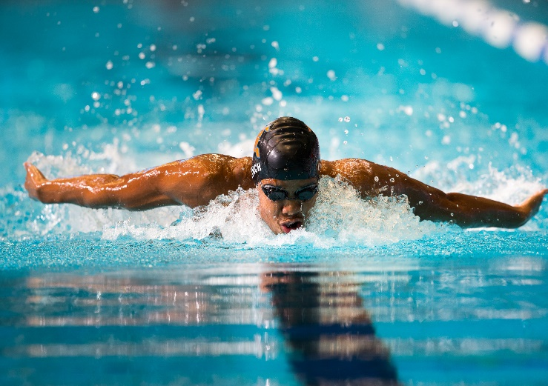
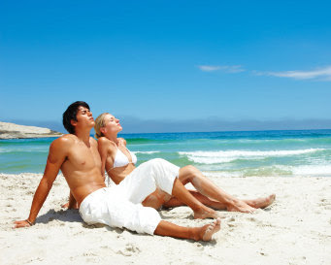
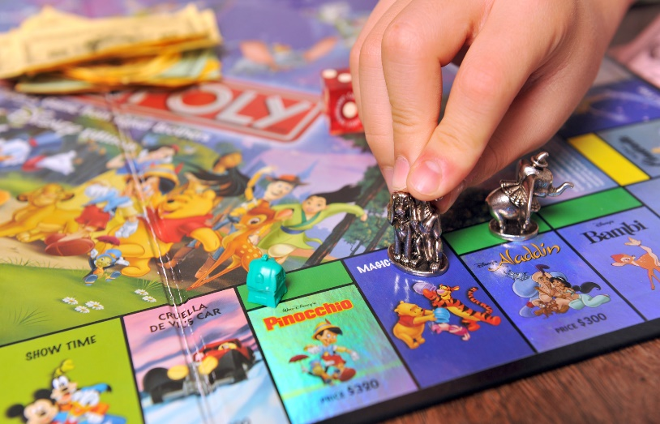
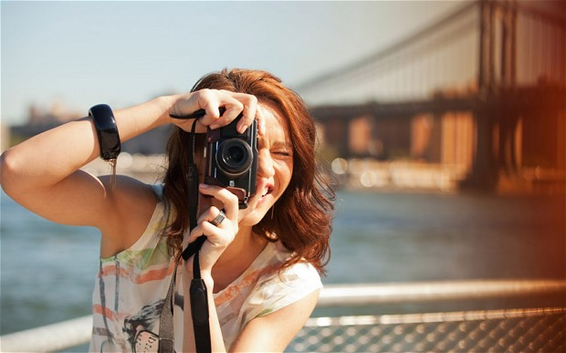
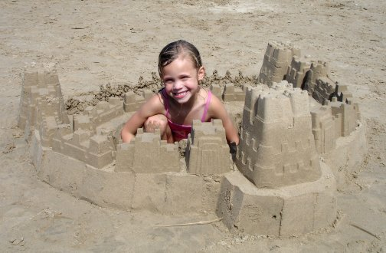
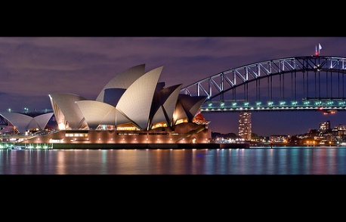
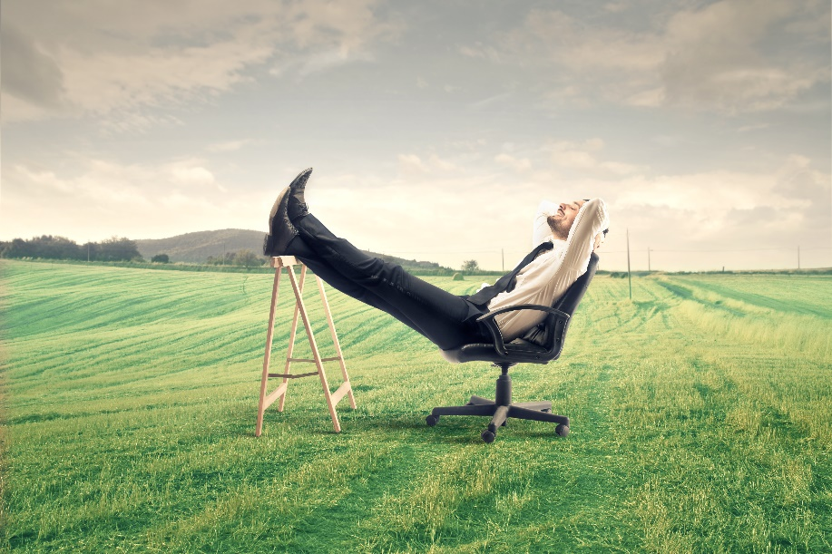
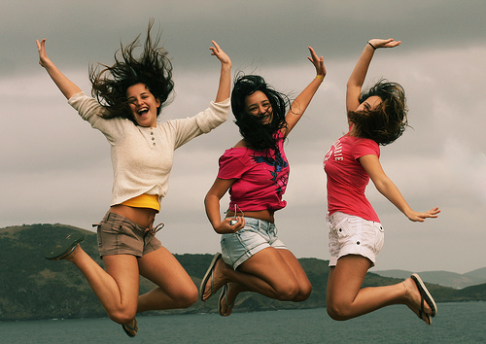
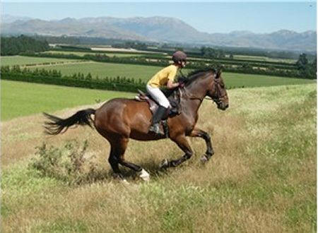
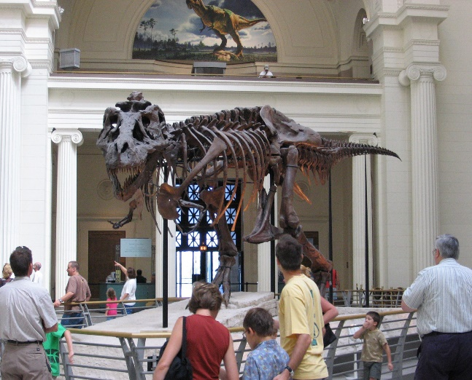
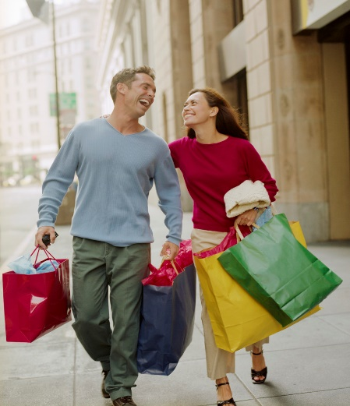
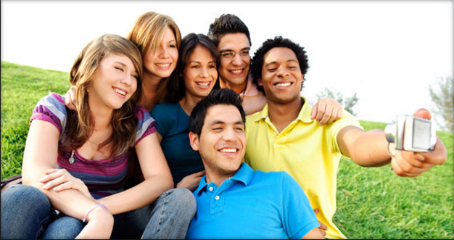
see different places
swim
sunbath
take photos
make sandcastles
play games
relax
have fun
visit museums
make friends
ride a horse
go shopping

Slide 28
drink –
drank
have –
had
do –
did
say –
said
take –
took
go-
went
get –
got
buy –
bought
see-
saw
think –
thought
find –
found
come –
came
eat –
ate
become –
became
make –
made

Slide 29
Our teacher us on a field trip
We much food
We we could do it
We three squirrels there
you any big animals?
We close to the crane
We a good clearing in the woods
We a big fire
you your snacks in the woods?
took
didn’t buy
didn’t think
saw
Did
see
didn’t get
found
didn’t make
Did
eat

Slide 30
A man travels the world over in search over what he needs , and returns home to find it
(Moore)

Slide 31
East or West
Home is best

Slide 32
 | Family | Friends | Weather | TV | Food
Jelena
Daniel
Ebru
X
X
X
X
X
X
X

Slide 33
She misses
In Spain, she likes
Her friends,
television
The weather
food – especially seafood

Slide 34
1)She doesn’t have any friends in Spain
F
2)She lives near the beach now
T
3)The weather was bad in Manchester
T
4)She doesn’t like seafood
F
F
5)She watches Spain TV all the time

