Slide 1

Alfred the Great
the first King of the West Saxons

Slide 2
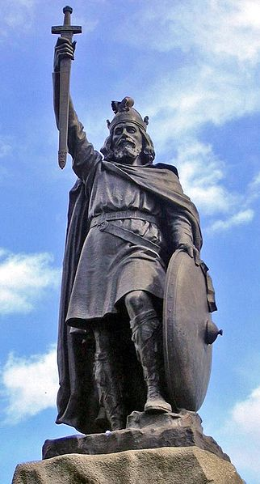

Slide 3
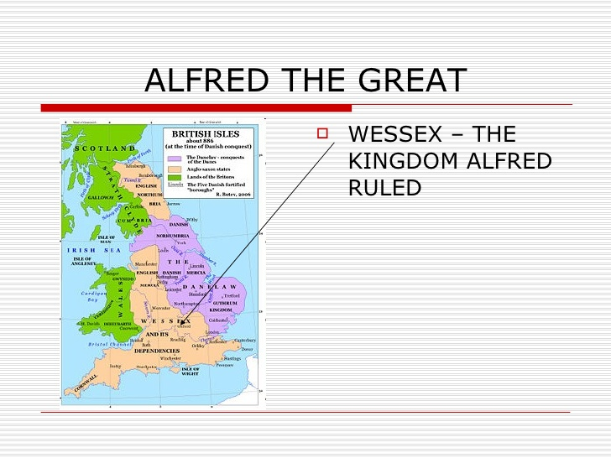

Slide 4
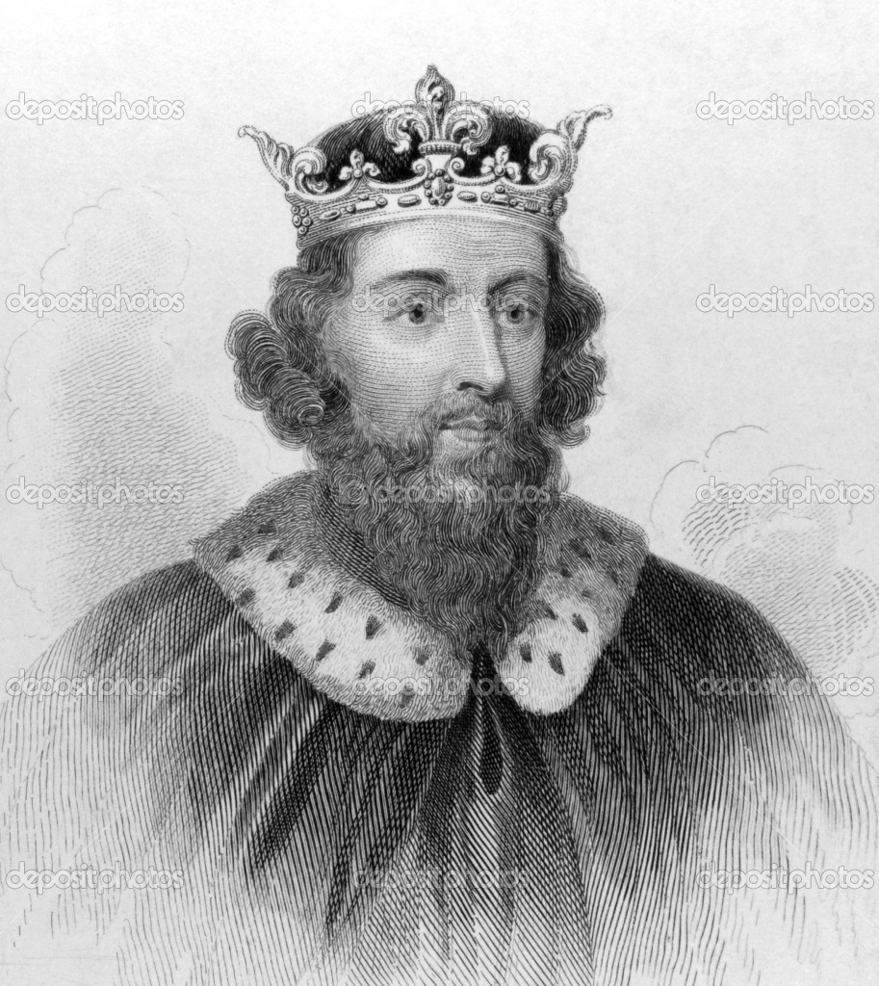
Alfred’s Life
Lived in 849-901
Had three brothers
Was the last of four brothers to rule the kingdom

Slide 5
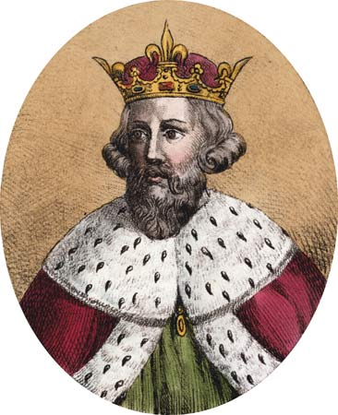
Alfred as a wise statesmen
Saved Wessex from the Vikings
Only defensive wars
Only London was added to his kingdom
Restored law and order
Retained Christianity
Built new fortresses
Reorganized his army
Beat the Danes 9 times in 871

Slide 6
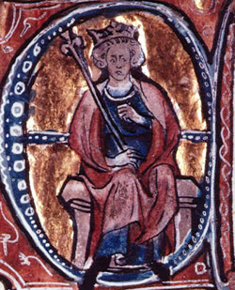
Alfred as an educator
Founded a palace school to teach Noblemen’s sons
Urged that each citizen should learn to read in their mother tongue

Slide 7
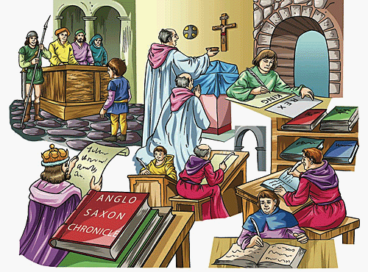
Alfred as a writer
Anglo - Saxon chronicle
The first prose work in English literature
Some parts written by Alfred The Great

Slide 8
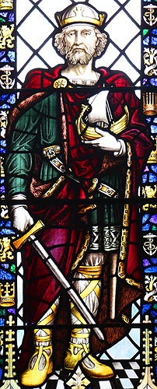
Alfred as a translator
Translated from Latin into Anglo-Saxon and Vise Versa
Bede’s “History of the English church”
Used as textbooks

Slide 9
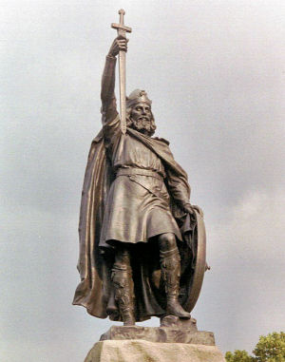
In honour Of Alfred
Alfred is the only British King or Queen to have the title of The Great
Several monuments in England

