Slide 1
Canada

Slide 2
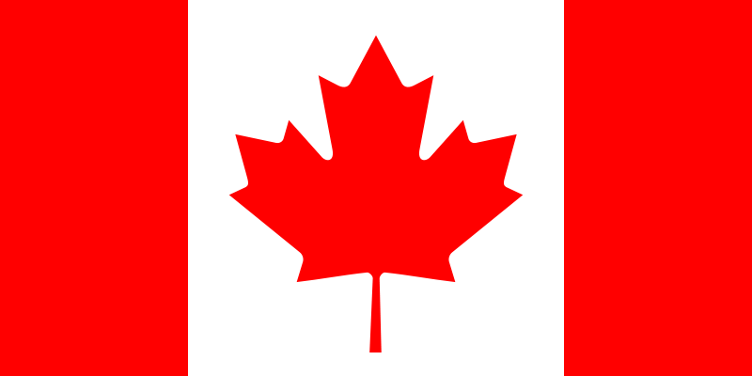
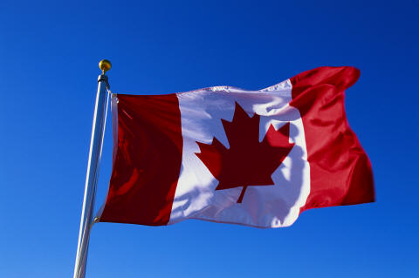
Flag of Canada
The National Flag of Canada, also known as the Maple Leaf and l'Unifolié (French for "the one-leafed"), is a flag consisting of a red field with a white square at its centre, in the middle of which is featured a stylized, 11-pointed, red maple leaf. Adopted in 1965 to replace the Union Flag.

Slide 3
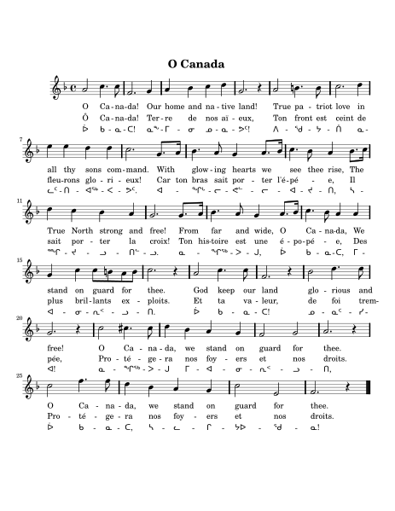

Anthem of Canada
"O Canada" is the national anthem of Canada. The lyrics were originally in French and translated into English in 1906. Robert Stanley Weir wrote in 1908 another English version, which is the official and most popular version, one that is not a literal translation of the French. "O Canada" had served as a de facto national anthem since 1939, officially becoming Canada's national anthem in 1980.

Slide 4

Motto of Canada
A Mari Usque Ad Mare (English: From Sea to Sea; French: D'un océan à l'autre) is the Canadian national motto. The phrase comes from the Latin Vulgate translation of Psalm 72:8 in the Holy Bible, which reads "Et dominabitur a mari usque ad mare, et a flumine usque ad terminos terrae" (King James Bible: "He shall have dominion also from sea to sea, and from the river unto the ends of the earth").

Slide 5
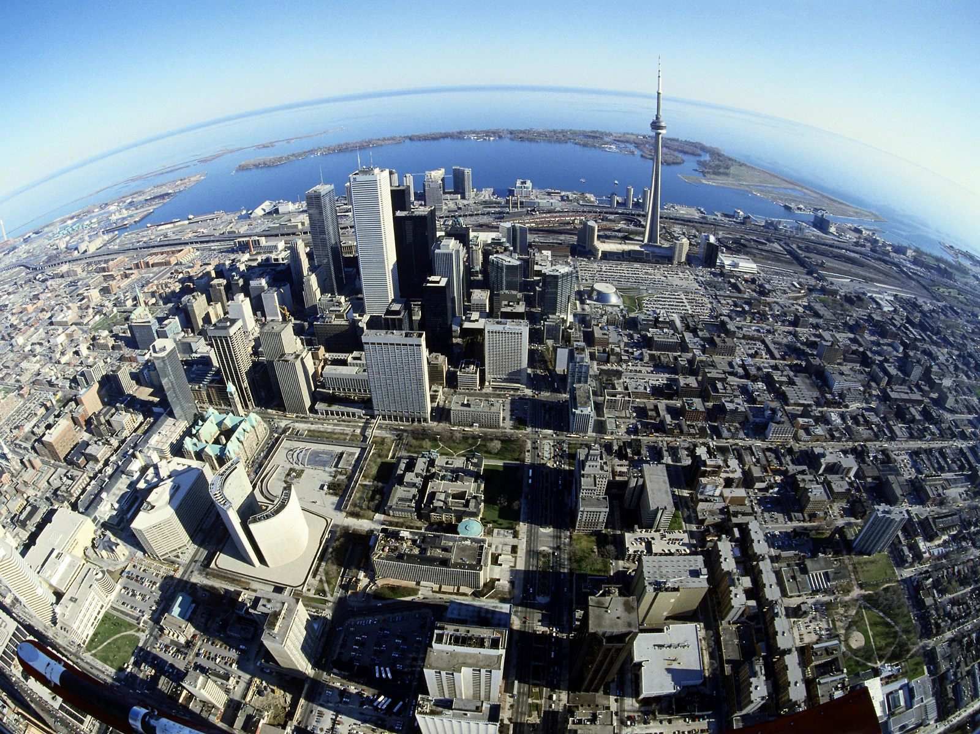
About country
Canada is a federal parliamentary democracy and a constitutional monarchy, with Queen Elizabeth II as its head of state. The country is officially bilingual at the federal level. It is one of the world's most ethnically diverse and multicultural nations. Its advanced economy is one of the largest in the world, relying chiefly upon its abundant natural resources and well-developed trade networks.

Slide 6
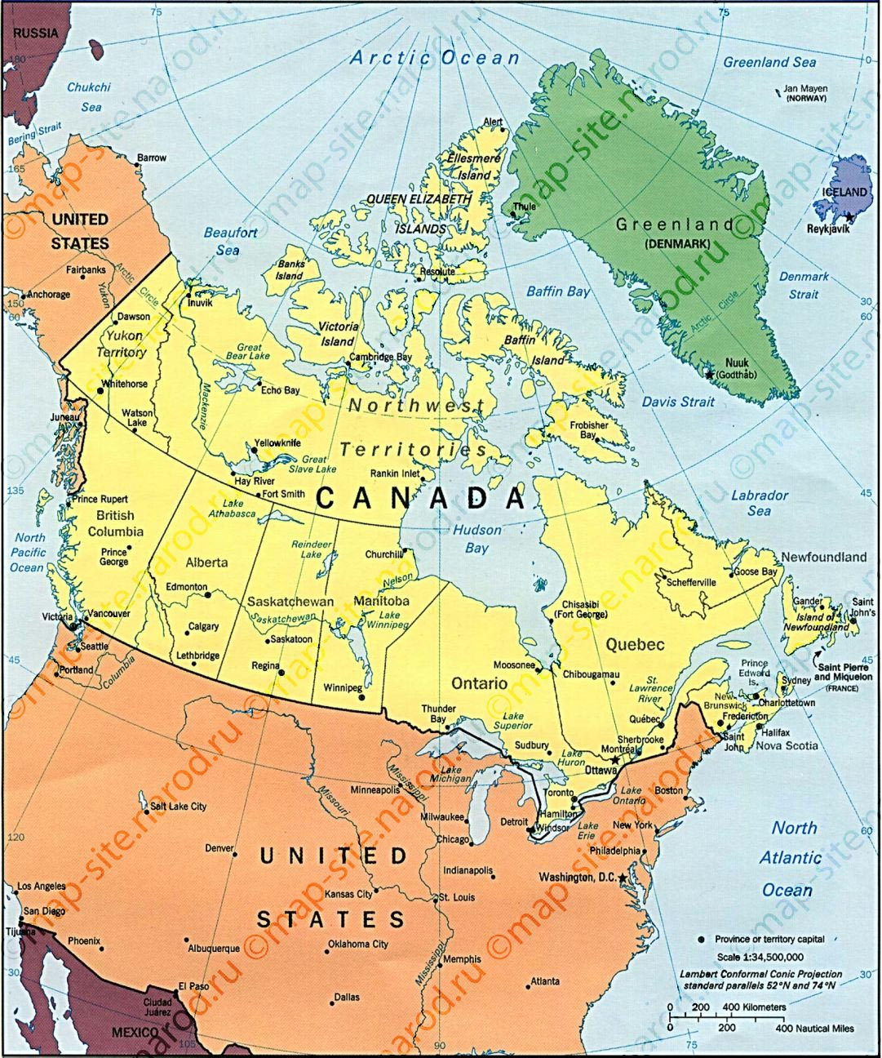
Geography
Canada occupies a major northern portion of North America, sharing land borders with the contiguous United States to the south and the US state of Alaska to the northwest. By total area (including its waters), Canada is the second-largest country in the world, after Russia. By land area alone, Canada ranks fourth.

Slide 7
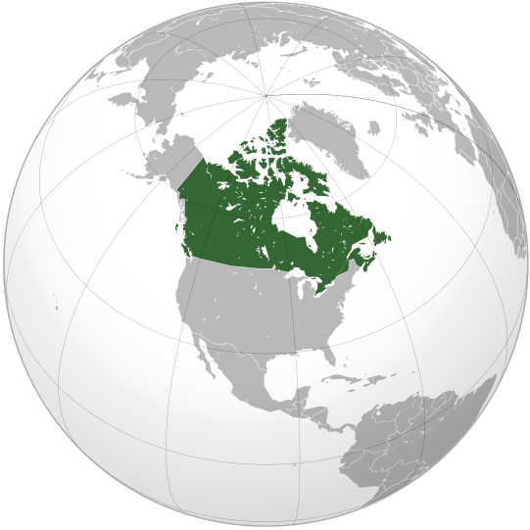
Highlights Summary
Capital | Ottawa
Largest city | Toronto
Demonym | Canadian
Government Monarch Governor General Prime Minister Chief Justice | Federal Parliamentary Constitutional Monarchy Elizabeth II David Johnston Stephen Harper Beverley McLachlin
Ethnic groups | 76.7% White 14.2% Asian 4.3% Aboriginal 2.9% Black 1.2% Latin America 0.5% Multiracial 0.3% Other
Currency | Canadian dollar ($) (CAD)

Slide 8
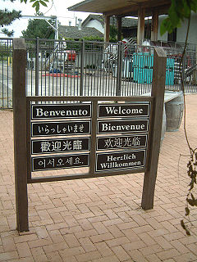
Language
Canada's two official languages are English and French. English and French have equal status in federal courts, Parliament, and in all federal institutions. Approximately 98 percent of Canadians speak English or French: 57.8 percent speak English only, 22.1 percent speak French only, and 17.4 percent speak both. In 2011, nearly 6.8 million Canadians listed a non-official language as their mother tongue.

Slide 9
