Slide 1
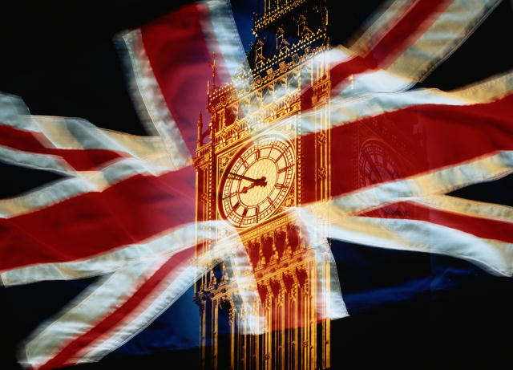
Football stadiums
in Great Britain

Slide 2
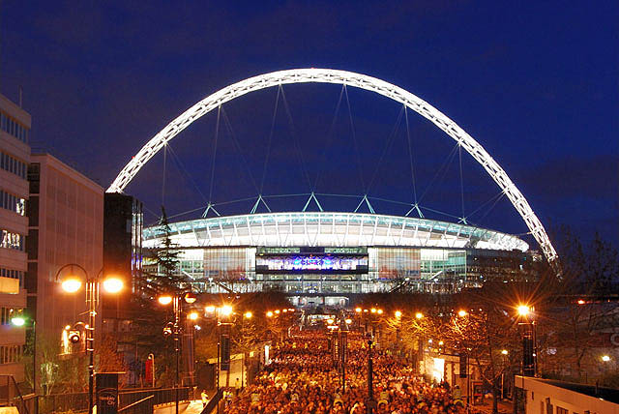
Wembley, London

Slide 3
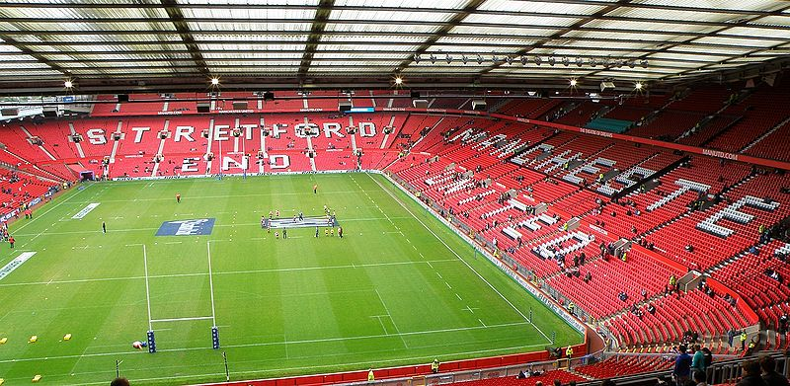
Old Trafford, Manchester

Slide 4
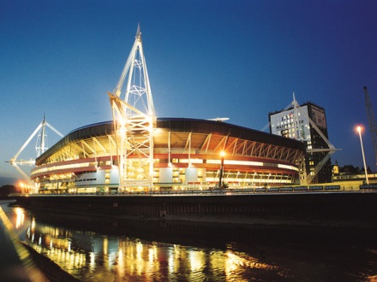
Millennium, Cardiff

Slide 5
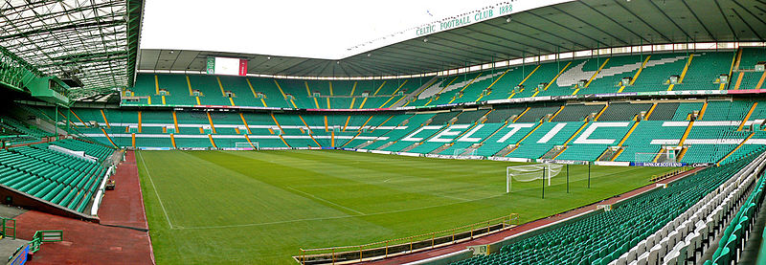
Celtic Park, Glasgow

Slide 6
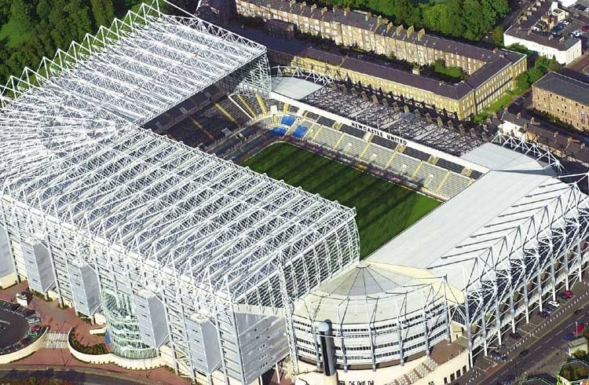
St James' Park,Newcastle upon Tyne

Slide 7
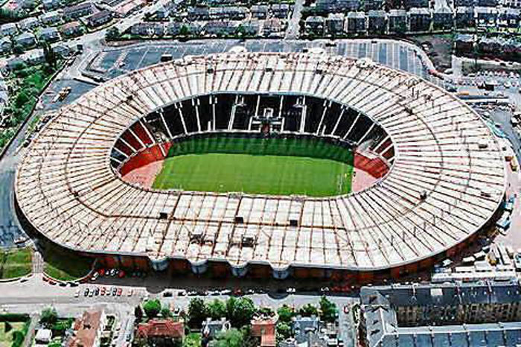
Hampden Park, Glasgow

Slide 8
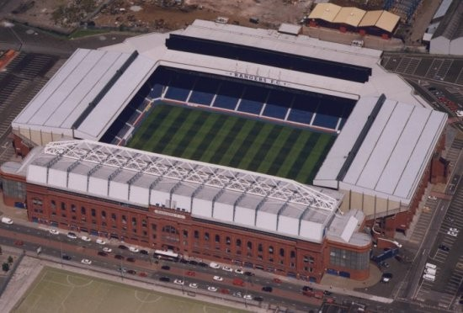
Ibrox Stadium, Glasgow

Slide 9
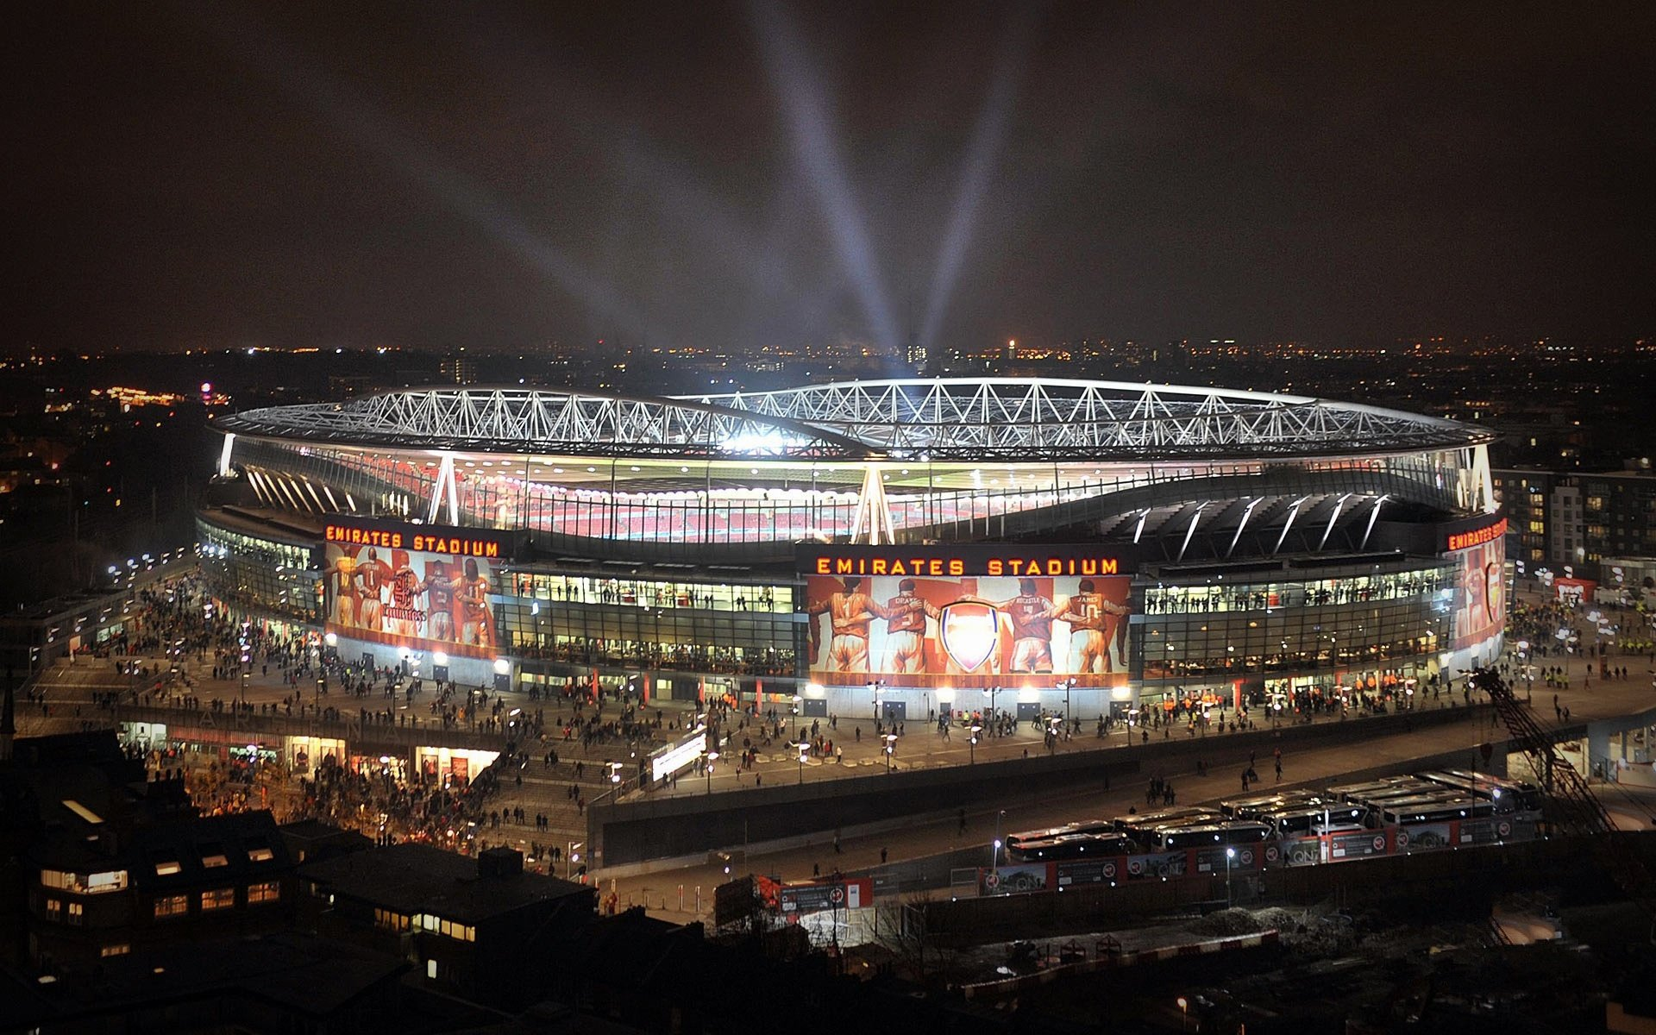
Emirates, London

Slide 10
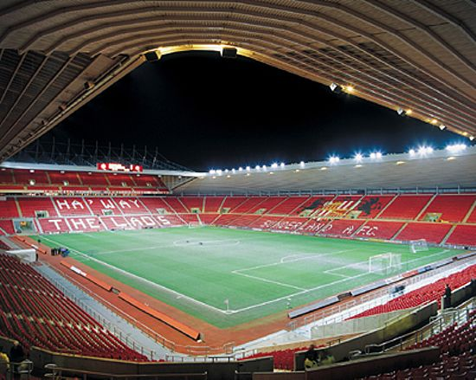
Sunderland Stadium Of Light

Slide 11
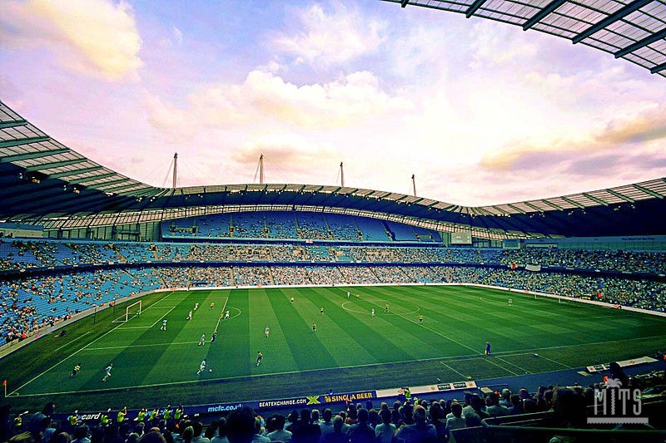
City of Manchester Stadium, Manchester

Slide 12
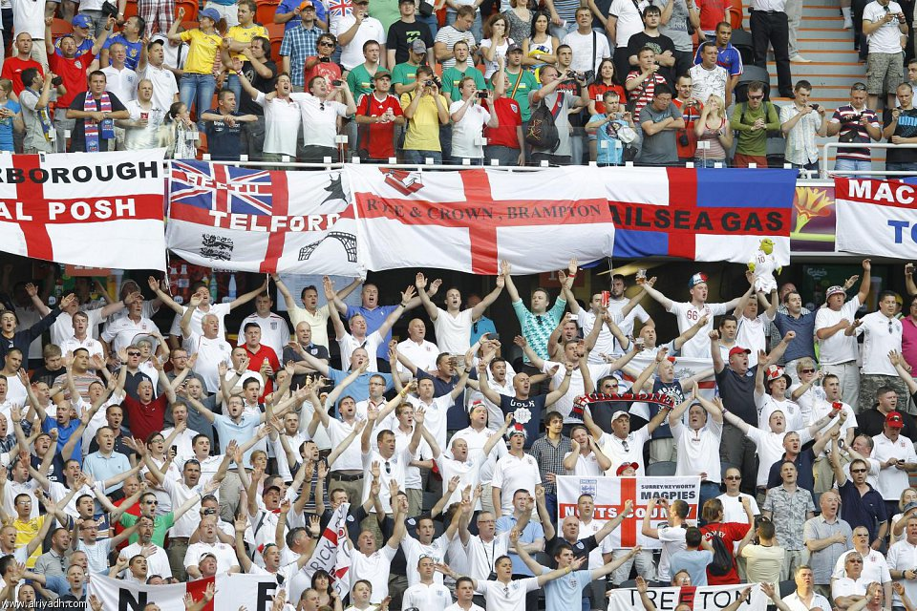

Football fans in Great Britain

Slide 13
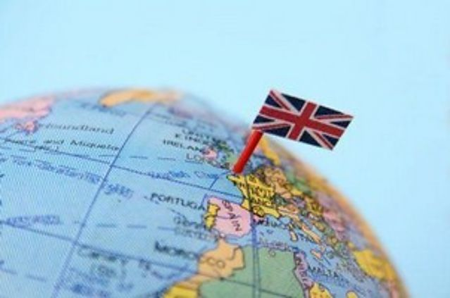
Anzhelika Yakymiv
10-A

