Slide 1
The Laughing Man
By Tanya Zarownaya

Slide 2

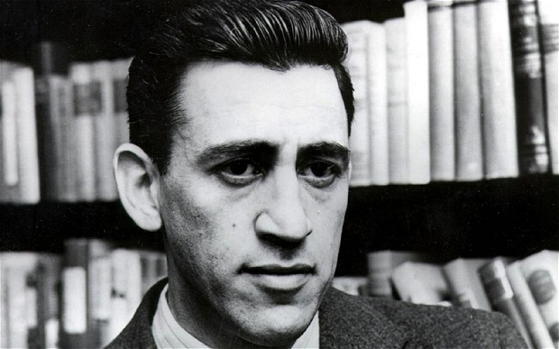
"The Laughing Man" is a short story by J. D. Salinger, published originally in The New Yorker on March 19, 1949; and also in Salinger’s short story collection Nine Stories.
It largely takes the structure of a story within a story and is thematically occupied with the relationship between narrative and narrator, and the end of youth.

Slide 3
Plot
An unnamed narrator recounts his experiences as a nine-year-old member of the Comanche Club in New York City in 1928. The leader of the club, “The Chief”, is a young law student at New York University who is described as lacking in physical attractiveness but appears beautiful to the narrator.
Every day, after the troop has completed its activities, The Chief gathers the boys for the next episode in an ongoing story about the eponymous Laughing Man. In the format of a serial adventure novel, The Chief’s story describes the Laughing Man as the child of missionaries who was kidnapped by bandits in China, who deformed his face by compressing it in a vise; he was obliged to wear a mask, but compensated by being profoundly athletic and possessed of a great Robin Hood-like charm and the ability to speak with animals.

Slide 4
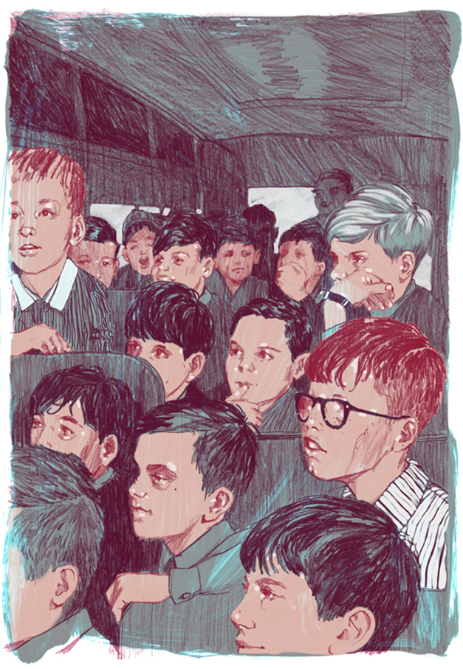
The heroic larceny tweaked his nose at the internationally famous detective.
Eventually, The Chief takes up with a young woman, Mary Hudson
As the Chief’s relationship with Mary waxes and wanes, so too do the fortunes of The Laughing Man. One day, the Chief presents an instalment where the Laughing Man is taken prisoner and in mortal danger
In the final instalment of the story, the Chief kills off the Laughing Man

Slide 5
Thank you for your attention

