Slide 1
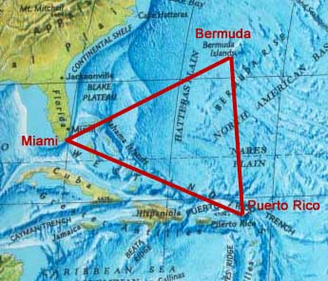
Bermuda Triangle
The Bermuda Triangle, also known as the Devil's Triangle, is a region in the western part of the North Atlantic Ocean, where a number of plains and ships are said to have disappeared under mysterious conditions. According to the US Navy, the triangle does not exist. In 2013 the World Wide Fund for Nature identified the world’s 10 most dangerous waters for shipping, but the Bermuda Triangle was not among them.

Slide 2
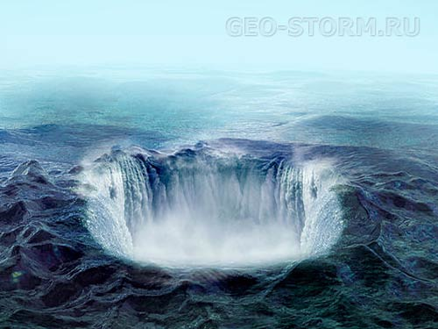
Origins
The earliest facts of unusual disappearances in the Bermuda area appeared in a September 17, 1950 article published in The Miami Herald. Two years later, Fate magazine published "Sea Mystery at Our Back Door". Sand covering the loss of several planes and ships, including the loss of Flight 19, a group of five U.S. Navy TBM Avenger bombers on a training mission. This article was the first to lay out the now-familiar triangular area where the losses took place. And it was first to suggest a supernatural and strange events in this region.

Slide 3
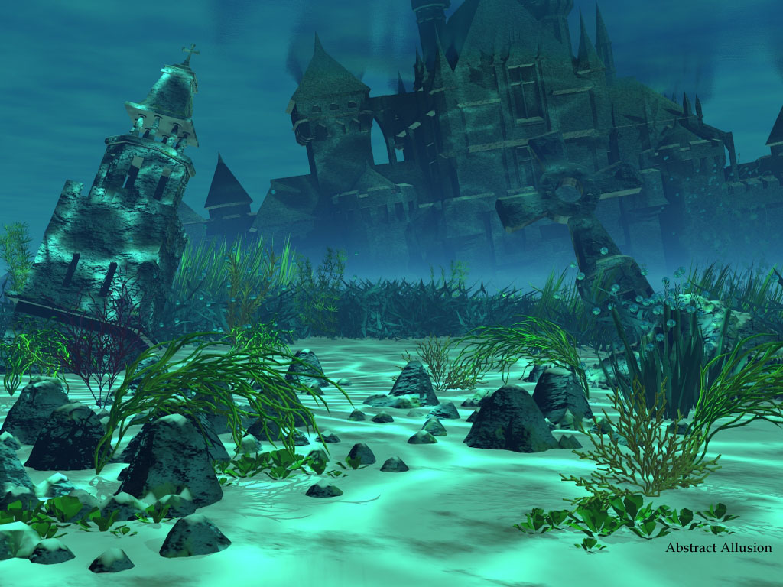
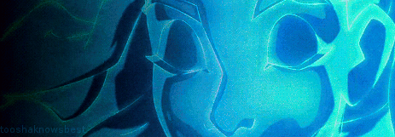
Of the various claims about the Bermuda Triangle, the suggestion that it is the location of the lost city of Atlantis is one popularized idea.

Slide 4
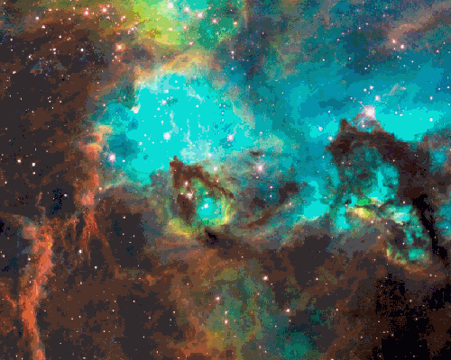
Portals leading into other dimensions and time is the theory that lacks its evidence. Some reports say that as many as 1,000 lives have been lost in the past 500 years and that more than 50 ships and 20 planes have been lost within the last century in the Bermuda Triangle.

Slide 5

Methane gas is an explanation for some disappearances in the Bermuda Triangle. In this area scientists have found vast fields of a natural gas called methane. Laboratory experiments have proven that bubbles of methane could indeed sink a ship.

Slide 6
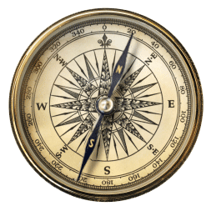
Strange disappearances in the Bermuda Triangle have been linked with evidence of compass and navigational problems, making geomagnetic fields a real case for disappearances in the Triangle.

Slide 7
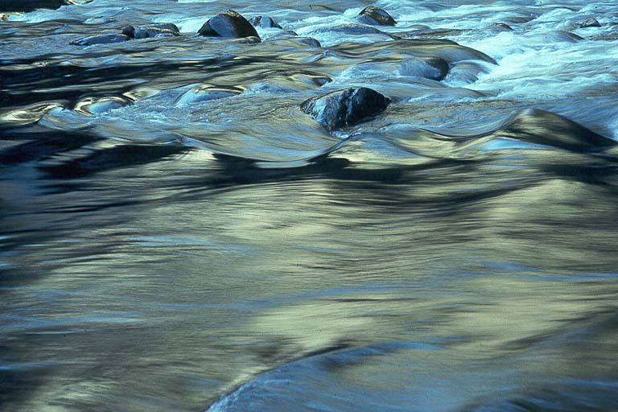
Many scientists think that Caribbean-Atlantic storms create unpredictable weather and strong water flows within the area of the Bermuda Triangle. That may be one of the biggest causes of disappearances in the Bermuda Triangle.

Slide 8
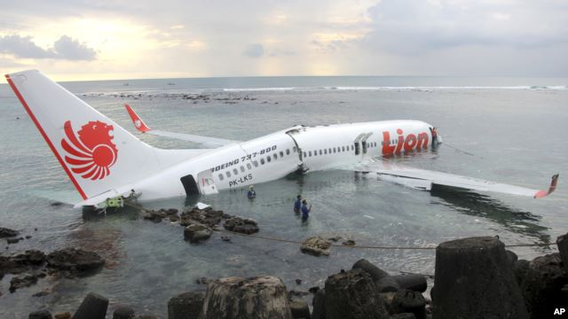
Human error is the number one reason for the loss of planes and ships in the Bermuda Triangle. Partial disorientation and sensory confusion is rare with pilots but are a well-known reasons for accidents in the sky and sea.

Slide 9
My personaly opinion
So as for me, I think that we should be very careful with our thoughts and wishes. There is a well-known proverb in English: “Think before you wish for”. If you are the pilot of a plane, which flies above the Bermuda Triangle, try to think in the positive way. Otherwise, your worries may come true. Enjoy your flight!

Slide 10
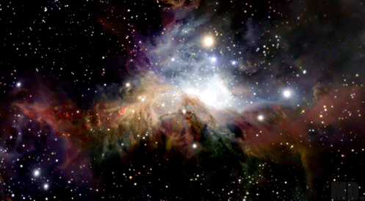
Thank you for your attention!

