Slide 1

English in the World
Drozd Daria

Slide 2
375 million people speak English around the world and there are more than 50 English speaking countries, where English is either the official or the primary language. It is the third most common primary language in the world (behind Mandarin Chinese and Spanish). The English language, which evolved from a combination of Old English and the German Anglo-Saxon tongue, began to be commonly used around the 5th century.

Slide 3
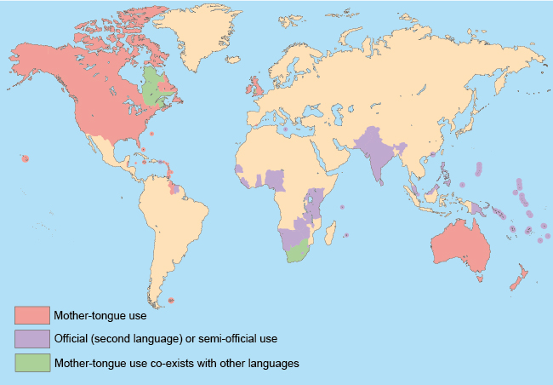

Slide 4
The countries with the highest populations of native English speakers are, in descending order: the United States (292 million), the United Kingdom (61 million), Canada (18.2 million), Australia (15.5 million), Nigeria (4 million), Ireland (3.8 million), South Africa(3.7 million), and New Zealand (3.6 million) in a 2006 Census.

Slide 5
English Speaking Countries in North America
The largest English speaking countries are located in North America--the United States and Canada. Although English and French are both the official languages in Canada, fully 85 percent of that country's population speaks English. In addition to the US and Canada, several Caribbean countries speak English. These are primarily the countries that were colonized by England, and include Antigua and Barbuda, the Bahamas, Barbados, Jamaica, Grenada, and the Turks and Caicos Islands. Bermuda, still a part of Great Britain, speaks primarily English as does the tiny, Central American country of Belize.

Slide 6
English Speaking Countries in Europe
The English language has its roots in northern Europe and so it is fitting that it is widely spoken there. More than 98 percent of the residents of the United Kingdom (England, Scotland, Northern Ireland, and Wales) speak English. In addition, English is the official language in the Republic of Ireland and the Isle of Man.

Slide 7
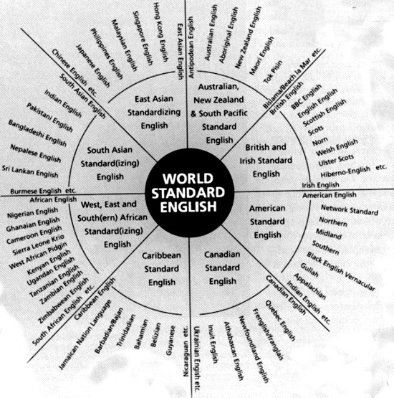

Slide 8
English Speaking Countries in the Rest of the World
The British Empire of the 19th and early 20th centuries as well as the popularity of American culture since World War II has brought the English language to all corners of the globe. It is rare spot where the population doesn't have at least a working understanding of the language. Major English speaking countries outside of Europe and North America include Australia, Nigeria, New Zealand, and South Africa. English is also the primary language in such diverse locales as Guam, Singapore, and the Philippines. Though only a minority of the people (12 percent) in India speak English, that still amounts to more than 125 millions persons in that densely-populated country.

Slide 9
British English history
Scientific Latin and Greek
Church Latin
Old Norse
The 4th century
Low German
Middle English
Modern English
Anglo Saxon
Old English
Danish
Norman French
Other Languages

Slide 10
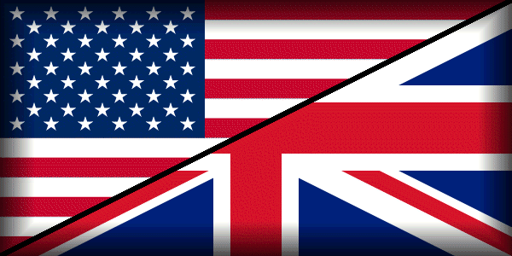
Some facts about English
There were only 30,000 words in Old English. Modern English has the largest vocabulary in the world – more than 600,000 words.
There are about 60,000 words in common use.
About 450-500 words are added to the English vocabulary every year.

Slide 11
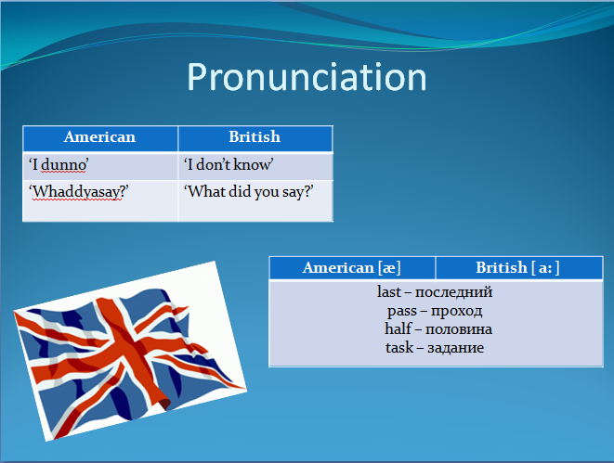

Slide 12
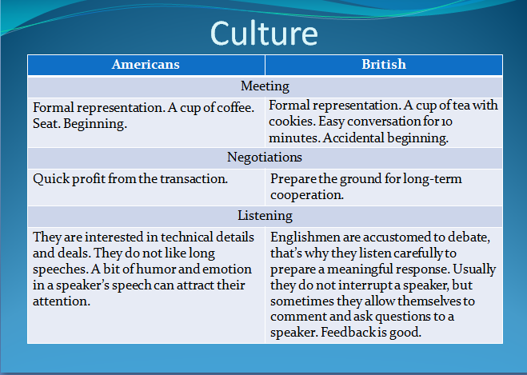

Slide 13


Thank you for attention !!)

