Slide 1
francis Scott Fitzgerald
The Major Events and Influences of the life of F. Scott Fitzgerald

Slide 2
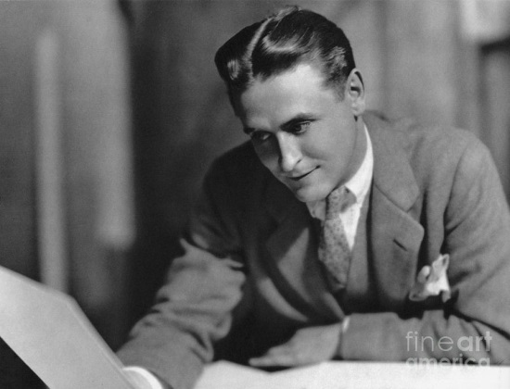
He was born 1896, 24 September
His father was a Southern gentleman whose persona he used to develop the character of Nick Carraway in the Great Gatsby.

Slide 3
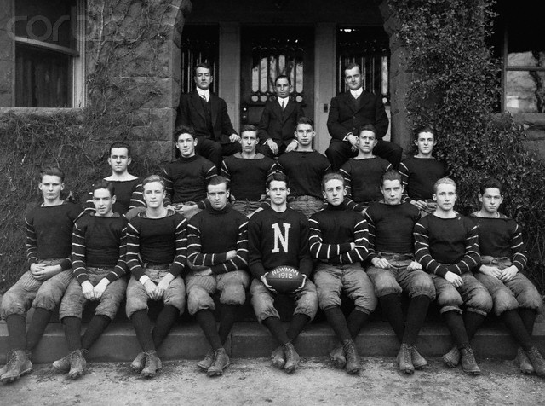
1911 Princeton football team which made him choose to attend Princeton. Football was an important part of young mens life and Fitzgerald endevoured to play for Princeton even

Slide 4

1913 He enters Princeton as an undergraduate.

Slide 5
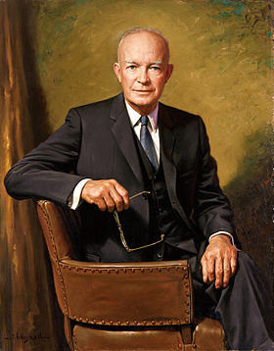
When the Fitzgerald was on the last course the USA entered the World War.
He joined the army.
Captain of his training platoon was D. Eisenhower.

Slide 6
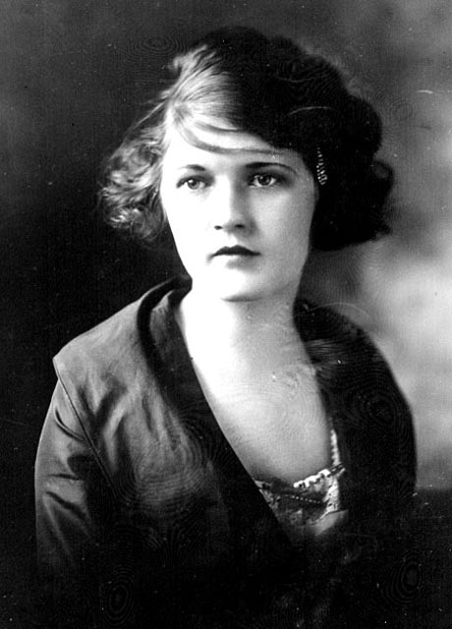
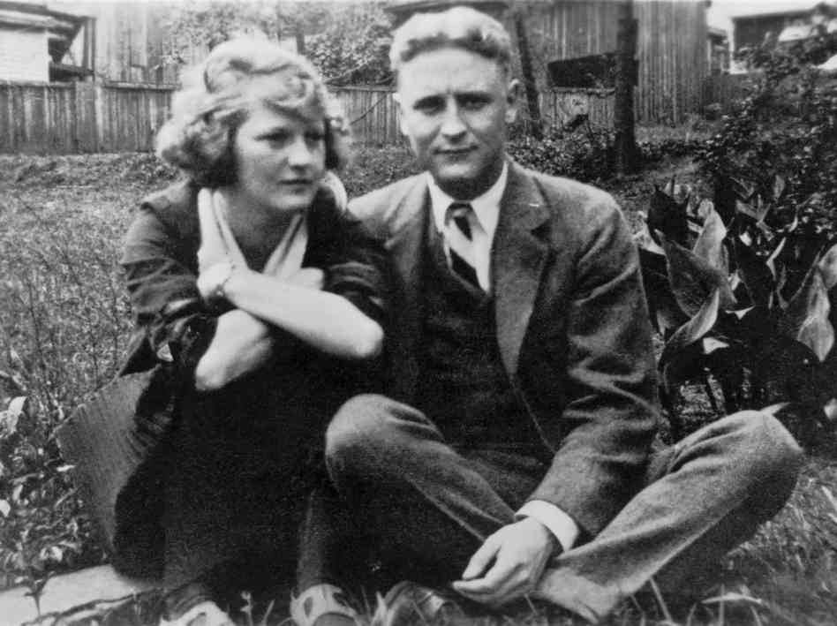
Zelda and Francis

Slide 7
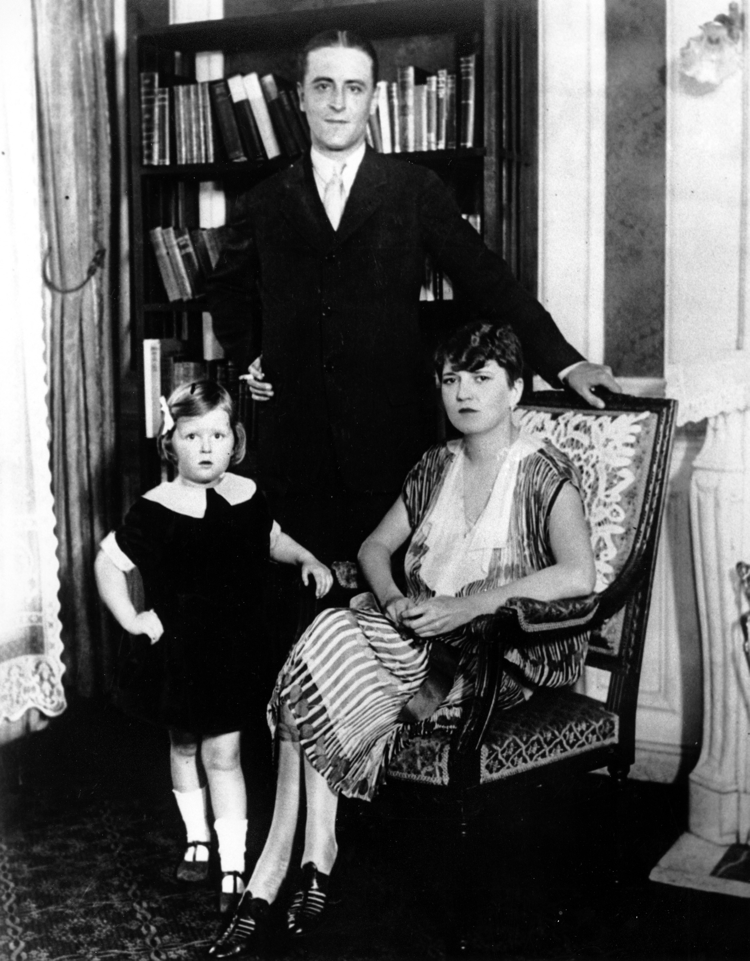

Slide 8
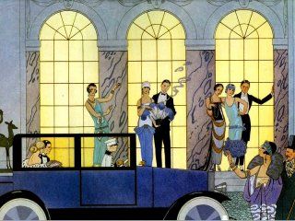
1920's-1940's were also known as the jazz age. Fitzgerald was an infamous reveler who had a fast and extravagant lifestyle. He could always be found on the party scene and became a very heavy drinker.

Slide 9
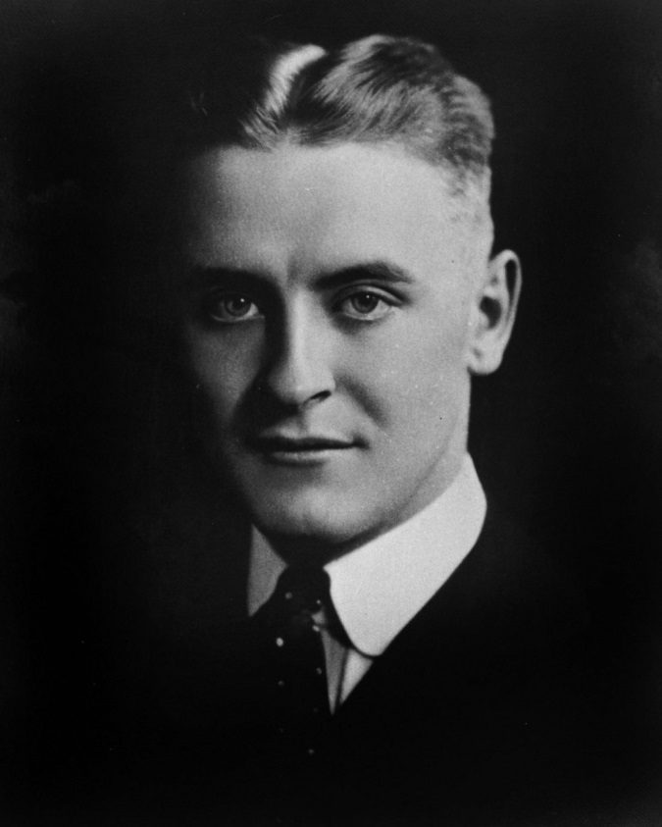
Fitzgerald hadn’t finished his last novel The Last Tycoon because of the heart attack in 1940. The novel awarded the highest marks from critics. The review of the novel was published on the first page of New York Times Book Review.

