Slide 1
pluses and minuses of the internet

Slide 2
In our time the internet shows by itself one of major parts of the world. Now about him know everything literally.

Slide 3
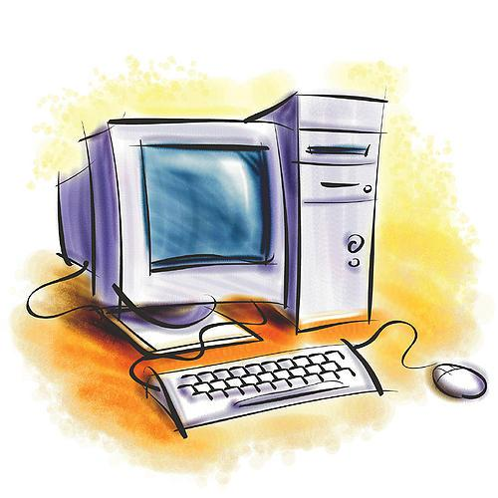
When someone reflects from you, why the internet is needed?

Slide 4
One of the main advantages of the Internet is much different information.

Slide 5
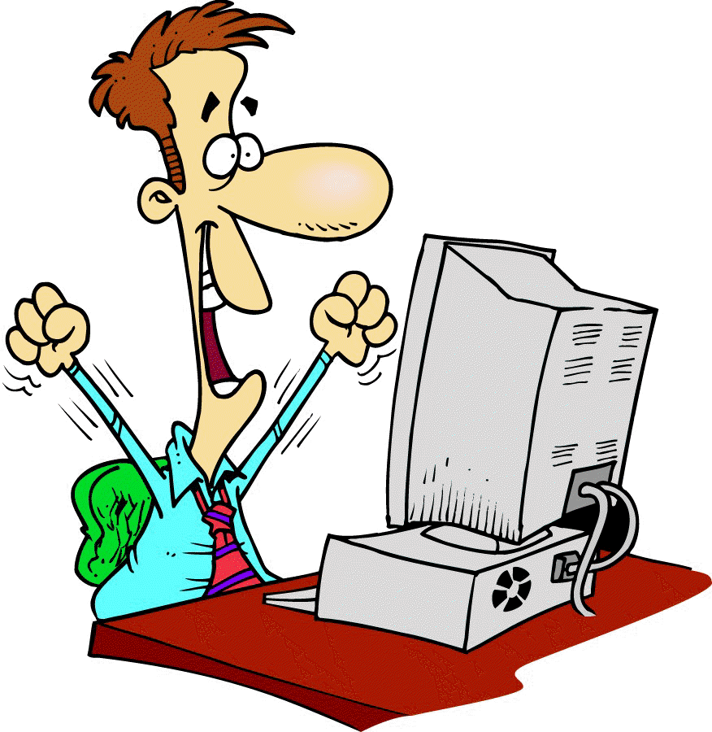
You can download many interesting films, sounds, books, computer games, programs for your computer.
Уou can read news about subject which is interesting for you.
Уou can chat and send mails to your friends.

Slide 6
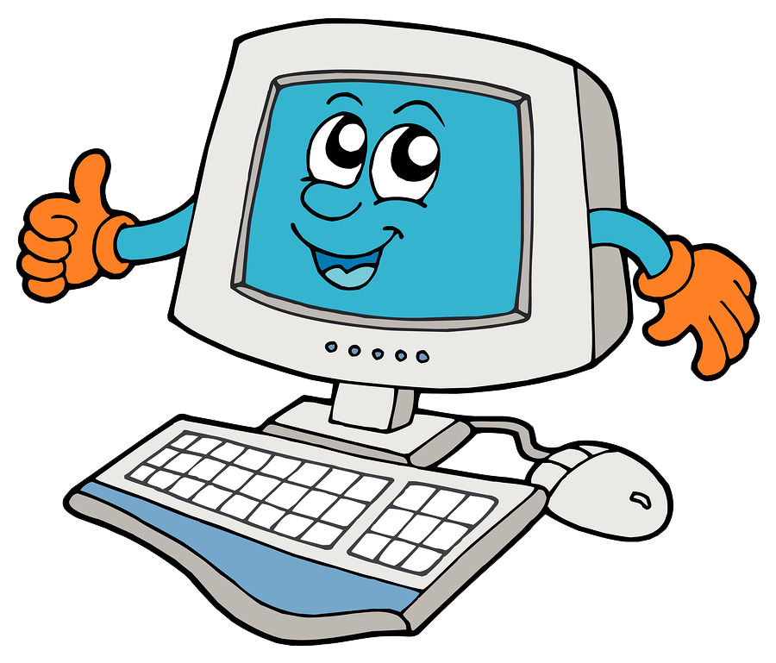
Some people earn due to the internet.
Due to the internet it is possible to pay shield.
The internet is a window in the WORLD.

Slide 7
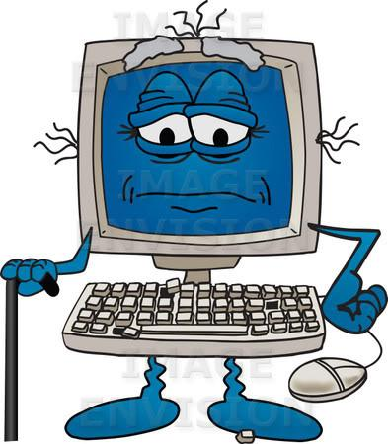
On the other hand, there are many disadvantages about using the Internet.

Slide 8
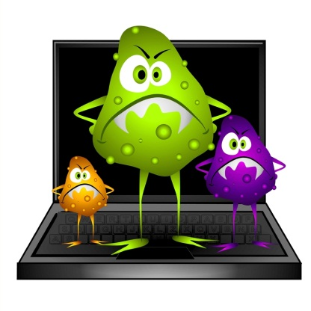
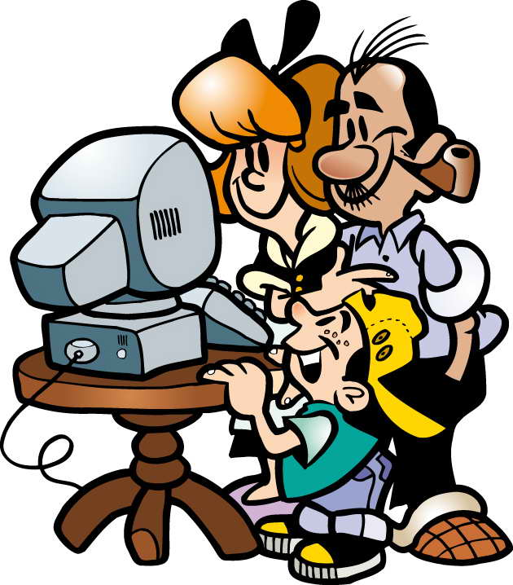
Уou can get viruses on your computer by visiting any web-sites you don`t trust and downloading files from them.
Уcan get blackmail or spam.
Using the Internet for many hours is not good for your sight.

Slide 9
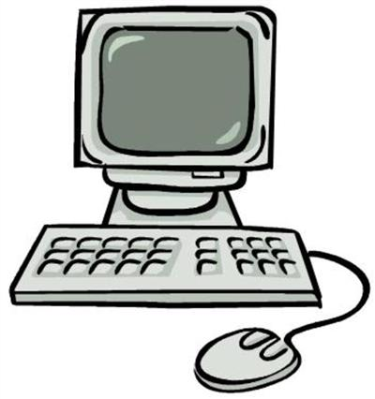
The Internet is neither good nor bad, it can be dangerous and useful at the same time, and everyone should make his own choice to use it or not.

