Slide 1
Republic of Ireland
By Yulia Lyalevych

Slide 2
Republic of Ireland is a sovereign state in Europe occupying about five-sixths of the island of Ireland.

Slide 3
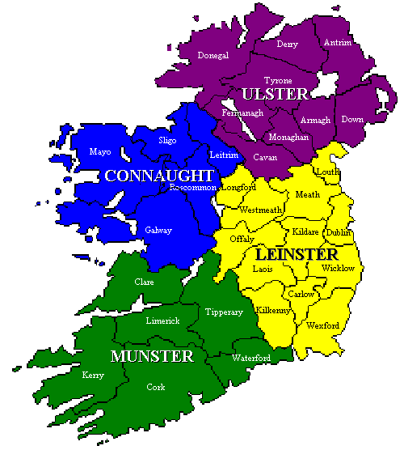
It is a unitary parliamentary republic with an elected president serving as head of state.

Slide 4
National symbols
Coat of arms
Flag

Slide 5
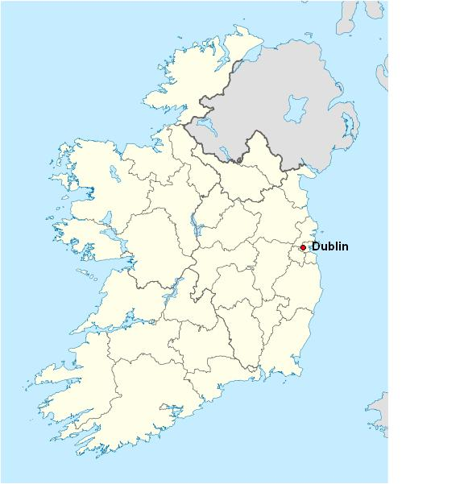
The capital is Dublin in the east of the island.

Slide 6
The population of Ireland stood at 4,588,252 in 2011, an increase of 8.2% since 2006.

Slide 7
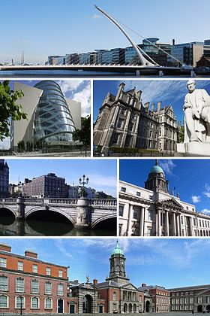
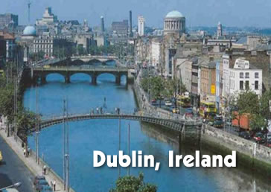
Dublin

Slide 8
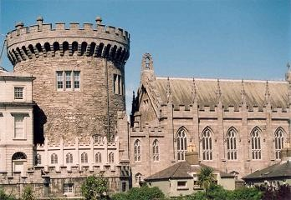
Dublin Castle was fortified in Ireland until 1922.

Slide 9
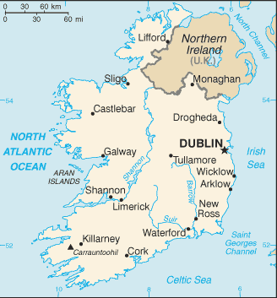
The state shares its only land border with Northern Ireland, one of the constituent countries of the United Kingdom.
It is otherwise surrounded by the Atlantic Ocean, with the Celtic Sea to the south, Saint George’s Channel to the south east, and the Irish Sea to the east.

Slide 10
The modern Irish state gained independence from the United Kingdom in 1922 following a war of independence resulting in the Anglo-Irish Treaty, with Northern Ireland exercising an option to remain in the United Kingdom. Initially a dominion within the British Empire called the Irish Free State, a new constitution and the name of "Ireland" were adopted in 1937. In 1949 the remaining duties of the British monarch were removed and Ireland was declared o republic, with the description Republic of Ireland.

Slide 11
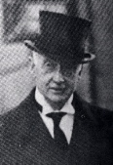
W. T. Cosgrave, the first head of government in the Free State.

Slide 12
The western landscape mostly consists of rugged cliffs, hills and mountains.

Slide 13
The central lowlands are extensively covered with glacial deposits of clay and sand, as well as significant areas of bogland and several lakes.

Slide 14
The highest point is Carrauntoohil (1,038 m or 3,406 ft), located in the Macgillycuddy’s Reeks mountain range in the southwest.

Slide 15
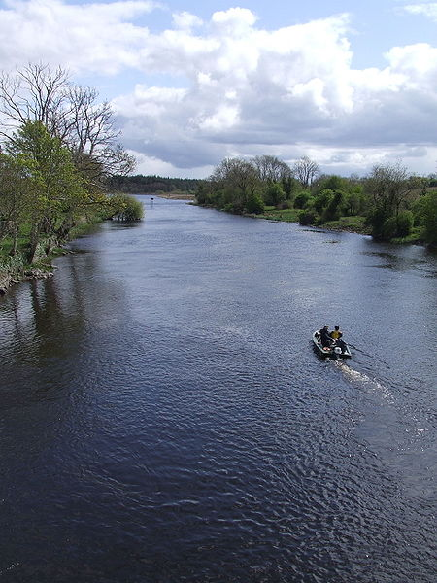
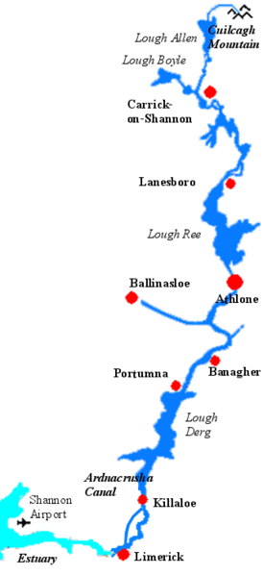
The River Shannon, which traverses the central lowlands, is the longest river in Ireland at 386 km in length.

Slide 16
The west coast is more rugged than the east, with numerous islands, peninsulas, headlands and bays.

Slide 17
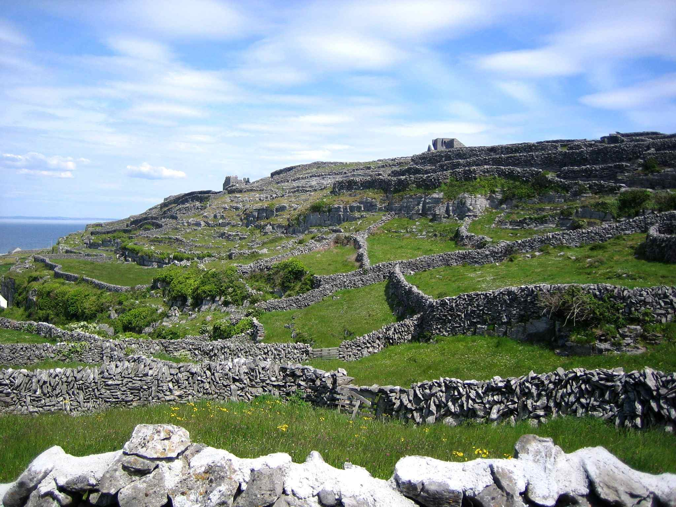
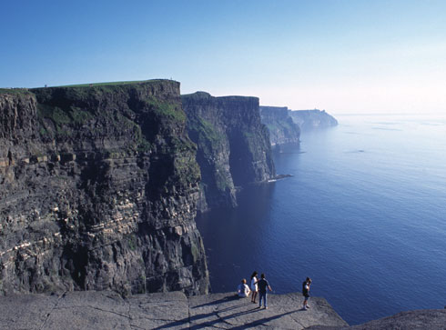
West Coast of Ireland

Slide 18
Ideal soil conditions, high rainfall and a mild climate give Ireland the highest growth rates for forests in Europe.

Slide 19
Government Buildings in Dublin

Slide 20
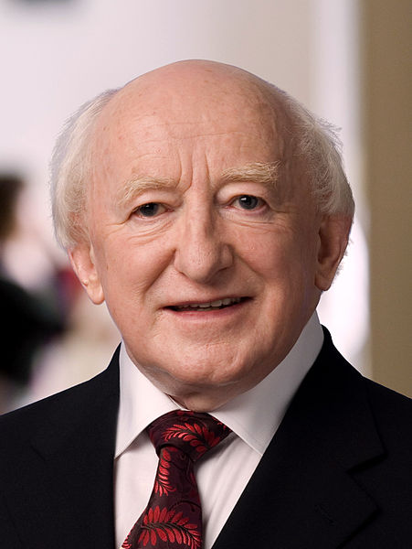
Current president of the Republic of Ireland Michael D. Higgings (since 11 November 2011)

Slide 21
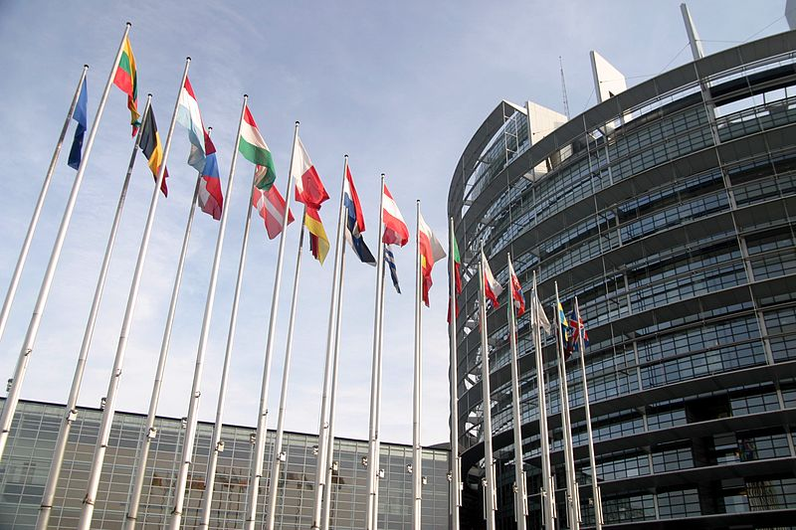
Ireland has been a member state of the European Union since 1973.
Ireland is the most pro-European EU member state with 66% of the population approving membership.

Slide 22
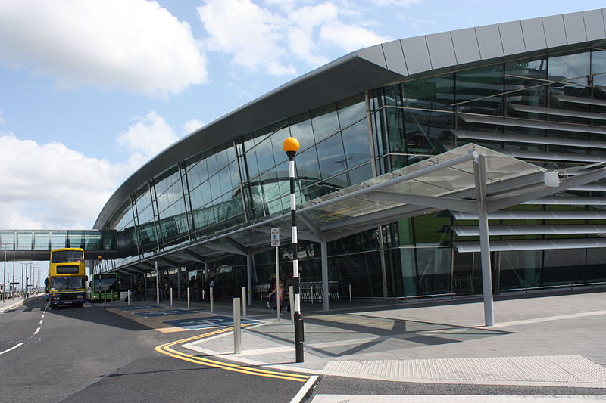
The country's three main international airports at Dublin, Shannon and Cork serve many European and intercontinental routes with scheduled and chartered flights.
Dublin Airport

Slide 23
The London and Dublin route is the busiest international air route in Europe, with 4.5 million people flying between the two cities in 2006.

Slide 24
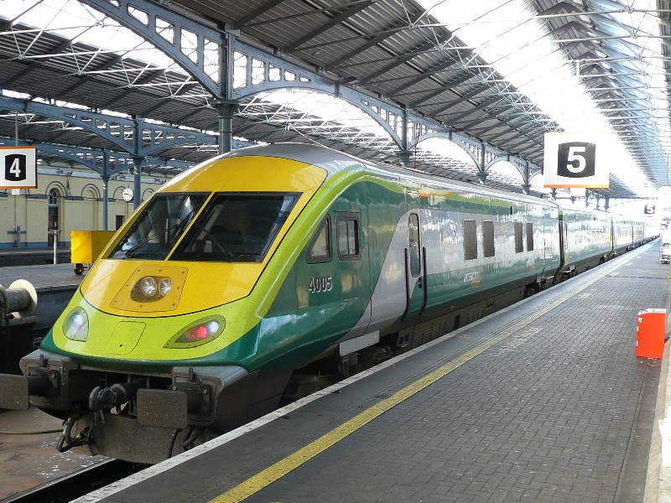
Dublin is the centre of the network with two main stations, Heuston station and Connolly station, linking to the country's cities and main towns.
Heuston station

Slide 25
Irish is the "national language" according to the Constitution, but English is the dominant language. In the 2006 census, 39% of the population regarded themselves as competent in Irish. Irish is spoken as a community language only in a small number of rural areas mostly in the west of the country.
Except in Gaeltacht regions, road signs are usually bilingual.
Most public notices and print media are in English only. Most Government publications are available in both languages, and citizens have the right to deal with the state in Irish.
As a result of immigration, Polish is one of the most widely spoken languages in Ireland after English and Irish. Several other Central and Eastern European languages are also spoken on a day-to-day basis.

Slide 26
Ireland has three levels of education: primary, secondary and higher education. The education systems are largely under the direction of the Government via the Minister for Education and Skills. Education is compulsory between the ages of six and fifteen years, and all children up to the age of eighteen must complete the first three years of secondary, including one sitting of the Junior Certificate examination.

Slide 27
Irish cuisine was traditionally based on meat and dairy, supplemented with vegetables and seafood. The potato eventually formed the basis of many traditional Irish dishes after its introduction in the 16th century.
Ireland is famous for the full Irish breakfast, which involves a fried or grilled meal generally consisting of bacon, egg, sausage, pudding, and fried tomato. Apart from the significant influence by European and international dishes, there has been a recent emergence of a new Irish cuisine based on traditional ingredients handled in new ways. This cuisine is based on fresh vegetables, fish, oysters, mussels and other shellfish, and the wide range of hand-made cheeses that are now being produced across the country.

Slide 28
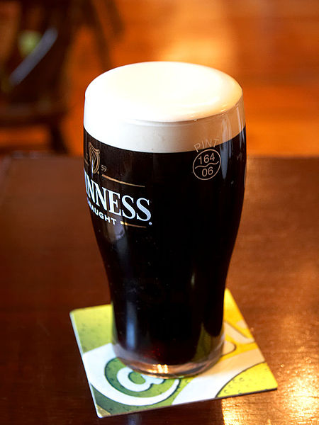
Popular everyday beverages among the Irish include tea and coffee. Alcoholic drinks associated with Ireland include Poitín and the world famous Guinness, which is a dry stout that originated in Dublin. Irish whiskey is also popular throughout the country, and comes in various forms, including single malt, single grain and blended whiskey.

Slide 29
Irish question
The Irish Question was a phrase used mainly by members of the British ruling classes from the early 19th century until the 1920s. It was used to describe Irish nationalism and the calls for Irish independence.
The phrase came to prominence as a result of the 1800 Act of Union which forced the parliament of Ireland into a single governing body with the parliament of Great Britain, based in Westminster, which partitioned the Island into two territories, a state now called Ireland, and Northern Ireland which still remains part of the United Kingdom.
In 1844, a future British Prime Minister, Benjamin Disraeli, defined the Irish Question:
“A dense population, in extreme distress, inhabit an island where there is an Established Church, which is not their Church, and a territorial aristocracy the richest of whom live in foreign capitals. Thus you have a starving population, an absentee aristocracy, and an alien Church; and in addition the weakest executive in the world. That is the Irish Question.”

Slide 30
Thanks for watching!

