Slide 1
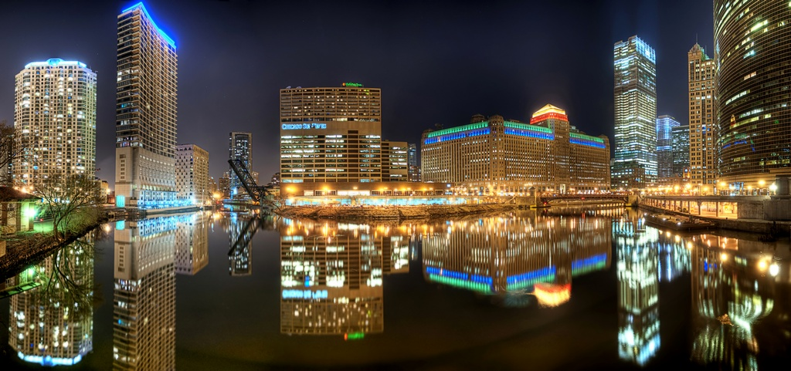
Chicago

Slide 2
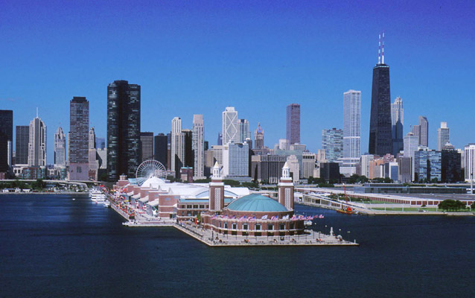
Chicago is a major transportation hub in the United States. It is an important component in global distribution, as it is the third largest inter-modal port in the world after Hong Kong and Singapore.

Slide 3
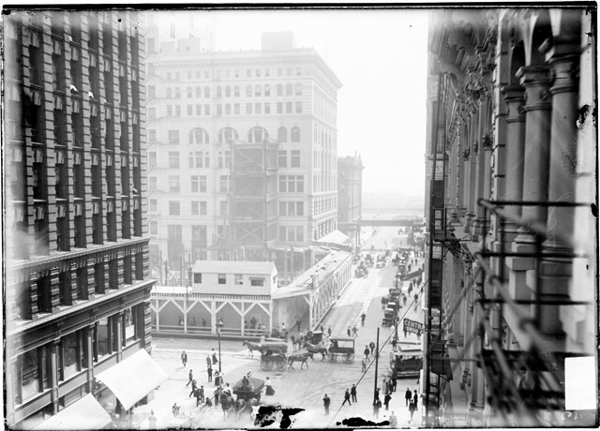
History

Slide 4
On August 12, 1833, the Town of Chicago was organized with a population of around 200.
Within seven years it would grow to a population of over 4,000.
State and Madison Streets, which was once known as the busiest intersection in the world (1897)
A flourishing economy brought residents from rural communities and immigrants from abroad. Manufacturing and retail and finance sectors became dominant, influencing the American economy.
Of the total population in 1900 no less than 77% were foreign-born, or born in the United States of foreign parentage.
In the 19th century, Chicago became the nation's railroad center

Slide 5
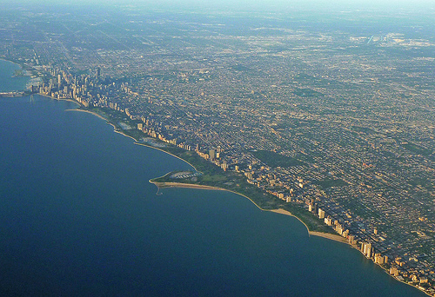
Geography

Slide 6
Chicago is located in northeastern Illinois on the southwestern shores of Lake Michigan.
The lake provides positive effect, moderating Chicago's climate; making waterfront neighborhoods slightly warmer in winter and cooler in summer.
Most of the city's high-rise commercial and residential buildings can be found close to the waterfront.
Its metropolitan area, sometimes called Chicagoland, is home to 9.5 million people and is the third-largest in the United States.

Slide 7
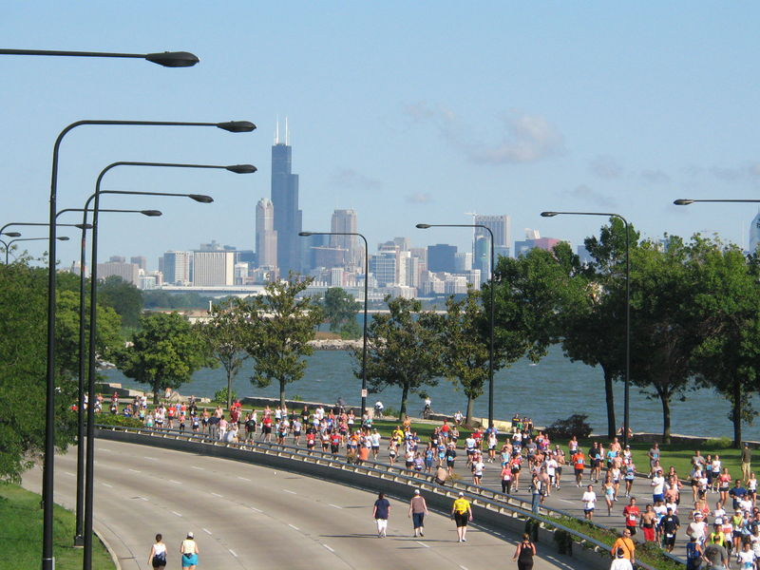
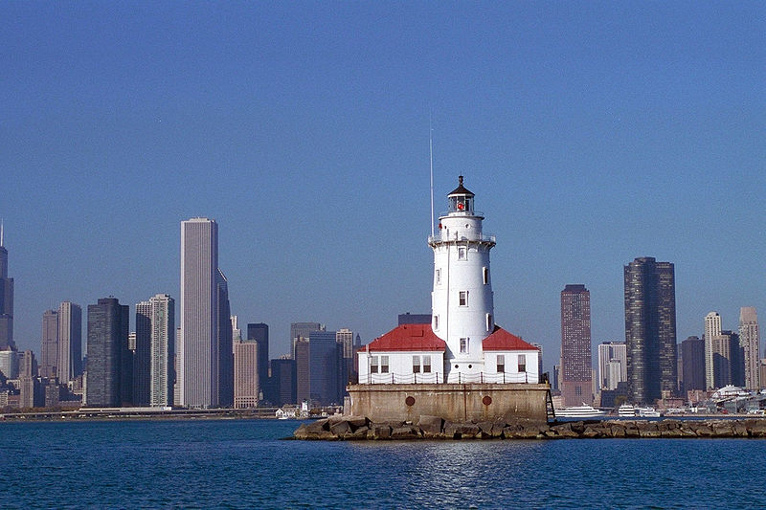
The city lies within the humid continental climate zone and experiences four distinct seasons.
The city can experience extreme winter cold waves and summer heat waves that may last for several consecutive days.

Slide 8
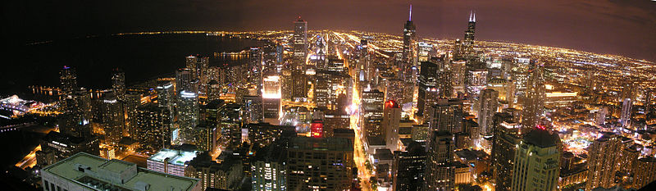
Cityscape

Slide 9
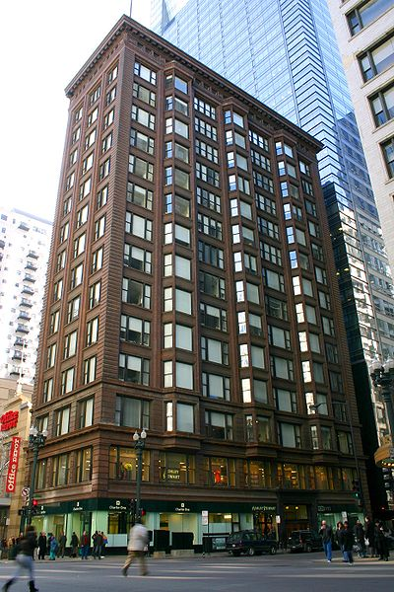
Architecture
The destruction caused by the Great Chicago Fire led to the largest building boom in the history of the nation.
Today, Chicago's skyline is among the world's tallest and most dense.

Slide 10
The Merchandise Mart, once first on the list of largest buildings in the world, currently listed as 44th largest (as of September 9, 2013), has its own zip code
Presently, the four tallest buildings in the city are Willis Tower, Trump International Hotel and Tower, the Aon Center (previously the Standard Oil Building), and the John Hancock Center.

Slide 11
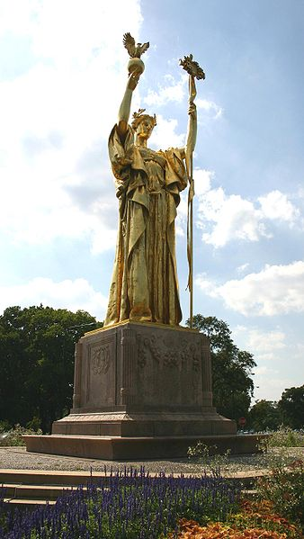
Monuments and public art
A number of Chicago's public art works are non-statuary and by famous artists. Among these are Chagall's Four Seasons; the Chicago Picasso; Miro's Chicago; Calder's Flamingo; Oldenburg's Batcolumn;
Some events which shaped the city's history have also been memorialized by art works.

Slide 12
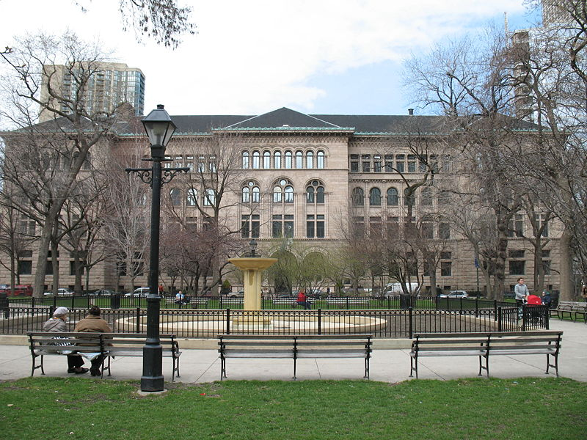
Parks
"City in a Garden"
Today, the Chicago Park District consists of 552 parks
Lincoln Park, the largest of the city's parks, covers 1,200 acres (490 ha) and has over 20 million visitors each year.

Slide 13
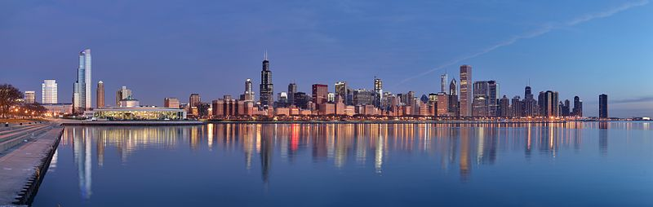
Culture
and contemporary life

Slide 14
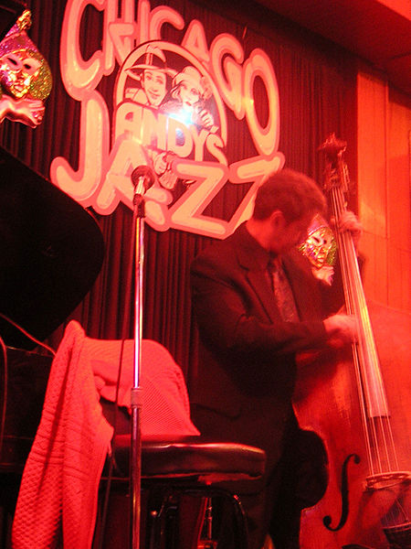
The city's waterfront allure and nightlife has attracted residents and tourists alike.
The city has many upscale dining establishments as well as many ethnic restaurant districts.
Downtown is the center of Chicago's financial, cultural, governmental and commercial institutions and home to Grant Park and many of the city's skyscrapers.

Slide 15
Entertainment, the arts,
and performing arts
Renowned Chicago theater companies include the Steppenwolf Theatre Company and Victory Gardens Theater in Lincoln Park; the Goodman Theatre in the Loop; and the Chicago Shakespeare Theater at Navy Pier.
Classical music offerings include the Chicago Symphony Orchestra (CSO), which performs at Symphony Center, and is recognized as one of the best orchestras in the world.

Slide 16
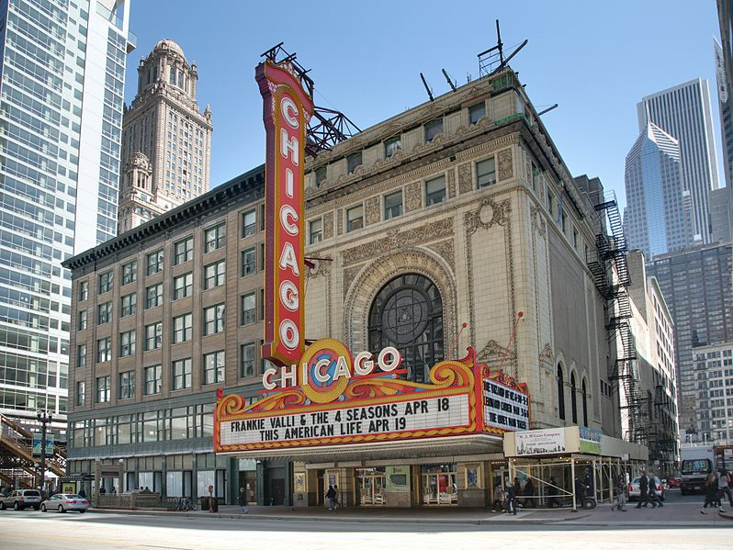

Slide 17
In the summer, many outdoor concerts are given in Grant Park and Millennium Park.
Other live-music genre which are part of the city's cultural heritage include Chicago blues, Chicago soul, jazz, and gospel.
The city is the birthplace of house music and is the site of an influential hip-hop scene. In the 1980s, the city was a center for industrial, punk and new wave.
A flourishing independent rock music culture brought forth Chicago indie.
Chicago has a distinctive fine art tradition. For much of the twentieth century, it nurtured a strong style of figurative surrealism, as in the works of Ivan Albright and Ed Paschke.

Slide 18
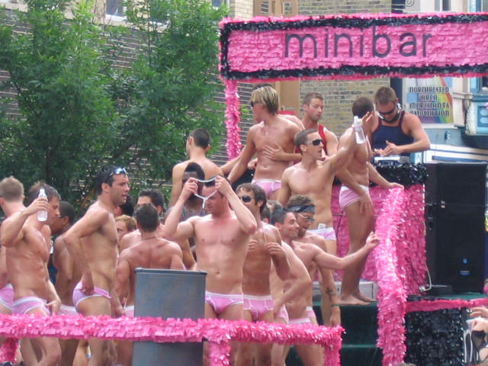
Chicago also has a nationally televised Thanksgiving parade that occurs annually. The McDonald's Thanksgiving Parade is seen across the nation on WGN-TV and WGN America, featuring a variety of diverse acts from the community, marching bands from across the country, and is the only parade in the city to feature inflatable balloons every year.

Slide 19
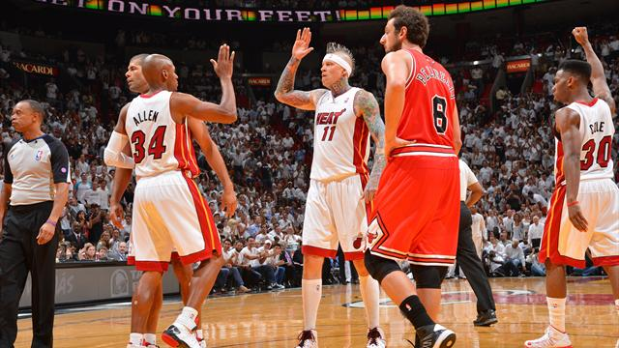
Sports
Chicago was named the Best Sports City in the United States by the Sporting News in 1993, 2006, and 2010.
The city is home to two Major League Baseball (MLB) teams: the Chicago Cubs of the National League and the Chicago White Sox of the American League

Slide 20
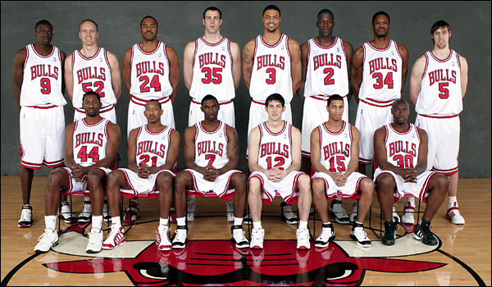
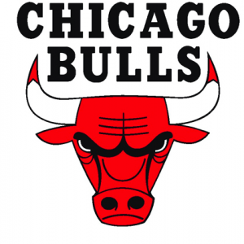
The Chicago Bulls of the National Basketball Association (NBA) is one of the most recognized basketball teams in the world. During the 1990s with Michael Jordan leading them, the Bulls took six NBA championships in eight seasons.

Slide 21
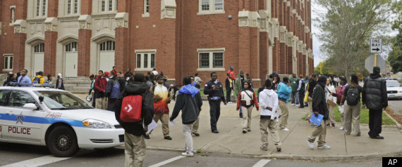
Education

Slide 22
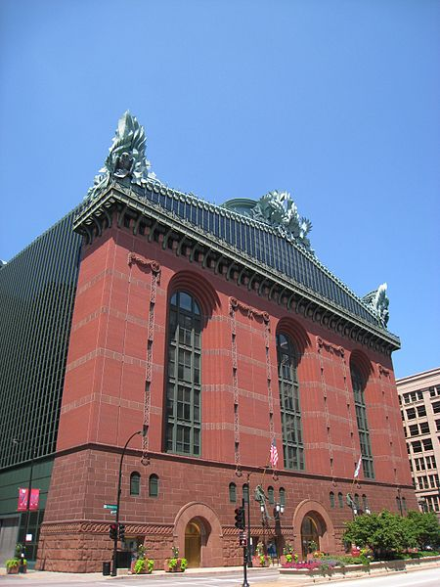
Chicago Public Schools (CPS) is the governing body of the school district that contains over 600 public elementary and high schools.
The Chicago Public Library system operates 79 public libraries including the central library, two regional libraries, and numerous branches distributed throughout the city.
Since its completion in 1991, the Harold Washington Library has appeared in the Guinness Book of Records as the largest public library building in the world

Slide 23
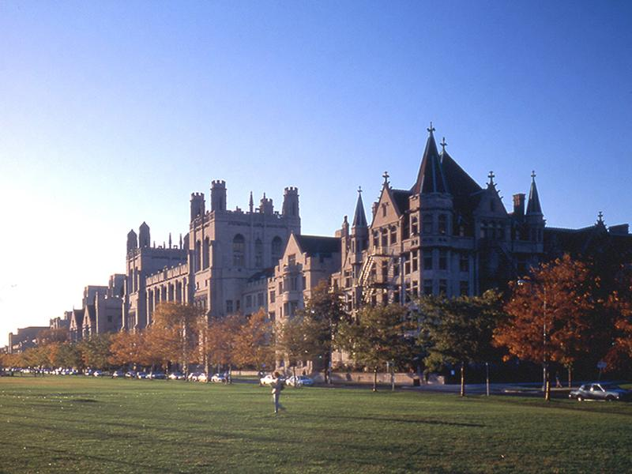
Since the 1850s, Chicago has been a world center of higher education.
The University of Chicago; Northwestern University; Loyola University Chicago; Illinois Institute of Technology; DePaul University; and University of Illinois at Chicago.

Slide 24
Thank you
for your attention

