Slide 1
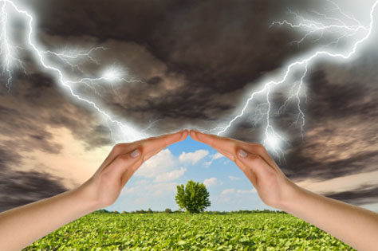
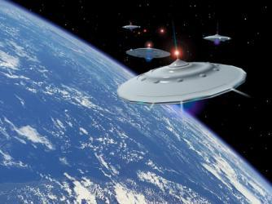
The Problems of this World Today

Slide 2
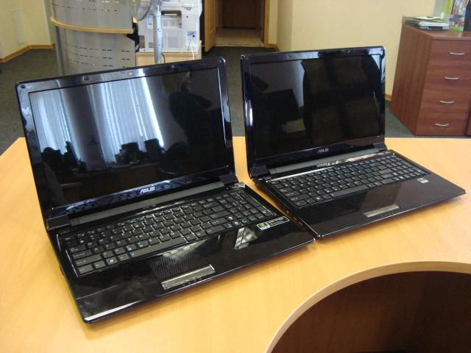
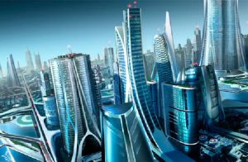
The technology and other scientific innovations have given us boundless opportunities to explore the world. At the same time, they have done much harm to the environment.

Slide 3
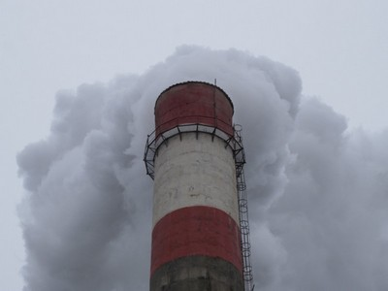
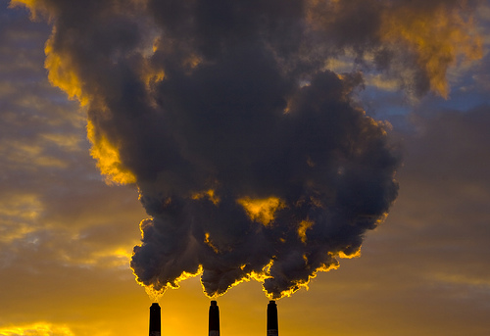
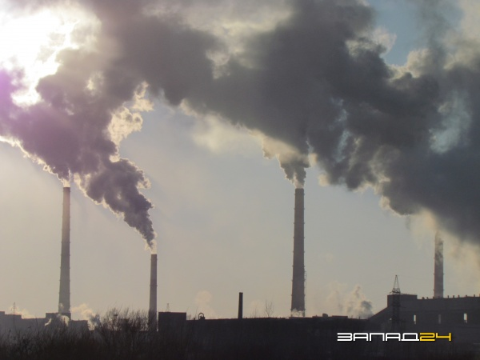
Firstly, it is the atmosphere pollution. Plants and factories emit harmful gases. In the process of industrial production lots of wastes are thrown into the air.

Slide 4
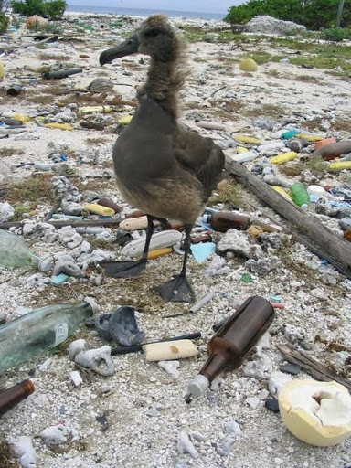
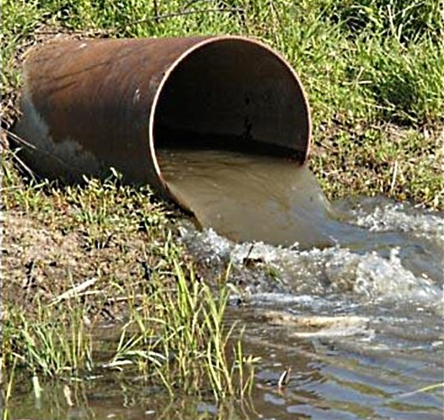
Secondly, hydrosphere pollution is not less important either. The leakage of oil or some other kind of fuel for technical reasons can cause a serious environmental accident. But it takes a long time the agueous medium to recover.

Slide 5
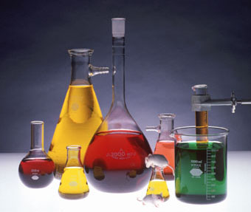
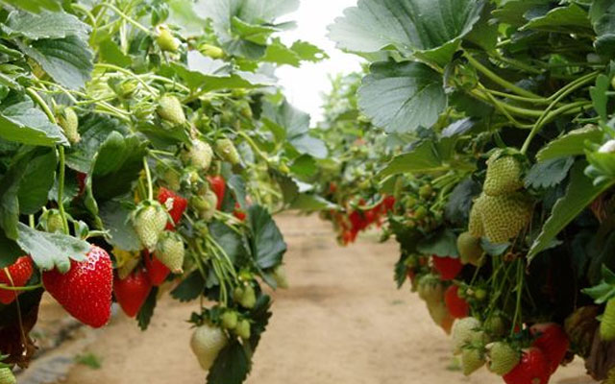
Thirdly, usage of different chemicals to kill detrimental insects or heighten the productivity erodes the soil and exhausts it of fertility.

Slide 6
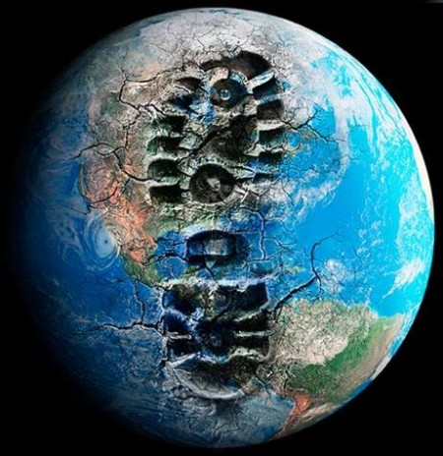
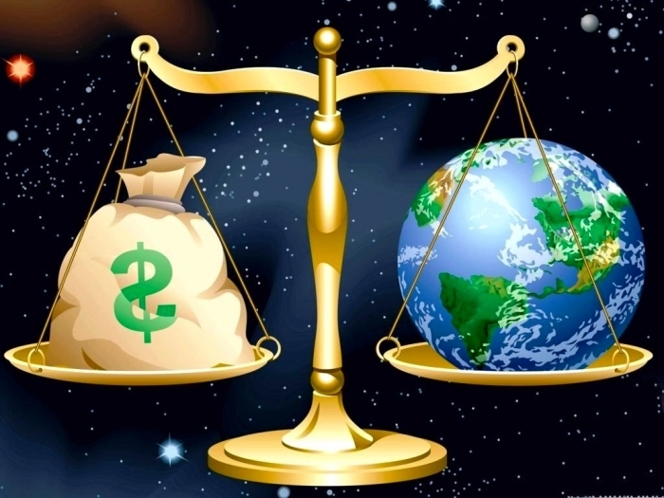
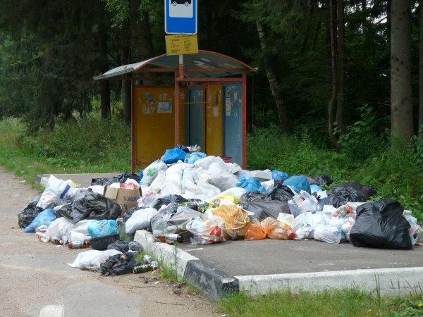
To sum up, it is necessary to fulfil our intentions on preservation of the environment so as to keep the world for our descendants and provide them with reliable existence.

