Slide 1
Citizenship for Young People
Martynenko Nataly
11-B
LRMBL

Slide 2
Citizenship
Citizenship is the status of a person recognised under the custom or law of a state that bestows on that person (called a citizen) the rights and privileges of citizenship. Such rights and privileges include the right to vote, work and live in the country and the right to return to the country, besides other rights.

Slide 3
Modern times
The modern idea of citizenship still respects the idea of political participation, but it is usually done through "elaborate systems of political representation at a distance" such as representative democracy. Modern citizenship is much more passive; action is delegated to others; citizenship is often a constraint on acting, not an impetus to act. Nevertheless, citizens are usually aware of their obligations to authorities, and are aware that these bonds often limit what they can do.

Slide 4
Citizenship education
"Active citizenship" is the philosophy that citizens should work towards the betterment of their community through economic participation, public, volunteer work, and other such efforts to improve life for all citizens. In this vein, schools in some countries provide citizenship education (subject).

Slide 5
United Kingdom
Citizenship is offered as a General Certificate of Secondary Education course in many schools in the United Kingdom. As well as teaching knowledge about democracy, parliament, government, the justice system, human rights and the UK's relations with the wider world, students participate in active citizenship, often involving a social action or social enterprise in their local community.

Slide 6
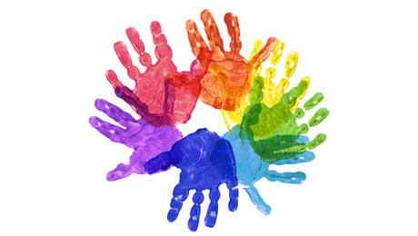
Ireland
It is taught in Ireland as an exam subject for the Junior Certificate. It is known as Civic, Social and Political Education (CSPE). A new Leaving Certificate exam subject with the working title 'Politics & Society' is being developed by the National Council for Curriculum and Assessment (NCCA) and is expected to be introduced to the curriculum.

Slide 7
The Foreign Youth Citizenship Programme
The Foreign Youth Citizenship Programme is an out-of-school education programme that aims to help young people develop the values and skills of good citizenship. The programme transforms Foróige's ethos of empowering youth and enriching communities into practical achievements by young people at local level. Young people taking part in the programme study their local area and take action to improve the community. Young people themselves and adults, see and believe that young people can make a positive difference to their communities.

Slide 8
Through the Citizenship Programme you and your group can make a real difference. You can positively influence the world in which you live. The Citizenship Programme helps you to:
Understand what is happening in your community and society.
Take action to bring about improvement
Develop good community values
Make a real difference to the world and lives of others
The programme can focus on Citizenship at local, national, European and wider international levels.

Slide 9
Good citizen, what he?
The first thing I would single out the knowledge of the laws of society and the fulfillment of their.
Law Abiding Citizen is certainly loyal to society and its values.

Slide 10
Good citizens are able to listen and hear each other. Know how to negotiate, seek and find compromises.

Slide 11
Good citizen - it is also socially active person, a member of the society to which it belongs, and all of society - different. Swedish society - one, American - another ,Japanese - third. Many models.

Slide 12
Аnyone can be a good citizen!
Hence to people something to strive for!

