Slide 1
San Francisco
The presentation made by
Tanya Bezkrovna

Slide 2
I heard about San Francisco previously and I want to recommend to you song about this city. The song written by John Phillips and sung by Scott McKenzie, was produced and released in 1967.
The San Francisco is a happening city that never sleep. People there are very gentle and enjoy every moment of life.

Slide 3
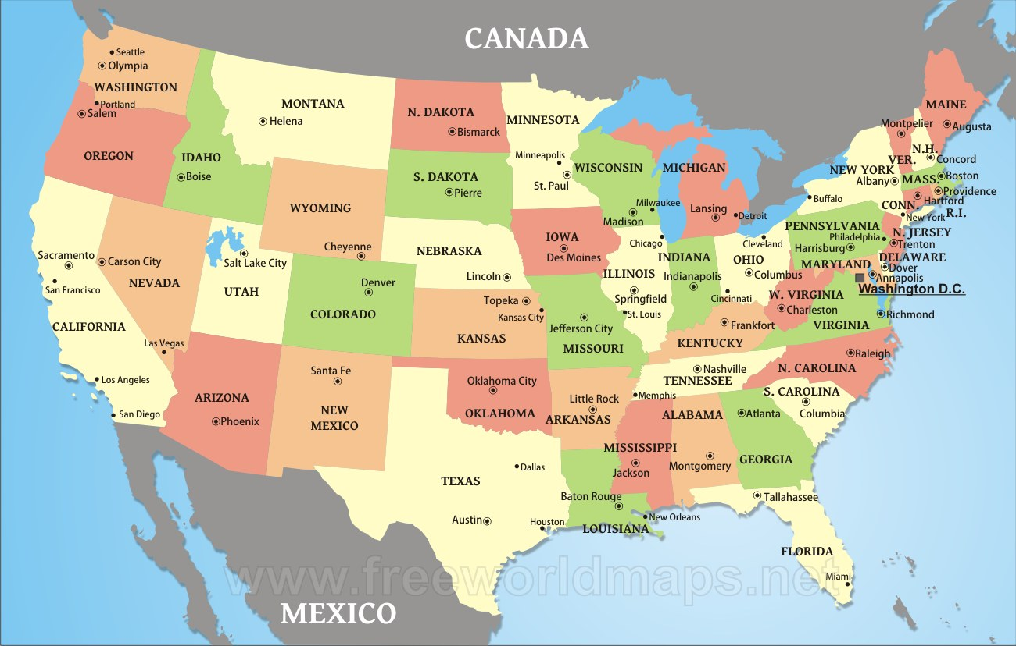
the leading financial and cultural center of Northern California

Slide 4
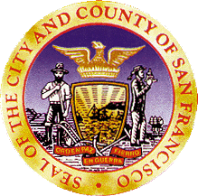
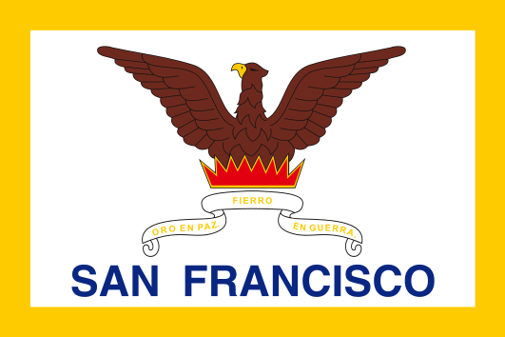
Flag and Seal
Nickname(s): The City by the Bay; Fog City; San Fran; Frisco; The City that Knows How; Baghdad by the Bay; The Paris of the West
Motto: Gold in Peace, Iron in War

Slide 5
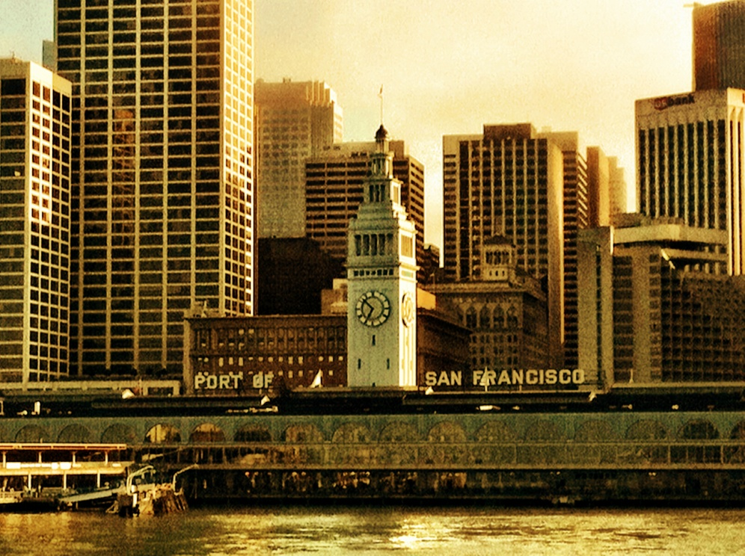
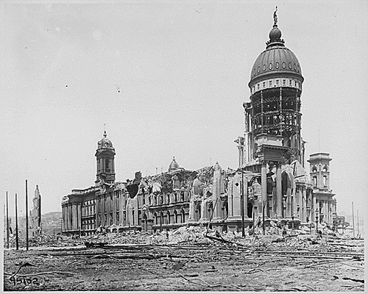
San Francisco
the only consolidated city-county in California
area is about 46.9 square miles (121 km2)
population: 8.4 million
was founded on June 29, 1776.
The California Gold Rush of 1849 brought rapid growth, making it the largest city on the West Coast at the time. Due to the growth of its population, San Francisco became a consolidated city-county in 1856.After three-quarters of the city was destroyed by the 1906 earthquake and fire, San Francisco was quickly rebuilt, hosting the Panama-Pacific International Exposition nine years later.

Slide 6
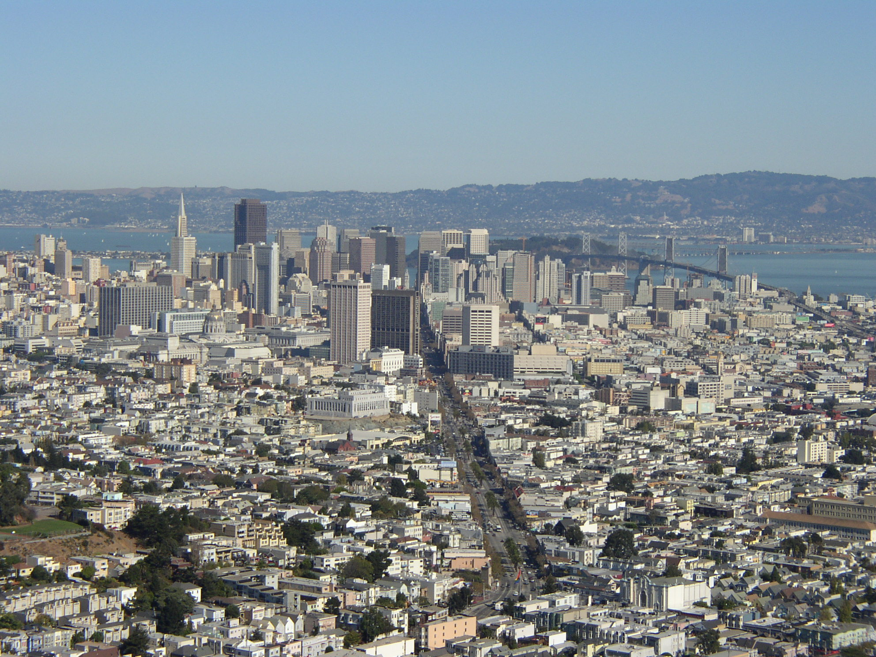
Today the city is renowned for its cool summers, fog, steep rolling hills, eclectic mix of architecture, and landmarks including the Golden Gate Bridge, cable cars, the former prison on Alcatraz Island, and its Chinatown district.

Slide 7
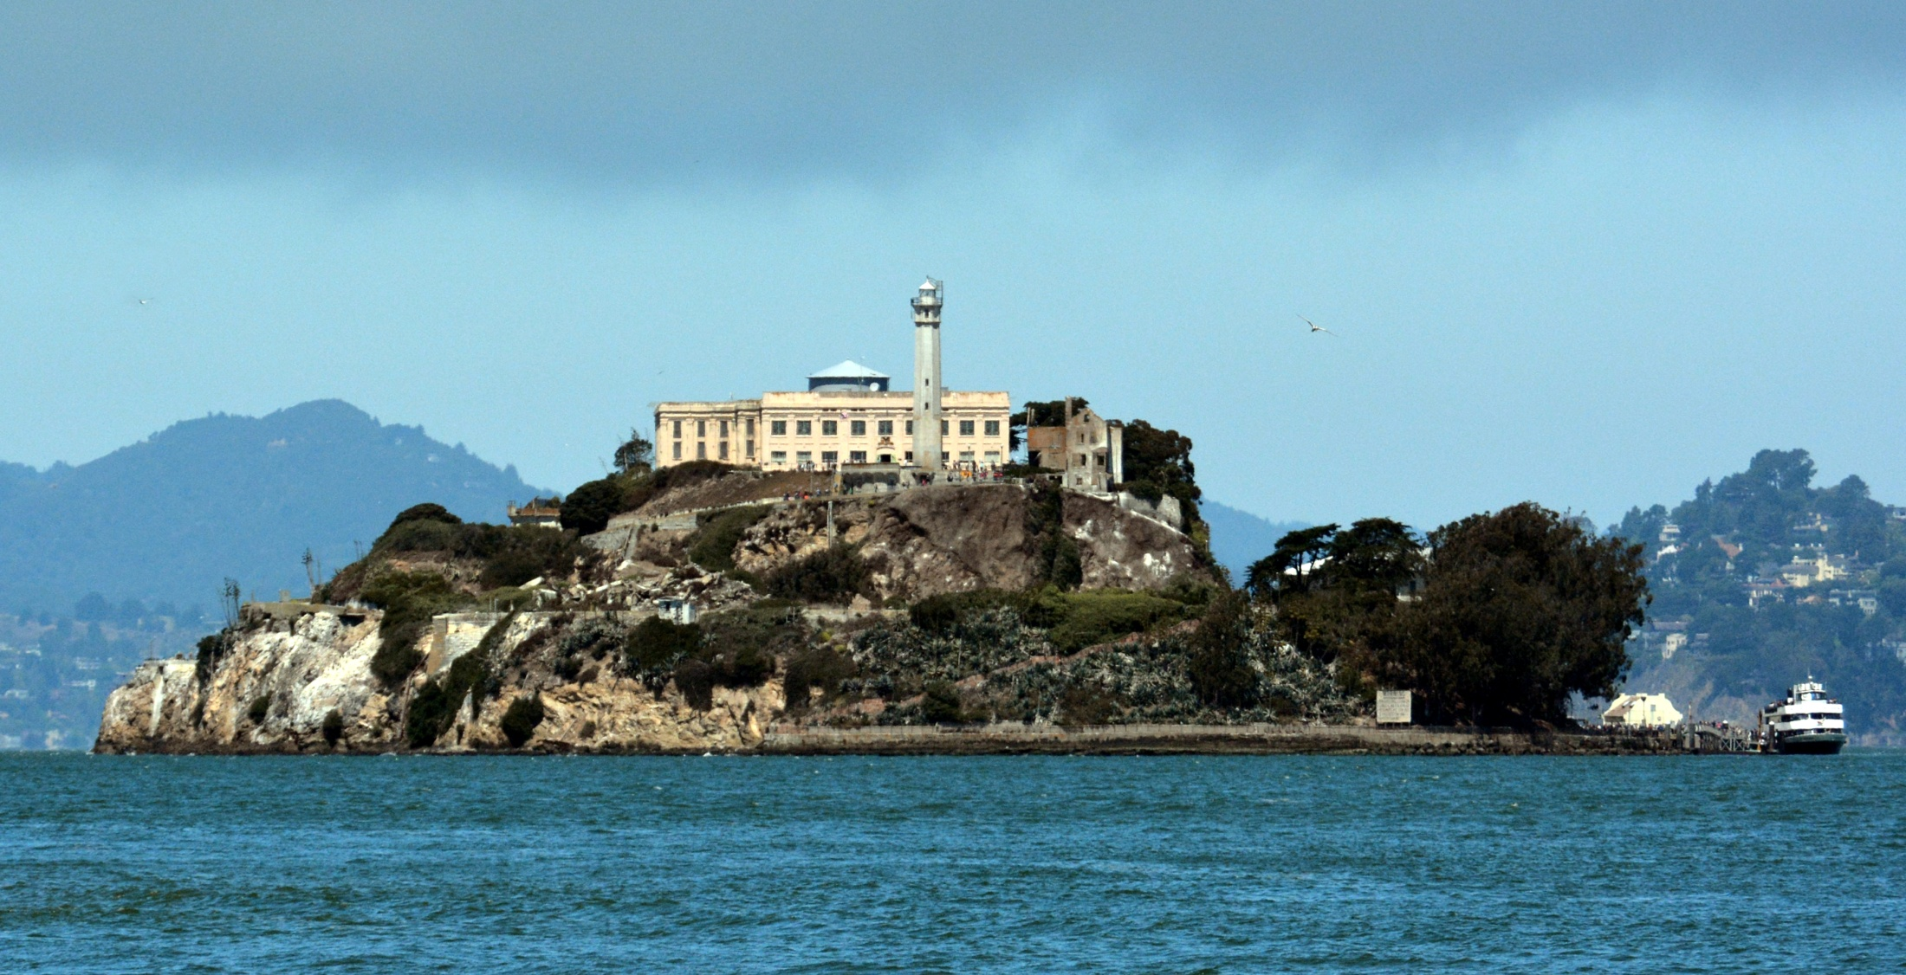
Alcatraz Island

Slide 8
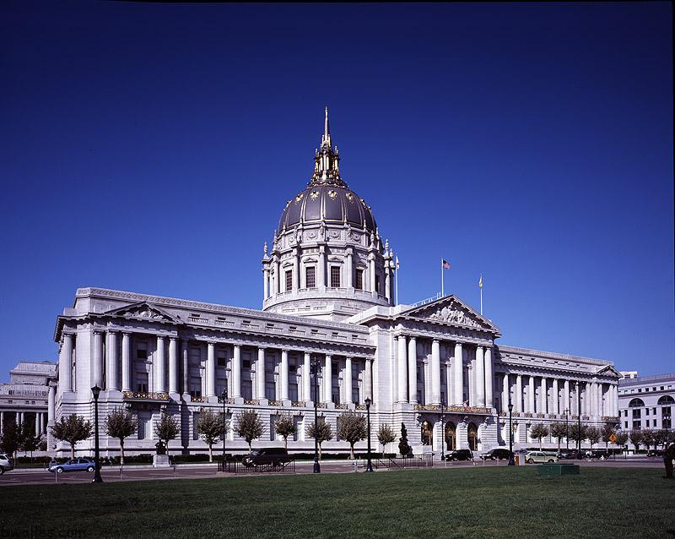
San Francisco City Hall HQ Wallpaper

Slide 9
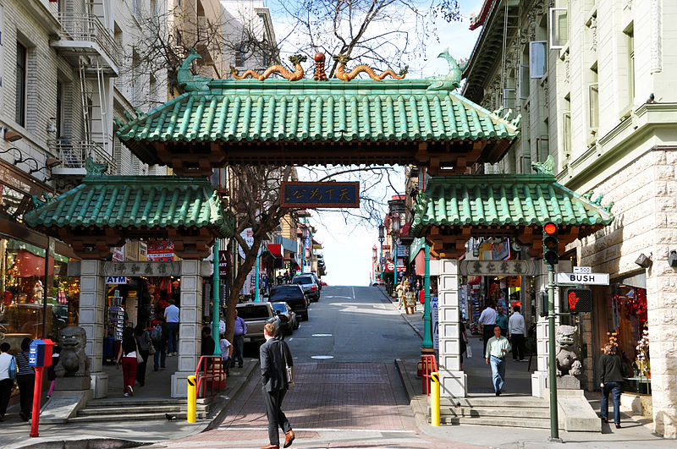
Chinatown
The largest Chinese neighborhood outside Asia

Slide 10
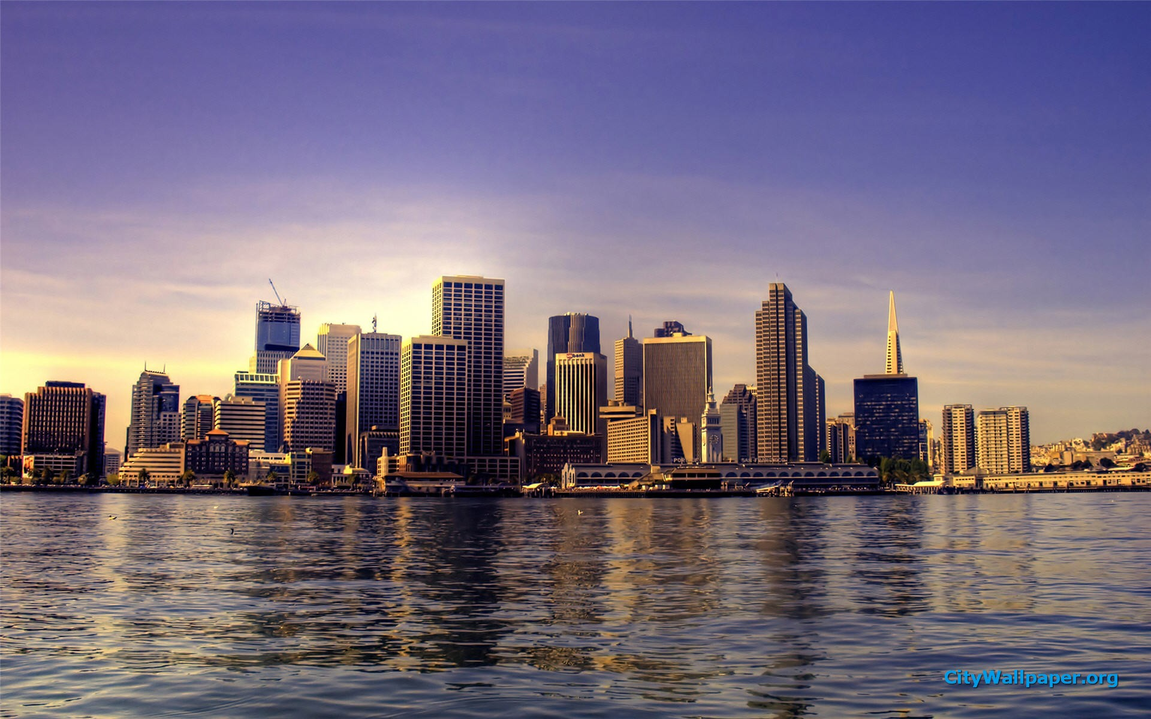
San Francisco also has a reputation as an intellectual, liberal and slightly crazy city – a city where new and different ideas can be explored.

Slide 11
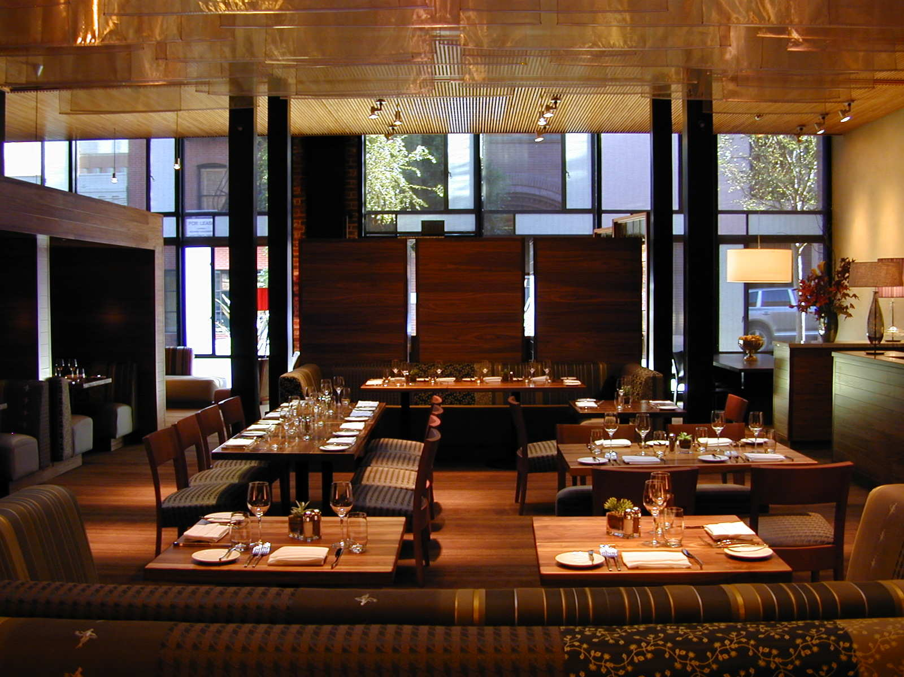
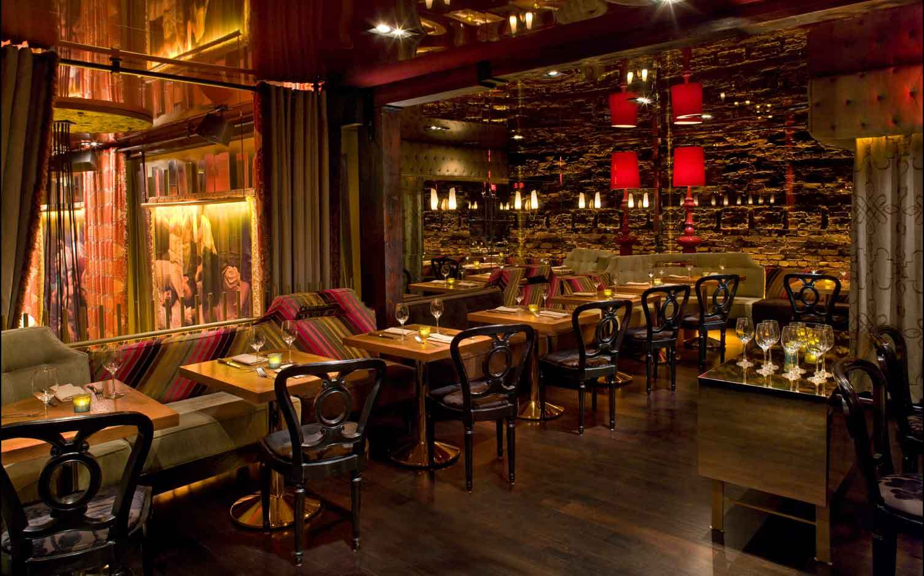
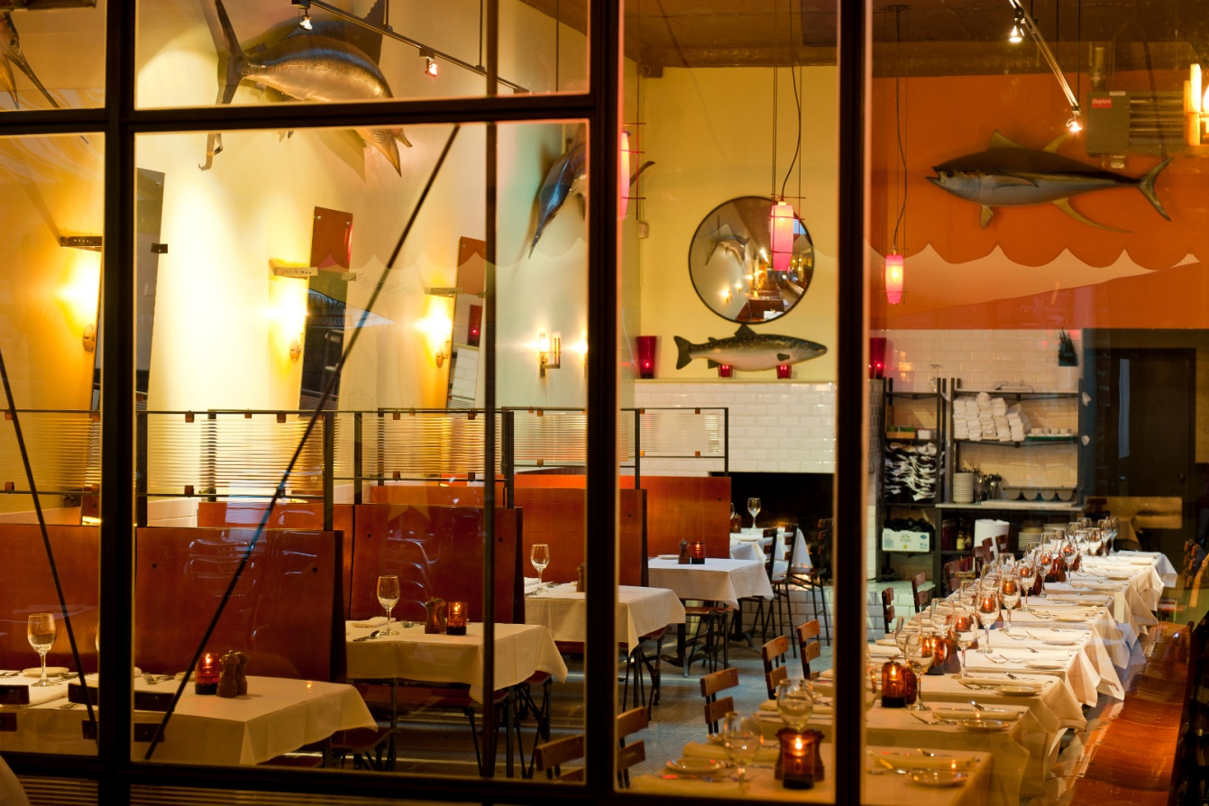
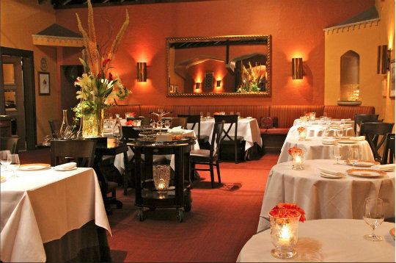
San Francisco has more then 4,500 restaurants, serving every cuisine including ‘Californian cuisine’

Slide 12
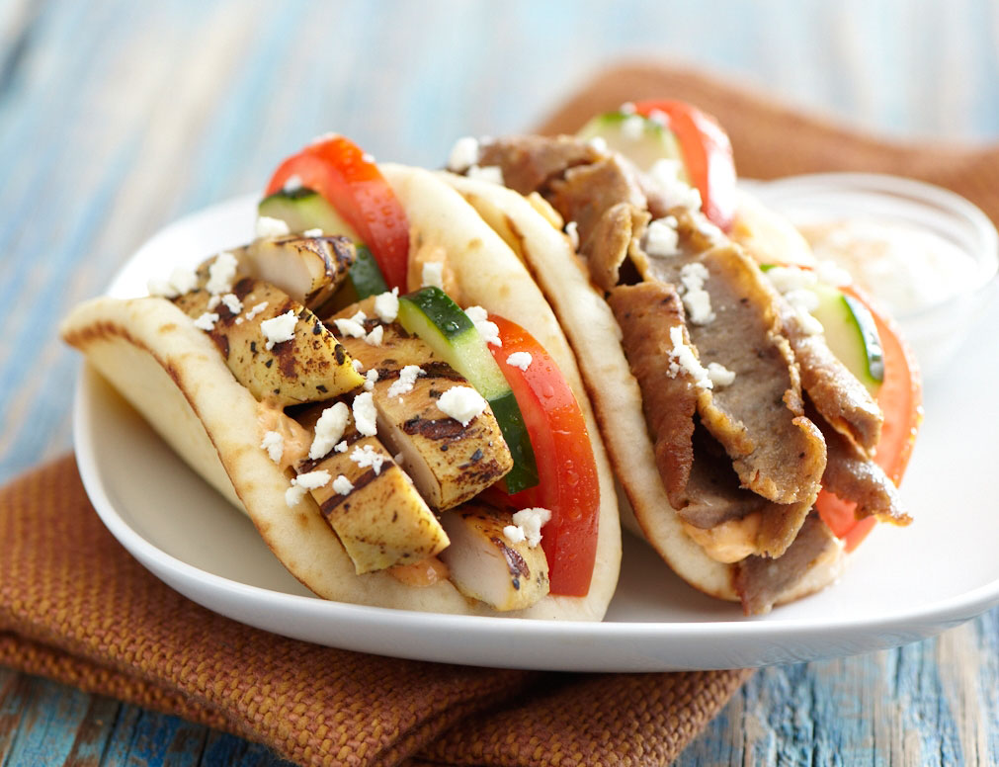
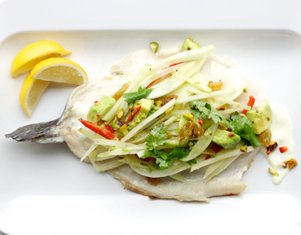
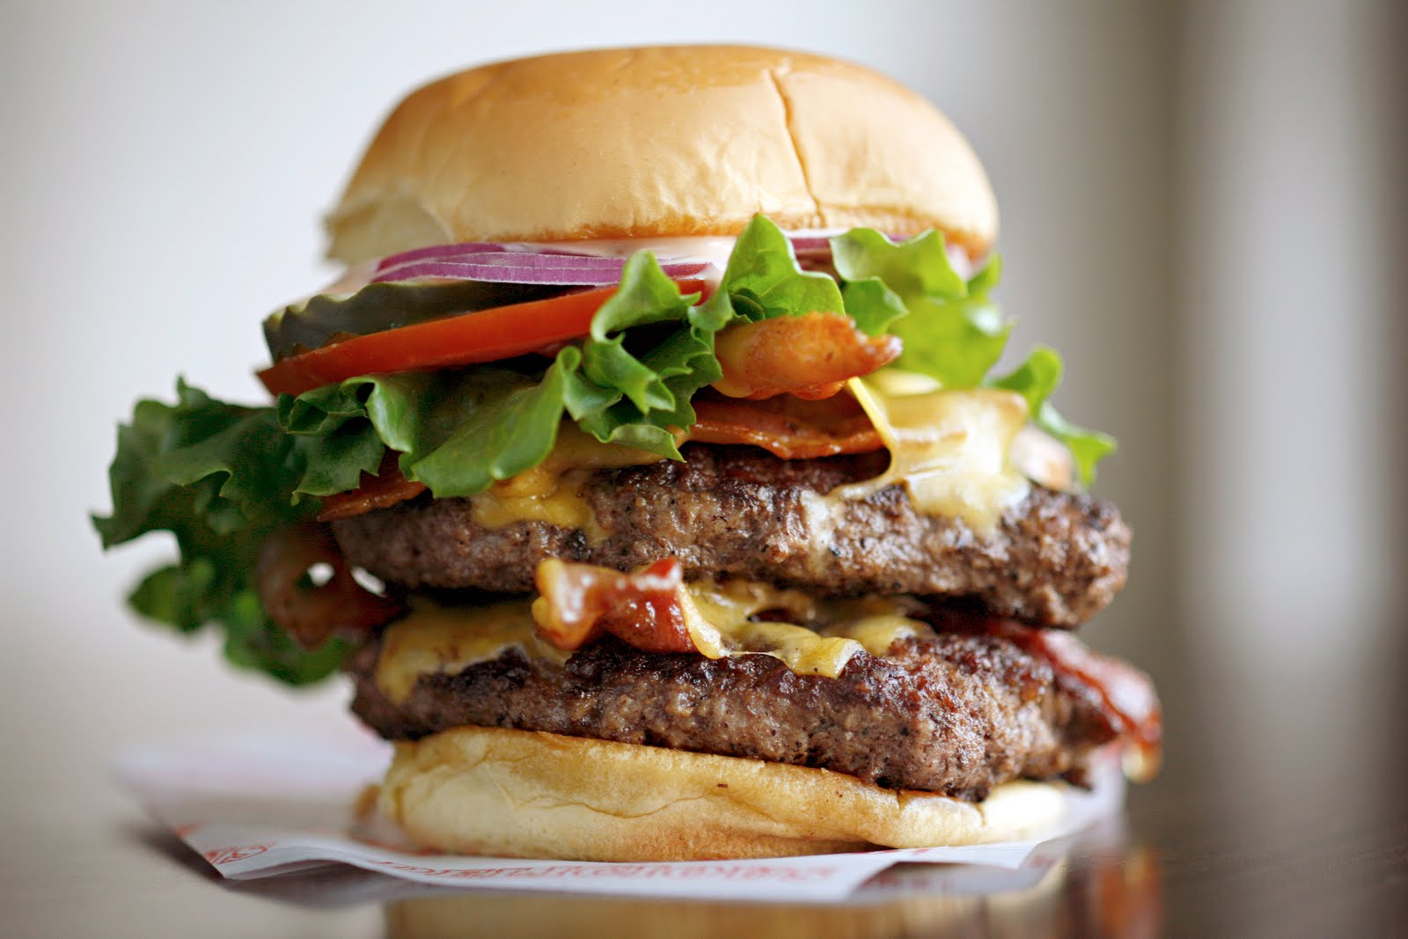
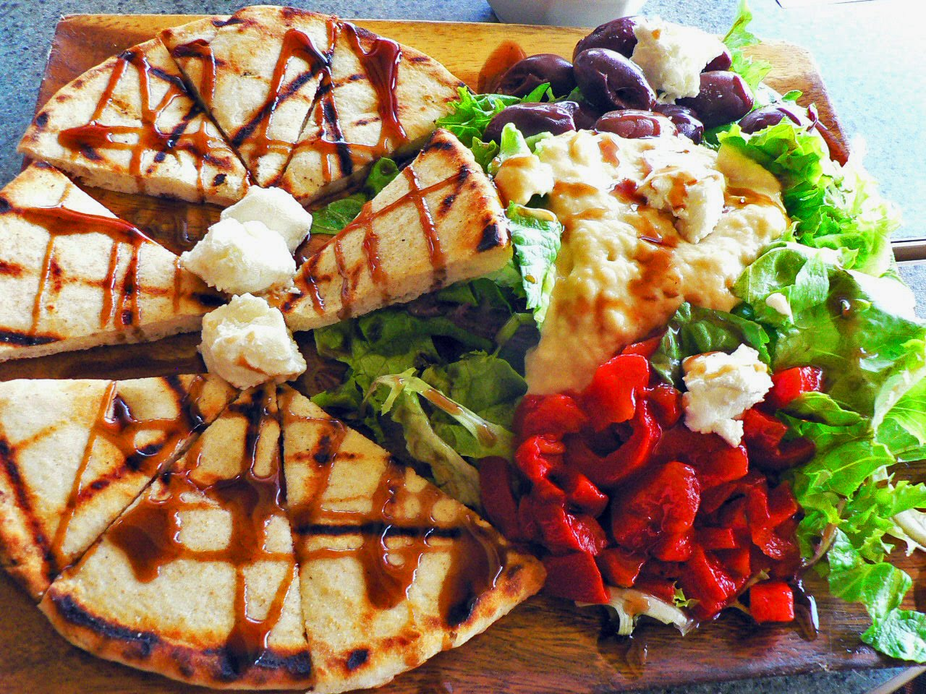

Slide 13
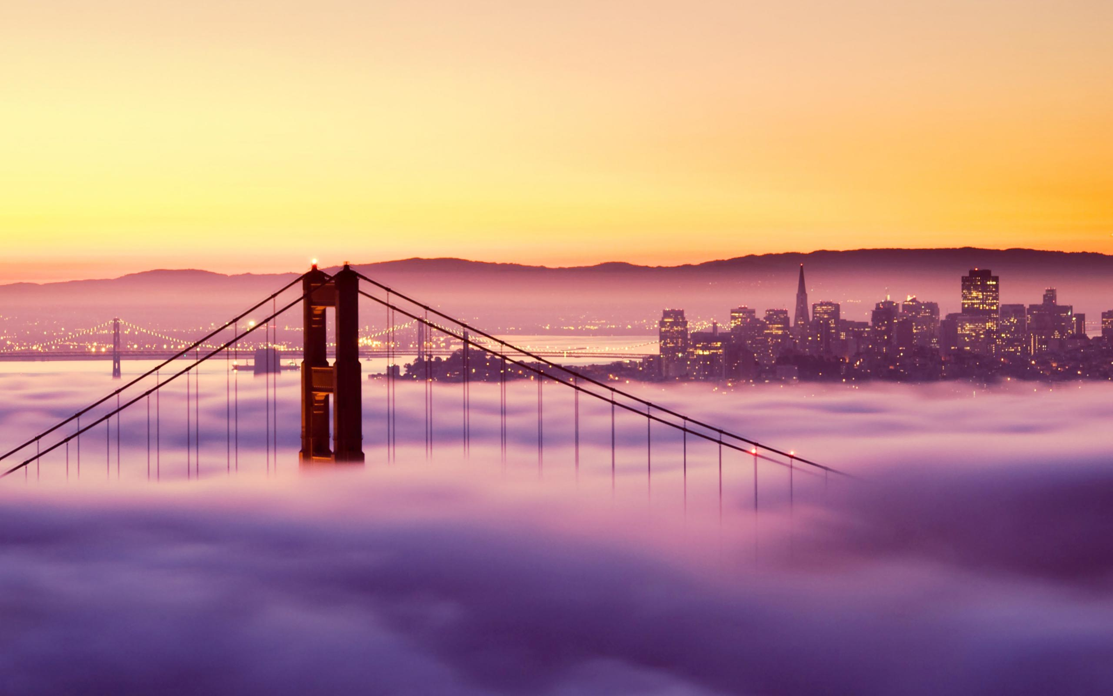
The city is surrounded on three sides by water and is wonderful city to explore by foot.

Slide 14
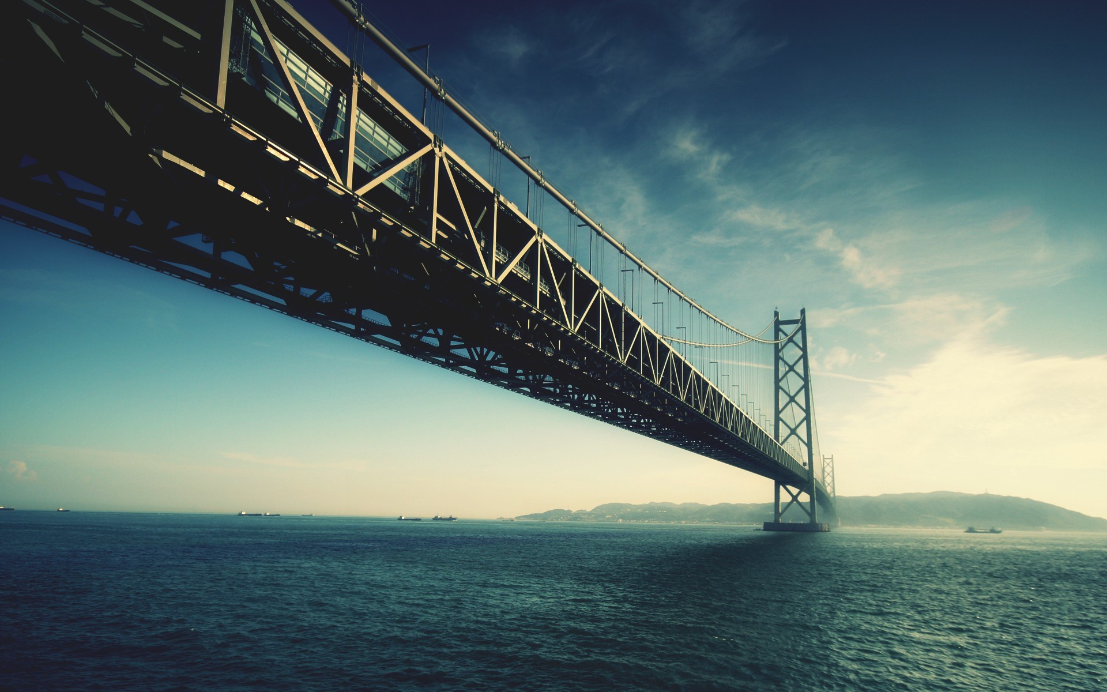

Slide 15
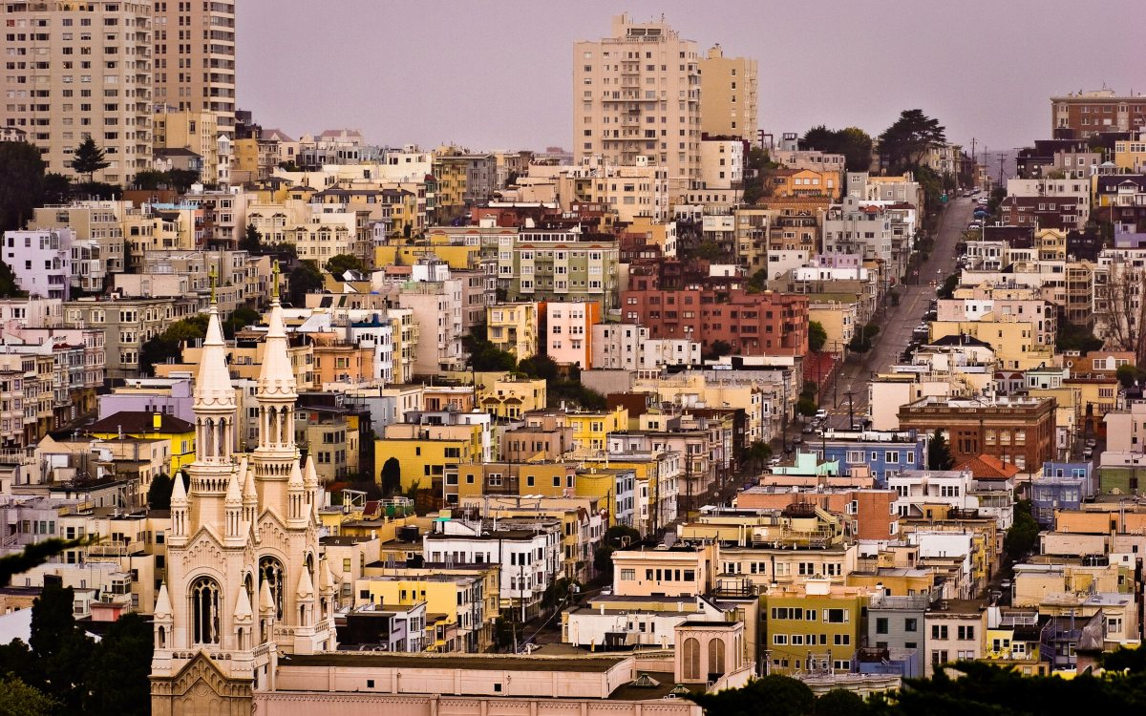

Slide 16
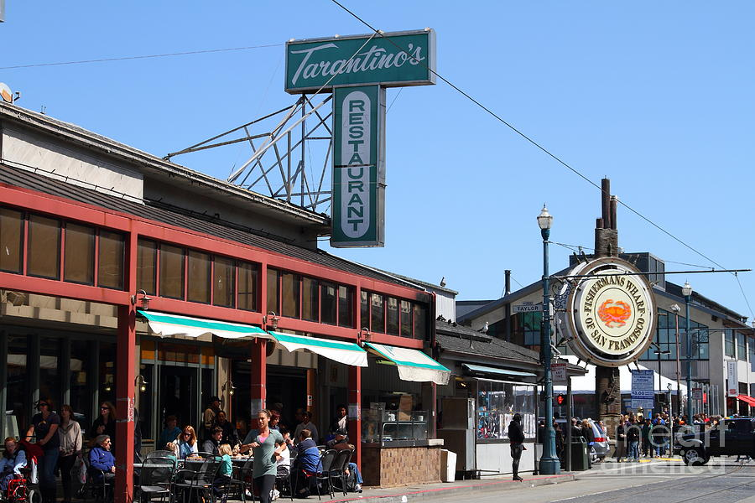

Slide 17
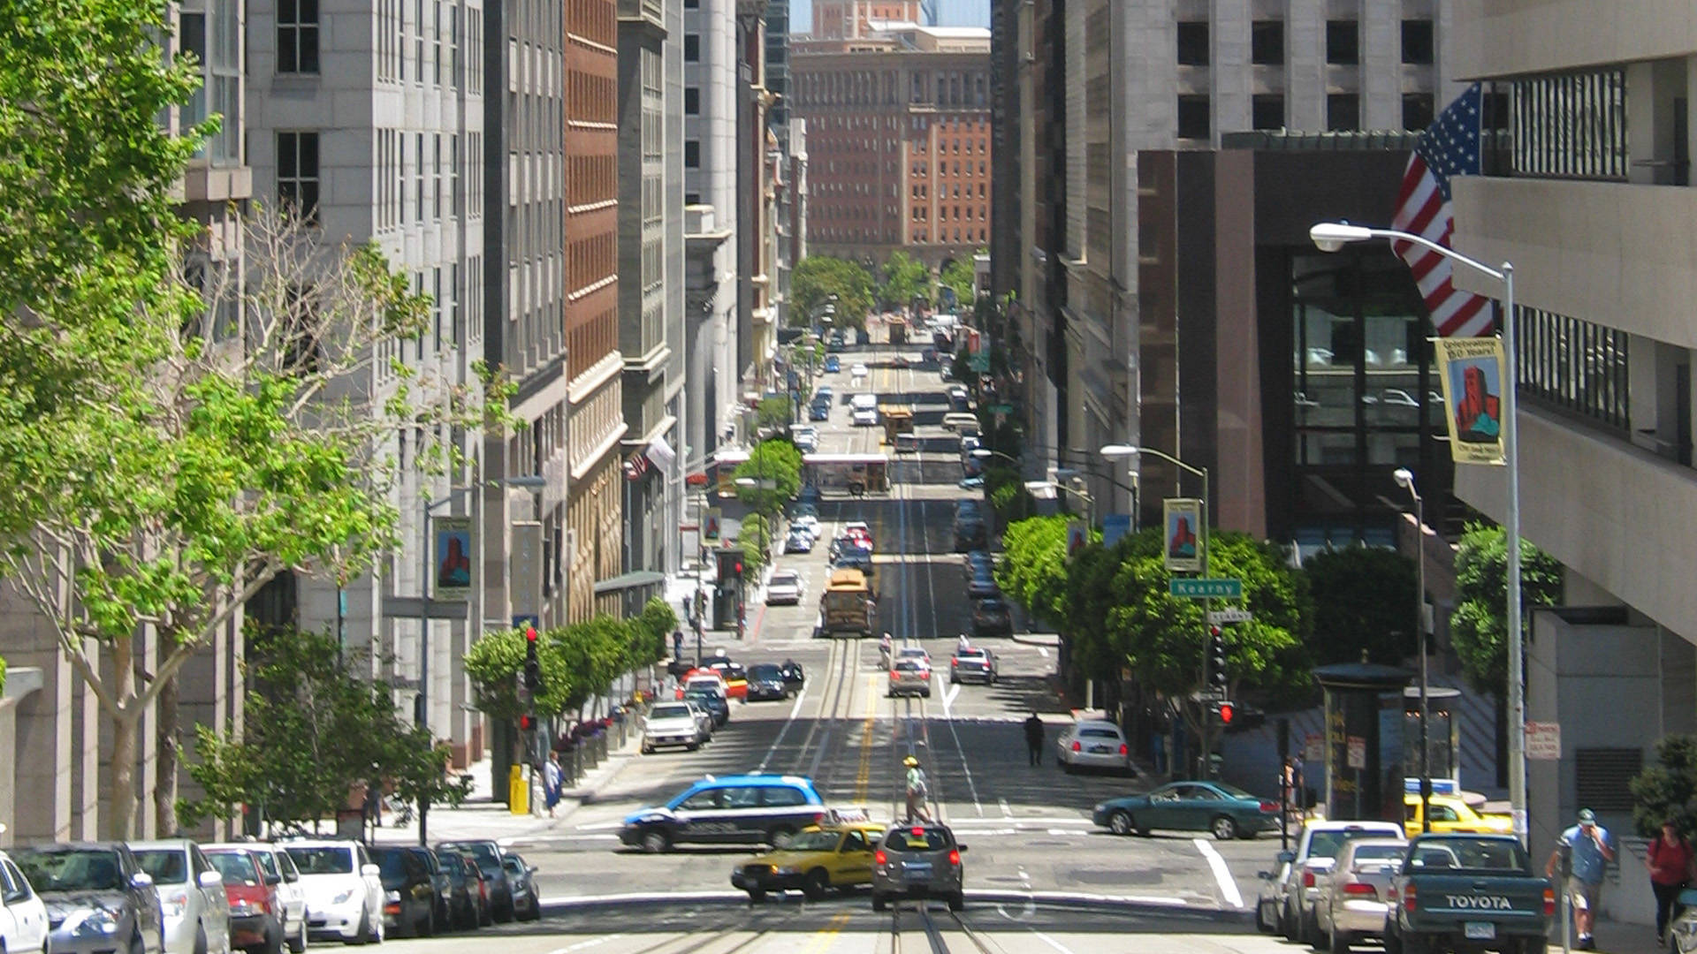

Slide 18
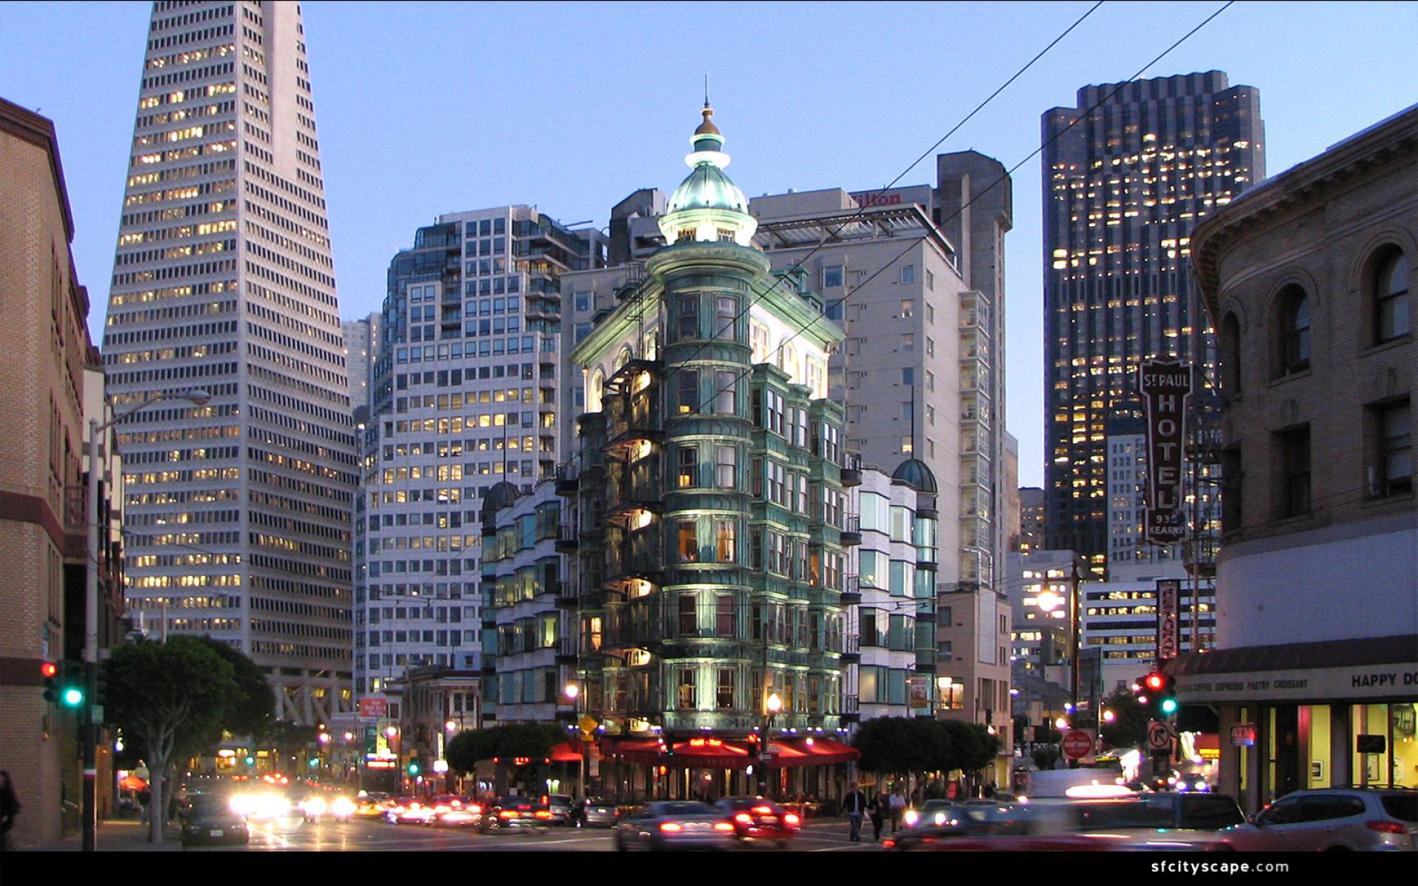

Slide 19
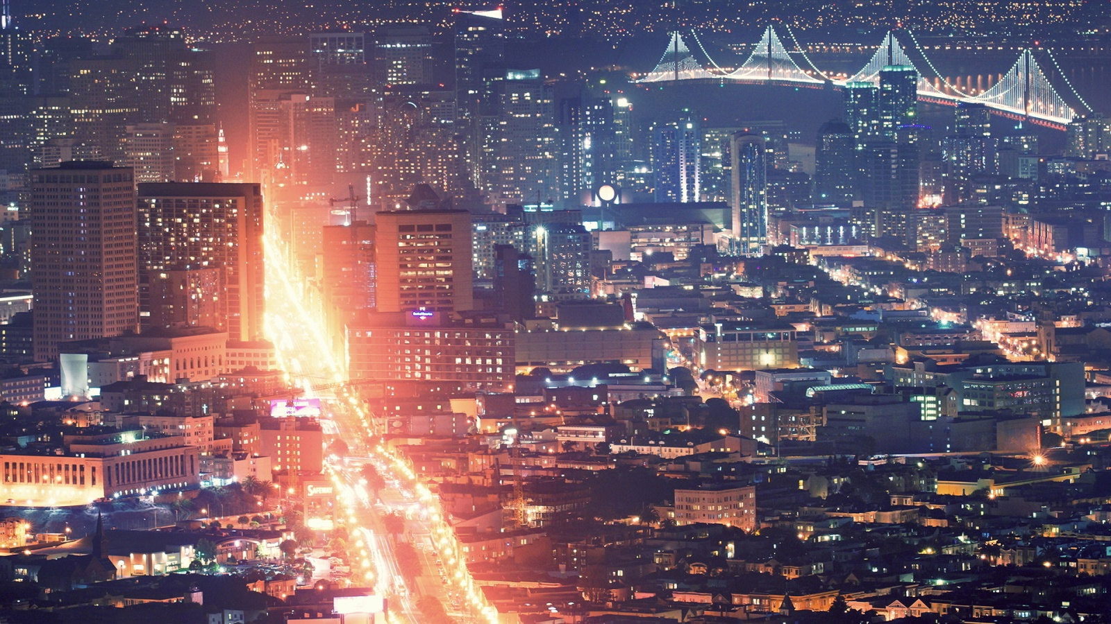

Slide 20
