Slide 1

My favorite jobs

Slide 2
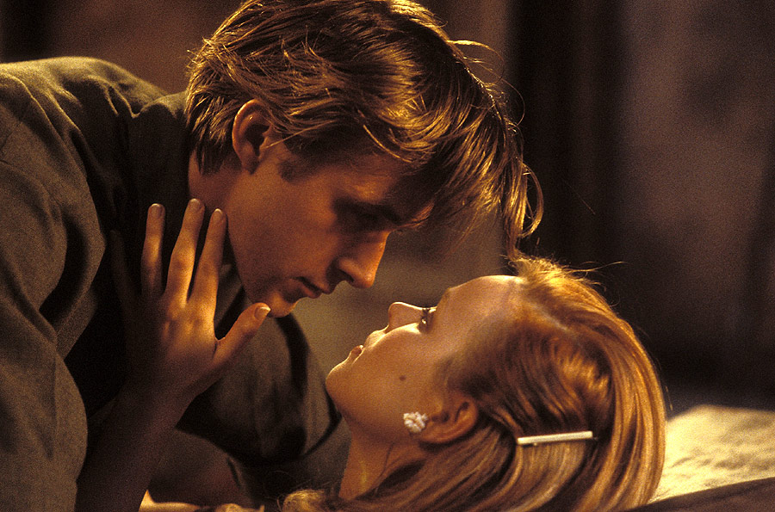
Actor

Slide 3
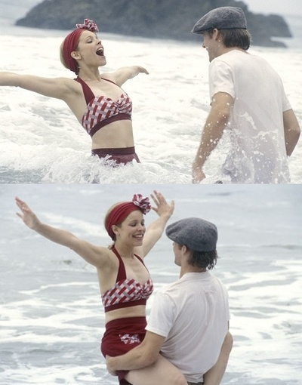
Actor (actor - one who acts) - Executive roles in drama, opera, ballet, vaudeville, circus performances and films, creator of scenic images.
Style, art direction and genre of actors determined character drama, nat. features theater, audience composition and staging principles. A. Art always gets the typical features characteristic of the style of a certain historical period.

Slide 4
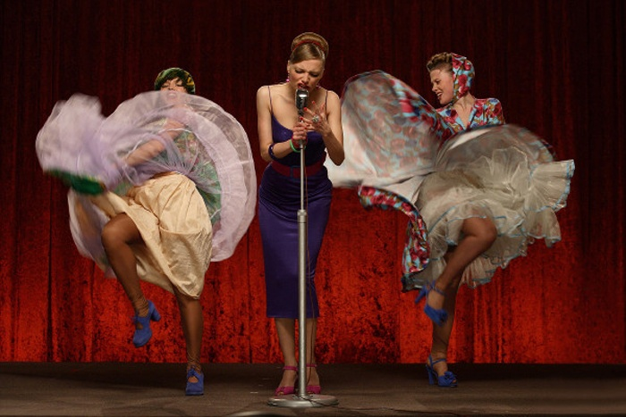
Singer

Slide 5
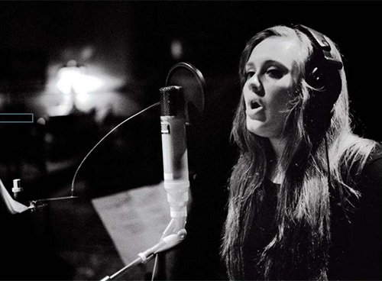
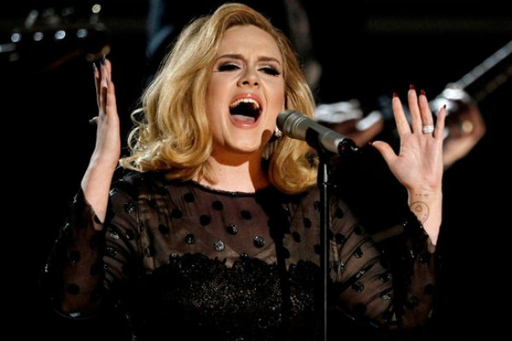
Singer or vocalist - a person engaged in singing. The term "singer" is more often used on singers that were performing a special school, but in many cases these words are synonymous. Depending on the type of music distinguished academic, folk and pop singers.

Slide 6

Accountant

Slide 7

Accountant (German Buchhalter, Buch - book , Halter - keep ) - Chief Operating workers Controller legality and correctness of operations at the bank , manager of technology operations , not only in my branch , but also on companies and organizations that currently serves Bank.
Technical work he does, and takes usually a control function, that checks and signs the papers with some operations where errors can contribute to loss of money and property, or where you want control over maintaining fiscal discipline.

Slide 8
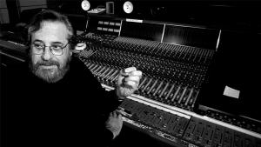
Music Producer

Slide 9
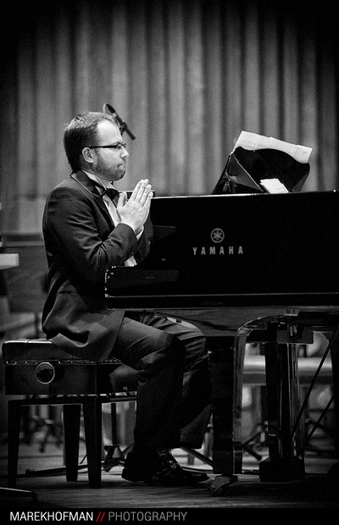
Music producer (born music producer, and record producer) - a person who is responsible for the image and musical style performers and recording process. Under his leadership, usually found control over sound quality, the choice of repertoire and ideology of the project (album, single, radio, etc.).. The producer is responsible for the selection of sound technicians and sound engineers, editors and assistants. Typically, major music labels have their own producers, but often the musicians themselves invite them interesting for producers from the other side.

Slide 10
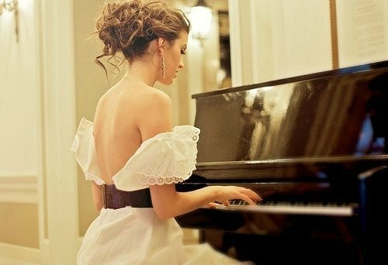
Pianist

Slide 11
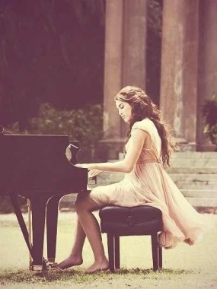
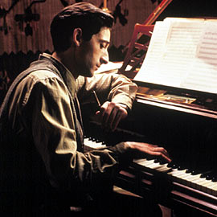
Pianist called musician who performs work on the piano. Professional pianists can act as independent artists, playing in the chamber ensemble, accompanied by an orchestra to accompany one or more musicians. Sometimes pianists perform in the Piano Ensemble, performing works written for two pianos or piano four hands.

Slide 12

Architect

Slide 13

Architect - a specialist who, through inputs creates a project of space. The main task of the architect - to create the most comfortable environment for human life.
Job includes all levels of spatial organization of the environment, from small to large forms of territorial systems.

Slide 14
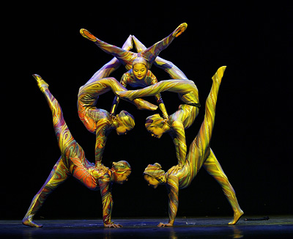
Acrobat

Slide 15
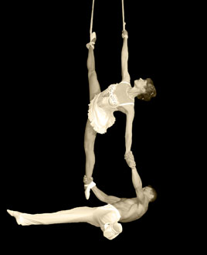
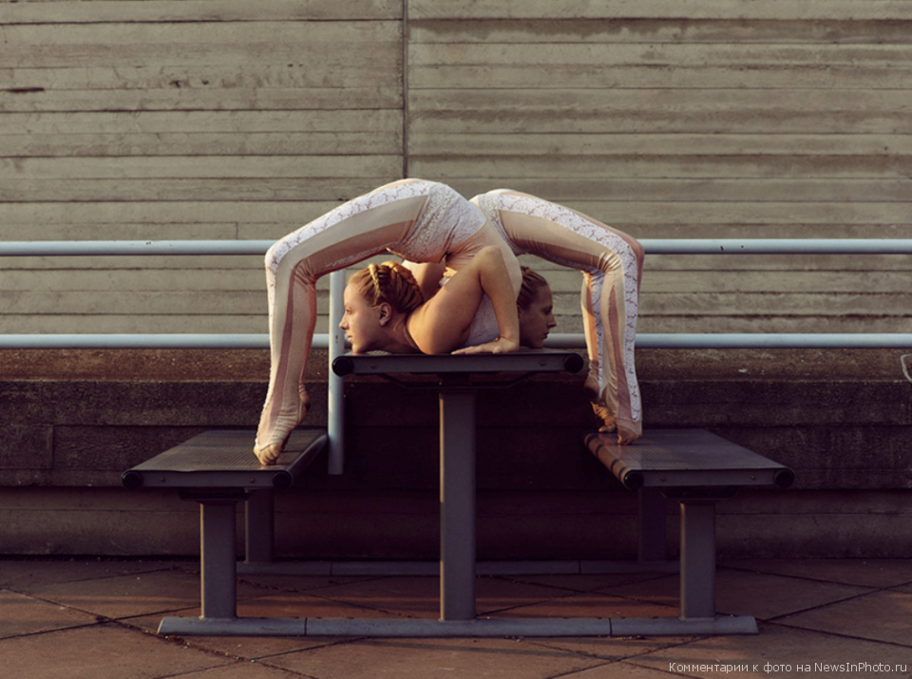
Acrobat - a person who performs a variety of complex acrobatic tricks and professionally engaged in gymnastics. Various tricks can be paired and group.

Slide 16
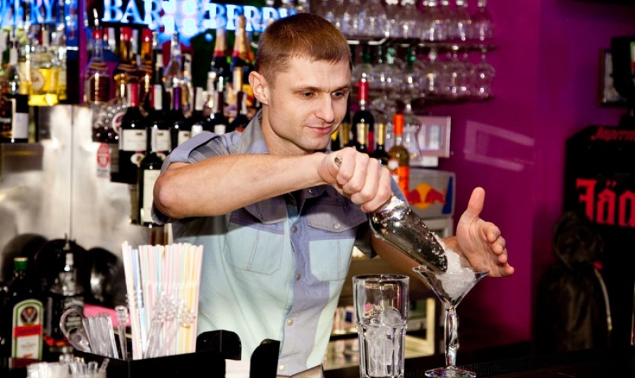
Bartender

Slide 17
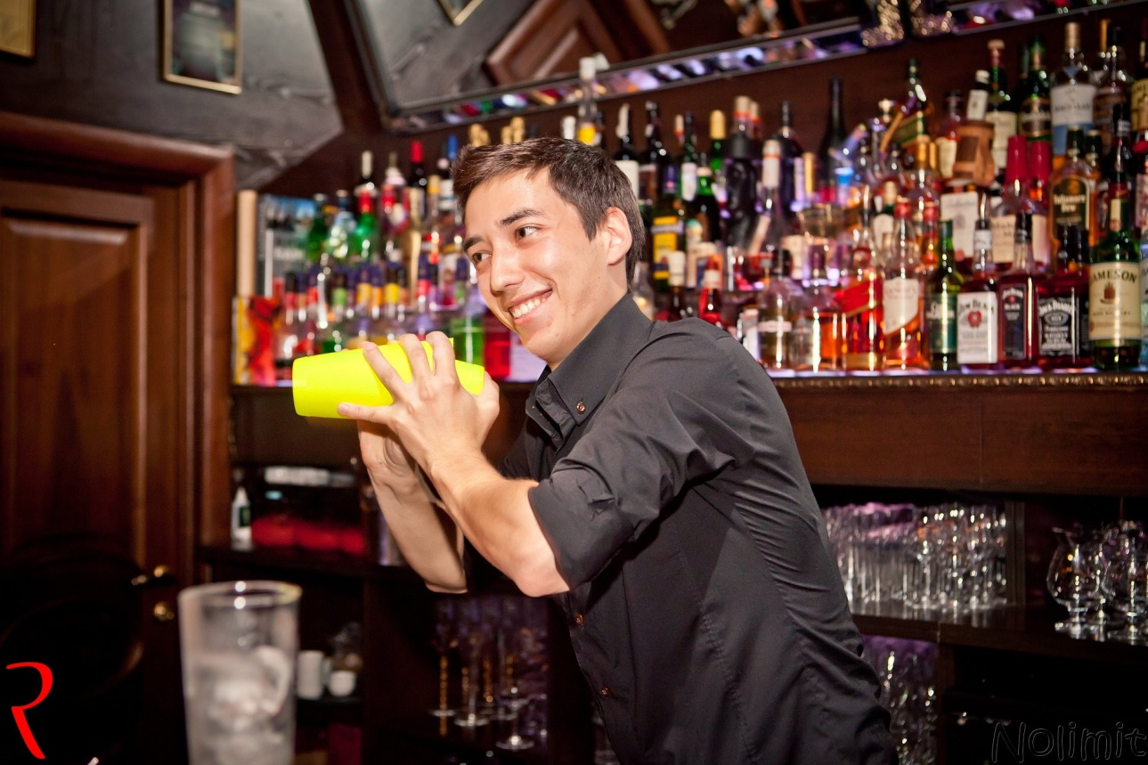
The bartender - a profession that appeared over a hundred years ago. The name comes from the English occupation. bar, which means fence, counter, counter, that protect the seller from the buyer. Earlier bars were the only independent company, they are now an integral part of restaurants and cafes. Scope, technical equipment bars are divided into dairy, beer, barbecue, express, wine, and for other purposes - for dancing, concert. The last time there were salad and soup bar.

Slide 18

Interpreter

Slide 19

Translator - 1) as intermediaries in communication, the need for which arises in cases where the codes used by the source and destination do not match. As an intermediary language translator can perform not only translation but also various types of adaptive transcoding. 2) A person who is professionally engaged in translation.
Most interpreters perform oral or written translation or combine these activities. Another case is the simultaneous translation.

Slide 20
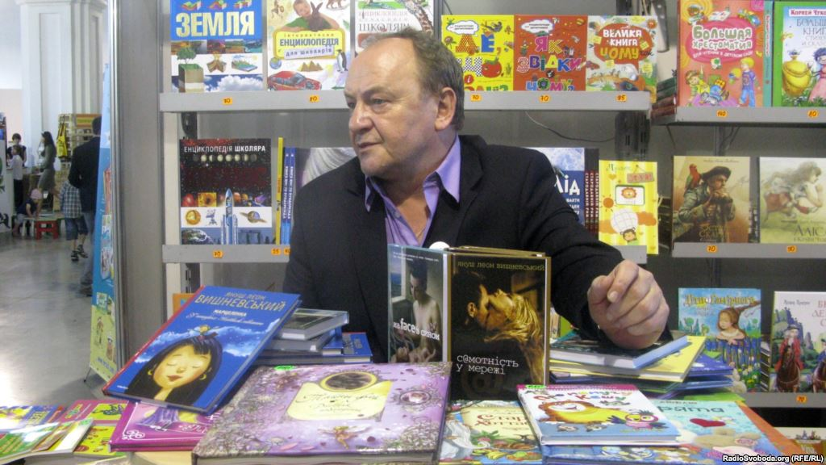
Writer

Slide 21
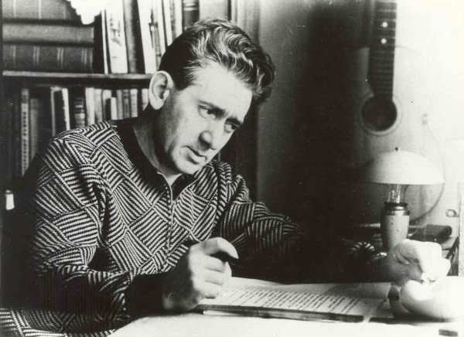
The writer - in the broadest sense is everyone who writes pieces (not necessarily artistic, scientific, and poetry), expresses his own thoughts, experience and vision of the world in writing. In a narrow sense is the author of works of art, the person for whose literary career is a profession. Synonyms for the word writer is a writer, a master of words, the employee pen.
Writer - the general name of persons involved in the creation, designed usually to the public readers.

Slide 22
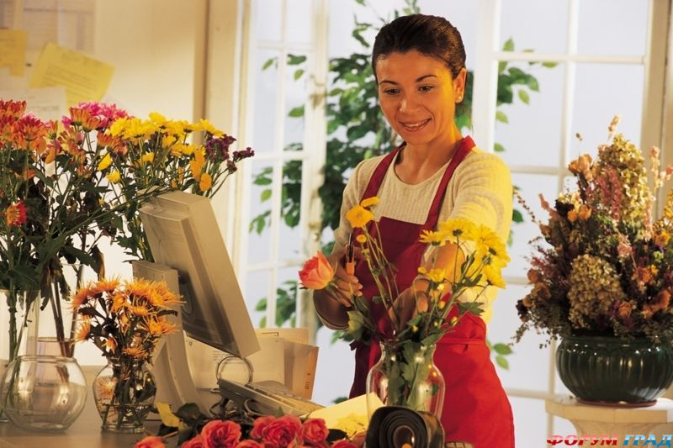
Florist

Slide 23
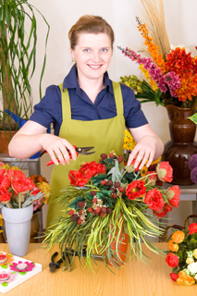

Florist - a person who creates floral arrangements for holidays, weddings and various rituals in selling florist, interior decorating, windows, knowledgeable in flowering plants.

Slide 24

Journalist

Slide 25
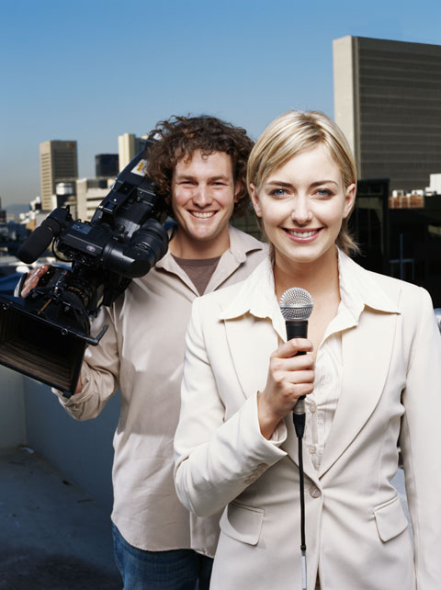
Journalist - a person who has been collecting, creating, editing, preparation and processing of information for the registered version of media that is associated with her employment or other contractual relationship, - or engaged in such activities on their own initiative. Journalist - a mirror of society, it must reflect reality. Calling a journalist - to benefit people and protect their interests and bring light into the darkness of ignorance.

Slide 26
Prepared
Pupil 10-A class
Sarny Lyceum "Leader“
Zhuchenya Kateryna

