Slide 1
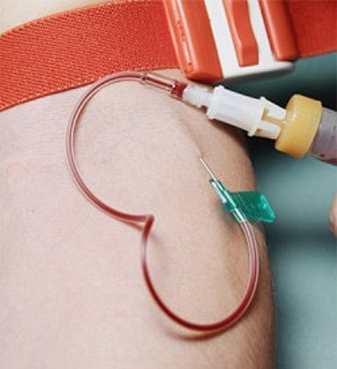
Blood
Performed:
Lubomir Kovalchuk

Slide 2
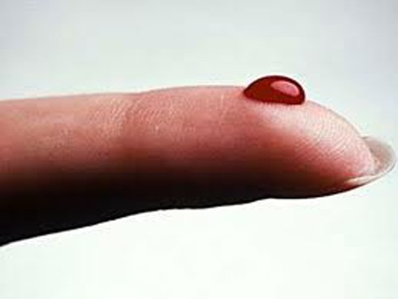

Blood - a rare connective tissue of animals that perform important functions in the maintenance of his life.

Slide 3
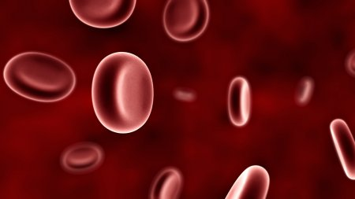
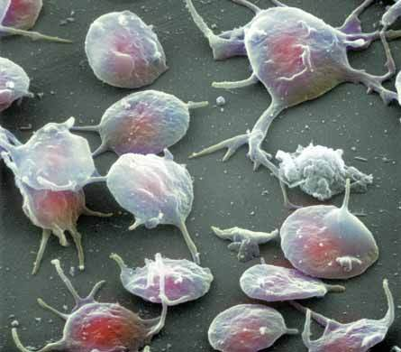
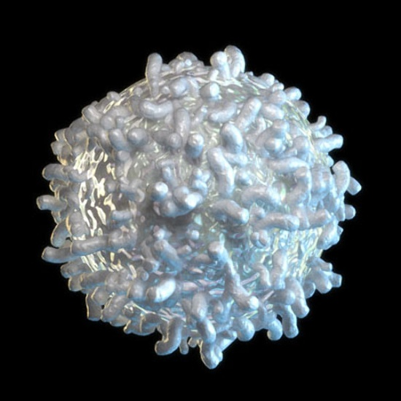
Blood is composed of plasma and formed elements (cells):
Red blood cells (erythrocytes)
Platelets (thrombocytes)
White blood cells (leukocytes)

Slide 4
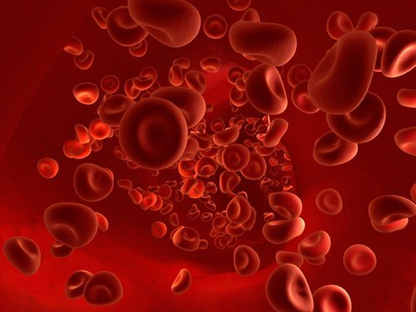
erythrocytes - the most numerous of the formed elements . Mature red blood cells do not contain nuclei and are shaped like biconcave disks. Circulating 120 days and destroyed by the liver and spleen. Protein found in red blood cells of iron ions - hemoglobin , which provides the main function of red blood cells - transport of gases in the first place - oxygen. It hemoglobin gives blood red color.

Slide 5
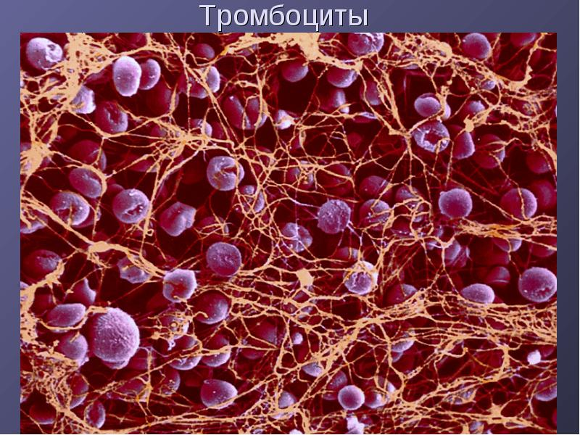
Thrombocytes - platelets, non-nuclear blood cells with a diameter of 2 - 4 mm, with irregular rounded shape and are formed in the red bone marrow from megakaryocytes. Together with plasma proteins ,they provide a blood clotting, arising from damaged blood vessels, leading to stop bleeding, and thus protect the body against life-threatening blood loss.

Slide 6
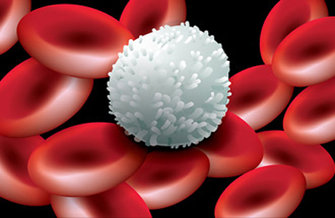
Leukocytes - consisting of cytoplasm and nucleus; formed in the red bone marrow, spleen and lymph nodes. They are involved in immune responses, choosing T cells that recognize a variety of viruses and harmful substances, B cells that produce antibodies, macrophages that destroy these substances.

Slide 7
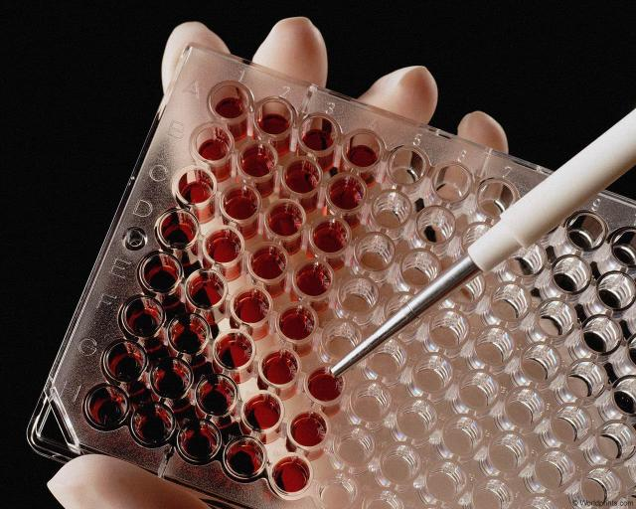
Blood groups
Blood group - a classification of blood for the presence or absence of certain inherited antigens on the surface of red blood cells.

Slide 8
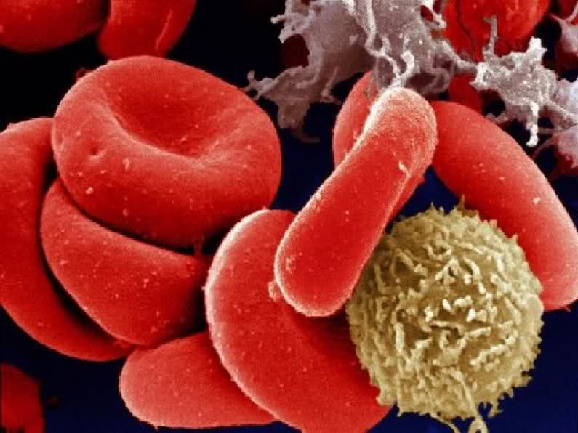
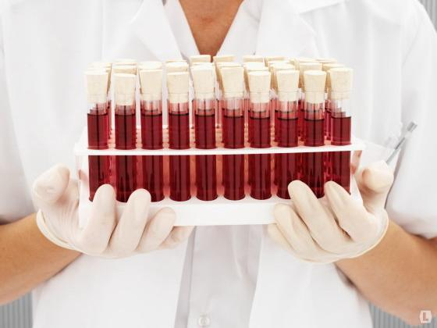
There are four blood types:
no agglutinogens and agglutinins from both - (0) also known as I;
only agglutinogens A and beta agglutinins - (A) also known as II;
only B agglutinogens and agglutinins alpha - (B) also known as III;
with both agglutinogens and agglutinins without - (AB) also known as IV.

Slide 9
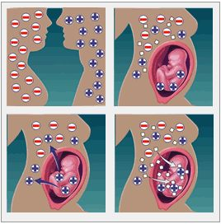
Rhesus - conflict
Rh factor - is the humoral immune response of Rh-negative mother to erythrocyte antigens Rh-positive fetus, in which antibodies are formed antirhesus

Slide 10
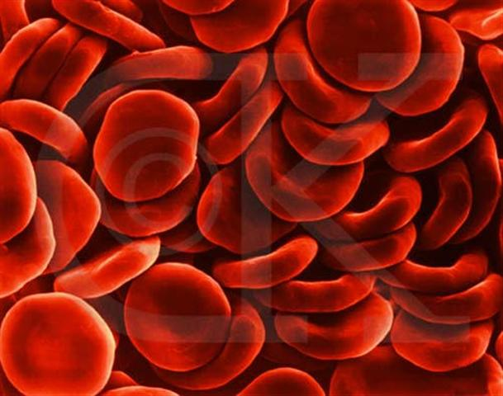
Thank you!

