Slide 1
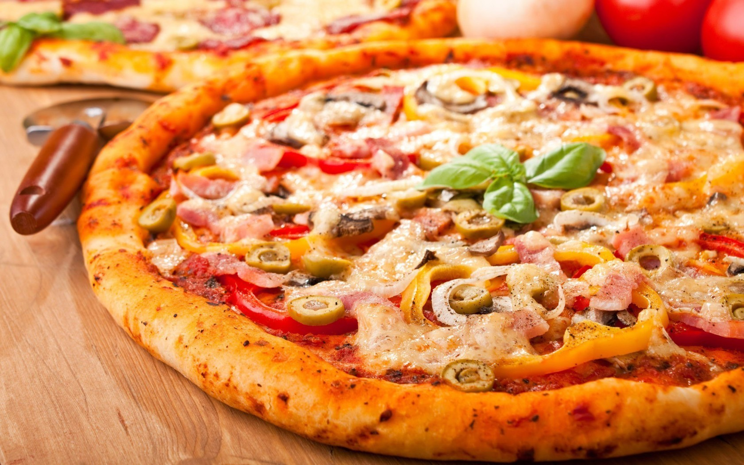
Pizza

Slide 2
Pizza

Slide 3
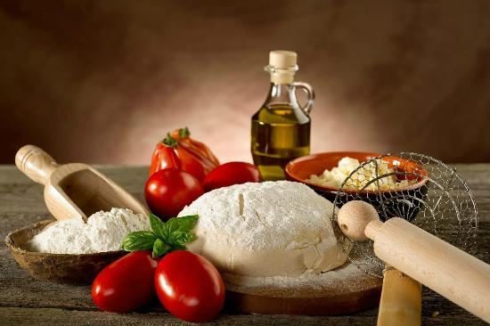
ingredients:
Dough:
1 package active dry yeast(about 2 teaspoons)
1 cup warm water
1 teaspoon sugar
2 tablespoons olive oil
2 ½ cups all-purpose flour
Pinch salt
Topping:
1 cap (8 ounces) tomato sauce
Browned ground beef
1 can sliced mushrooms(drained)
Thinly sliced green pepper and onions
½ cup grated Parmesan cheese
1 to 2 cups shredded Mozzarella cheese

Slide 4
1. Add yeast to the water and stir until dissolved

Slide 5
2. Add sugar, oil, flour, and salt

Slide 6
3. Put the mixing bowl filled with dough in warm water for 5 minutes to rise

Slide 7
4. Pat dough out on a well-greased cookie sheet or pizza pan or

Slide 8
5. Lay toppings on dough in order listed

Slide 9
6. Bake at 400° for 15 to 20 minutes

Slide 10
Delicious appetite

