Slide 1

Music in my life

Slide 2


I love music, I think people can not live without it.
We can hear music everywhere: in the streets and at home, over the radio and on TV, in the shops and in the parks.

Slide 3


People all over the world are fond of music.
They listen to music, they dance to music, they learn to play musical instruments.

Slide 4

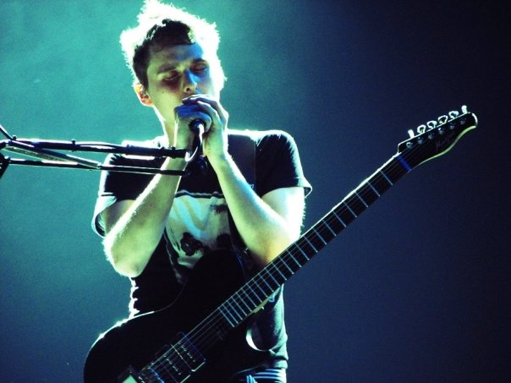

There are a lot of different kinds of music: pop, jazz, rap, rock and other.

Slide 5


As for me, I also enjoy listening to rock music.
The music I hate is heavy metal. I find it noisy and dreadful.
Though some young people are fond of this style of music, it is not to everyone's taste.

Slide 6


I enjoy listening music because it reflects my moods and emotions.

Slide 7
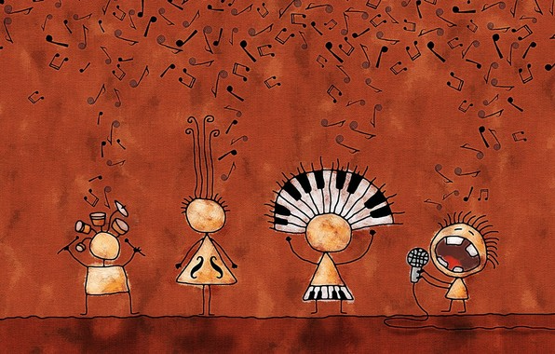

Sometimes I attend music halls and the concerts, when popular groups and singers are there.
I like watching music programs on TV.

Slide 8
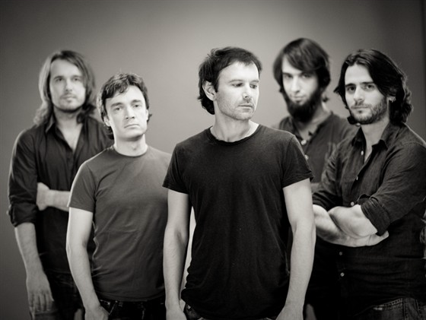
Okean Elzy

Slide 9
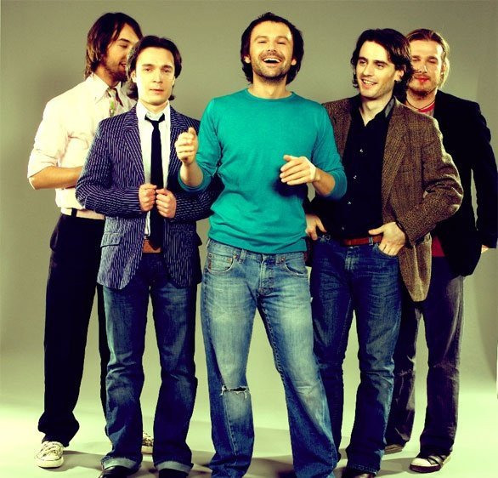
The band was formed in Lviv in 1994.
Okean Elzy is the most famous and most decorated Ukrainian rock band.

Slide 10
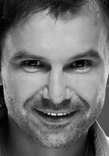
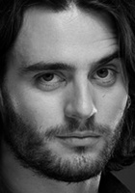
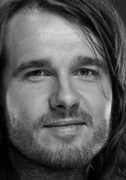
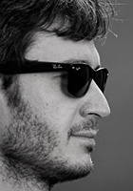
Band members
Slava Vakarchuk
Vocals,
songwriter
Milos Jelic
Keyboards,
arrangements
Denis Dudko
Bass guitar
Denis Glinin
Drums

Slide 11
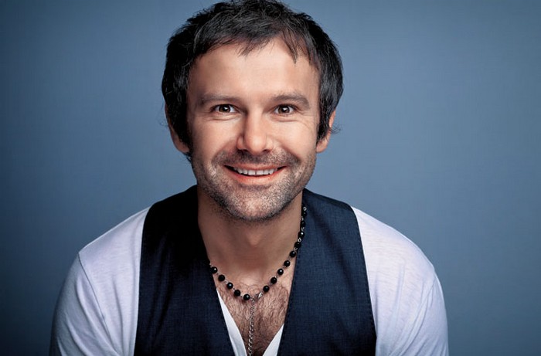
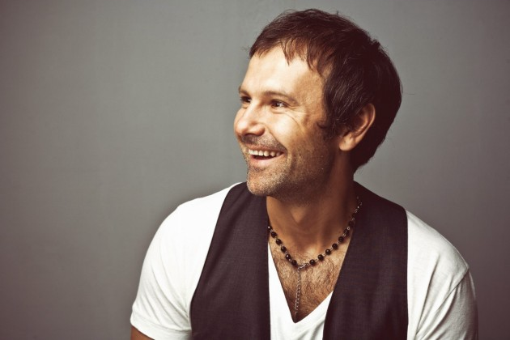
The band vividly express themselves through in-depth lyrics, a unique musical style, and an impressive on-stage drive and energy.

Slide 12

Songs
Stina
Obijmy
Koly Navkolo Ni Dushi
Na Linii Vognyu
Zeleni Ochi
Koly Tobi Vazhko
Ne Pytai

