Slide 1
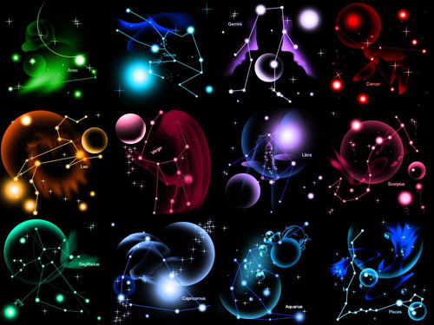
Signs of zodiac
By Stupar Dasha 9-2

Slide 2
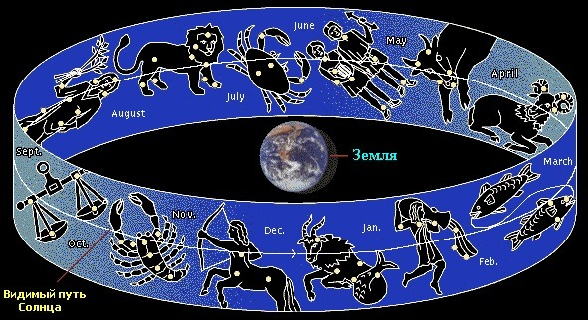
12 Signs of zodiac

Slide 3




Signs of zodiac : Fire

Slide 4




Signs of zodiac : Water

Slide 5
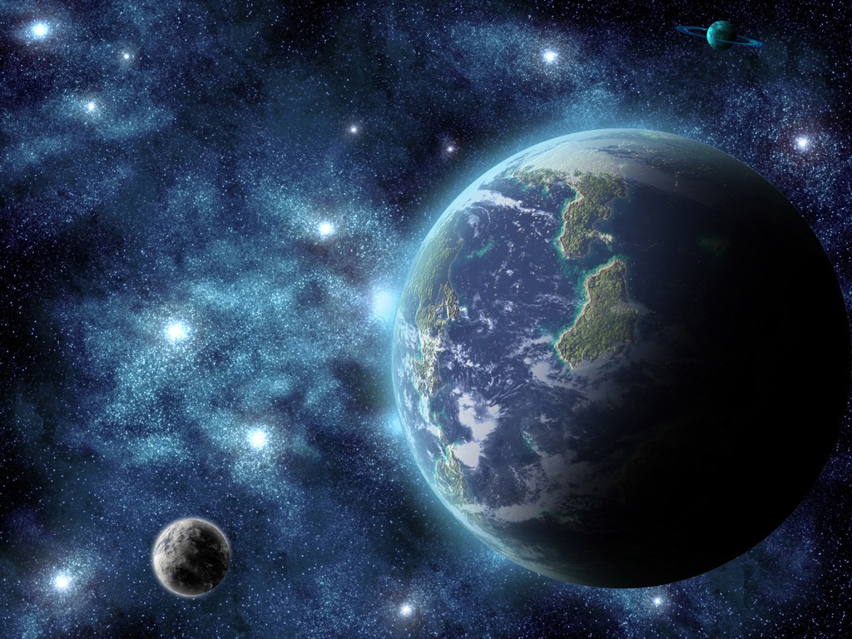



Signs of zodiac : Earth

Slide 6




Signs of zodiac : air

Slide 7







Woman’s signs of zodiac:

Slide 8







Man’s signs of zodiac:

Slide 9

My sign of zodiac is Virgo

Slide 10
Signs of zodiac, with whom I will be happy.

Slide 11


Slide 12


Slide 13
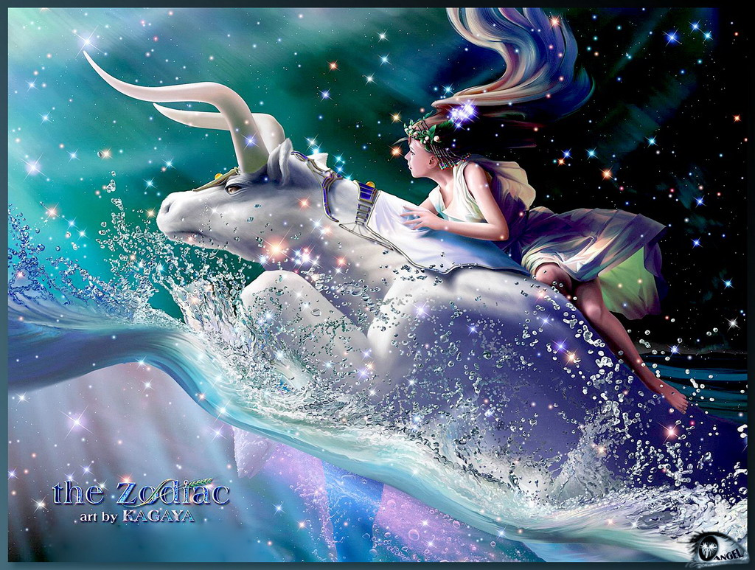

Slide 14
Signs of zodiac, with whom I will not be happy.

Slide 15
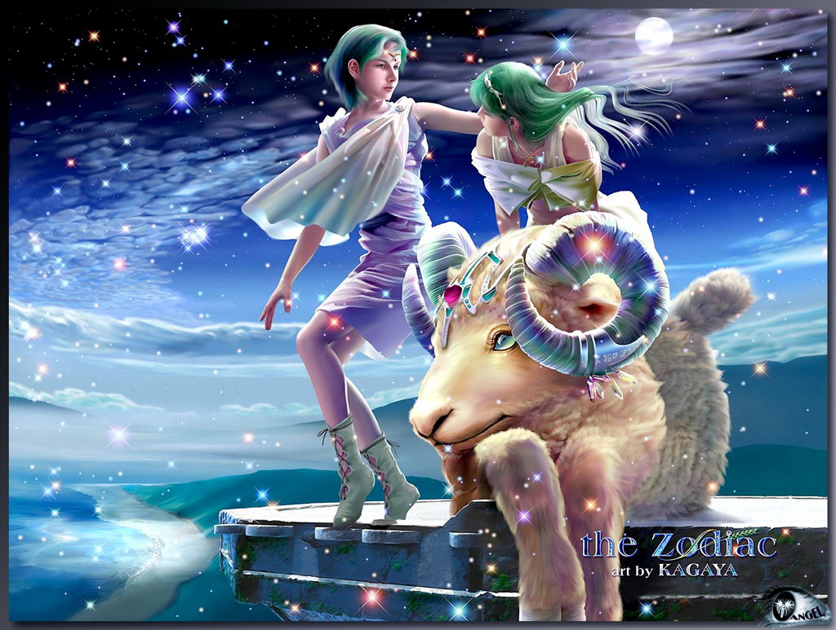

Slide 16
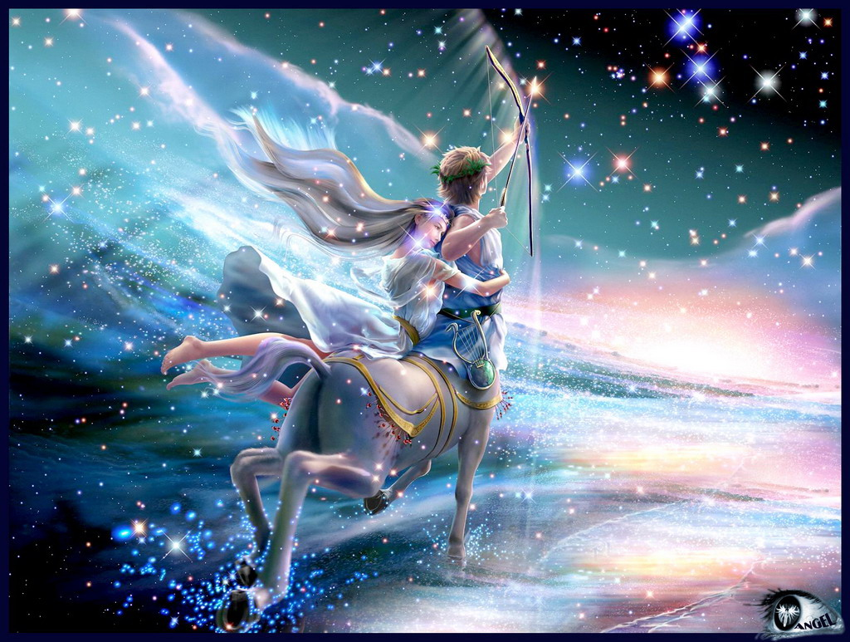

Slide 17


THE END

