Slide 1
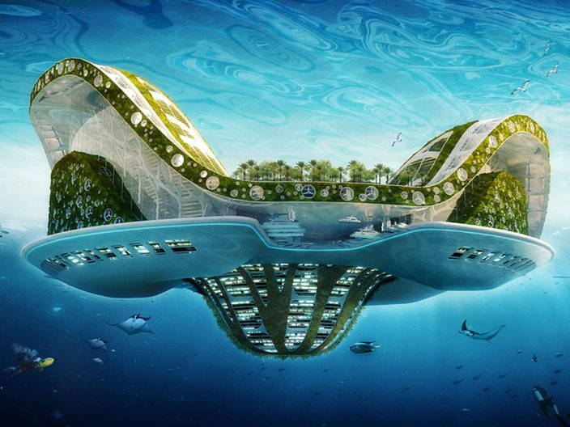
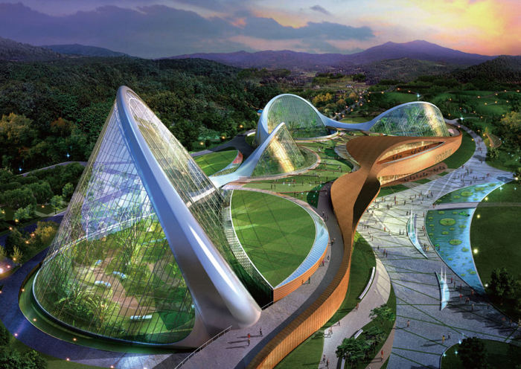
City of the future
Prepad
Ellina Shevchenko
Form 10-B

Slide 2
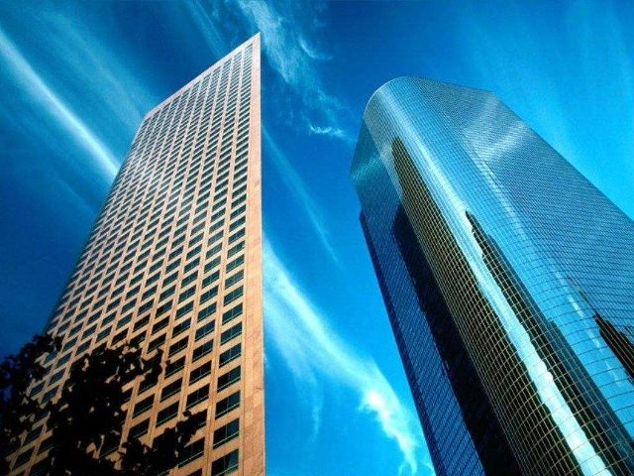
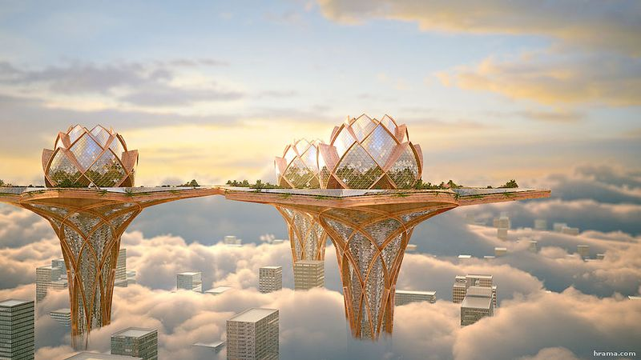
I believe in a better future. I really hope that we humans will improve the world in which we live. Therefore, the city of the future will be very different from modern the better.

Slide 3
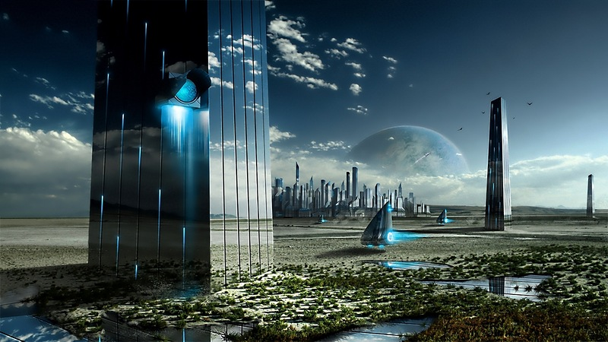

Slide 4
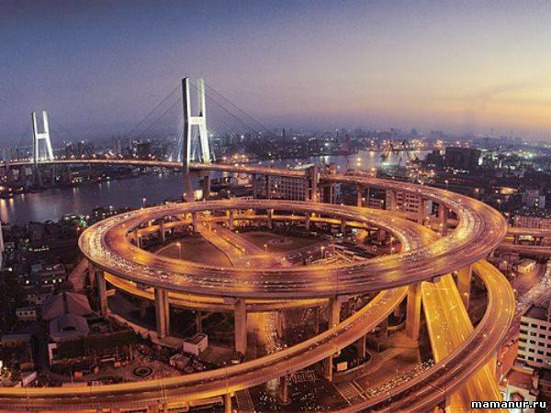
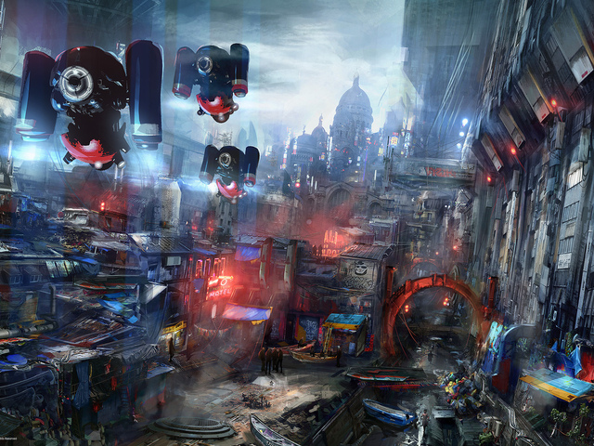
First, in the future the city will be clean, because all plants and other enterprises that pollute the environment today use new security technologies .
There will be clouds of red dust metal , chemical emissions, dirty water in the seas and rivers. But life in vyruvatyme as usual , so the streets will be many cars. But all of them will go to environmental fuel

Slide 5
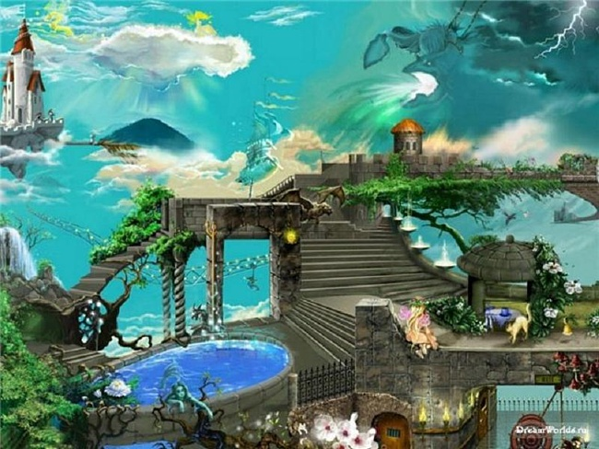

Slide 6
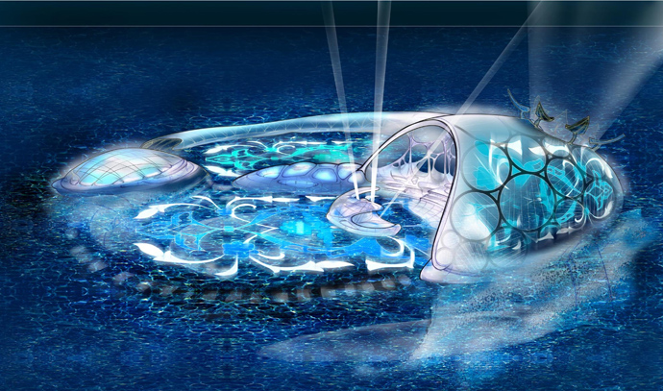
Second, the city of the future will be very comfortable for living. Apart from the usual shops and cafes will run a variety of home shopping delivery service - and it will be available to everyone .
There will also be many new forms of public transport , very fast and safety .

Slide 7
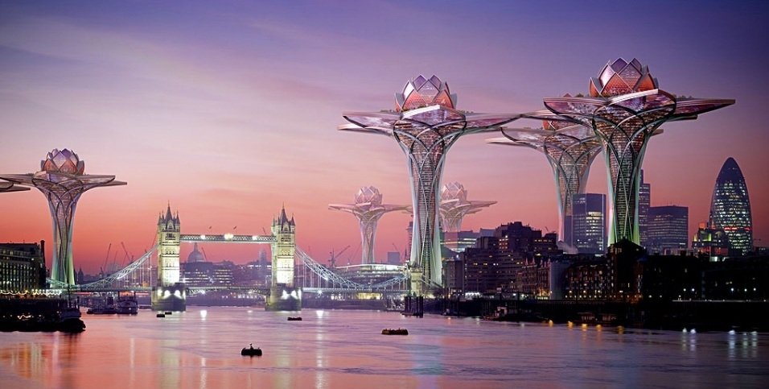

Slide 8
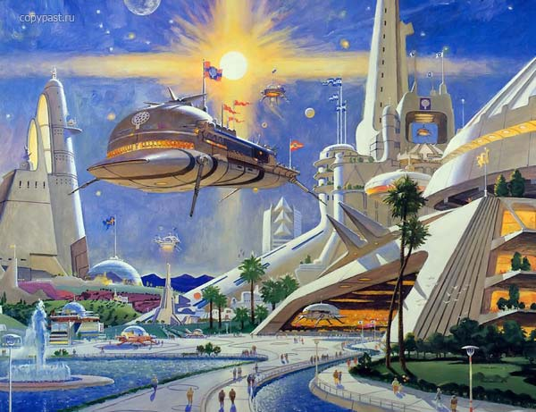
The city of the future a lot of attention paid to the cities rest. It will be built many parks , cinemas, viewing platforms. Where neither the sea , nor the river be made artificial ponds where you can swim and sail boats . Each city will resemble a spa.

Slide 9
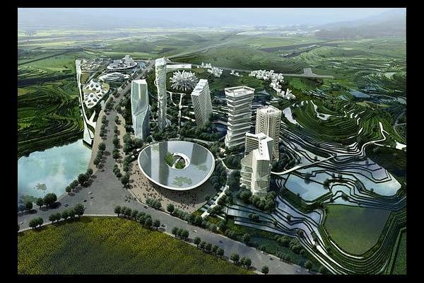

Slide 10
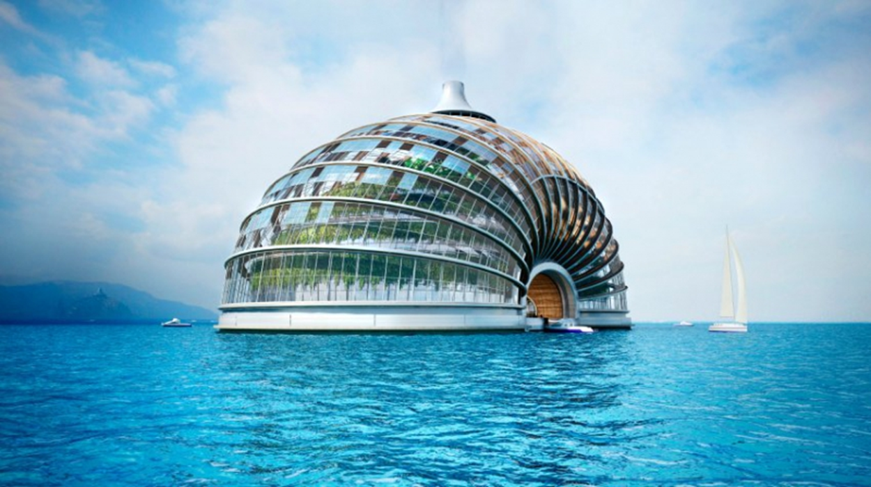
I would like to see the city of the future were different and unlike each other - large and small, with skyscrapers and cottages, and that people feel comfortable and safe to live in them. Maybe I'm from the future is different from the city of science fiction novel , but I think it is that we really can do it

Slide 11
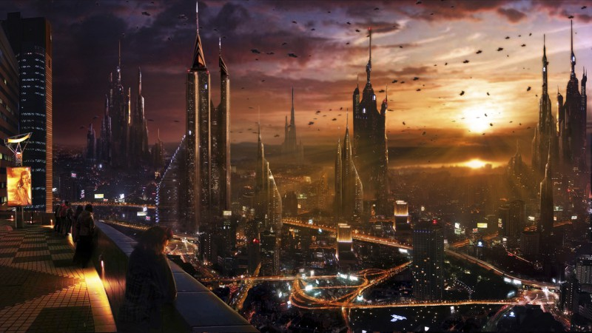

Slide 12
Thanks for your
attention

