Slide 1
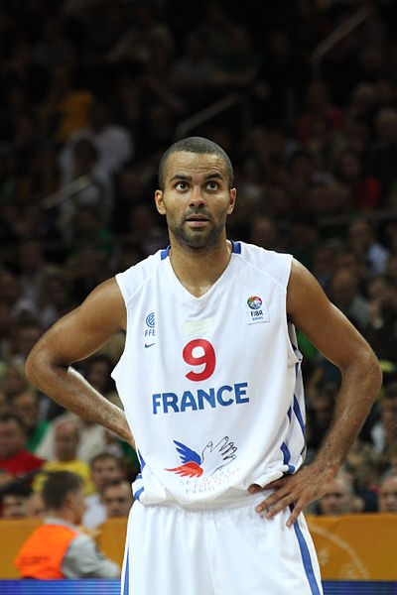
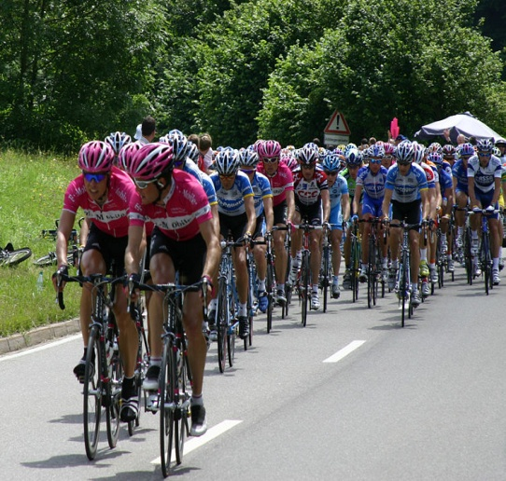
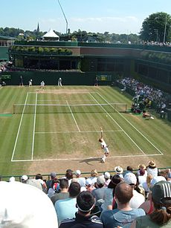
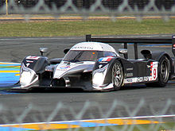
Sport in France
      Popular sports played in France include football, judo, tennis and basketball. Several major tennis tournaments take place in France. The Tour de France is the oldest and most prestigious of Grands Tours, and also the world's most famous cycling race.

Slide 2
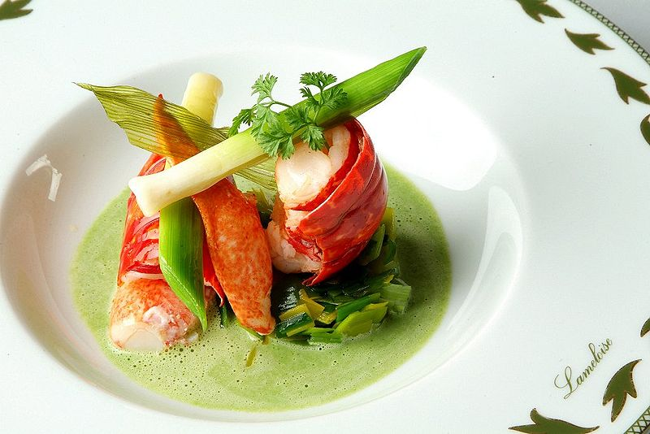
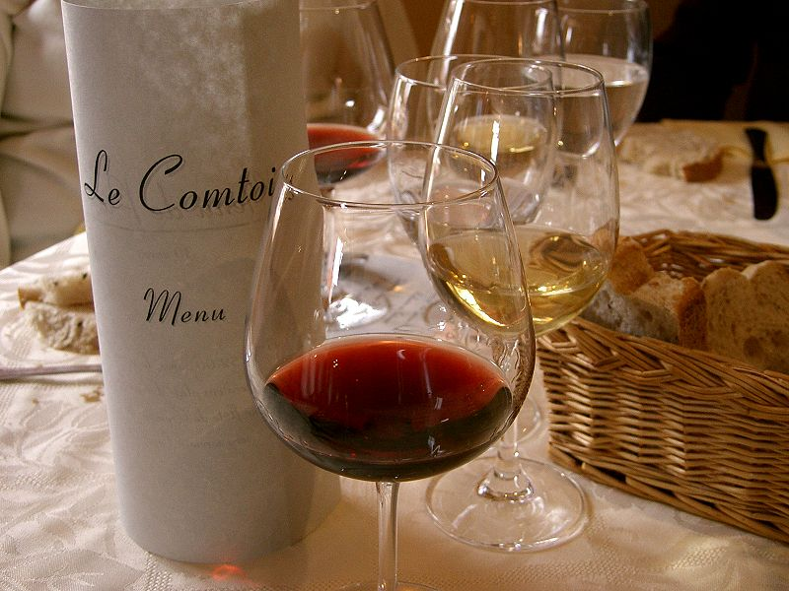
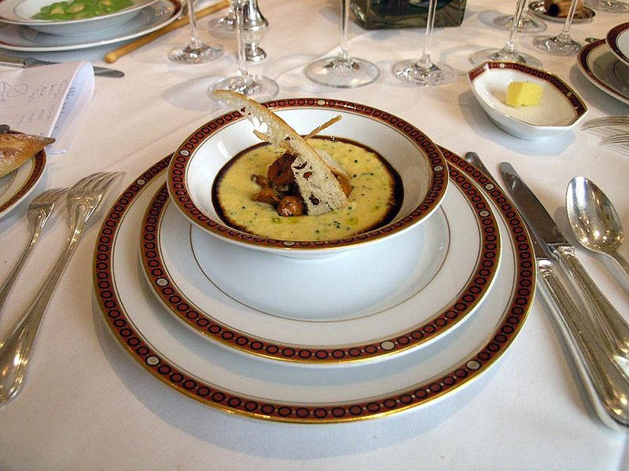
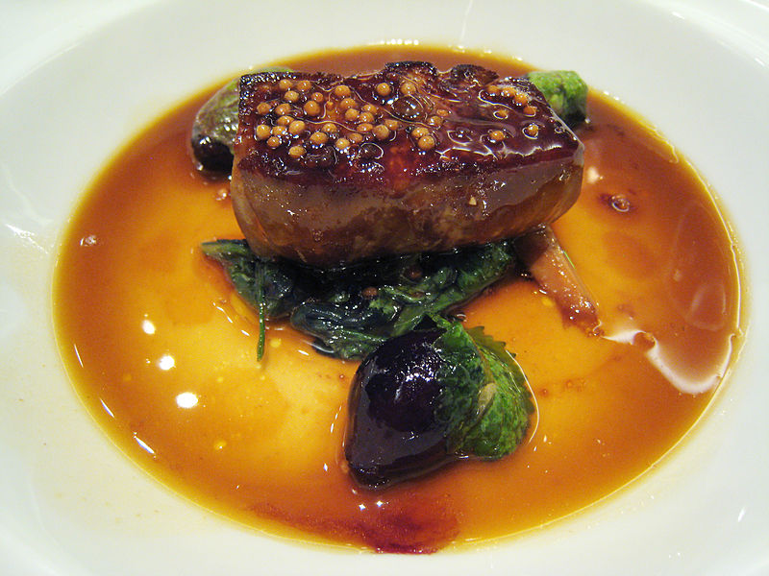
French cuisine
French cuisine is renowned for being one of the finest in the world. French cuisine is extremely diverse.

Slide 3



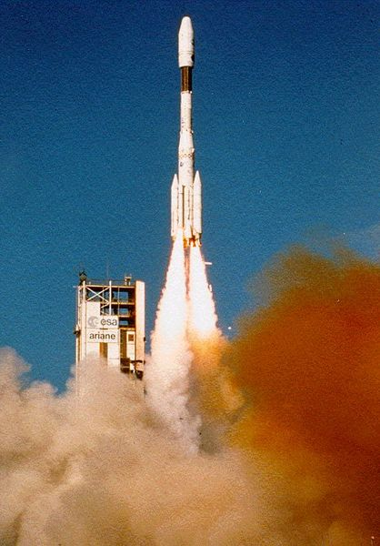
Sciences
Neon sign
France has been since the Middle Ages a major focus of knowledge and discoveries.
Modern stethoscope.

Slide 4
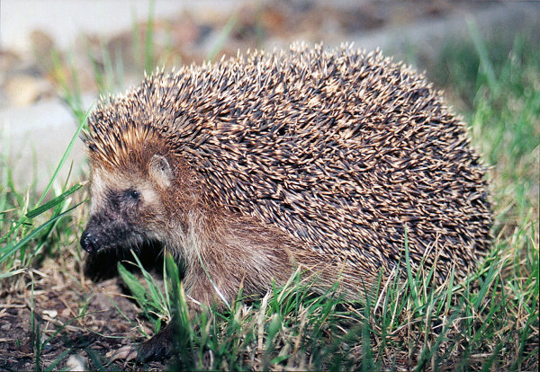
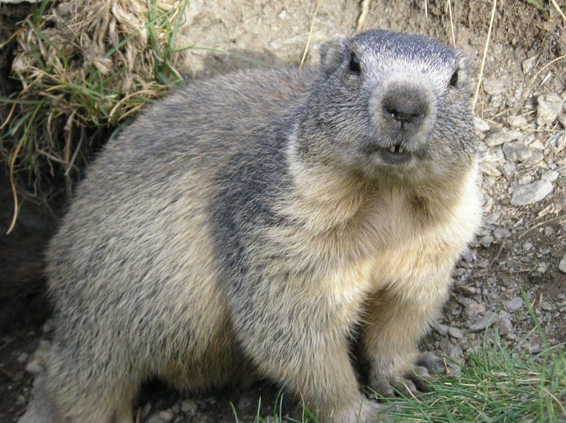
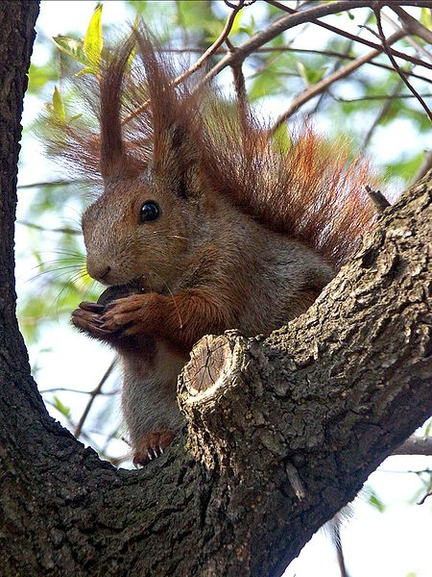
Animals
There are 120 mammal species in France.
Rodents make up the largest order of mammals.
Among endangered species are the badger, the otter, the beaver, the tortoise, the marmot of the Alps, and the brown bear and the lynx of the Pyrenees.

