Slide 1

Presentation:
MY DREAM SCHOOL

Slide 2
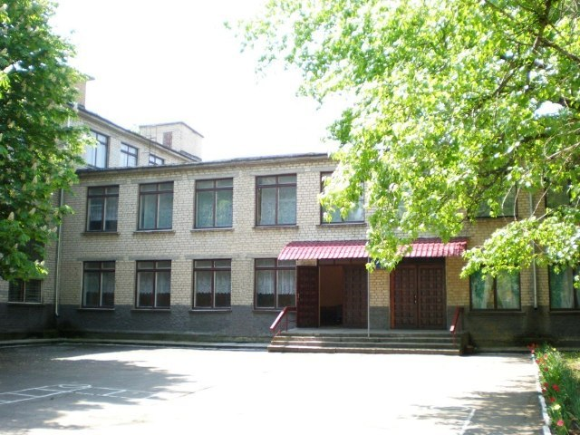
School is very important in our life.
We spend much time in school.
We communicate, study, have
friends here.
We are preparing for future life.
Our knowledge improved.
By Verbna Anastasia

Slide 3
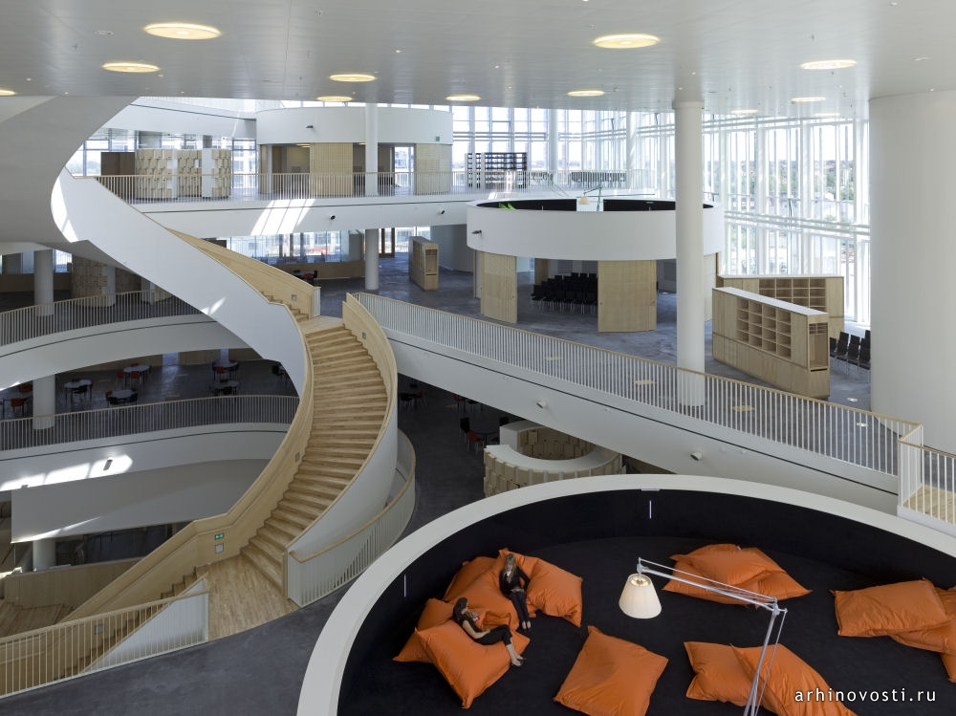
My dream school…
Must be new and modern.
Has good teachers.
Has good equipment.
Must be large and spacious.
Gives good knowledge.

Slide 4
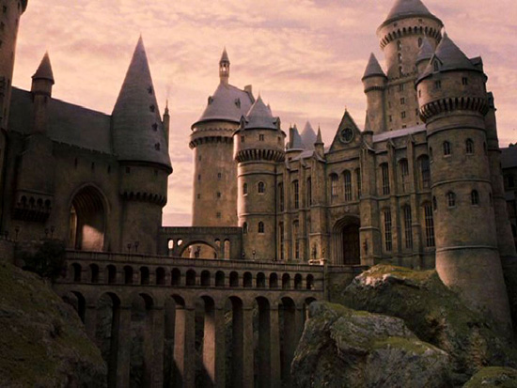
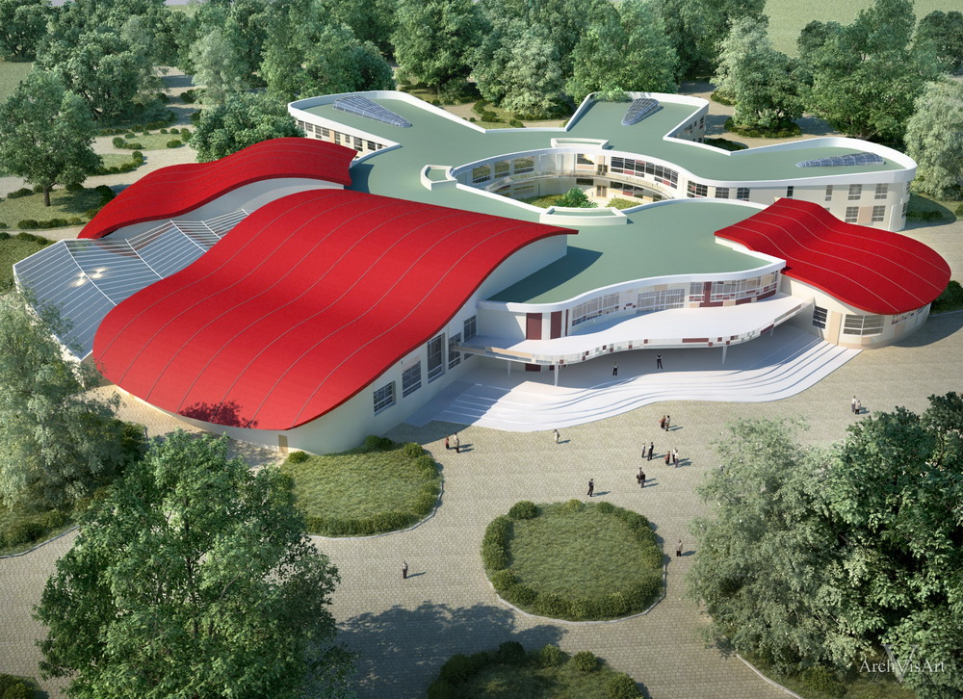
School`s VIEW.
School must be appealing look the outside, for example:

Slide 5
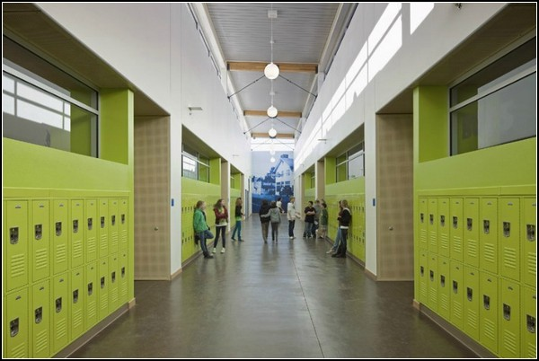
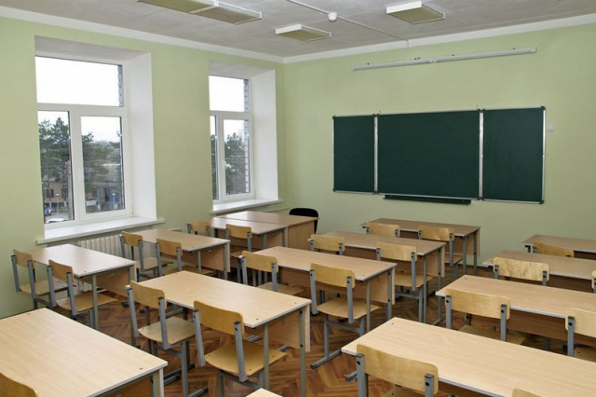
It must be spacious and have many windows also must be bright and modern.

Slide 6
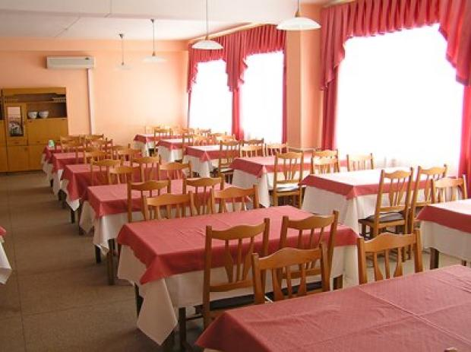
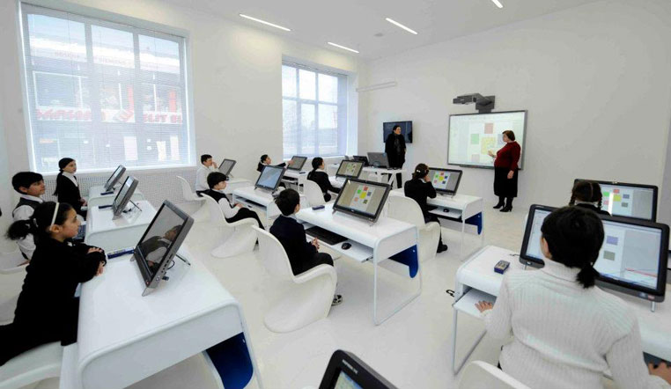
Good computer lab, a large library, spacious classrooms, bright hallways, great food in the dining room.

Slide 7
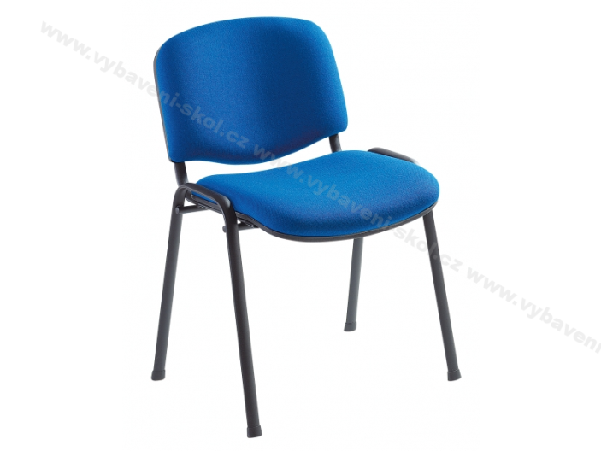
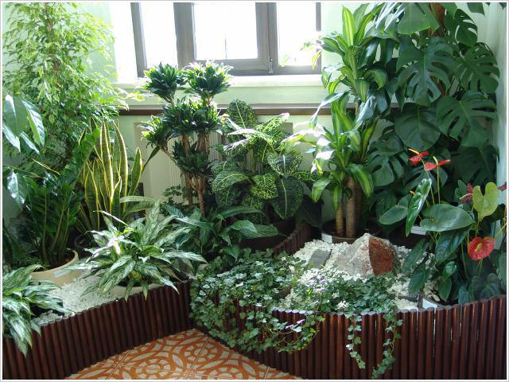
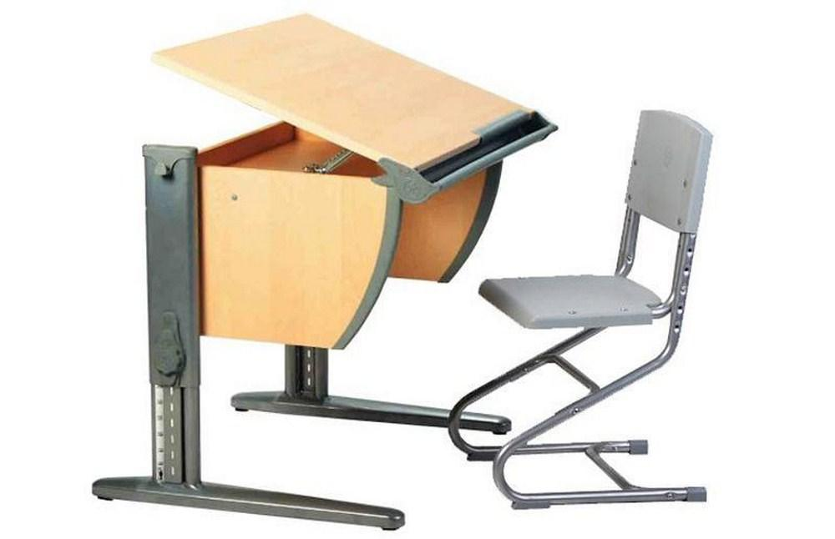
Classes must have a lot of flowers, children to sit on soft chairs by comfortable desks.

Slide 8
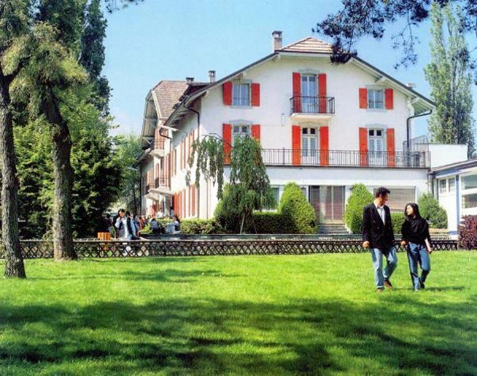
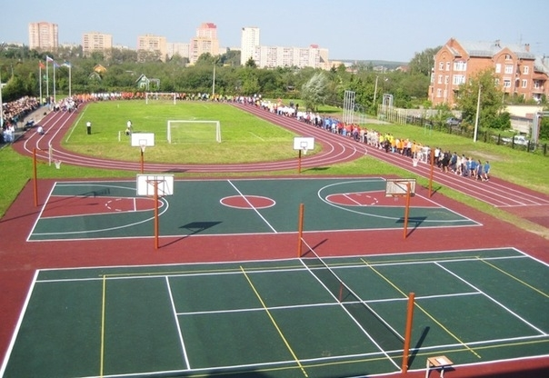
School area must be large and clean, have enough places to relax.

Slide 9
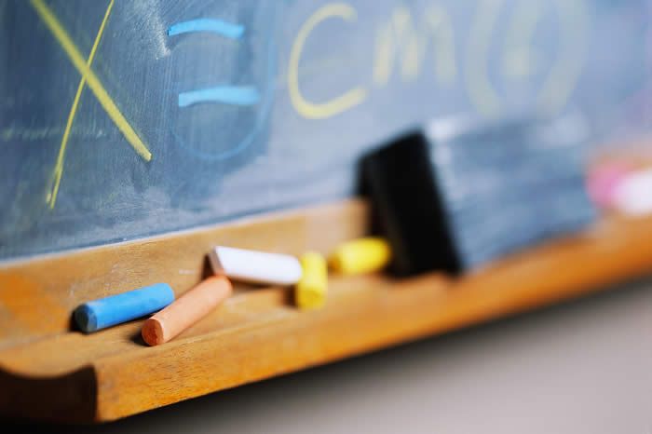
Timetables must be made wisely.
Monday:9 hours in school
physical culture
physical culture
algebra
Tuesday:9 hours in school
Ukrainian literature
physical culture
physical culture
Wednesday:10 hours in school
web design
Thursday Friday Saturday and Sunday Closed
By Harin Jaroslav

Slide 10
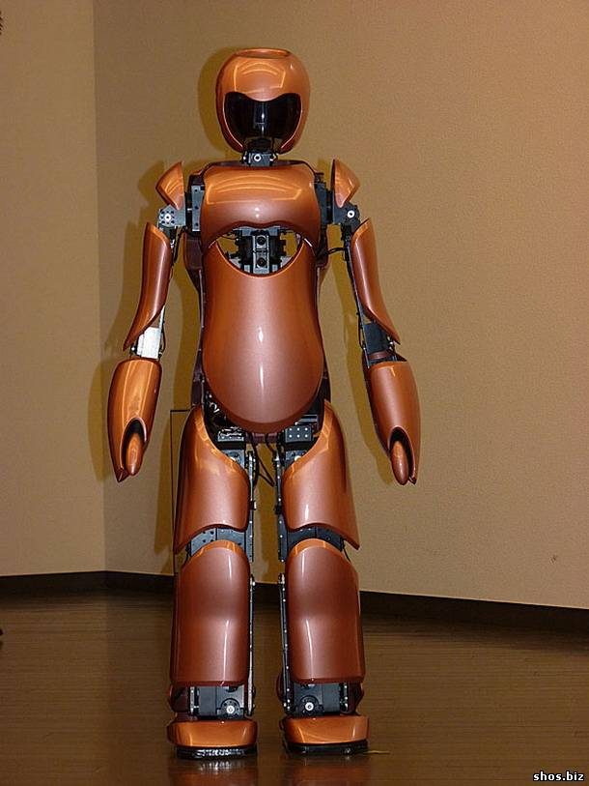
Teacher in the future.
Twenty of the super teachers in the entire school. One of them is our class teacher. It can do 2 things at once, also conducts classes all from the comfort of students

Slide 11
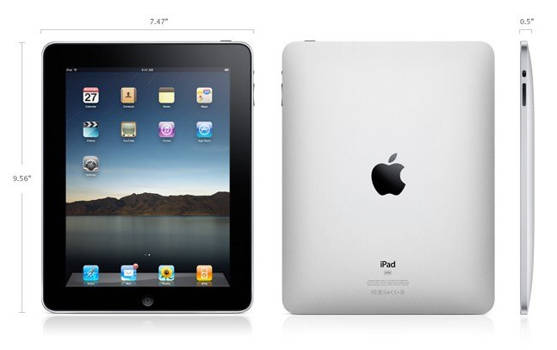
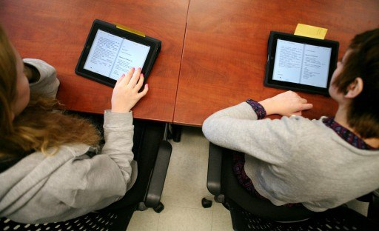
Books in the future.
Our e-books are very popular in our school, they are at all. We wear them because they are very light, unlike books. Estimates put us in the e-zine for parents to see our estimates at any moment. Replaced in the a diary in electronic journal as books to e-books.

Slide 12
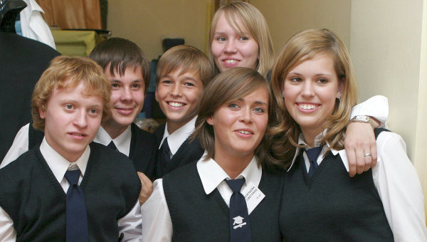
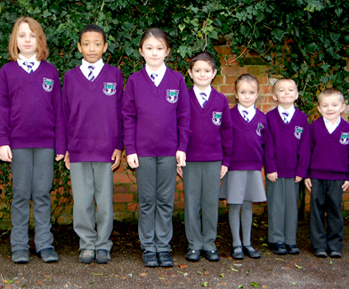
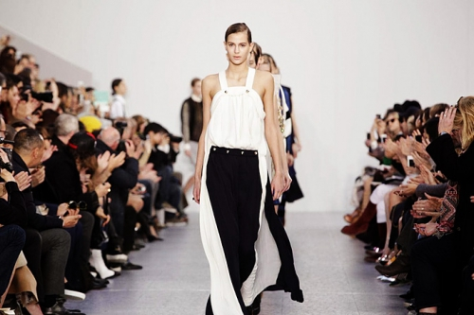
School uniforms in the future.

Slide 13
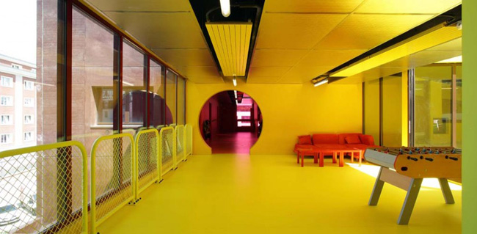
I never thought about what should be the school of my dreams . For me, at my school are satisfied . But when I was asked which school I can see your dreams I truly thought . I had to think long and about this. But if I dream given the opportunity , I would like to have in the school pool. That in winter , cold weather, swimming with friends in a warm, clear water . Great idea to have a good school library. Where can I seek not a long book, and that the library was equipped with this technology, which would help you to quickly find literature.
Also not a bad idea to have a botanical area with exotic plants . For there were flowers in which children could take care of yourself , grow and experiment and give to teachers.
I would like to have in school competitions in training or in the second area where the prize would be a trip abroad .
But everything I wrote about my dream school is an all- in -all my thoughts, but in reality you need a lot of money .

Slide 14
Our group came to this conclusion:
Everybody wants to study in schools that are new and modern.
Students want to have good grades, knowledge, teachers, uniforms, equipment, etc.
Children always felt as at home at this school.
We satisfied our Lyceum.

