Slide 1
Sports in my life

Slide 2
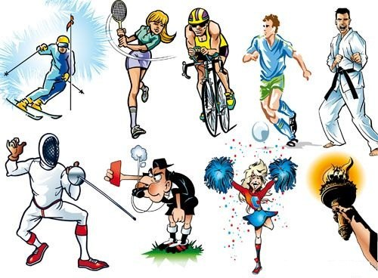
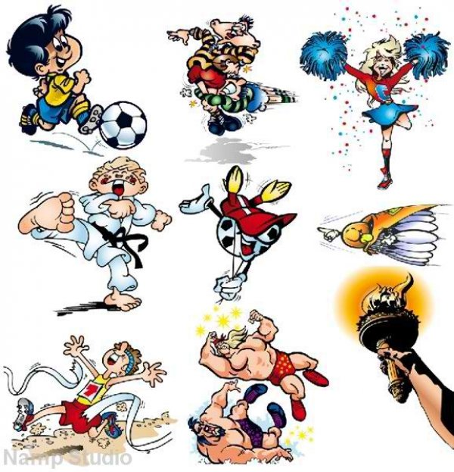
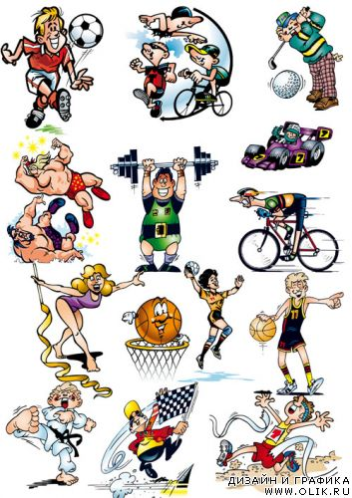
European sports
football, fencing and gymnastics - have been popular in Ukraine in the early twentieth century. Created the first team and various sports clubs athletes, organized the first race.
Sports that begins in childhood strengthens the character to life.
Sport taught me to set some goals and achieve them. This I was not responsible grove your time in vain.
I choose what I like and not others. I chose my profession because I like it and I will always do their work with great enthusiasm.
All this had an impact sport which I took as a child.

Slide 3
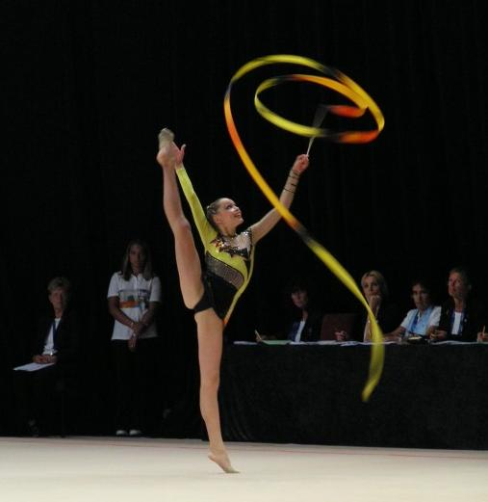
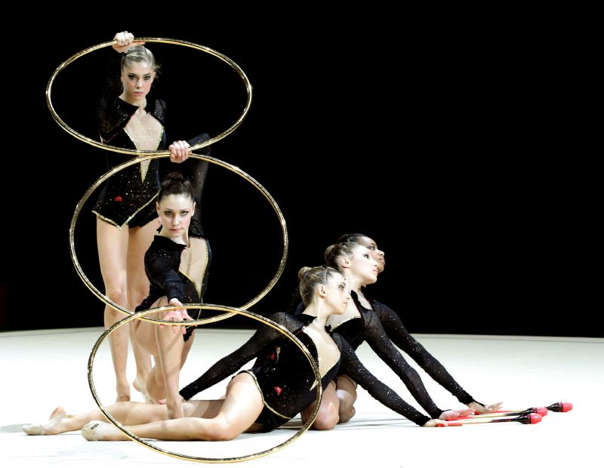
Rhythmic gymnastics - a relatively young sport.
In a short period of its existence, this sport has won international recognition and has many fans in all corners of the globe.
In the USSR gymnastics as a sport originated and developed in the 1940s.

Slide 4
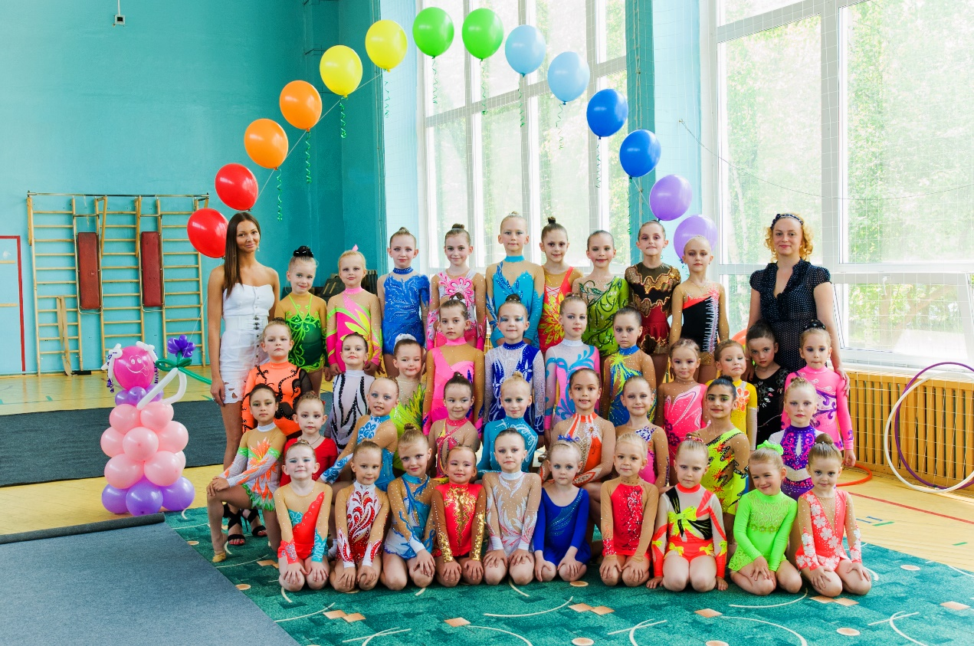
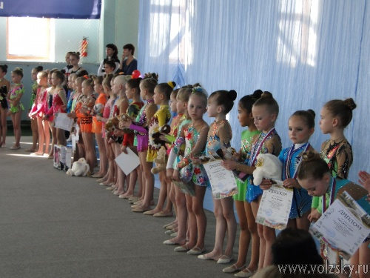
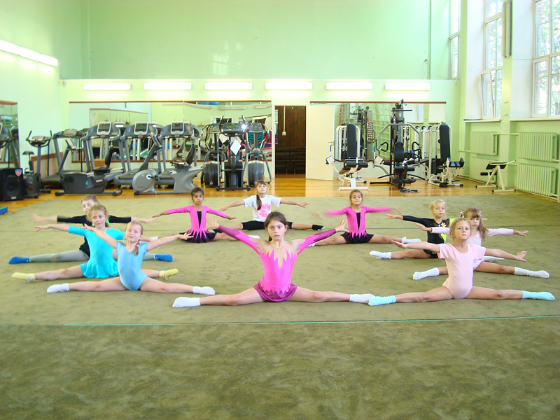
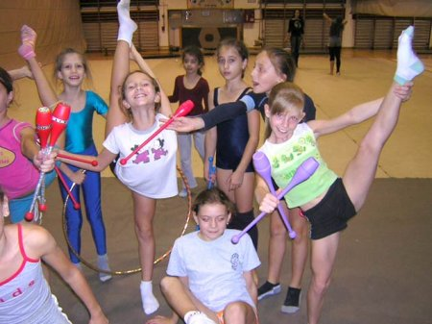
I started practicing rhythmic gymnastics in 4 years. In CYSS №1.
For 3 years I have achieved remarkable of endurance and speed. Athletics is the queen of sports.
Every six months we had competition between different regions of Ukraine where I took prizes.

Slide 5
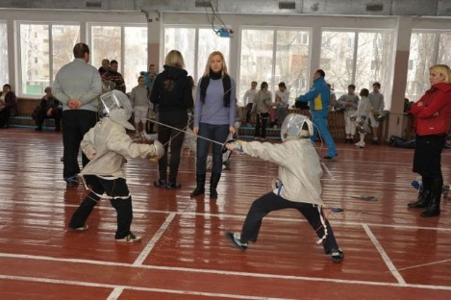
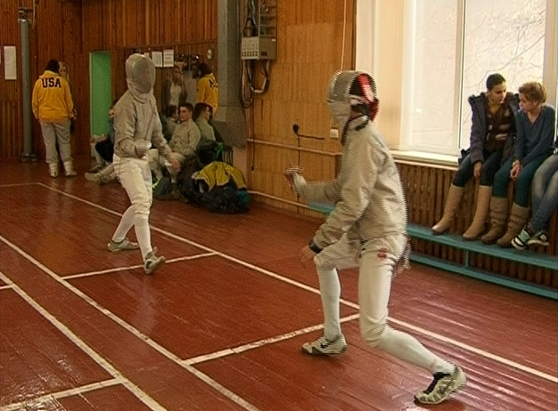
From 9 to 14 years engaged in saber. In CYSS №2. Fencing - individual sport. Our school participated in various competitions in the region between the cities and national competitions. I participated in the Open Championship Cherkasy region with saber in CYSS number 2.
Participation in the championship was young fencers from Cherkasy, Kyiv, Khmelnitsky, Odessa.

Slide 6
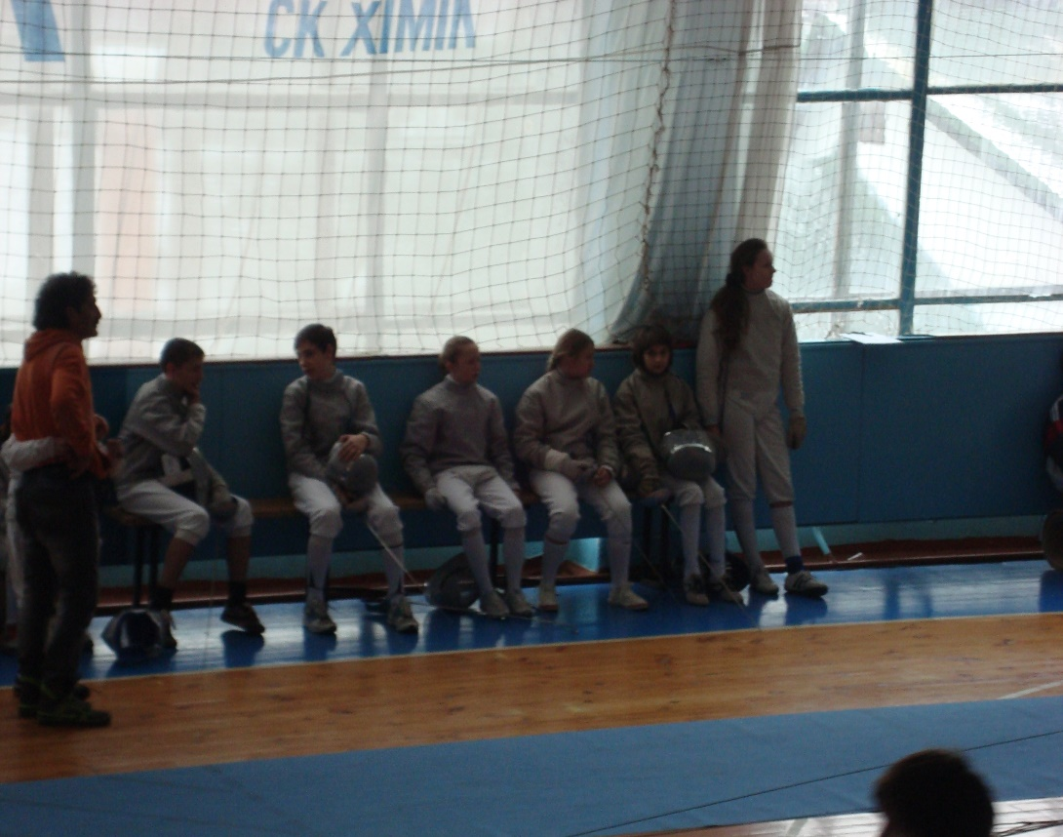
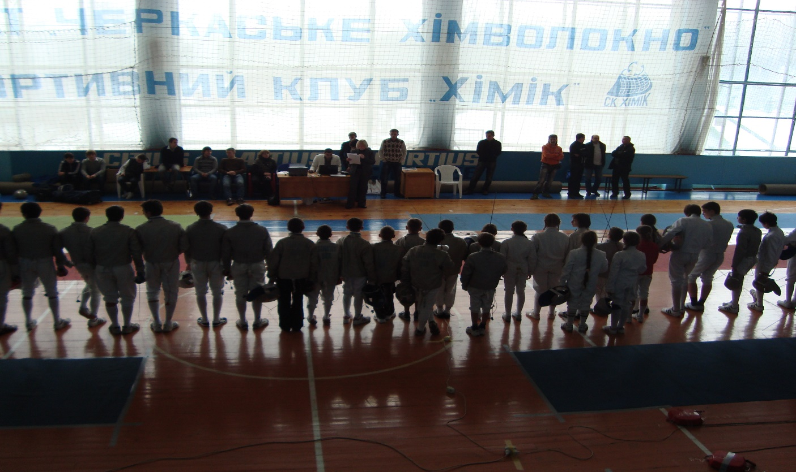
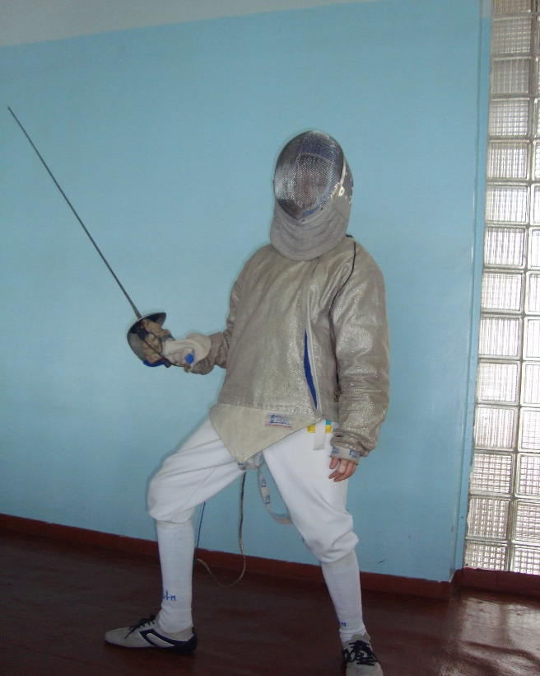
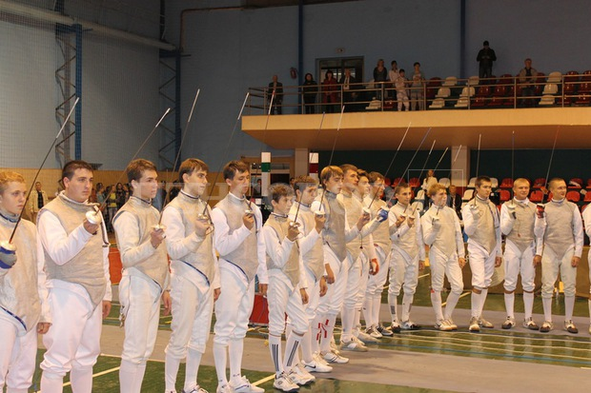
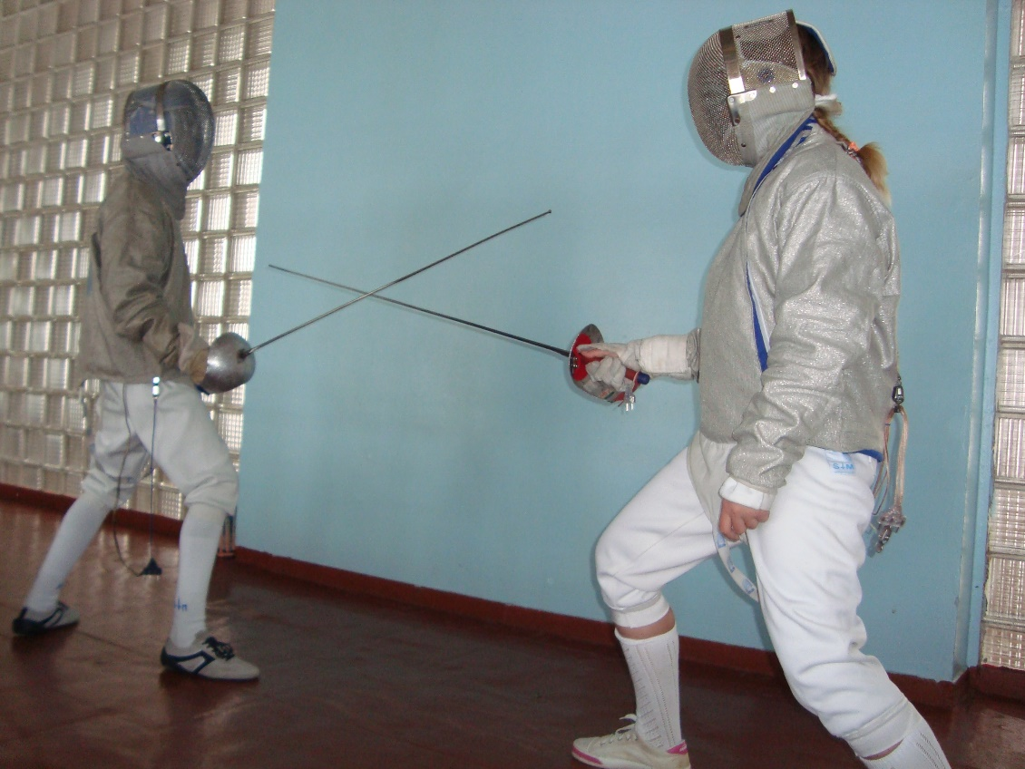
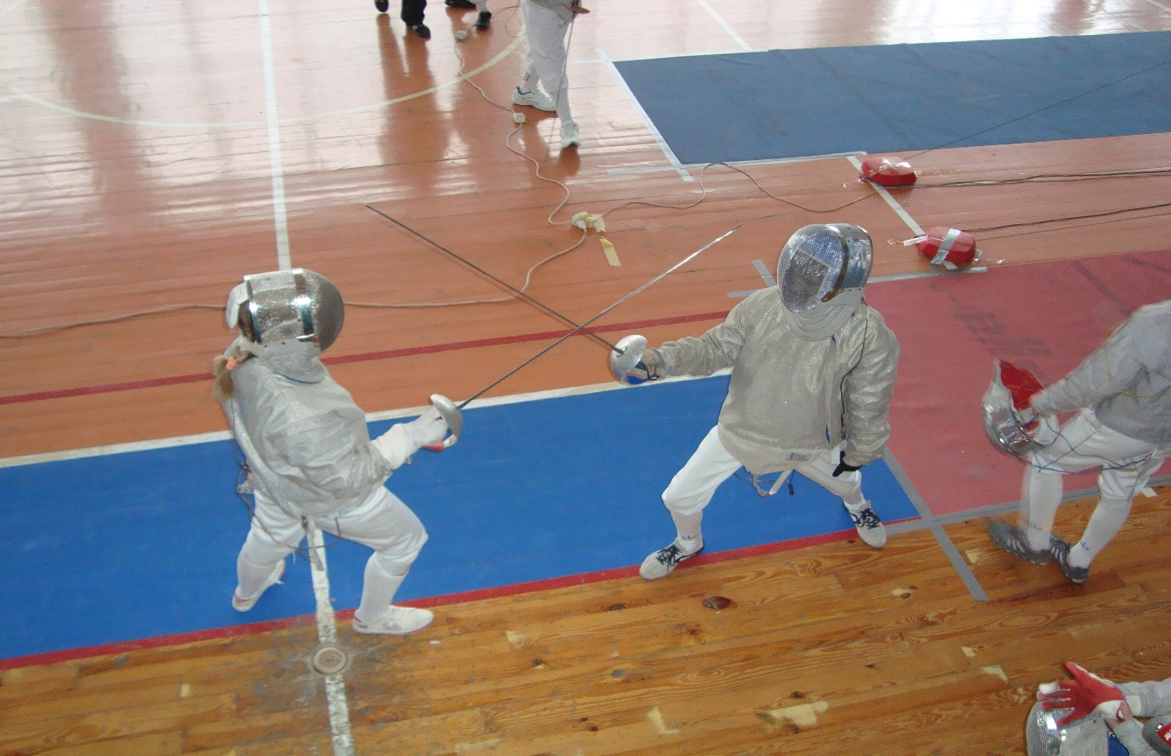
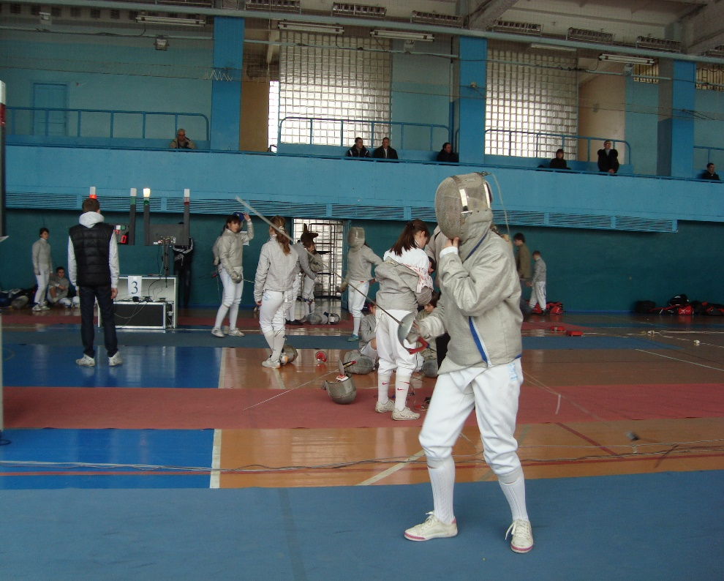

Slide 7
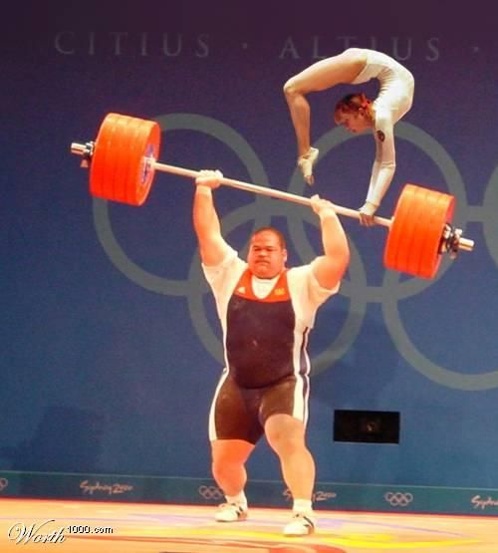
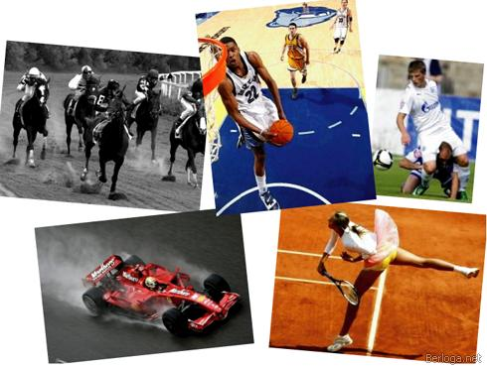
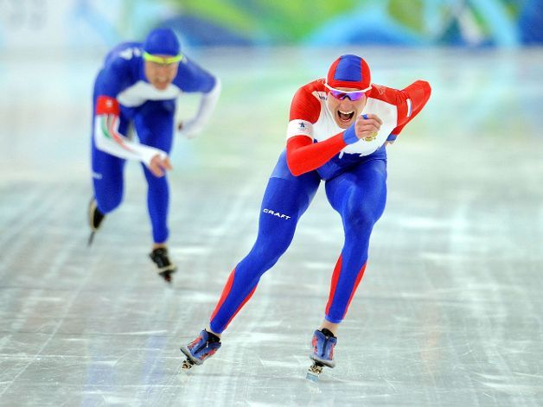
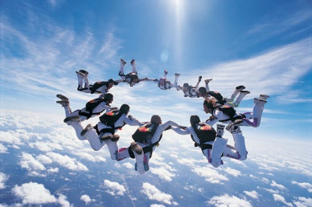
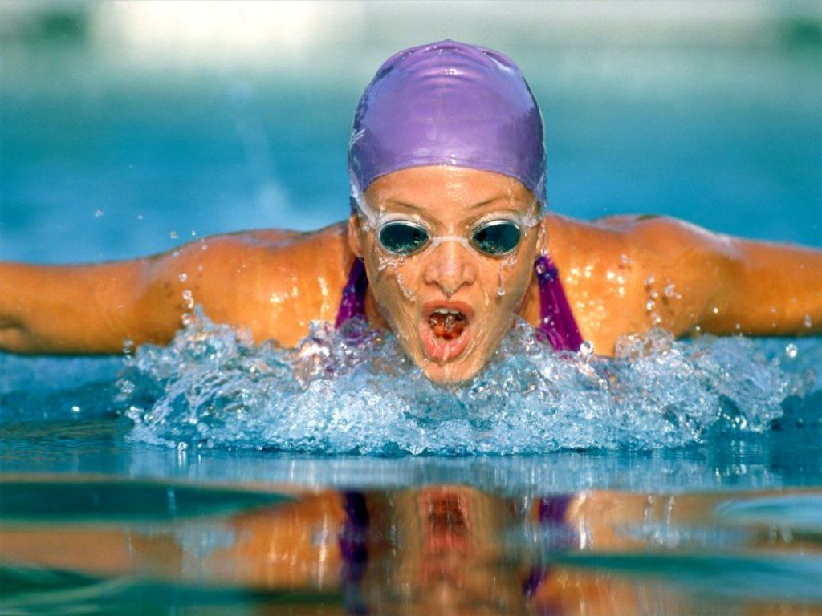
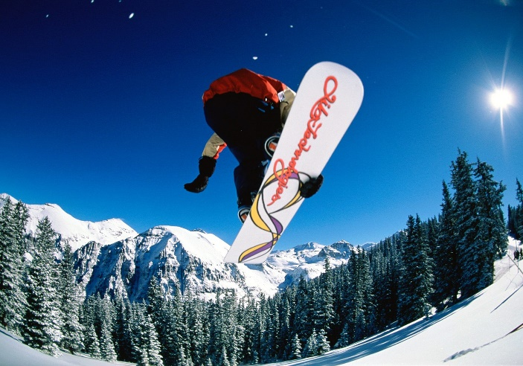
Sport is very important in our lives. Sport is good for everyone. It helps a person to be physically fit, and in addition it brings character and willpower.
Sports help to promote health.

