Slide 1
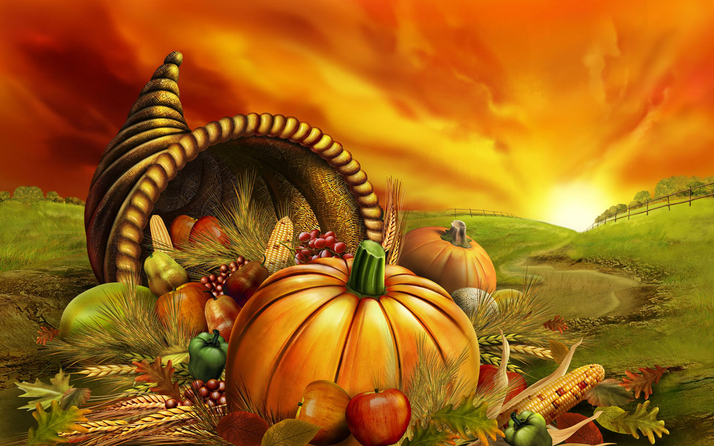
Thanksgiving Day Celebration in United States

Slide 2
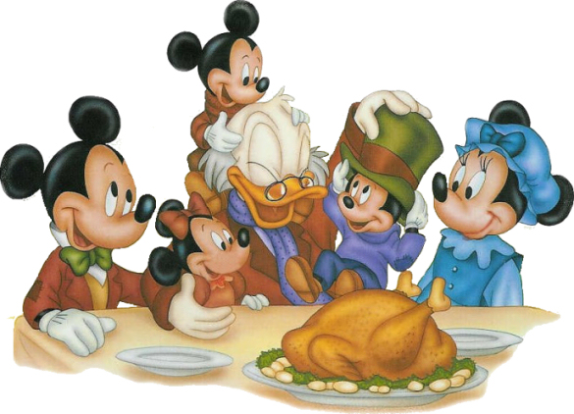
Celebrated on the fourth Thursday in the month of November every year, it is a time for communal thanksgiving, feeling gratitude, lavish feasts.

Slide 3
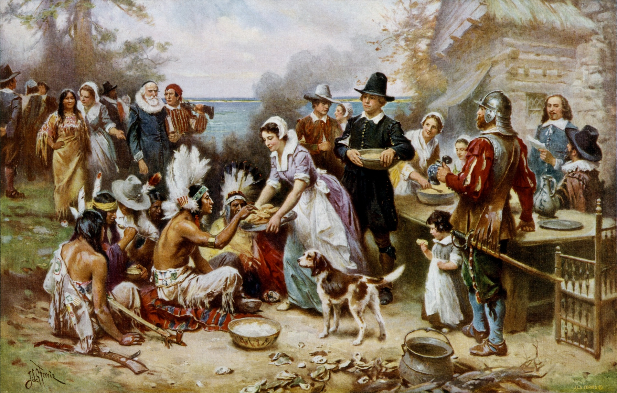
The original pilgrims celebrated the autumn harvest with a feast of thanks. The feast popularly known as the 'First Thanksgiving Day Feast' was held as a gesture of thanks to almighty God . It was celebrated in the year 1621.

Slide 4
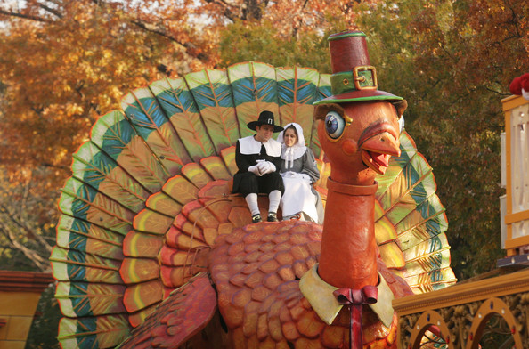
Аfter the United States gained independence, Congress recommended one yearly day of thanksgiving for the whole nation to celebrate.

Slide 5
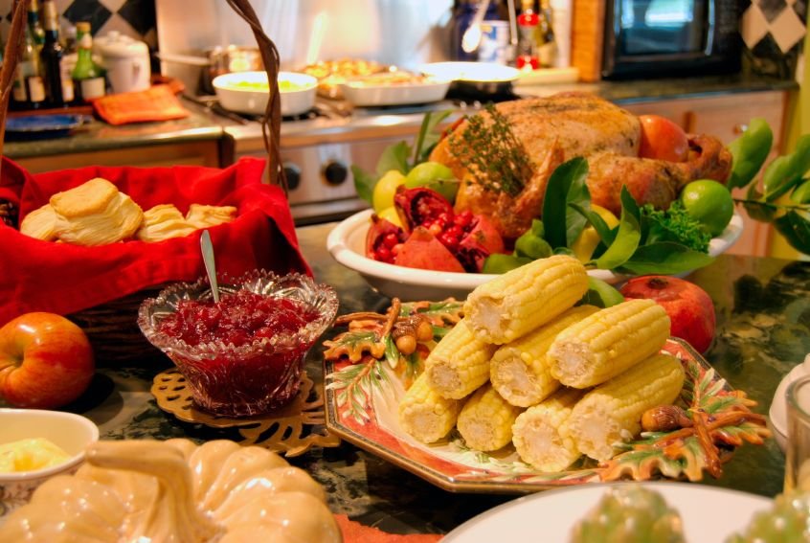
Thanksgiving Day is a time of festivity, family meals and reunions in America. Carved turkeys, Pumpkin Pie, Corns, Cranberry Sauce are the traditional dishes adorning the dinner tables in almost every house.

Slide 6
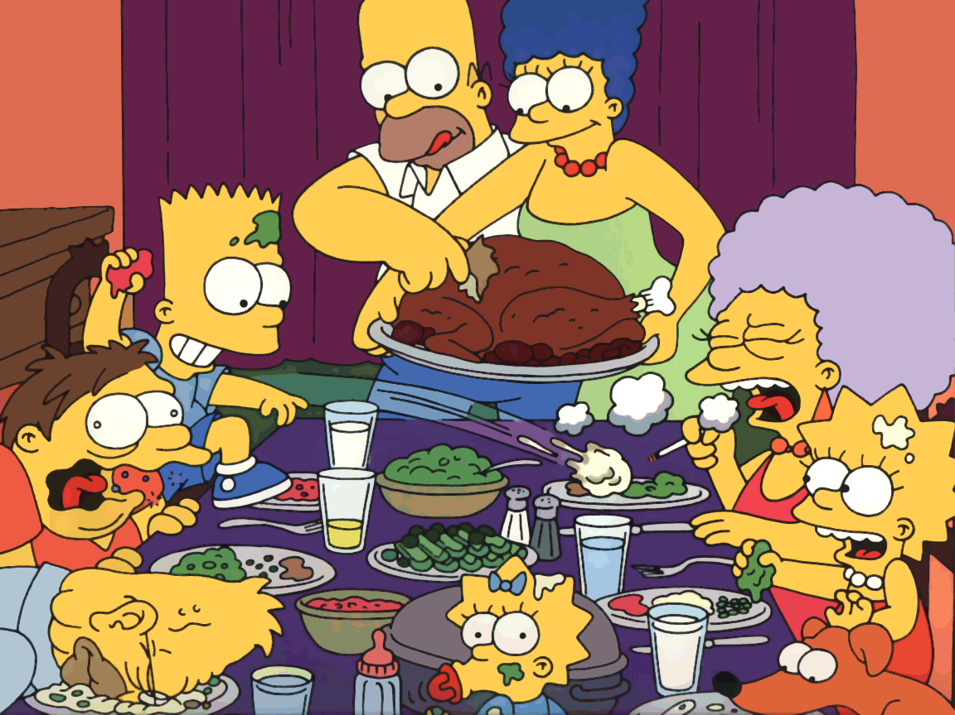
Thanksgiving is a time for gifting your family and friends. The day is a time to show your gratitude and respect to your elders, friends.

Slide 7
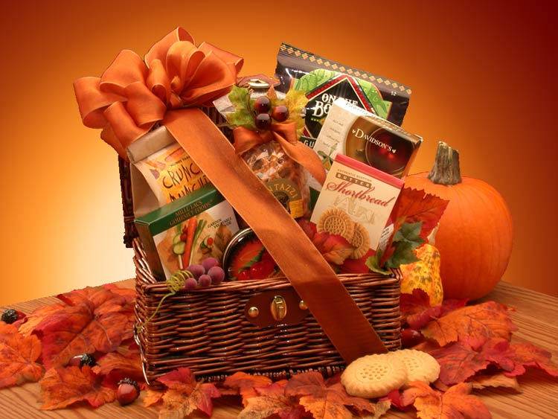
Popular gifts include flowers, jewellery, baked cookie hampers, chocolate gift baskets, candy-wreaths, wine.

Slide 8
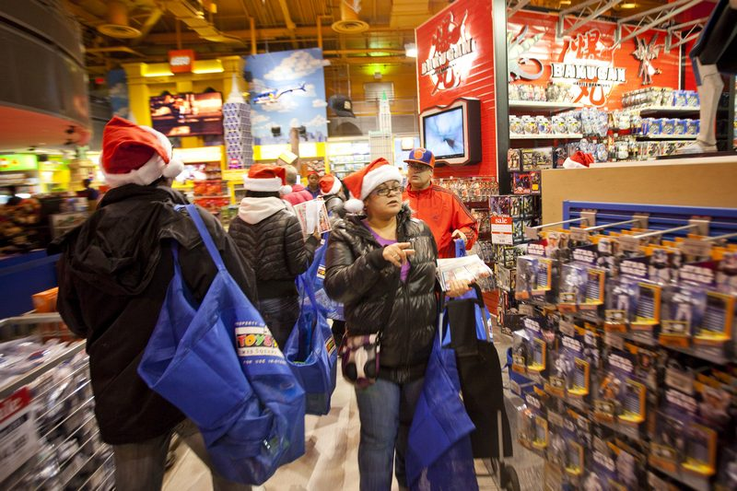
Black Friday and Festive Spirit
Thanksgiving day is the official beginning of the Christmas season. USA witnesses maximum sales volume on the very nest day. The following Friday after thanksgiving is famously known as 'Black Friday'.

Slide 9
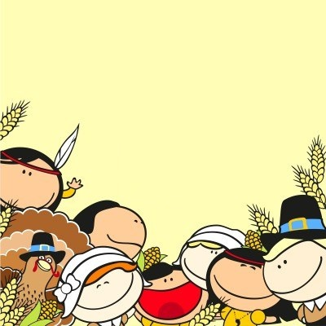
The ongoing festive spirit, shopping spree, helps the shopkeepers to register maximum sales and profits. The entire atmosphere during the time is euphoric, people get in a holiday mood. Families visit restaurants, amusement parks, gift each other, decorate their house.

Slide 10
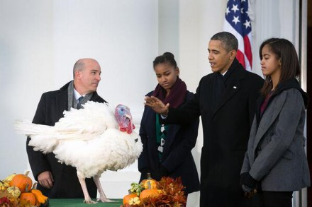
In modern times the President of the United States, will "pardon" a turkey, which spares the bird's life and ensures that it will spend the duration of its life roaming freely on farmland.

