Slide 1
Salvador Dalí

Slide 2
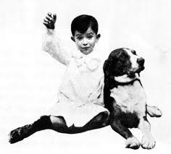
PAINTER’S CHILDHOOD

Slide 3
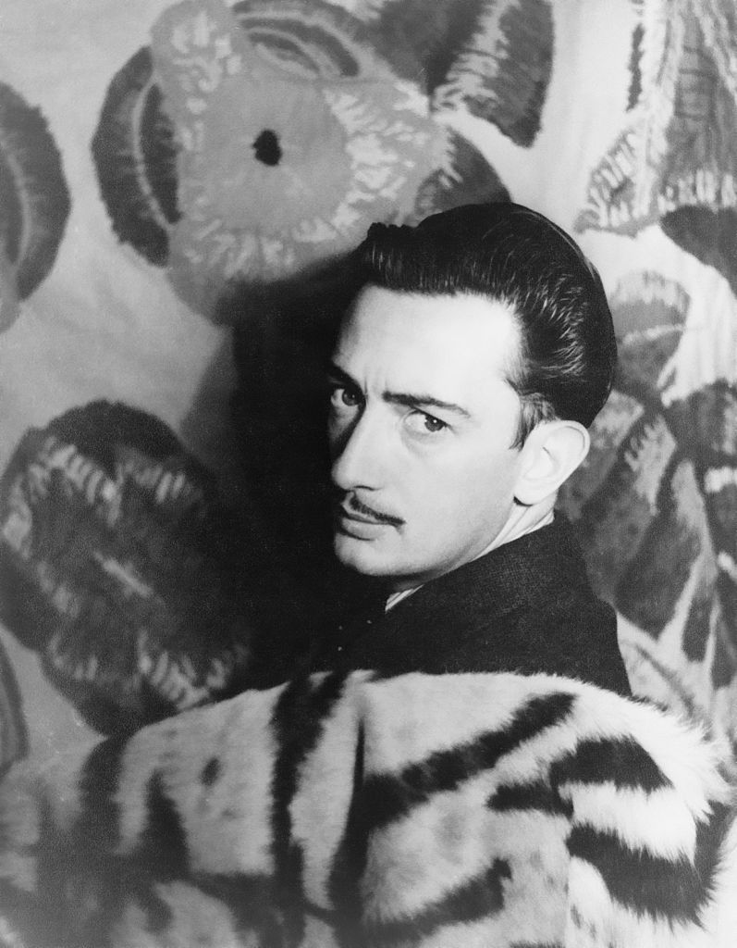
Dali at the Academia de San Fernando

Slide 4
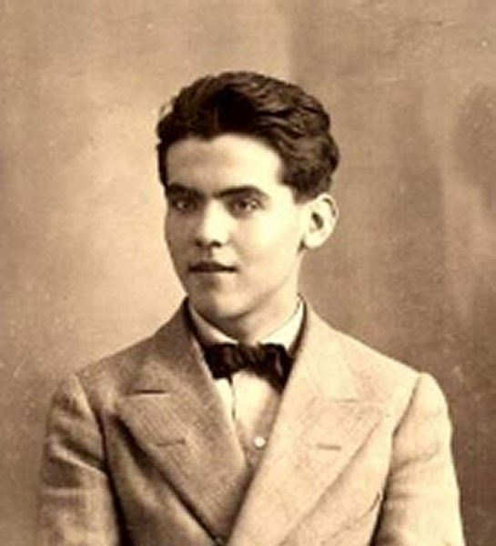
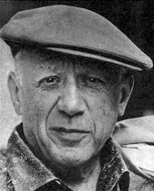
LIFE IN PARIS
Federico García Lorca
Pablo Picasso

Slide 5
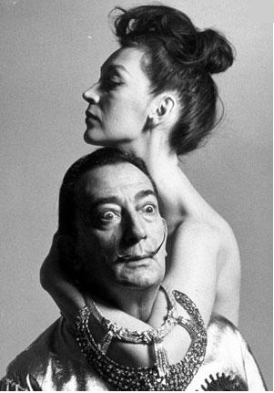
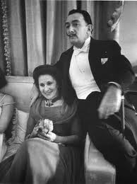
Gala Dalí (Elena Ivanovna Diakonova)

Slide 6
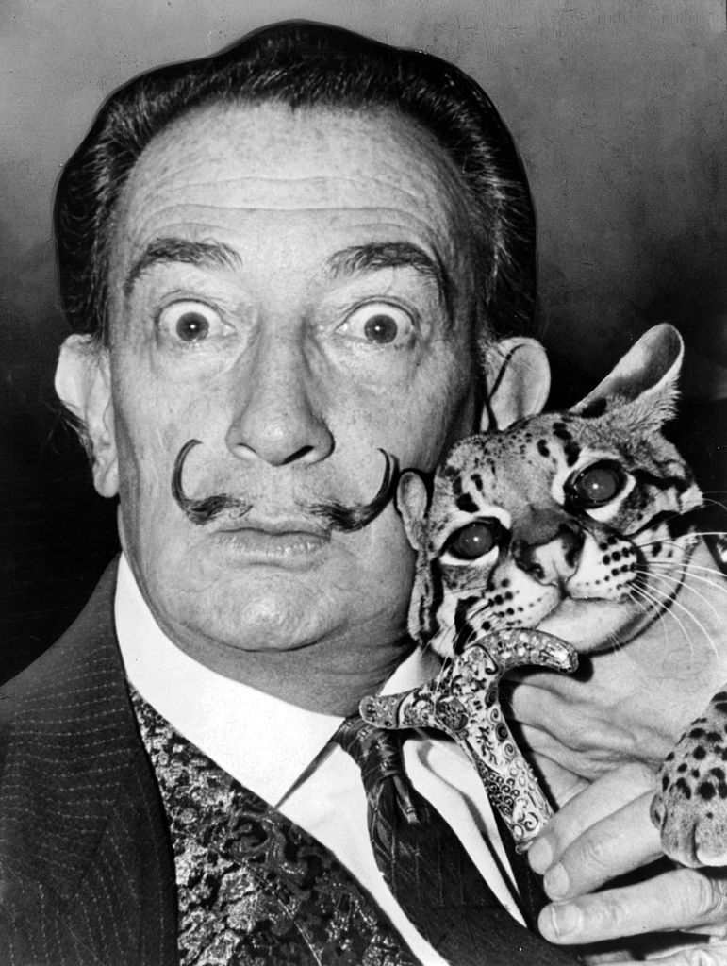
Later Years

Slide 7
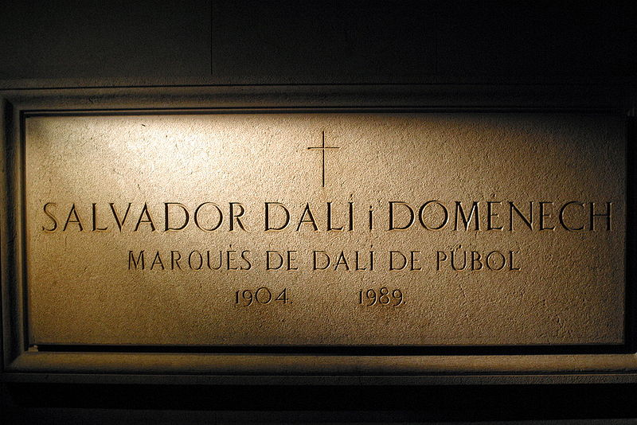
Illness and death

Slide 8
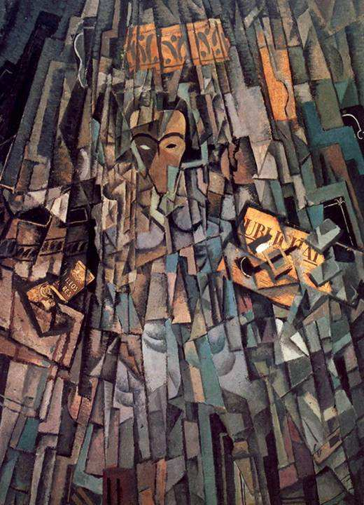
Cubist self-portrait

Slide 9
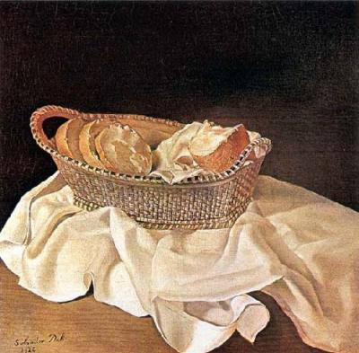
The Basket of Bread

Slide 10
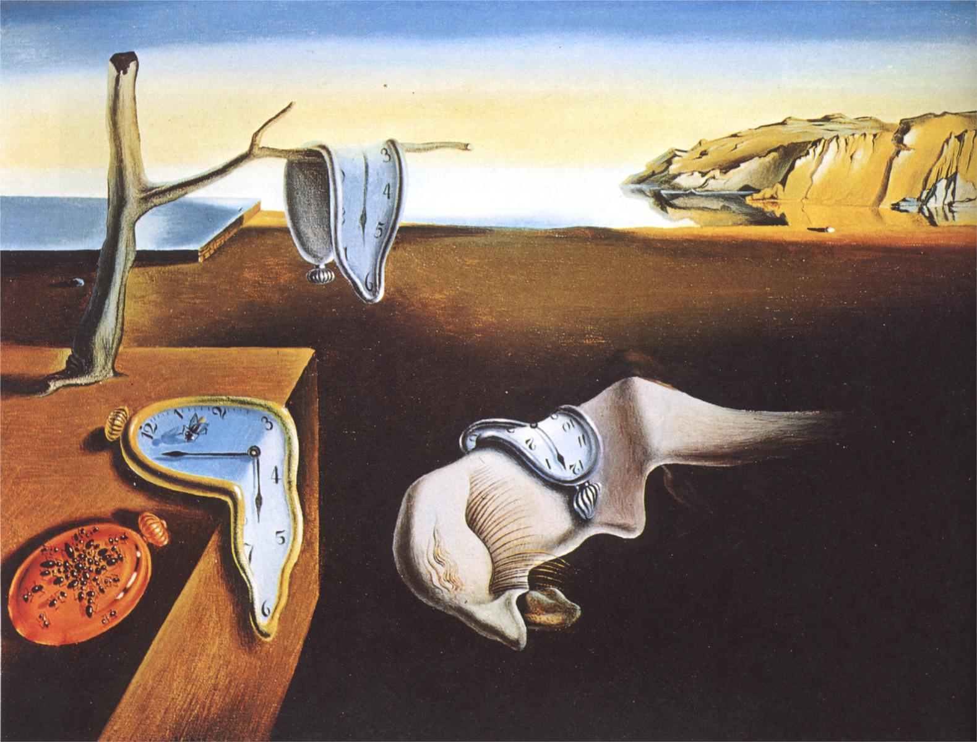
The Persistance of Memory

Slide 11
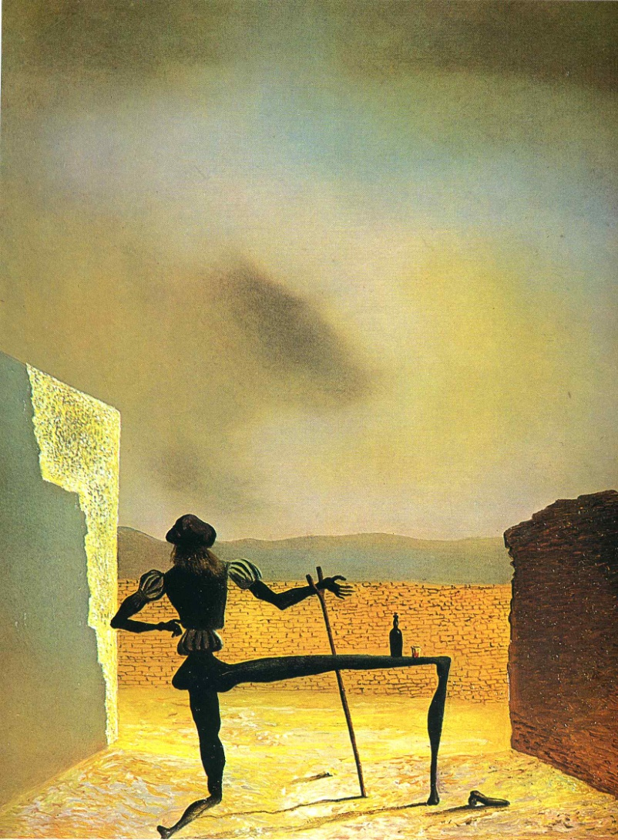
The Ghost of Vermeer of Delft Which Can Be Used As a Table

Slide 12
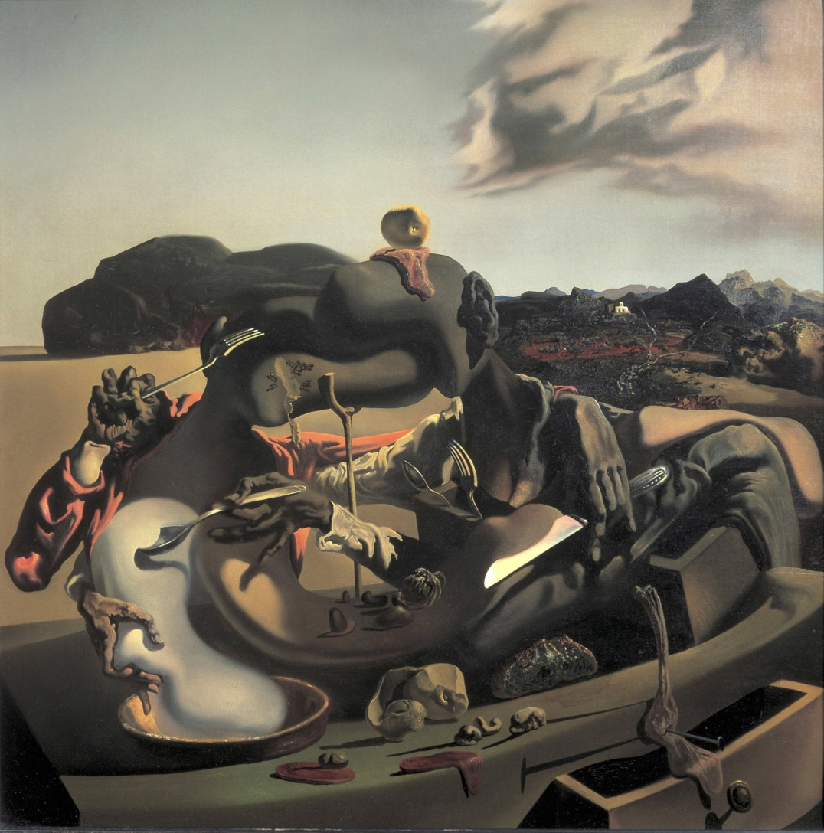
Autumn Cannibalism

Slide 13
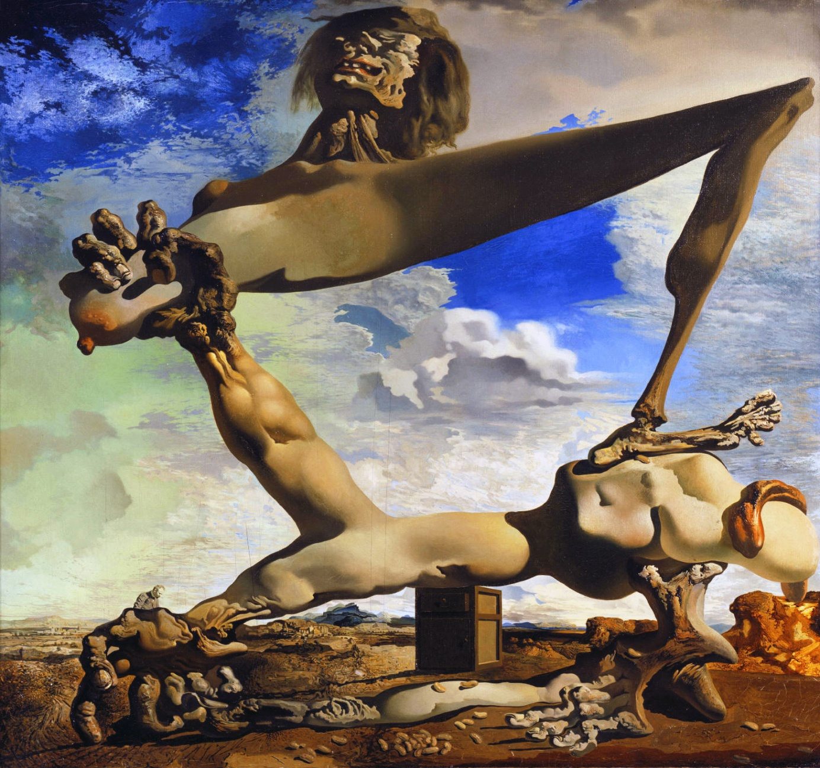
Soft Construction with Boiled Beans (Premonition of Civil War)

Slide 14
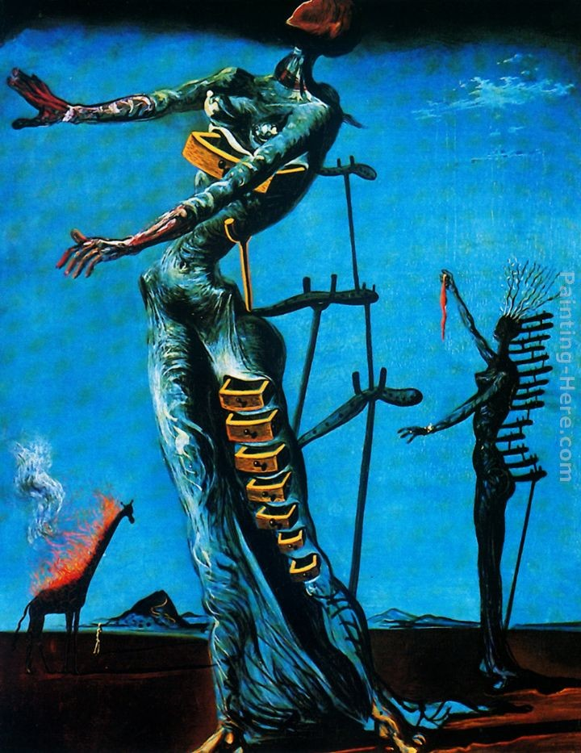
The Burning Giraffe

Slide 15
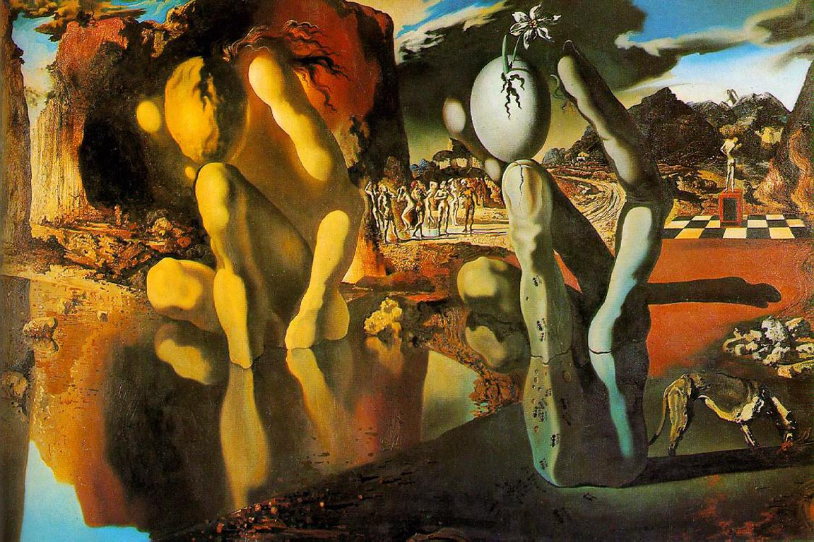
Metamorphosis of Narcissus

Slide 16
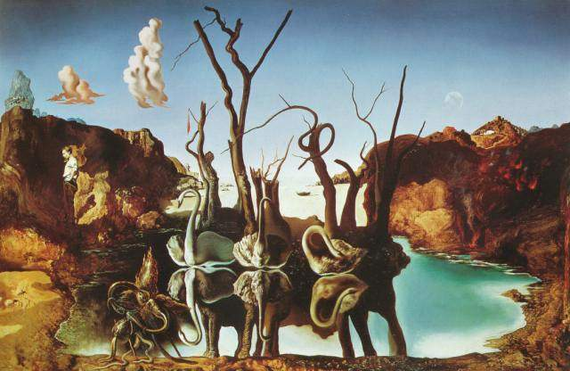
Swans Reflecting Elephants

Slide 17
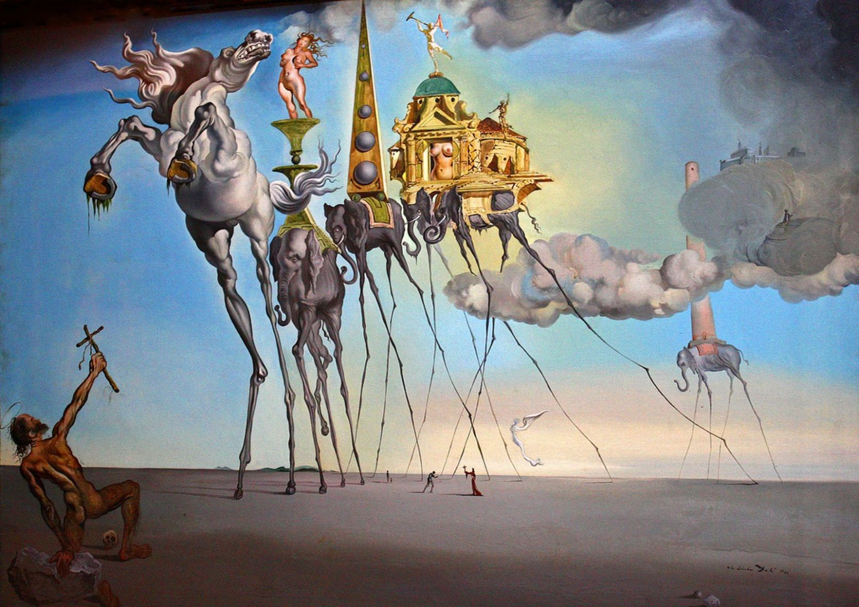
The Temptation of St. Anthony

Slide 18
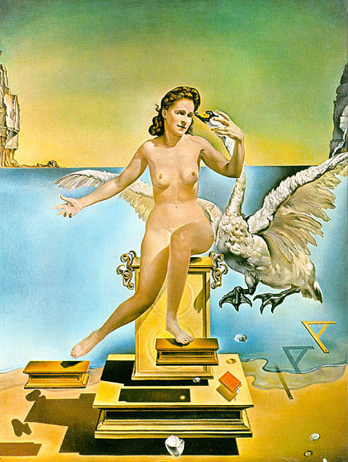
Leda Atomica

Slide 19
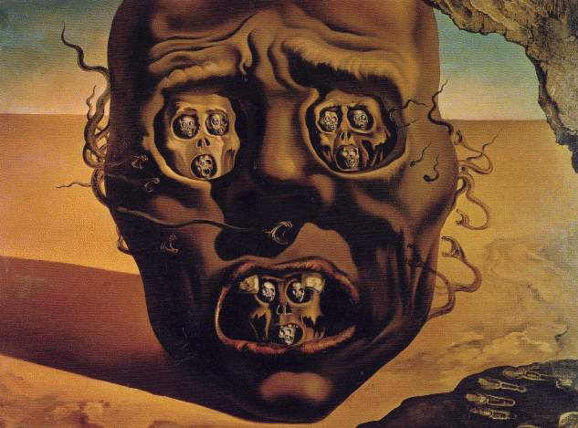
The Face of War

Slide 20
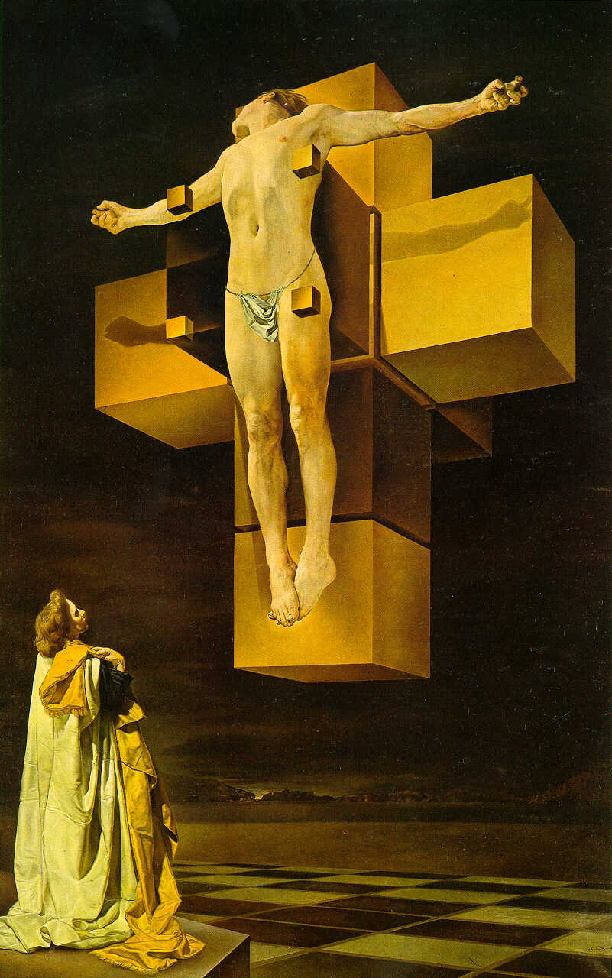
Crucifixion (Corpus Hypercubus)

Slide 21
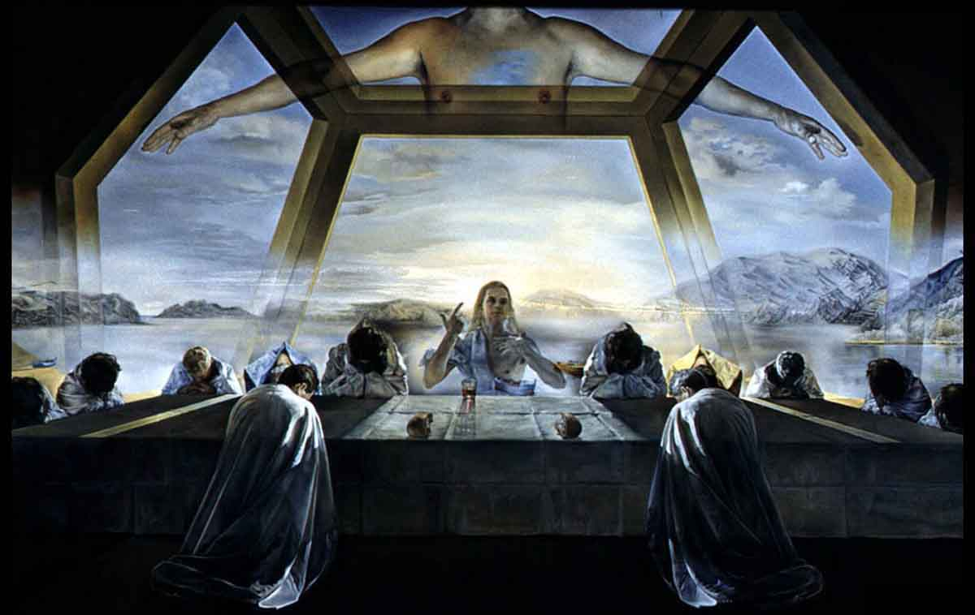
The Sacrament of the Last Supper

Slide 22
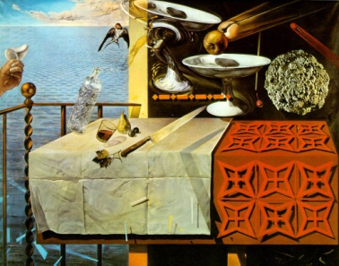
Living Still-life

Slide 23
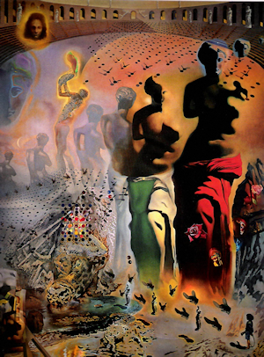
The Hallucinogenic Toreador

Slide 24
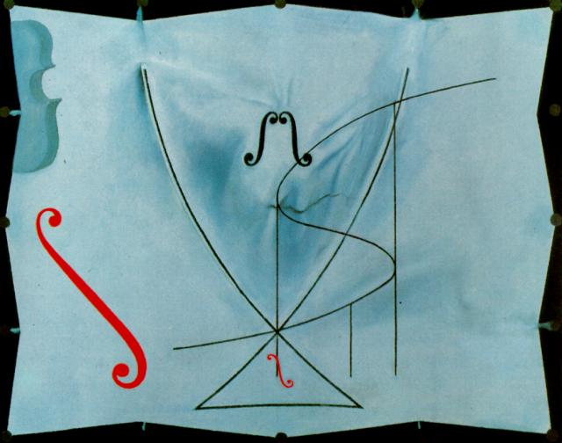
The Swallow’s Tail

Slide 25
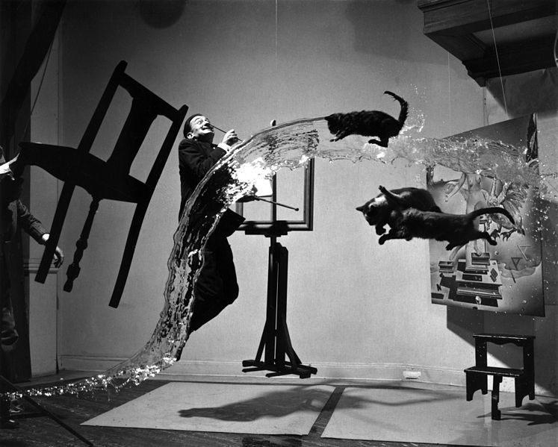
Dali Atomicus

Slide 26
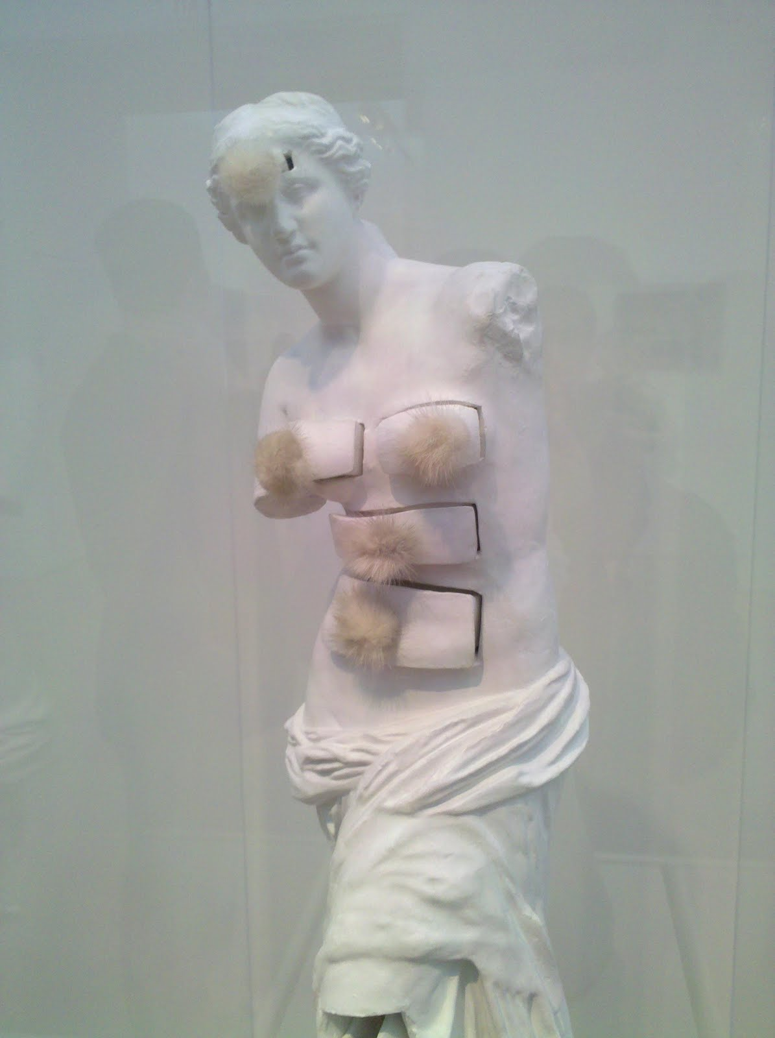
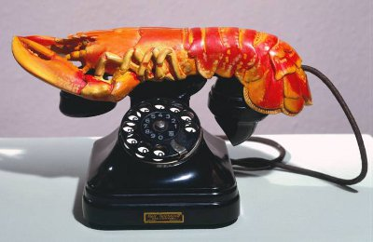
Dali as a Sculptor
Venus de Milo with Drawers
The Lobster Telephone

Slide 27
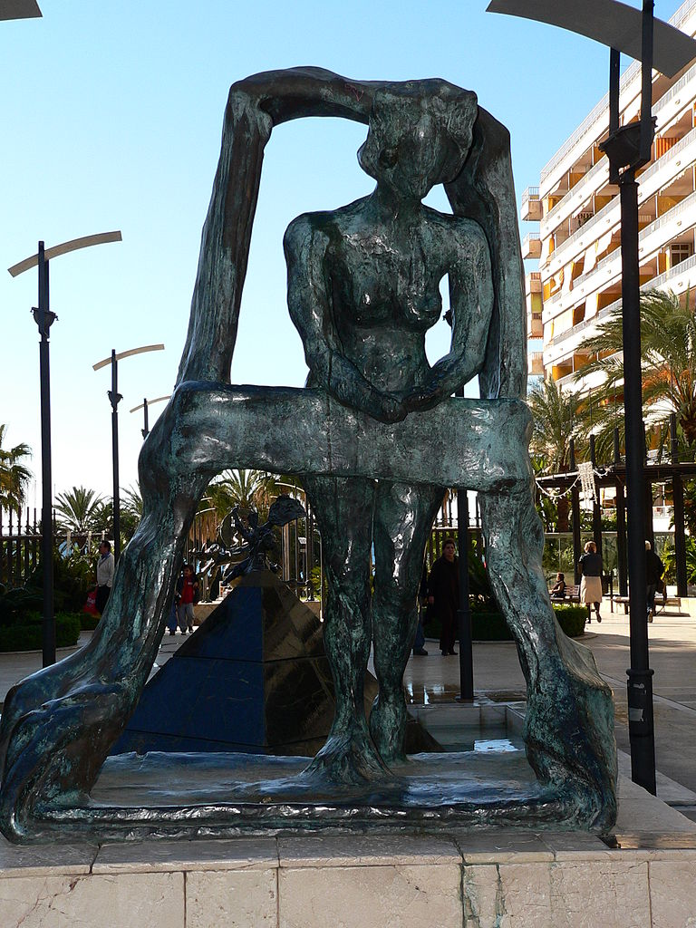
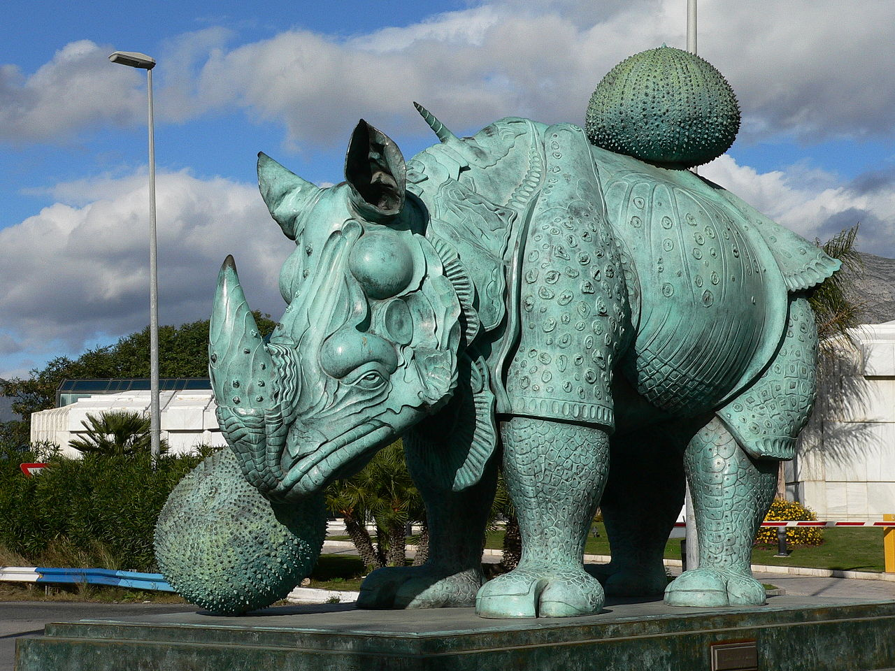
Gala at the Window
Rhinocerapterus

Slide 28
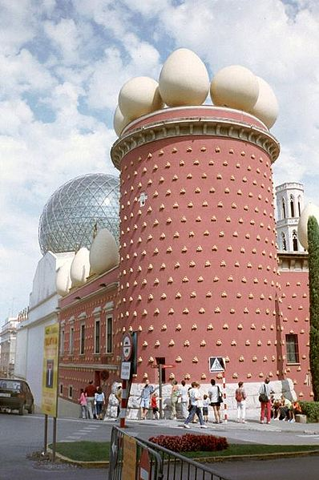
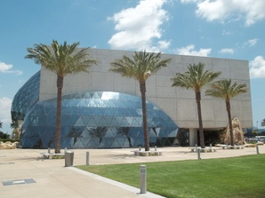
Museums of Salvador Dali

Slide 29
THANK YOU FOR YOUR ATTENTION!!!

